Slide 1
Navigating Unemployment Compensation:
A Workshop for Adjunct Faculty in Maryland
Disclaimer: This presentation does not constitute legal advice.

Slide 2
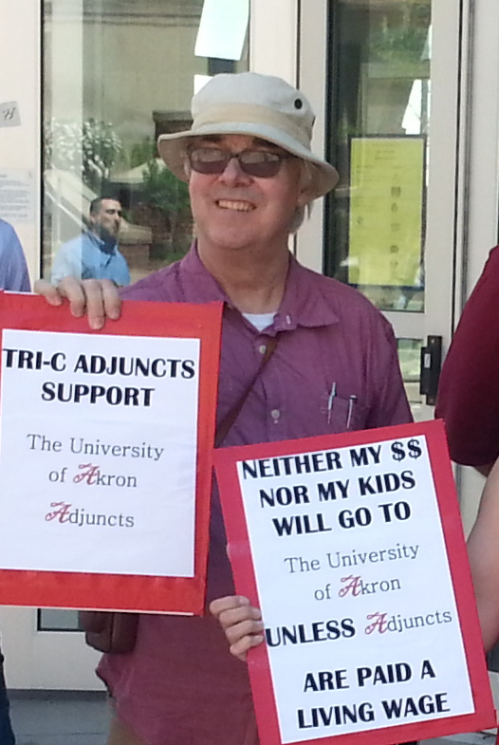
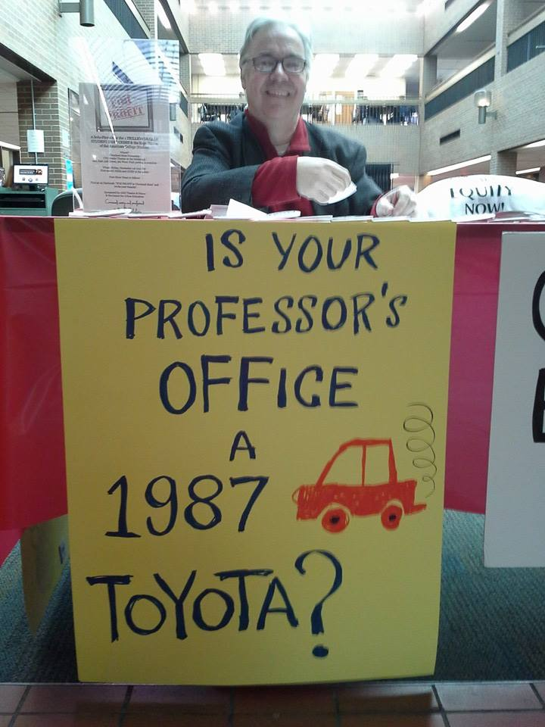
In memory of our dear friend and tireless advocate
for adjunct faculty rights and quality education
David B. Wilder 1955-2017

Slide 3
Who We Are
Introductions: Why are you here?
Have you previously applied for UC in Maryland?

Slide 4
Why Apply?
It’s your right under the law if you have lost all or a substantial part of your income, you are unemployed through no fault of your own, and you are able to and available for work. If your teaching load is less than 90% of what you taught in the current term, you are eligible for UC based on reduced income.
It is a way to force institutions to assume some of the costs of the “flexibility” of contingent employment

Slide 5
Educational Employees – barred from receiving benefits because of having “reasonable assurance of re-employment.
Prior to 2017 - Adjunct faculty were subsumed under this rule that covered school teachers etc.

Slide 6
What has changed since 2017?
Department of Labor clarified to states that adjuncts do not have “reasonable assurance of continuing employment” in the way that K-12 teachers do.
The essential strategy in adjunct applications for UC and appeals of agency denial/defense against employer challenges: explaining that you do NOT have either a contract or “reasonable assurance of continuing employment” in the next academic term and in any academic term.
https://wdr.doleta.gov/directives/attach/UIPL/UIPL_5-17.pdf

Slide 7
Unemployment Insurance (UC) Financing
Private employers- pay quarterly UC taxes that go up if layoffs go up.
Public sector employers (most)- pay dollar-for-dollar the cost of UI benefits paid to their former employees.
Source: policymattersohio.org
This is why institutions don’t inform adjuncts about UC or encourage them to apply and it is why they appeal (contest) claims, asserting that adjuncts have “reasonable assurance of re-employment,” which under federal law makes educational employees without contracts ineligible for UC.
Employers are trying to control costs.

Slide 8
Unemployment for Adjuncts hinges on whether the claimant has “reasonable assurance” of continued employment “in the next academic year or term.” YOU DON’T!
New DOL guidance clarifies that if employers offer work that contains contingencies within the employer’s control, there is no reasonable assurance. The guidance also clarifies that the summer is an academic term.
Contingencies include being able to reassign classes to other faculty, cancel classes for low enrollment or lack of funding, or other reasons.
In Maryland, eligibility (lack of reasonable assurance) has been determined in the past based on employer’s lack of control over funding and enrollment. It will be up to the state to determine which standard should be used. However, adjuncts are subject to having classes reassigned to FT faculty, which it beyond your control.
In Maryland, educational employers are required to report to the state a list of all employees who they claim have “reasonable assurance.” Not being on this list will help one’s case, but being on this list does not prove that these employees actually do have reasonable assurance. The law requires the agency to determine whether reasonable assurance exists.

Slide 9
Unemployment cases have been won (claim upheld) based on the Contingencies Within the Employer’s Control argument. Most convincing evidence for this control has been employer discretion to give assigned classes to FT faculty (and to other adjuncts if FTF have contracts). Type of evidence needed: witnesses who affirm that classes can be given to others; employment language asserting employer right to cancel/reassign classes, evidence of past cancelations and reassignments.
Additional evidence for Contingencies Within the Employer’s Control: enrollment and funding. Employer will argue this is outside Employer control; DOL guidance states the opposite: if Employer has discretion over how general funds are allocated, then funding is within Employer’s control. We also argue that enrollment is within Employer control because Employer can decide how many students must be enrolled for class to run.

Slide 10
https://www.dllr.state.md.us/employment/uibenefits.shtml
Note: YOU CANNOT FILE OVER THE INTERNET IF:
You have worked and earned wages from a state other than Maryland in the last 18 months (regardless of where you live).
You worked for the Federal Government in the last 18 months.
You have worked for more than 3 employers in the last 18 months.
You have filed for unemployment insurance in another state in the last 18 months.

Slide 11
Application process
Apply online as soon as you’ve completed your work for the semester. There may be some question as to your last day of work– generally it is the last day you have to be on campus.
State where/when asked that you are unemployed because of lack of work
Receive notice of financial eligibility
Respond to any further requests for information – you may receive a questionnaire designed for educational employees with specific questions regarding “reasonable assurance.” Your answer is always that you do not have reasonable assurance
In the event of denial, appeal – pay attention to deadlines and file claims while appealing
https://www.dllr.state.md.us/employment/clmtguide/uiclmtpamphlet.pdf

Slide 12
Work Search Requirements
All Maryland unemployment insurance claimants must be able and available for work. You must make 3 or more work search contacts per week in your customary occupation for which you are qualified
You do not have to accept a job offer is it is not “suitable” or if you have good cause to refuse.
Factors which are taken into consideration in determining whether work is suitable include, but are not limited to, previous work experience, prevailing salary for the job in your geographical area, physical and mental fitness, risk to your health, safety, the distance from your home, your length of unemployment, and prospects for obtaining work in your customary occupation.

Slide 13
Process for responding to agency denial or employer appeal (challenge) (Note: continue to file weekly claims during appeals and do not miss appeal filing deadlines!)
A claimant for unemployment insurance who has been denied benefits may file an appeal of that denial to the Appeals Division. An employer may appeal a determination granting benefits to a former employee. You may appeal and request a hearing. The appeal must be filed in writing and must be filed by mail, fax or in person within 15 calendar days from the date the determination was mailed. The last date to file an appeal as well as the address to which the appeal should be directed is printed on both monetary and non-monetary determinations. Your name must be legibly printed and your signature must be included on the request for appeal. Appeals cannot be filed by E-mail. DO NOT FILE AN APPEAL FROM AN INITIAL BENEFIT DETERMINATION TO THE BOARD OF APPEALS.
If an appeal is filed, a hearing will be held by a Hearing Examiner, who will then issue a written decision. That decision is appealable by a claimant, an employer or the Department to the Board of Appeals.
The Board of Appeals is the last level of appeal within this Department. The next level of appeal is the Circuit Court. You have thirty days from the date of the Board of Appeals' decision to file an appeal to a Circuit Court. You may file your appeal in the Circuit Court for Baltimore City or one of the Circuit Courts in a county in Maryland. Your appeal rights are printed on the front page of the Board's decision.
An Administrative Appeal is a petition to the Court to review an agency’s decision-making process for yielding a particular decision or action of that agency. Administrative Appeals may be filed in the Civil Department . If you do not agree with decisions made or actions taken by a state or local government agency, you may file a Petition for Administrative Appeal in the Circuit Court. However, keep in mind that the Court does not substitute its judgment for that of the agency; the purpose of judicial review of agency decisions/actions is to examine its decision-making process in terms of the interpretation of applicable laws and the facts that the agency utilized in making decisions.

Slide 14
General tips – approach and attitude
Stay patient and polite
Keep it simple
Be honest but understand the law
Stand up for yourself
Do NOT use the word “contract” since it is not applicable for contingent academic employment. Say “employment documents.”
Get help! File with your colleagues, get help from SEIU Local 500, ask questions, write your state representative and senator about your experience or if you need help in case of a challenge or denial

Slide 15
General Tips: Documentation to collect
Summer teaching request and response(s)
Evidence of summer term/summer courses being offered to students (even if not in your field)
Employment documents and institutional documents with language describing the contingent nature of your employment (see example)
Evidence of your classes or those of other adjuncts being canceled or reassigned in the past (emails, letters)

Slide 16
Essential claims and arguments:
Key elements:
NO CONTRACT (avoid using that term!)
NOT OFFERED WORK (OR OFFERED LESS WORK) IN NEXT ACADEMIC TERM, WHICH IS SUMMER, if summer classes are offered
SUMMER IS NOT A VACATION PERIOD
IN ANY TERM, ADJUNCT WORK CONTAINS CONTINGENCIES WITHIN THE EMPLOYER’S CONTROL BECAUSE CLASSES CAN BE RESCINDED OR REASSIGNED AT ANY TIME FOR ANY REASON

Slide 17
Essential claims and arguments : Language to use
1. Part-time adjunct faculty do not have “contracts” as defined for UC. (See UIPL 5-17.) For FT NTT faculty, summer as next term is key, as well as nature of employment documents.
2.Reason for separation = “I am unemployed due to lack of work in the next academic term.” If applying at end of spring, the next academic term at most colleges is summer. Be prepared to explain that Summer is not a vacation or recess in higher education.
3. I am unemployed at the end of every semester (not continuously employed) because I do not have a contract or “reasonable assurance” of reappointment.
4. As an adjunct faculty member, by definition I do not have “reasonable assurance” of continued employment because the employment I am offered contains contingencies within the employer’s control.

Slide 18
Sample employment document language
“The College reserves the right to cancel this contract and/or class(es) for any or no reason, including but not limited to, if enrollment is insufficient, or if the College determines it must assign the class(es) to a full-time faculty member, or for any other reason. This contract and employment is subject to all appropriate College approvals and policies. Contracts are offered by semester and/or academic year, based on the needs of the College. Acceptance of this contract does not guarantee that the College will offer you additional contracts in the future.” [Cuyahoga Community College, Ohio]
Adjunct faculty receive assignments ranging from one day to one semester and contracts for adjunct faculty teaching credit courses are for one semester at a time. (Howard Community College)

Slide 19
Tricky Questions: “When did you start working there?”
“Most recently, I started work on January 17th of this year.” (The first day of your first class.)
NOT “I first started teaching there in January of 2007.” Hearing officer will insist on knowing the first term/year you worked for that institution. Answer, but point out that you were terminated after each term you taught and rehired for each term you taught. If you did not teach during every summer term since your first term working, then there were terms you did not teach.

Slide 20
Another tricky question: “Will you return to teach there in the Spring/Fall?”
“I don’t know. I do not have reasonable assurance of reappointment, though I have requested work and am able and willing to work.”
NOT “Yes, I have an appointment letter for three course sections in the Spring or Fall.”
NOT “Over the past several years I have always been able to come back in the Spring/Fall.” If asked if you have come back, say “Yes, I have often been rehired after being terminated, and I also knew the offer of rehire could be rescinded at any time for any reason.”

Slide 21
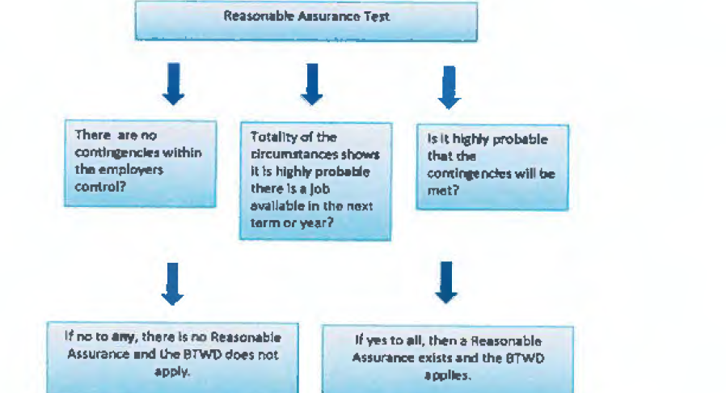
Key section of flowchart from UIPL 5-17. If there is any contingency within the employer’s control, there is no Reasonable Assurance and you are eligible to collect.

Slide 22
Possible Situations
I received a “reasonable assurance” letter from my college.
Receipt of such a letter is not sufficient proof of reasonable assurance. UIPL 5-17 explains that the state agency must investigate the actual facts and circumstances of each claim.
I teach at multiple institutions.
UIPL 5-17 explains that ODJFS cannot deny UC based on the determination of reasonable assurance at only one institution.
I am teaching fewer courses next term (remember: summer is a “next” term.
If your teaching load is less than 90% of what you taught in the current term, you are eligible for UC based on reduced income.
I have a 9 month appointment.
Eligibility will depend on the terms of your appointment (does it include summer classes?), whether it is determined to be a contract for the purposes of UC, and if so, when you sign it.

Slide 23
Summary:
File on your last day of work and respond to any requests for information. Throughout the time you are collecting UC, be sure to fulfill all requirements for showing that you are seeking work
In answer to the request for the reason you became unemployed from each employer, say:
“I am unemployed due to lack of work (or reduced work which puts you at less than 90% of what you currently have) in the next academic term.”
At this stage, collect supporting materials in case you are asked for more information or your claim is contested by any of your employers.
3. If asked for more information, provide it, and politely remind the agency representative of UIPL 5-17. Please let us know what additional information you are asked to provide.
4. If denied due to the assertion that you allegedly have a contract, review how that determination is being made and consider whether to appeal.

Slide 24
Summary (continued)
5. If denied due to a "reasonable assurance" assertion by any of your employers, appeal and provide the following:
A statement that the next academic term is Summer, and you do not have work during the Summer term (provide evidence of the Summer term and your lack of work or reduced work in the Summer term). The recess period is the time between the Spring term and the Summer term when no classes are offered at all. (When applying after the Fall term, the recess period is the time between the Fall and Spring when no classes are offered at all.)
Refer to Example V.5 in UIPL 5-17, which provides the example of a higher education institution that has a quarter system (Fall, Winter, Spring, Summer) rather than the much more common semester system (Fall, Spring, Summer).
“As an adjunct faculty member, I do not have reasonable assurance of continued employment between academic terms because my employment has contingencies within the employer's control.” (Provide evidence of employment documents and institutional rules which clearly show that the institution reserves the right to rescind your employment at any time for any reason). UIPL 5-17 states that if there is even one contingency within the employer's control (see flowchart), claimant does not have reasonable assurance.

Slide 25
NOTE:
Although this has never come up, if at any point Example I.a.1 (the example that seems to describe the employment situation of most adjunct faculty) on the first page of Attachment II of the UIPL is cited as justification for denying your claim, reply that the example does not apply to your case because it assumes that
1) the summer is not an academic term (in fact the language of the example indicates it is a K-12 example, not higher ed), which is almost certainly not true in your case and that
2) the only contingency in that example case is enrollment and in that case the enrollment contingency has been determined to be outside the employer's control.
In your case, you will have provided evidence that several contingencies apply to your employment and that at least one is within the employer's control. The UIPL flowchart reinforces that if there are any contingencies within the employer's control, the claimant does not have reasonable assurance and is therefore eligible for UC.

Slide 26
A model for changing the law itself
Cervisi v. Unemployment Ins. Appeals Bd., 208 Cal.App.3d 635
“an assignment that is contingent on enrollment, funding, or program changes is not a ’reasonable assurance’ of employment
Adjuncts in Maryland can lobby the legislature to amend the law to ensure adjuncts receive unemployment.

Slide 27
Adjuncts in Maryland have received unemployment benefits!
Hello Anne,
Just to update you, I am one adjunct who HAS been able to get unemployment insurance from the State of Maryland.
I applied shortly after that meeting at Catonsville (May 18th?) where you urged us to try. I'm sure I applied within the next few days. I did not apply online---I did my application by phone. After about three weeks, I had a phone interview that was only about 4 minutes long. I was told to be ready for another phone interview the following week, but the call never came. It took me until this week (June 20) to get the VISA card which has my first UI payment connected to it.
The payment is not huge---it's about half what I would have earned from CCBC if I had continued working at my regular rate over the last month. However, it is a big help right now..
(A colleague who applied online got her card much sooner, but I don't know what information she gave them, either.)
Altogether, not a terribly painful process---a bit confusing, but then I had not actually collected unemployment since about 1978, and had not even TRIED since 1993. It is clearly not a gravy train, but together with the few hours I'm getting a week teaching for the Citizenship Program, it should get me through the summer.
Mark Chalkley

Slide 28
Keep in touch!
Anne McLeer, Director of Higher Education, SEIU Local 500 - mcleera@seiu500.org
Let us know when you file
Let us know any response at each step
Encourage others to file too!

