Slide 1

Adjunct Advocacy
The Adjunct Edge Conference
10/26/2019
Facilitator Dr. Paul H Comitz
UMBC /UMUC Adjunct since 2000

Slide 2

Agenda
Adjunct Fast Facts
Adjunctification
A Recurring Conversation
Uncomfortable Questions
Talking Points and Engagement
Advocacy Groups
Resources and References

Slide 3
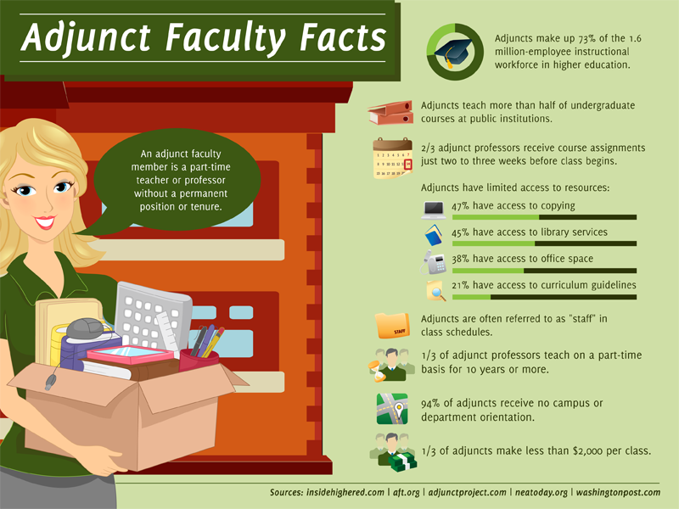
Adjunct Fast Facts
Retrieved from https://drkassorla.wordpress.com/2014/08/20/refusing-the-adjunct-route/

Slide 4
Adjunctification
Overreliance on adjunct faculty members
  More than half of all US Faculty members now hold part-time contingent appointments [Jenkins]
  Pervasive system of part-time “contingent” faculty
  Longstanding trend in higher education to hire contingent part-time faculty
    Tuition costs continue to spiral beyond the reach of many
    UMUC – very few (if any) full-time teaching positions
How long before we reach 90% adjuncts
  Denial
  See The Adjunct Crisis
Jenkins, Rob The Chronicle of Higher Education, Straight Talk about Adjunctification (2014, December 15)
retrieved from https://www.chronicle.com/article/Straight-Talk-About/150881
Notes:
Right now, colleges are eliminating full-time positions, especially in fine arts and humanities, because they can get cheap adjunct labor. There is no reason to hire a full-time professor for $50 or $60K plus benefits when they can get eight adjuncts to take the place of that professor for less than $20K a year and they can skip the benefits. It’s a great bargain!

Slide 5
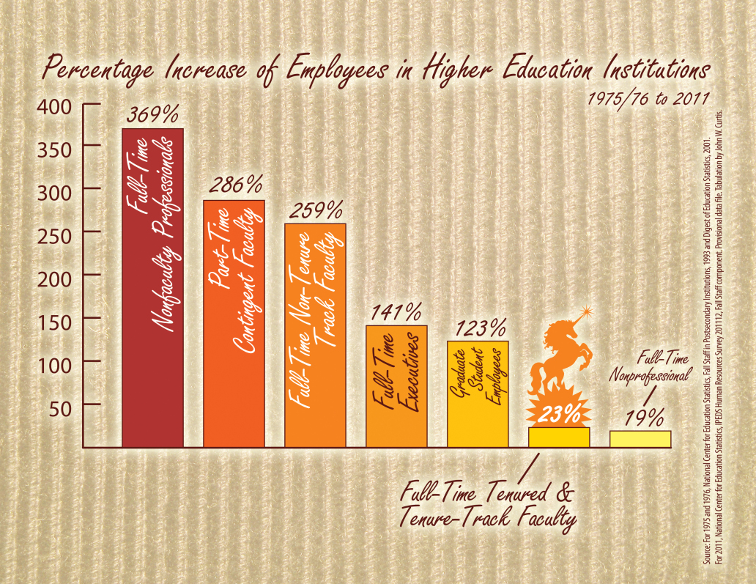
Hiring Practices over 40 years
See https://precaricorps.org/about/why-we-need-a-foundation/
Notes:
Full-time tenured/tenure track faculty increased by a mere 23%, while part-time contingent faculty increased a dramatic 286% and full-time non-tenure track faculty (NTFF) by 259%. Full-time non-faculty professionals, or the administrative class, increased 359%.

Slide 6
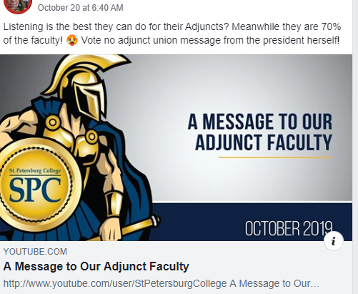
A Recurring Conversation
Our adjuncts are very important
We need to treat our adjuncts better
We are listening to our adjuncts
We don’t want our adjuncts to feel like hired help
Real Concrete Reform is Needed

Slide 7
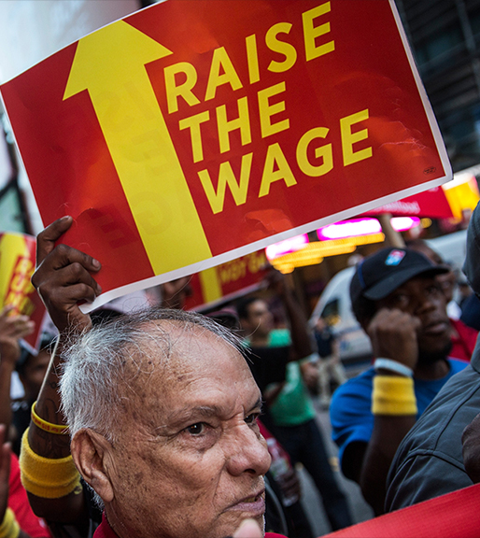
Uncomfortable Questions
Adjunct faculty teach the same courses as tenured faculty
Tenured faculty receive approximately 4x (or more) salary
  …plus generous benefits
Suppose this was the case in other labor markets?

Slide 8

Uncomfortable Observations
Exploitation of adjunct labor
If you are a tenured (or tenure-track) faculty member, you are both the instrument and the direct beneficiary of exploitation.
See
https://www.chronicle.com/article/The-Great-Shame-of-Our/239148?cid=wcontentgrid_41_2

Slide 9

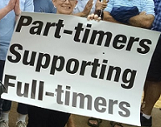
Uncomfortable Observations
From the blog of Academe magazine:
  5300 Wealthy college Administrators
    6 and 7 figure salaries
  “Their careers are largely built on the backs of 800,000+ adjunct faculty”
An adjunct office

Slide 10
A Path Forward
Campus Equity Week
  Usually the last calendar week in October
    October 21–25, 2019
  CEW 2015 - Called for a 15 minute “teach-out” by adjunct faculty
Join with full-time, tenure and non-tenure track faculty
  Motivation for tenure track
    Complicity in the exploitation of adjunct labor
Engage your Colleagues, Administrators, and Your Community

Slide 11

A Path Forward
Talking Points
Employment practices that degrade both faculty and students must be changed.
  See The Delphi Project
    Tools and resources to help create new faculty models and better support faculty off the tenure track to enhance higher education institutions.
    http://pullias.usc.edu/delphi/
https://www.campusequity2017.com/adjunct-facts
Notes:
Employment practices that degrade both faculty and students must be changed. The quality of higher education is compromised when faculty are not paid a living wage, not afforded job security, and not treated like the professionals they are.

Slide 12

A Path Forward
Talking Points
Approximately 75% of teaching faculty are off the tenure track
  > 800,000 workers
  The New Faculty Majority
    See http://www.newfacultymajority.info/
  Faculty Working conditions are student learning conditions
This Majority Deserves a Voice
https://www.campusequity2017.com/adjunct-facts

Slide 13

A Path Forward
Talking Points
The general public is misinformed.
  Precarity
    No job security
    No predictability in schedule
      the adjunct professor is stuck in a perpetual juniority. Regardless of experience, education, credentials, publishing, participation in the university community--s/he can never attain seniority as long as the employment status remains the same.
        The Female Precariat
    Full time faculty can bump adjuncts in almost any or all circumstances
https://www.campusequity2017.com/adjunct-facts

Slide 14

The adjunct condition is defined above all, materially, by being hired as an adjunct. The key feature is that adjuncts are hired over and over again to do the same job, each time with a nominally new contract letter or similar document. Doing research on the adjunct phenomenon years ago, I was told by an authority in higher education that the biggest single determinant in faculty pay is SENIORITY. In the regression analyses, seniority as a determinant outweighed gender; seniority outweighed ethnicity; seniority outweighed education level and the other KSAs. With all due respect to any members of either Jackson Lewis or organized labor reading this, seniority outweighed even presence or absence of a union.
Employers in colleges and universities have addressed this material driver of faculty pay--seniority--with near-fiendish effectiveness. The strategy is contingent hiring. No matter how long a woman or a man teaches courses at the university of your child's choice, the adjunct professor is stuck in a perpetual juniority. Regardless of experience, education, credentials, publishing, participation in the university community--s/he can never attain seniority as long as the employment status remains the same. The strategy is particularly effective against adjuncts hired by semester, but it is also effective against adjuncts hired with somewhat longer contracts and against full-time 'lecturers', the universities' most recent trend.

Slide 15
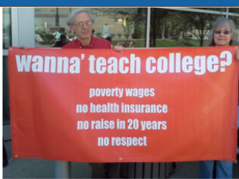
A Path Forward
Talking Points
The general public is misinformed
Adjunct salaries are approximately $2700 per course nationwide
  Many adjuncts cannot earn a living wage
  Adjuncts are routinely asked to do uncompensated work
Notes:
Consider the following scenario:
1) An adjunct faculty member is assigned an online class that has a
low probability of actually running. This usually occurs when the
registrar adds extra "overflow" sections.
2) The week before the class is scheduled to start the adjunct
faculty member notes that there are only two students registered
in the class.
3) The adjunct faculty member requests a status from the department
but does not receive a response.
4) Subsequent to the request the adjunct receives notification from
the department to prepare the classroom.
5) The adjunct responds that they have posted a notification in the
classroom, advising students that the class is unlikely to run.
6) The department chair (the individual that scheduled the adjunct
in the low probability class to begin with) notifies the adjunct that
they must take down the message and fully prepare the classroom.
The department chair goes on to say "we shouldn't concern our
students this way."
7) It takes the adjunct about an hour to prepare the classroom and
about a half hour for all the emails and administrative actions.
8) The adjunct receives no compensation of any kind.
Do you believe this is fair treatment? Should adjuncts be
compensated for preparatory work outside the classroom in
situations like this? Should adjuncts be scheduled to
teach classes that have a very low probability of running?

Slide 16


Slide 17

A Path Forward
Talking Points
Many part-time contingent/adjunct faculty do not have access to any benefits--health insurance, retirement contributions, sick leave, or even office space.
    No or limited health insurance
    Denial of unemployment insurance
      http://www.unemploymentforadjuncts.com/campaign/

Slide 18
Advocacy Groups
New Faculty Majority
The Adjunct Crisis , Adjunct Nation
UBMC AFAC and UMUC AFA
Many others
Maryland Adjuncts
  Join the Group
  Offer your thoughts and ideas
  We will post information about other efforts to organize
  On Facebook Maryland Adjuncts
    https://my3.my.umbc.edu/groups/adjuncts/posts/55669
    On Facebook
      https://www.facebook.com/Maryland-Adjuncts-798516990232901/?ref=hl
You are invited to join the Facebook group
Maryland Adjuncts

Slide 19
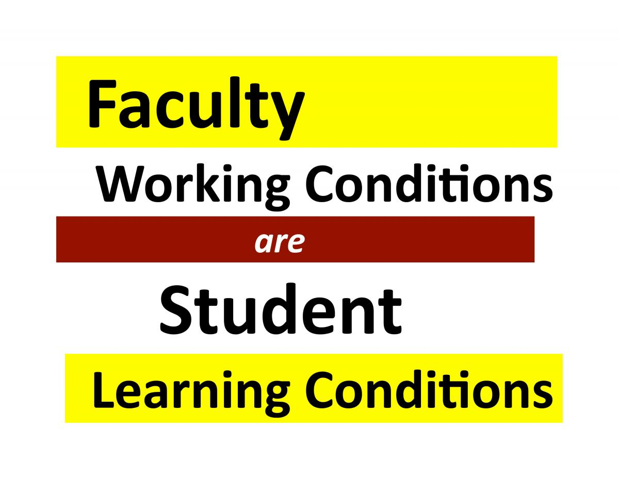
Reform the System
Be reasonable ….but reform the system
See the NFM 7 Goals
  Compensation: Equity in Compensation: Equal Pay for Equal Work
  Job Security: Equity in Job Security: Automatic Contract Renewals after Probationary Period
  Academic Freedom: Equity in Academic Freedom: Freedom from Retaliation in All Teaching and Research
  Faculty Governance: Equity in Faculty Governance – Right to Participate Equally for All Faculty Members
  Professional Advancement: Equity in Professional Advancement: Progressive Salary Steps and Equal Access to Professional Development Opportunities for All Faculty
  Benefits: Equity in Benefits: Access to the Same Health Insurance & Retirement Benefits for All
  Unemployment Insurance: Equity in Unemployment Insurance: Access to the Same Benefits as Other Seasonal Employees

Slide 20
References and Resources
The New Faculty Majority
Precaricorps
The Adjunct Nation on twitter
Steve Street National Unemployment Compensation Initiative
The Adjunct Crisis
The Great Shame of Our Profession
The Contingent Campus – Adjunctification And The Growth Of The Academic “Precariat”
Poster for Campus Equity Week
Background Facts on Contingent Faculty Positions
Straight Talk About Adjunctification
Campus Equity Week Adjunct Facts

