Slide 1
PAW CREDIT MEMOS and What to Do About Them!

Slide 2
You get this email message from AP
Hello, we have a credit memo for this closed PO. In order to process it, we need you to please request that Procurement reopen the PO, then enter a returned receipt. Thank you.
What does this mean? What do I do?

Slide 3
What is a Credit Memo (CM)?
A credit memo is an invoice from the supplier with a negative amount.
Credit memos are issued by the supplier when you return an item, or if you never received the item and you contact them for the credit.
Credit memos from most Punchout suppliers (i.e., Amazon, Dell, Apple, etc.) are entered into the PAW system by the supplier. You do not upload it yourself.
If you get a credit memo from a non-punchout supplier, such as BWM Global, or EESCO Pump & Valve, you need to “create” the CM in PAW. More about that in a moment.

Slide 4
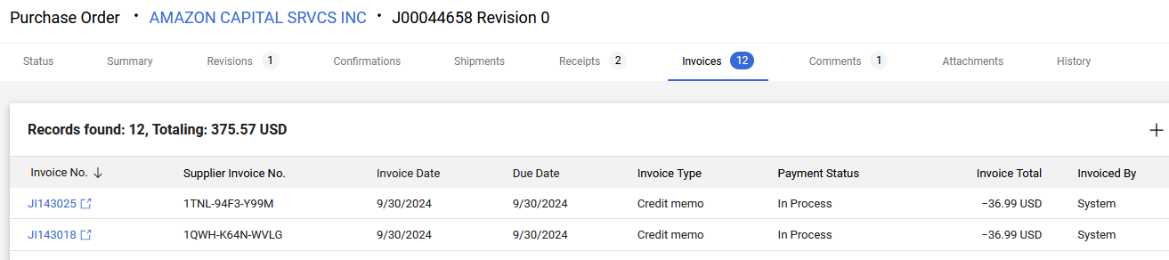
Example of System Credit Memos
This is an excerpt of 2 invoices, which are CMs, of 12 for this PO.
Amounts are -36.99 each, invoiced by the System.
The Supplier is a Punchout.

Slide 5
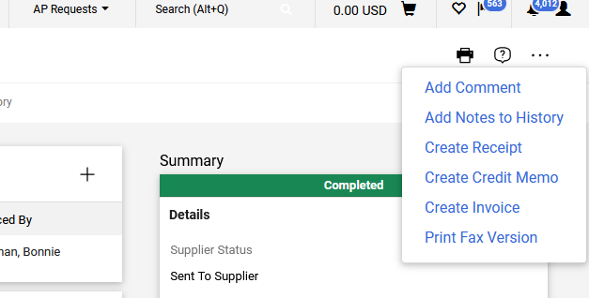
How to create an credit memo for a Non-Punchout Supplier
Instructions for creating invoices for Purchase Orders can be found at: https://procurement.umbc.edu/paw-procurement-training/
Creating a Credit Memo is very much the same.
1. Go to the 3 horizontal dots at the top right of the PO and choose “Create Credit Memo.”

Slide 6
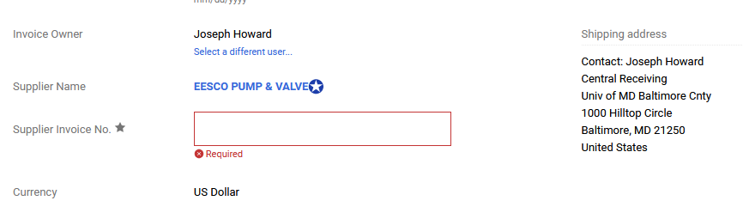
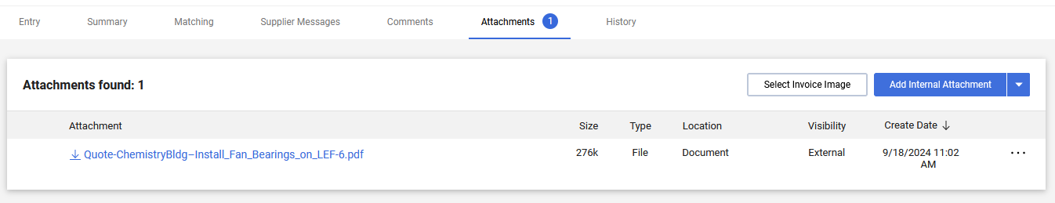
2. Enter the Supplier’s invoice/Credit Memo number
3. Go to the Attachments Tab, and add/upload the PDF of the Credit Memo

Slide 7
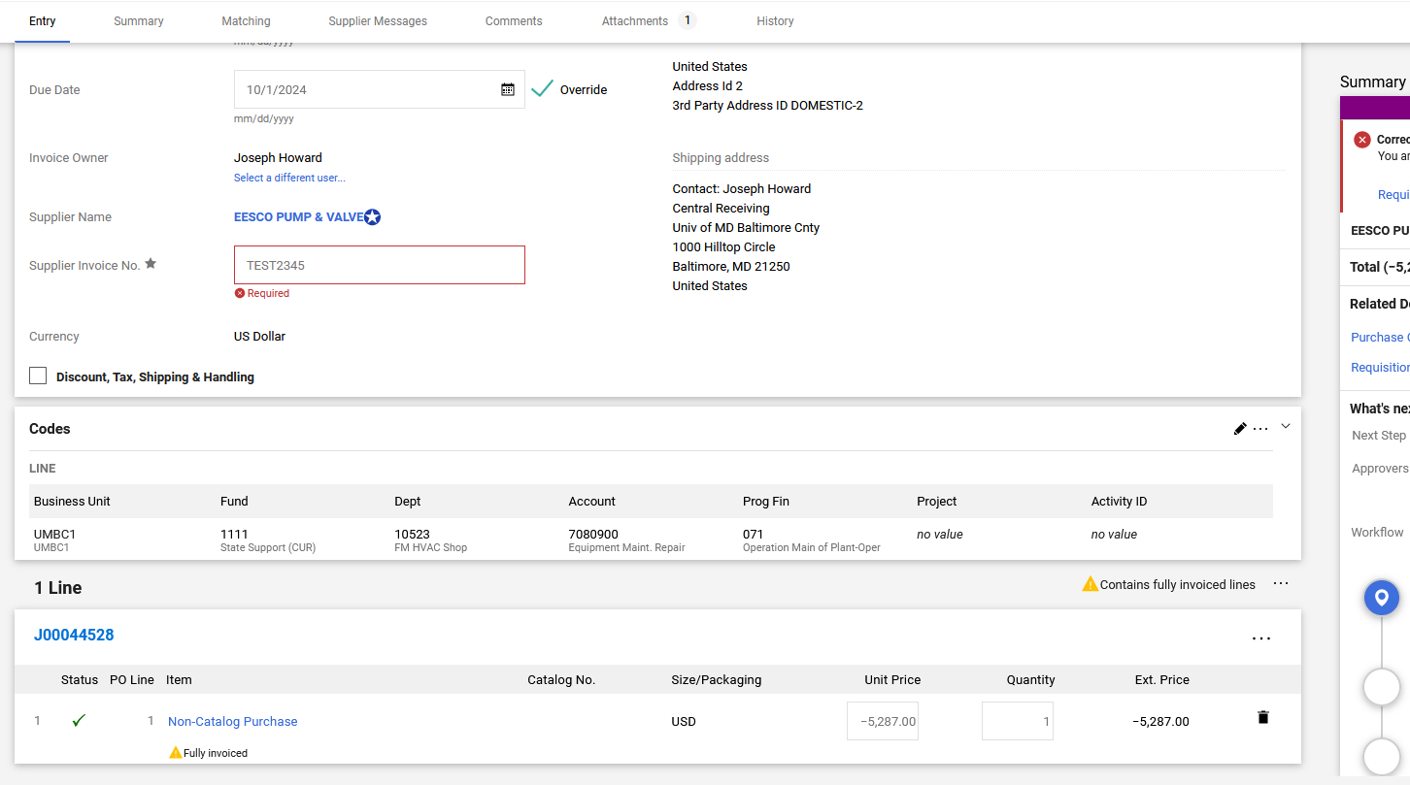
4. Go back to the Entry tab and enter the “Unit Price” (negative) and “quantity”. Make sure the quantity is not zero.
Shipping?

Slide 8
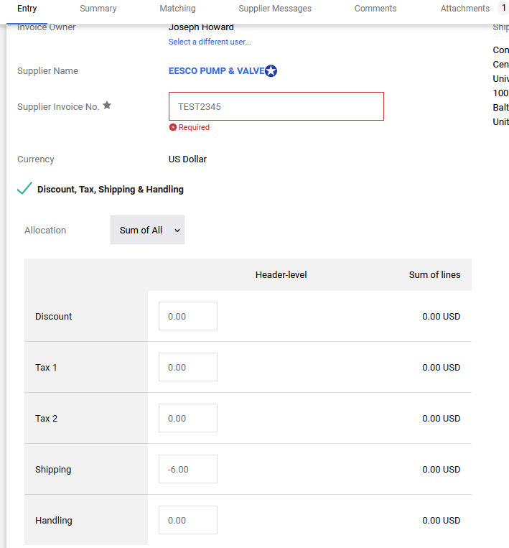

If Shipping is included on the Credit Memo
You need to separate the shipping credit from the item price credit when creating the credit memo. Only the negative item price (even if it is partial) is included in Step 4.
5. If there is shipping, click the Discount, Tax, Shipping & Handling Box. Enter the shipping amount as a negative in the box. The item price plus shipping should equal the total CM amount.
6. To complete the CM, click Complete in the upper right corner:

Slide 9
What to do if the PO is closed
AP cannot process an invoice or credit memo if the PO is closed. Do not request that Procurement close a PO if there is an outstanding invoice or CM. Also, you cannot create a CM or enter receipts if the PO is closed.
If the PO is closed, please submit an RT ticket in the Procurement queue and request that it be re-opened. AP cannot re-open a PO.

Slide 10
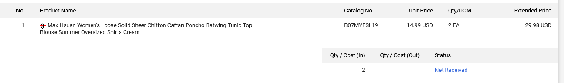
When to add received, returned or canceled receipts
AP sees a credit memo attached to a PO and needs to process it. We look to see what receipts have been entered in the PO…
In this example, we have a credit memo for -$29.98. The items are showing as Net Received. We are going to submit a comment that we need you to enter a returned receipt. We are assuming that because you received the item already, that you must have returned it to get a credit memo from the supplier. Enter a returned receipt.

Slide 11
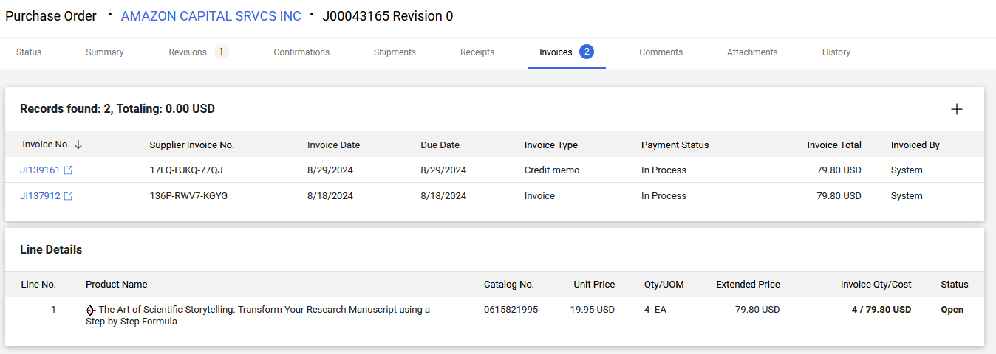
In this example, we have an invoice and a credit memo and no receipts. If you received the item and returned it, enter a received receipt, then enter a returned receipt (you cannot return an item you haven’t received). If you never received the item, enter a canceled receipt.

Slide 12
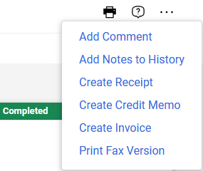
Entering Quantity Receipts
PLEASE DO NOT ENTER COST RECEIPTS when receiving items that can be returned. Cost receipts only have the choice of received and canceled. PAW will get confused if someone enters first a cost received, then either cost canceled, or quantity returned. There is no fixing those scenarios in PAW!! USE QUANTITY RECEIPTS!!
Steps for entering quantity receipts: Received, returned and cancelled receipts are created the same way, as the choice is a drop down menu.
1. Go to the three horizontal dots on the upper right, and choose Create Receipt.

Slide 13
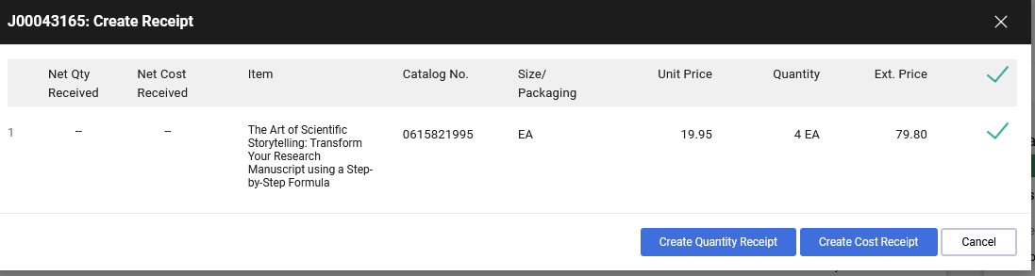
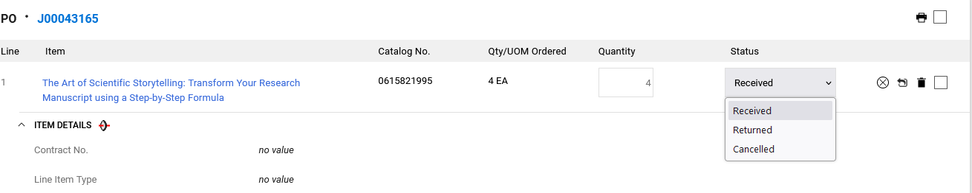

2. Choose Create Quantity Receipt.
3. Enter the quantity and click on the drop down menu. It defaults to Received and often the quantity defaults to zero, so please enter the correct quantity! (If it is zero, nothing will change.)
4. Click Complete in the upper right corner.

Slide 14
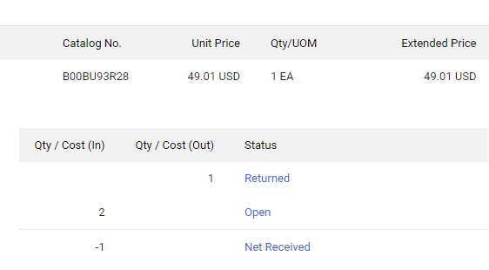
Check the Results!!
It is always good to check your results after you submit anything in PAW. You can check your receipt by going to the summary page of the PO, and clicking on the Receipts Tab. It will show you if you successfully entered the receipt that you intended. If you don’t see the item returned or canceled, check the quantity of the receipt and make sure it is not zero.
If you get this result, where the item ordered is 1, but the open item says 2, you put in a returned receipt without a received receipt. Correct it by entering a received receipt.

Slide 15

In conclusion
When we need to process a credit memo, AP looks for the correct receipts – received, returned or canceled.
We do not need you to supply any verbiage from the supplier unless we are working with you to resolve a problem and ask you for it.
If you need assistance, please ask us!! Best to enter an RT ticket in the AP queue!

