Slide 1

Accounts Payable Best Practices
Dos and Don’ts
Linda Rothfus, Manager, AP & Business Services
limiller@umbc.edu

Slide 2
Invoices – POs or Contracts
Each invoice should clearly show the name and address of UMBC.
Each invoice must sufficiently describe, in detail, the goods/services received. The invoice should be in US dollars.
Each invoice must include the vendor’s name, remittance address, EIN #, PO or Contract # and invoice #.
UMBC Is exempt from all forms of taxes, except excise tax, admission & amusement taxes, sales tax on hotel rooms.
Sales tax on food- only restaurants, not grocery stores, etc.

Slide 3
Invoices – POs or Contracts Continued
The State of MD will not pay from quotes or pro-forma invoices.
Invoices for parking fees or other driving violations of employees will not be paid.
All international payments must be made by wire transfer.

Slide 4
Payment Requests
What can be paid on a Payment Request?
Same rules apply as to PO Invoices/Contracts.
UMBC does not pay for food services served during normal staff meetings.
UMBC will not pay for expenses incurred at state employees’ social events such as Holiday parties, retirement parties, baby showers, etc.
Gifts, contributions or donations are unallowable.

Slide 5
Payment Requests Continued
Costs for alcoholic beverages are not paid/reimbursed.
UMBC does not pay for funeral flowers, special gifts or other emoluments.
Please make sure that supplier name & remit address
matches what is in PAW.
60 Day Rule for employee reimbursements.
All attachments must be legible.

Slide 6
Payment Requests Continued
All international payments must be made via wire transfer.
All receipts must be detailed/itemized.
Meal Reimbursements; if attended by all UMBC employees, you must include the meal approval form. All meal reimbursements must include a list of names and affiliations.
Individuals can only be reimbursed conference fees after they attend the conference.
Tips on meals cannot be more than 20% of the subtotal.
Attachments should be in PDF format.

Slide 7
Additional Information
Please have suppliers sign up for EFT/ACH payments (X-10 Form).
If an expense can be paid using the departmental P-card, please do so.
Please have employees take advantage of our punch-out suppliers in PAW, like Amazon.
When reimbursing someone for out of pocket expenses do not use an account code that generates a 1099.
Verify that the chart string be used is accurate.

Slide 8
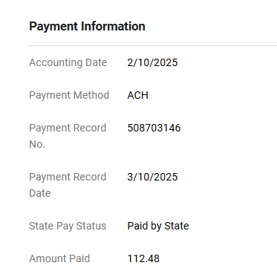
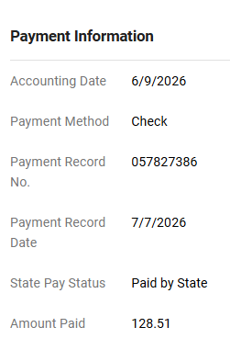
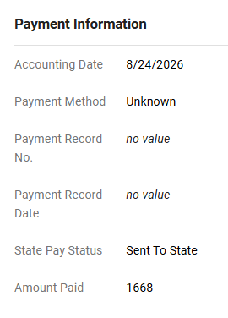
Payment Information-PAW
(Invoice Summary Tab)

Slide 9
Additional PAW Trainings
Creating Invoices in PAW and Credit Memos will be covered in the following trainings:
September 15th: Procurement Virtual PAW Training 1
September 17th: Procurement Virtual PAW Training 2

Slide 10

If you need assistance, please ask us!! Please enter an RT ticket in the AP queue!
Additional information can be found on our website:
AP Guidance

