Slide 1
Hannah’s Ramps
A V-LINC Project
for
The UMBC ASME Student Chapter

Slide 2
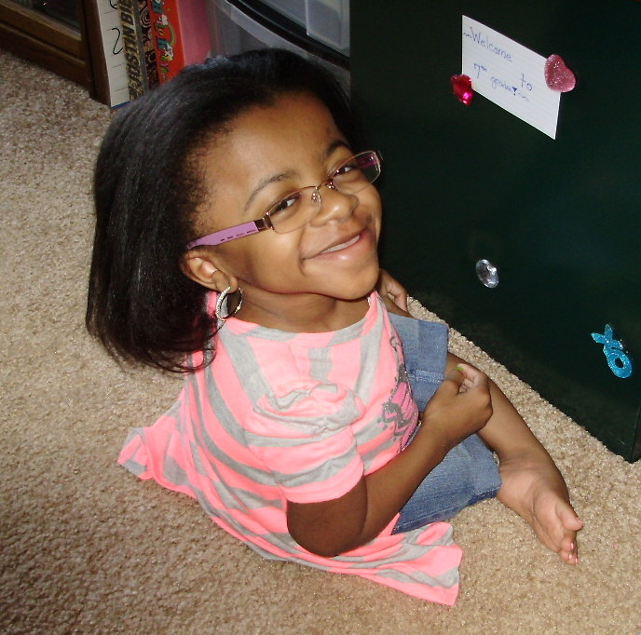

Slide 3
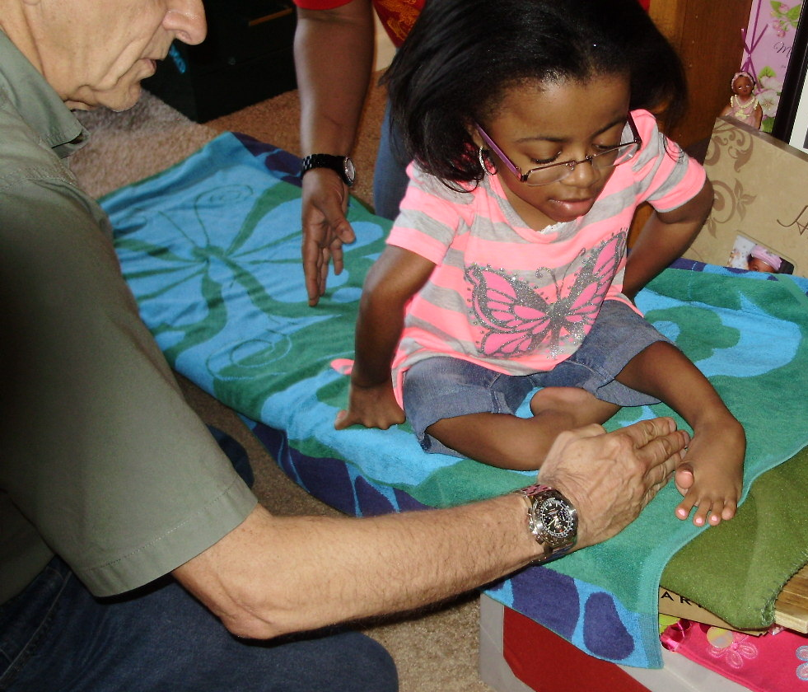

Slide 4
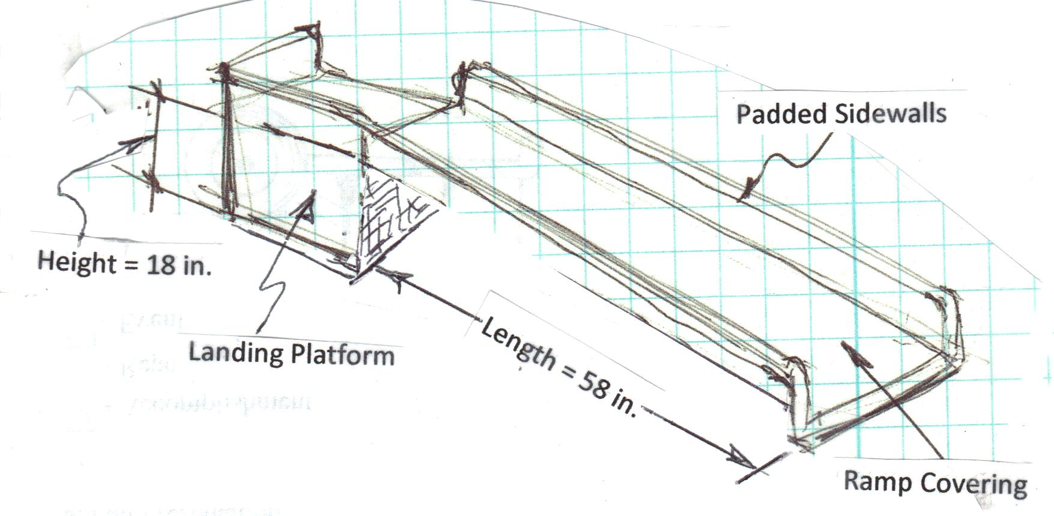
Ramp for Bed Access

Slide 5
Project Requirements
Ramps must be safe and sturdy; support load of 60 pounds
(F. S. = 2).
Ramps must be easily detached from Landing Platforms
(Landing Platforms are NOT part of project).
Ramps must “hook onto” Landing Platforms. Will be attaching to ½-inch thick plywood wall .
Toilet access ramp: Height = 15 in., Length = 51 in.,
Width = 18 in.
Bed access ramp: Height = 18 in., Length = 58 in.,
Width = 18 in.

Slide 6
Optional Requirements
(if Primary Reqs. are met, and time allows)
Padded Sidewalls – Must be high enough to insure Hannah can’t fall off; padded to protect from abrasions.
Ramp Covering -- Covering must allow cleaning; and compatibility with Hannah’s comfort.
More information on these Optional Requirements will be provided if and as needed.

Slide 7
Project Tasks
Create Project Schedule -- Use Gantt (bar) chart format.
Brainstorm – Come up with long list of ideas; ignore cost and practicality for now. Include both material and design options. Document, with sketches & preliminary pros and cons for each idea.
Identify Most Promising Designs – Work with UMBC & V-LINC Advisors to reduce list to two or three best designs.
Analyze: Study each “best design,” to allow Final Design selection based on:
(a) minimal deflection
(b) weight (lightness)
(c) cost
(d) ease of handling, and
(e) reliability of the completed ramps.
4. Fabricate & test to verify analytical results for weight and deflection.

Slide 8
Deliverables
Bed access ramp
Toilet access ramp
Engineering report, documenting all work done on project

Slide 9
QUESTIONS?

