Slide 1



Hannah’s Ramps
Progress Report: Phase One
December 2012

Slide 2

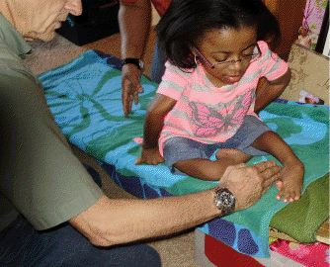
Background
Hannah is an exceptionally bright 12 year-old girl born with a severe case of brittle bone disease (Osteogenesis Imperfecta Type III).
She is unable to walk, but she can move rapidly across the floor using her hands and arms to propel herself.

Slide 3
Objectives
At 12 years old, Hannah must still rely on her mother to lift her into bed and onto the toilet.
Our team endeavors to give her independence and privacy in these tasks through engineering.
Our team must design and fabricate two ramps:
  Floor to bed
  Floor to toilet

Slide 4
Design Requirements
Must support 60 pounds weight
Factor of safety = 2
Must be easily detachable from landing platform
Must be easy to assemble: simple, light, and requiring no tools
Must have dimensions that would allow closet/shower storage
Must be 18” wide
Bed access ramp must be 18” tall and 58” long
Toilet access ramp must be 15” tall and 51” long
Maximum incline is 17˚

Slide 5
Proposed Designs
Grouped by Category

Slide 6
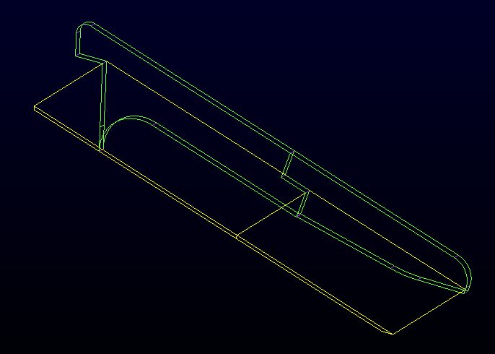
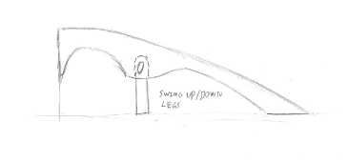
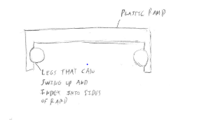
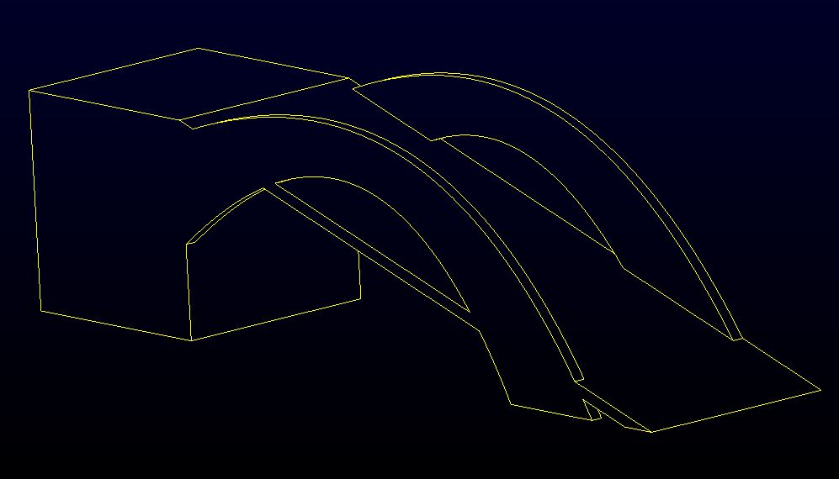
Preliminary Ramp Designs

Slide 7
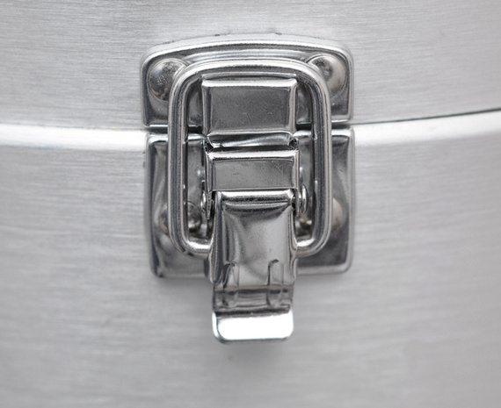
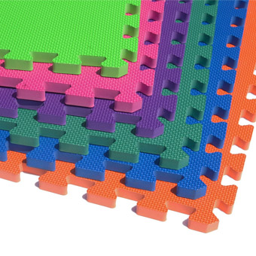

Preliminary Mount Designs
http://www.greatmats.com/products/dense-foam-mats.php
http://www.photo-dictionary.com/phrase/7333/latch.html#b

Slide 8
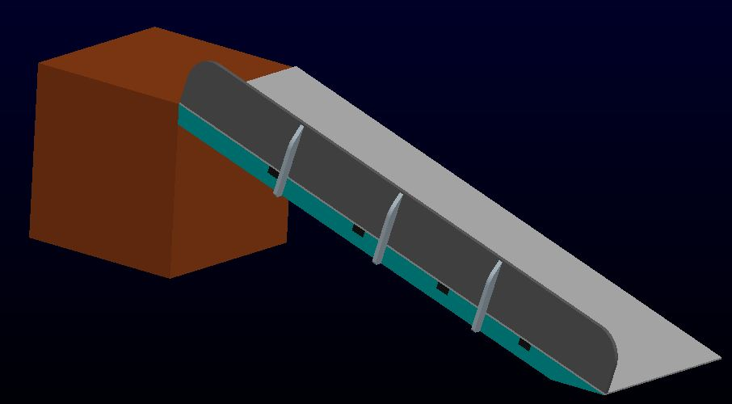
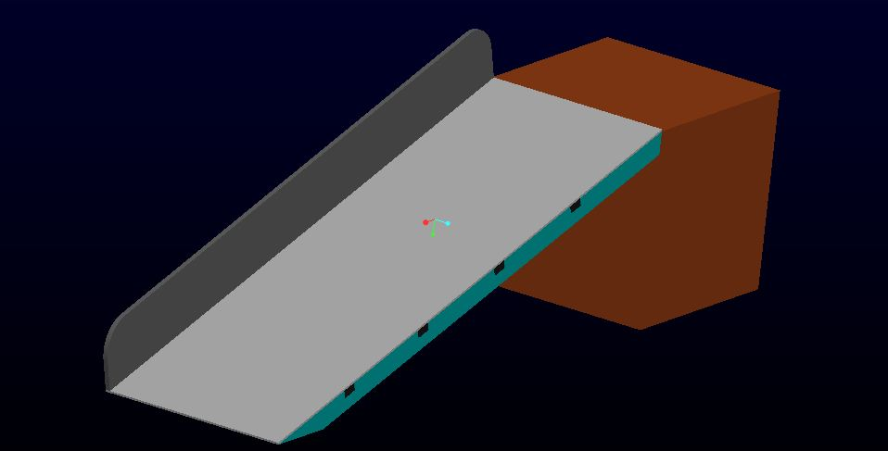
Wooden Ramp

Slide 9
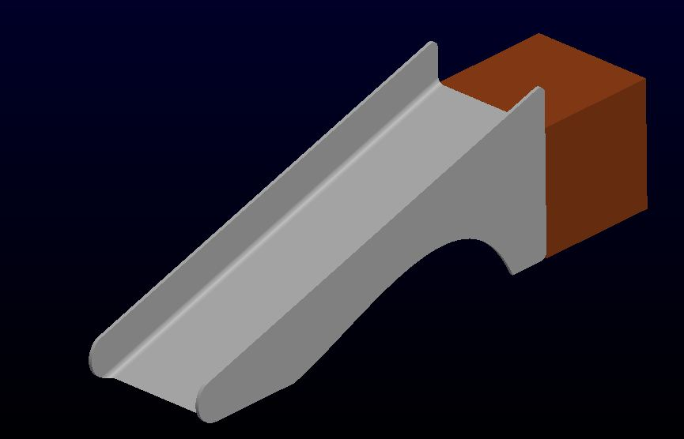
Composite / Plastic Ramp

Slide 10

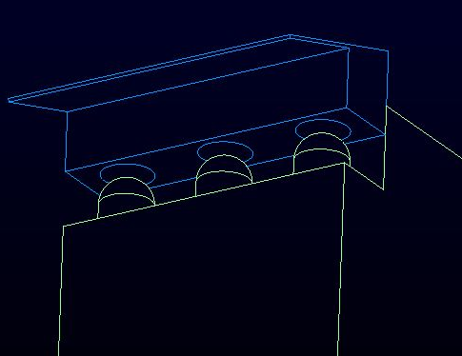
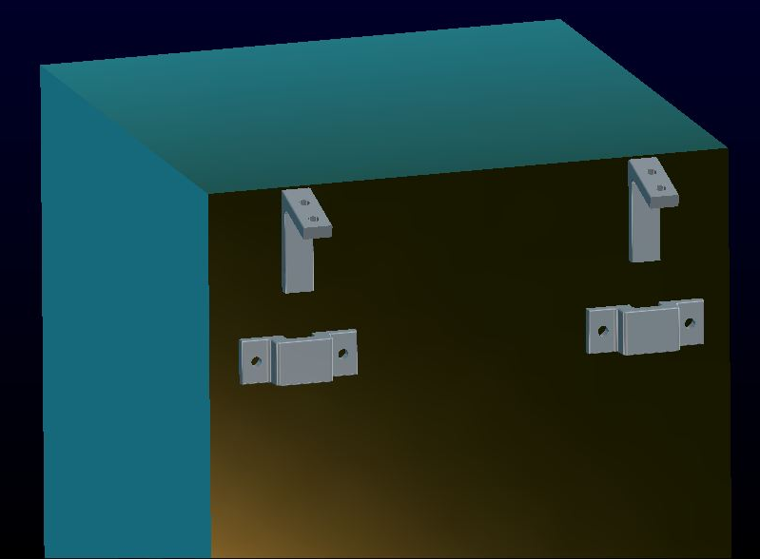
Ramp Mount Designs
Hook and Sleeve Design
Peg and Hole
Slot and Bracket

Slide 11
Consideration for Future Features
Necessary for Final Product

Slide 12
Ramp Boundaries
Not part of this immediate project, but required for final product
Side walls or rails on the ramp will prevent Hannah from falling off either side by accident
These may be permanent installments or removable

Slide 13
Box Platform
Not part of this immediate project and must be designed for final product
Currently designed as merely a plywood box
The chosen joint design will lock on to the platform

Slide 14
Conclusions
Decision Matrix

Slide 15
Decision Matrix Criteria
Which ramp design should be chosen? The design of Hannah's ramps should be lightweight, easy to assemble, durable, storable and aesthetically pleasing. The interface between Hannah and the ramps should be soft, washable, removable and potentially replaceable. The general dimensions (length weight and height) are fixed and all designs will conform to the preset constraints. Each design is assumed to support at least 60lbs. Winner: TBD
Criteria | Definition
Ease of Installation/Disassembly | The ease in which the ramps can be put together or taken apart
Cleanliness | As the ramps are used, how easy are they to be cleaned?
Durability | How well will the ramps deal with regular use.
Weight | The ramps must be lightweight and easy to move.
Robustness of Design | How strong is the design? Does it seem rugged or is it unstable?
Complexity of Fabrication | How complex are the mechanisms on the ramps? Will they require machining, CNC, etc?
Cost | How much will the ramps cost to fabricate?
Size and Storability | When not in use, what are the ramps footprints? How easily can they be stored?
Comfort | The ramps should be comfortable to use. Hannah should be able to get a grip on the surface but it should not be abrasive.

Slide 16
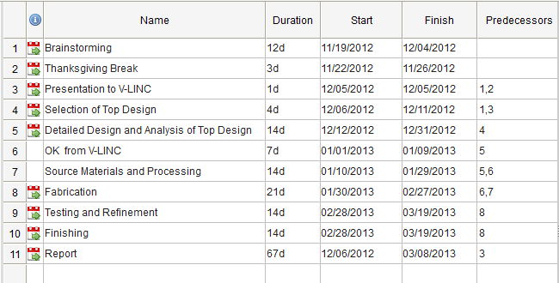
Schedule

Slide 17
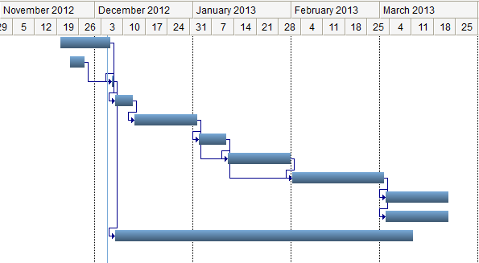
Schedule-Gantt Chart

Slide 18
Decision Matrix
 |  | Current Designs
Decision Factors |  | Baseline: Pet Ramp | Design 1 | Design 2 | Design 3
Criteria | Wt. | 0 | 1 | 2 | 3
Ease of Installation/Disassembly | 15.0% | 5
Cleanliness | 15.0% | 4
Durability | 15.0% | 4
Weight | 15.0% | 5
Robustness of Design | 10.0% | 3
Complexity of Fabrication | 5.0% | 4
Cost | 5.0% | 4
Size and Storability | 10.0% | 4
Comfort | 10.0% | 1
Weighted Scores |  | 3.9 | 0.0 | 0.0 | 0.0

Slide 19
Time for Questions · Time for Questions ·

