Slide 1

PageUp
Applicant Tracking System

Slide 2
As of November 2, 2017:
88 requisitions
3009 applications submitted
  20% increase in nonexempt applications over same time period in 2016.
57 individuals hired
15 Training sessions conducted since April

Slide 3
Enhancements & New Features
Additional communication emails
Additional users added to communication emails
  Payroll Preparers receive email when candidate has accepted the job offer
  Addition of Search Committee Chair field on requisition to receive communications
Enhancements to streamline HR Employment and back office procedures
  Offer letter and/or Personnel Requisition no longer required with new hire paperwork submitted to Payroll
Choice Program – Custom recruitment process for Fellows

Slide 4
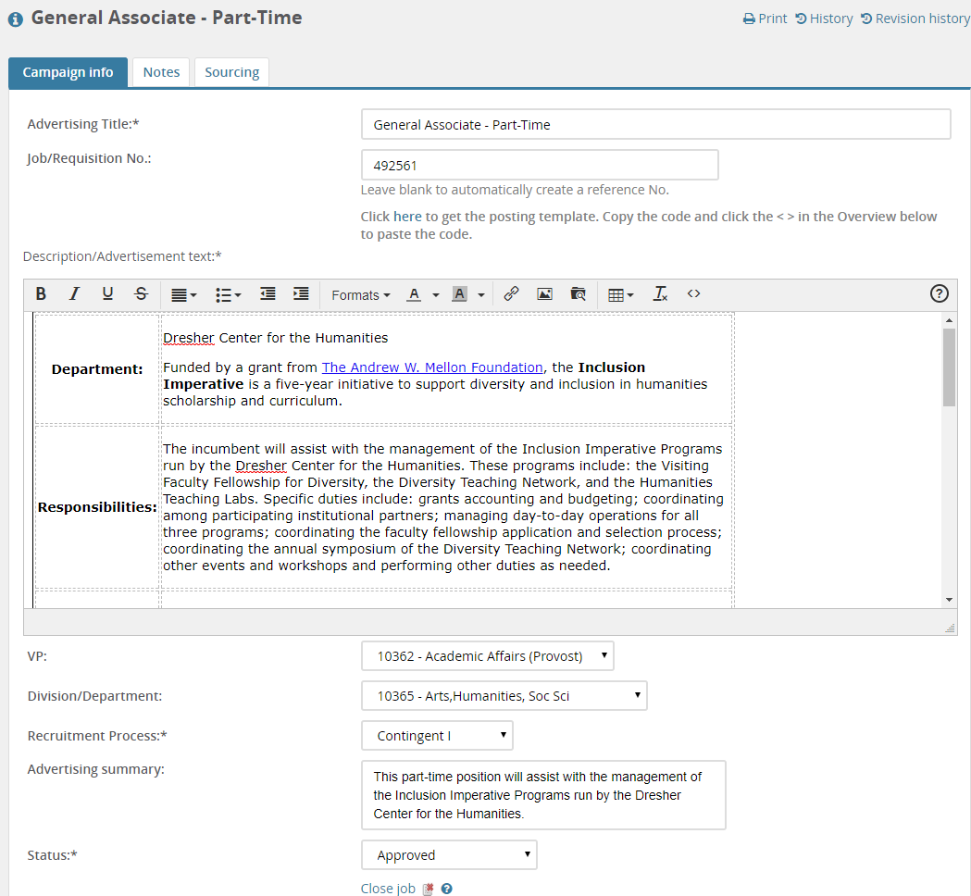
Campaign

Slide 5
What is next?
Continue to make tweaks and enhancements to the system
Short version of the exempt application form (cover letter and resume upload)
Ability to add specific, position related, question(s) to the general application.
Librarian Faculty project
Training Continues
  November 14th – HR Liaison and Hiring Manager Training
  November 28th – Hiring Manager and Search Committee Chair Training (Managing Applications)

Slide 6
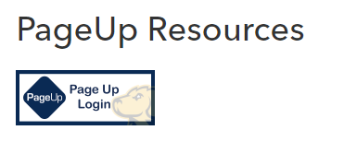
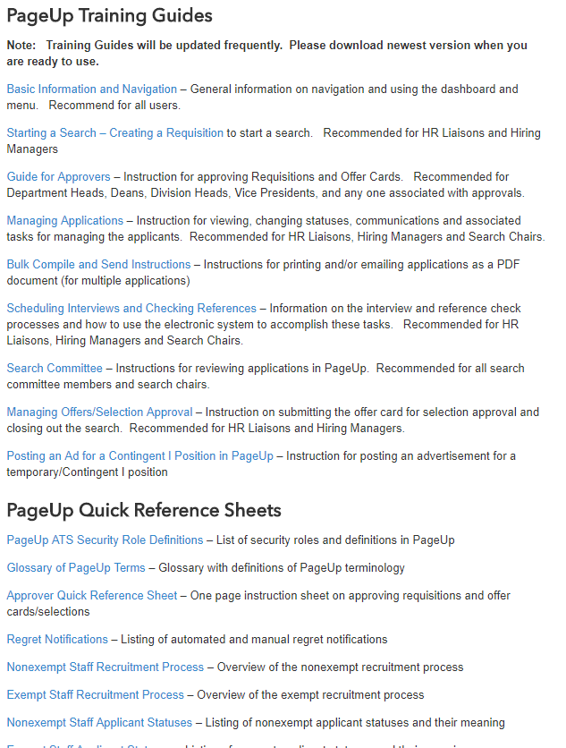
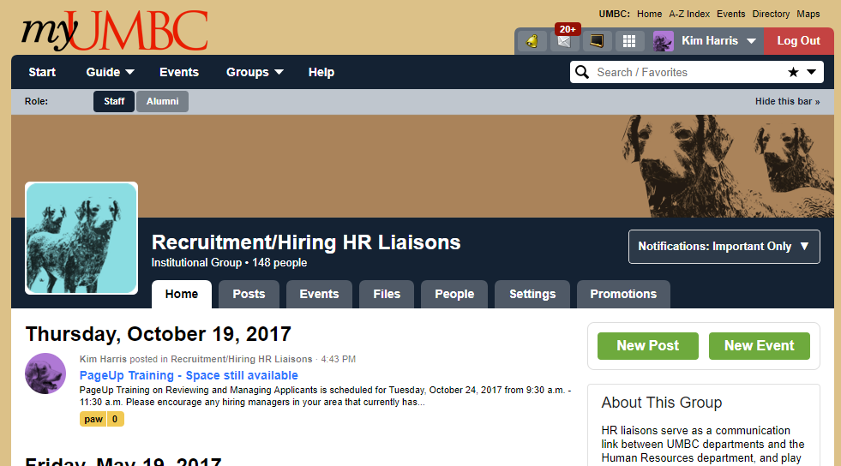
Keep Abreast of the Latest News
Join MyUMBC Recruitment/Hiring HR Liaisons Group
for frequent users of PageUp.

