Slide 1
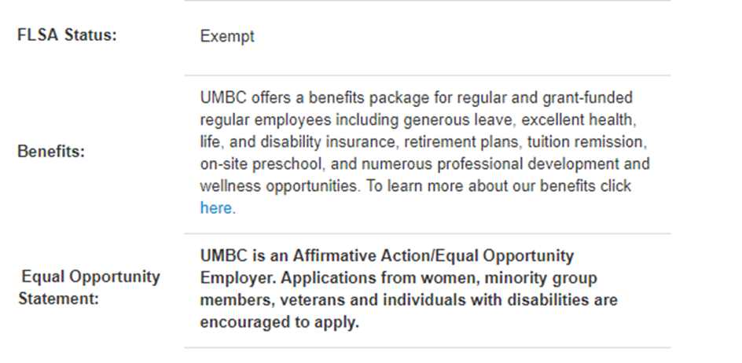
What is New?
Faculty Librarians Implemented in PageUp
4 positions currently in recruitment
Benefits information included in the bottom of each Job Posting

Slide 2
New Look – Hiring Manager Dashboard
Notes:
PageUp has upgraded many of their screens to make it more user friendly for mobile phones and tablets.
One of the most visible changes is to the Hiring Manager dashboard. Instead of the rainbow bubbles, we now have Tiles that represent the various actions. Functionality remains the same. And the training manuals are more visible on the right side.

Slide 3
New Reports
Notes:
Along with the Diversity and Search Committee responses reports which I mentioned at the last meeting, we now have implemented two new reports to track Advertising Sources and Event/Interview Bookings, or Schedules.

Slide 4
Application Sources Report
Notes:
Advertising Sources Report
We now have the ability to track all application sources in a nice colorful bar graph. We do this by giving you a unique URL at the time of your job posting. This is an example of a job that is using several different sources. The graph shows the subsources of each category. If you click on the Plus sign on each category, it will open up and show you the candidate’s name along with their current status. This can be downloaded into excel and the data manipulated so that you can tell which sources are giving you the BEST (those that got to Interview stage), not just the most. This is helpful for future recruitment and budgeting.

Slide 5
Event/Interview Booking Report

Slide 6
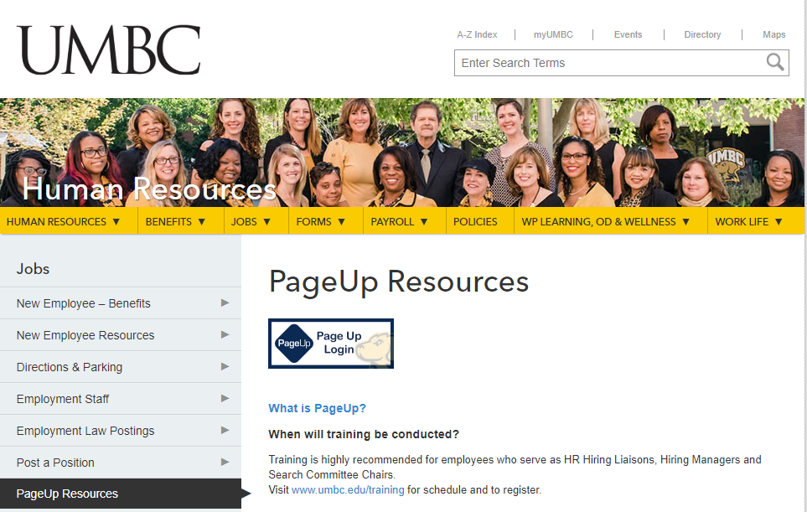
Instructions for locating and using Reports is available on the HR website under PageUp Resources

Slide 7
Google Calendar Link
Notes:
When you set up interviews, the system will now send you a notice that the candidate has accepted the interview, along with a link to add to your Google Calendar. This will occur when you add yourself and other users to the event upon set up.

Slide 8
Coming Soon
Additional features for Search Committees
Selection Criteria
Supplemental application questions
Faculty Requisition Implementation Project

