Slide 1
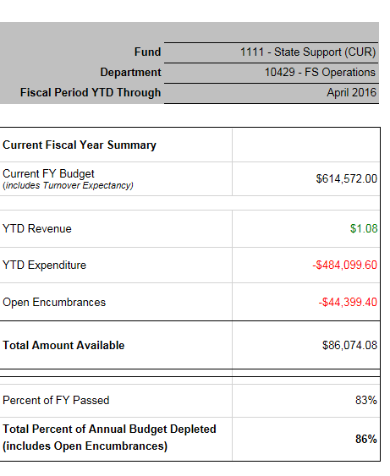
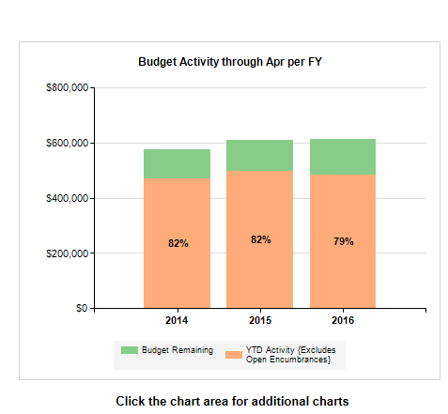
NEW REX FINANCE REPORTS
www.umbc.edu
Notes:
Nico – Real – Making progress
Community Engagement

