Slide 1
Business Administrators Meeting (BAM)
Wednesday, September 29, 2021

Slide 2
Agenda
9:00am Welcome: Kathy Dettloff
9:10am Financial Services Highlights
      Financial Reporting: Kathy Dettloff
      Budget Update: Kristy Michel
      Travel System: Gayle Chapman
9:50am Procurement Update: Elizabeth Moss
10:10am Human Resources Updates
      Hybrid Workplace Training Series: Jill Wardell
      Lunch with HR: Valerie Thomas
      Staff announcements/introductions
10:25am Questions
2

Slide 3
Welcome
Welcome
Kathy Dettloff
3

Slide 4
Business Administrators Meeting
Reporting Initiative Update
Reporting Initiative Update
4

Slide 5
Reporting Initiative Update
Goal: To have one “single source of truth.” Reports that have parameter flexibility to allow end-users the ability to run reports to manage operations. Reports should be user friendly.
Last time we met we introduced you to HelioCampus, which is currently being used for student reporting, as a possible solution for financial reporting
After further exploration, it is now necessary to look at other alternatives
Software is being researched that will provide UMBC the financial reporting functionality to ensure we fulfill our fiduciary responsibility
Input will be solicited to ensure the new reporting tool can meet user needs.
5

Slide 6
Reporting Initiative Next Steps
Convene a group of REX “super users” to guide our initiative and gather input from others
Identify changes in accounting practices and account code structure that will improve reporting
Develop a timeline and project plan for implementation
6

Slide 7
Budget Update
Kristy Michel
Budget Update
7

Slide 8
FY 2022 Budget by Fund
All Funds Budget - $523.3M
8

Slide 9
All Funds Revenue: $523.3 Million
Where Does it Come From?
9

Slide 10
All Funds Expenses: $523.3 Million
Where Does it Go?
10

Slide 11
Total Revenue: $292.4 Million
State Support Revenues by Category
11

Slide 12
Total Expenditures: $292.4 Million
State Support Expenses by Category
12

Slide 13
Total Revenue: $64.6 million
Auxiliary Revenues by Unit
13

Slide 14
Total Expenses: $64.6 Million
Auxiliary Fund Expenditures by Category
14

Slide 15
Total $47.5 Million
Self Support Funds by Category
Revenues
Expenditures
15

Slide 16
Introduction
UMBC Travel System
Gayle Chapman, Assistant Controller
Linda Rothfus, Manager, Business Services
Peggy Ingle, Assistant Manager, Business Services
I’dia Bey, Working Fund Custodian, Business Services
Joe Kirby, Assistant Vice President, DoIT
16

Slide 17
What is the UMBC Travel System?
UMBC Travel System
The Travel System (TS) is a robust in-house fully integrated system for processing and submitting travel Pre-Approvals (PA) and Reimbursements (RB)
BENEFITS include:
Fully automated workflow
Drop-down boxes, links and look-up tables for convenience
Unlimited travel duration per single submission
Automatic notification to travel agencies
Administrative Portal for managing multiple travelers
17

Slide 18

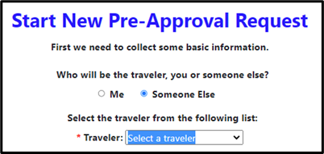
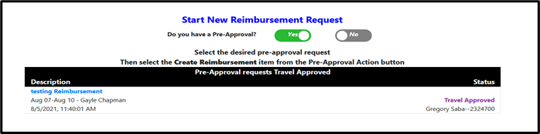
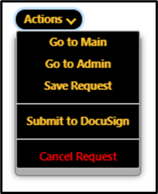
UMBC Travel System
Creates an automated workflow
DocuSign is used for approval workflow
18

Slide 19
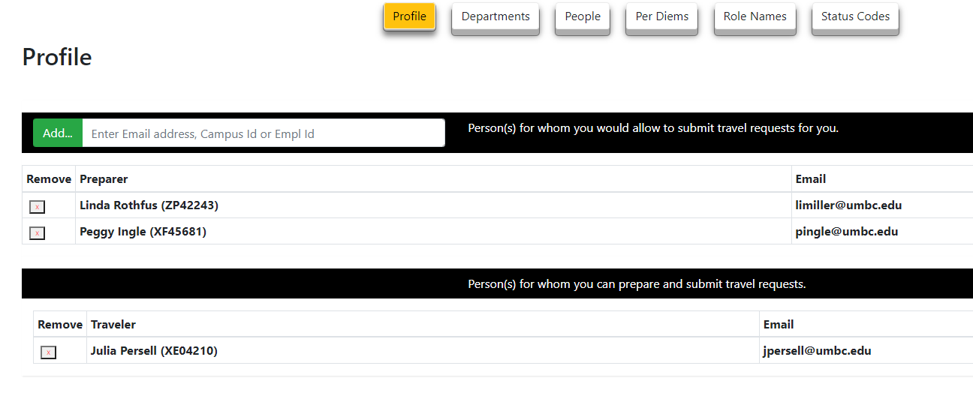
UMBC Travel System
19

Slide 20
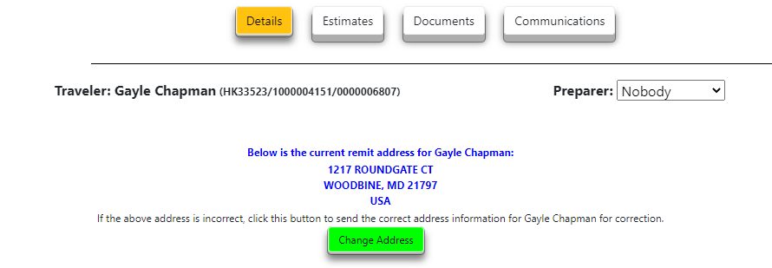
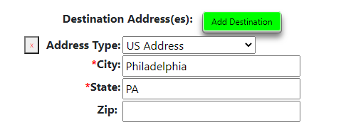
UMBC Travel System
Change address
conveniently
Add unlimited
destinations
20

Slide 21
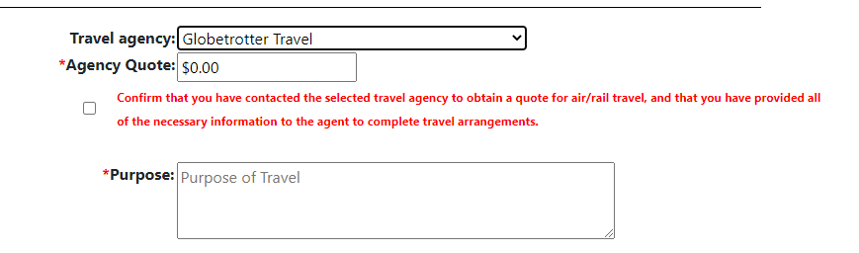
UMBC Travel System
Choose travel agency:
NONE
Globetrotter Travel
Travel Leaders
Omega
Anthony Travel (athletics only)
Other
21

Slide 22
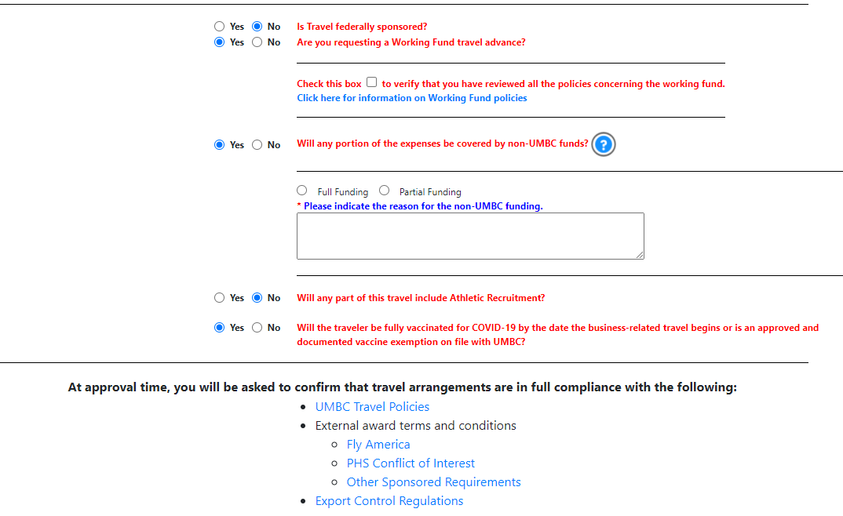
UMBC Travel System
Workflow for
Working Fund
Includes personal funds in calculation
Links to
policies
22

Slide 23
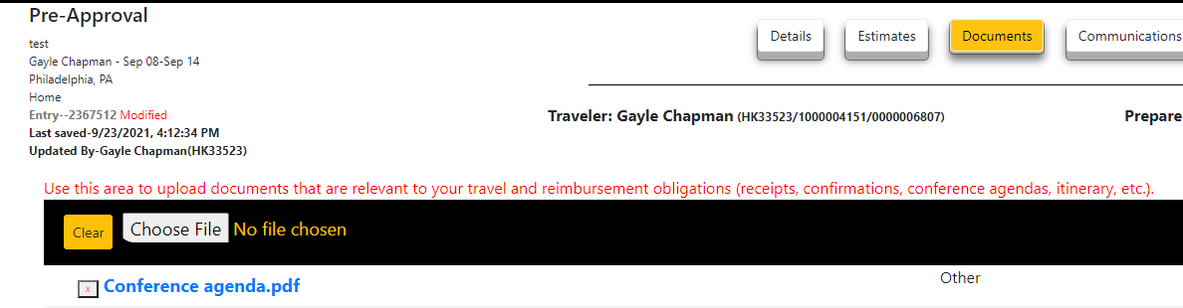
UMBC Travel System
Documents and other data in the Pre-Approval carry over to the Reimbursement.
The document number assigned to the Pre-Approval is the same document number for the Reimbursement
23

Slide 24
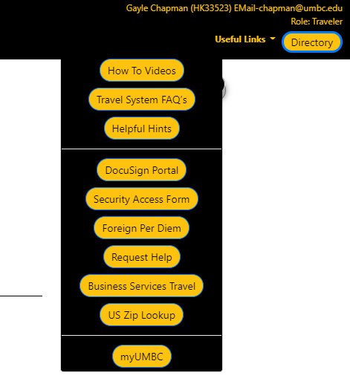
UMBC Travel System
Provides a number of convenient useful links and the Directory
24

Slide 25
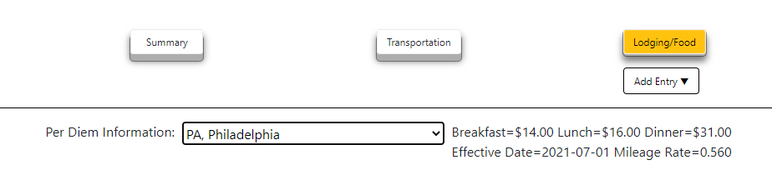
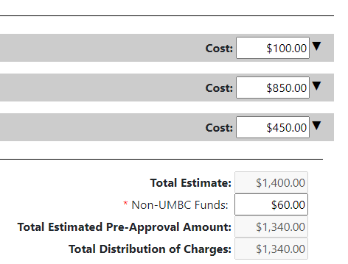
UMBC Travel System
Provides current per diem meal and mileage rates and drop down of high costs cities.
Automatically totals estimates/expenses
25

Slide 26
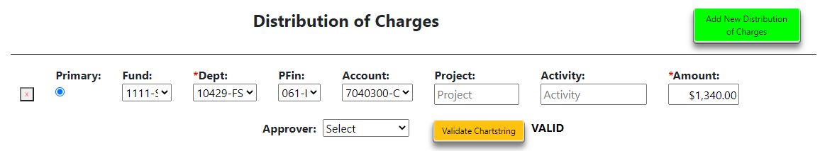
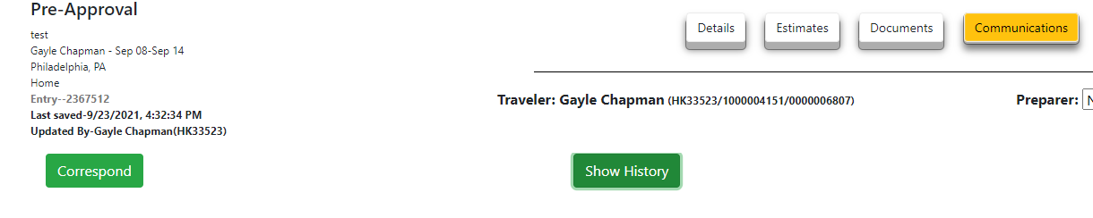
UMBC Travel System
Add up to 5
Chart strings
Select approvers from drop down
Validate chart strings
Send emails within the TS
Check the PA or RB system history
26

Slide 27
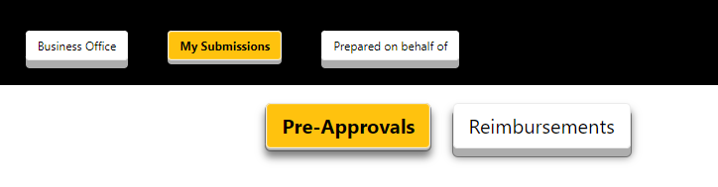
UMBC Travel System
Manage multiple requests
27

Slide 28
UMBC Travel System
UMBC is successfully using Travel System (TS)
TS went live on August 25th. As of September 27th:
40 Pre-Approvals were created in TS and completed
31 Reimbursements have been created and completed
27 Requests are in processing at different stages
18 Tickets have been issued by travel agencies
28

Slide 29
UMBC Travel System
More information, FAQs and training videos can be found at:
Businssservices.umbc.edu/travel
Join us for live (virtual) training sessions:
Creating a Pre-Approval in the Travel System
on October 15th at 10 am
Creating a Reimbursement in the Travel System
on October 20th at 2 pm
https://my3.my.umbc.edu/events/workshops-and-training
29

Slide 30

PAW PROCUREMENT SYSTEM
User Interface Changes
PAW Procurement
30

Slide 31

Timeframe for new UI
Toggle button available now in Test
October 15th
  Toggle button will appear in production
  New user interface will appear in Test
Friday, November 12th
  New user interface will be in production
  Classic interface will no longer be available
31

Slide 32
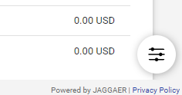
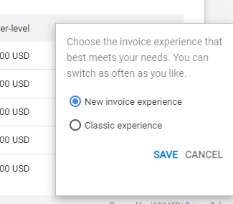
Toggle Button
32

Slide 33
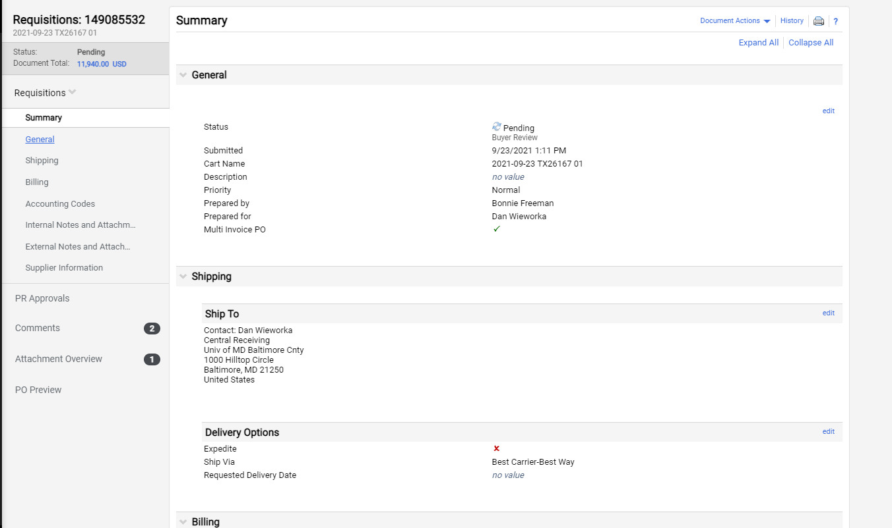

33

Slide 34
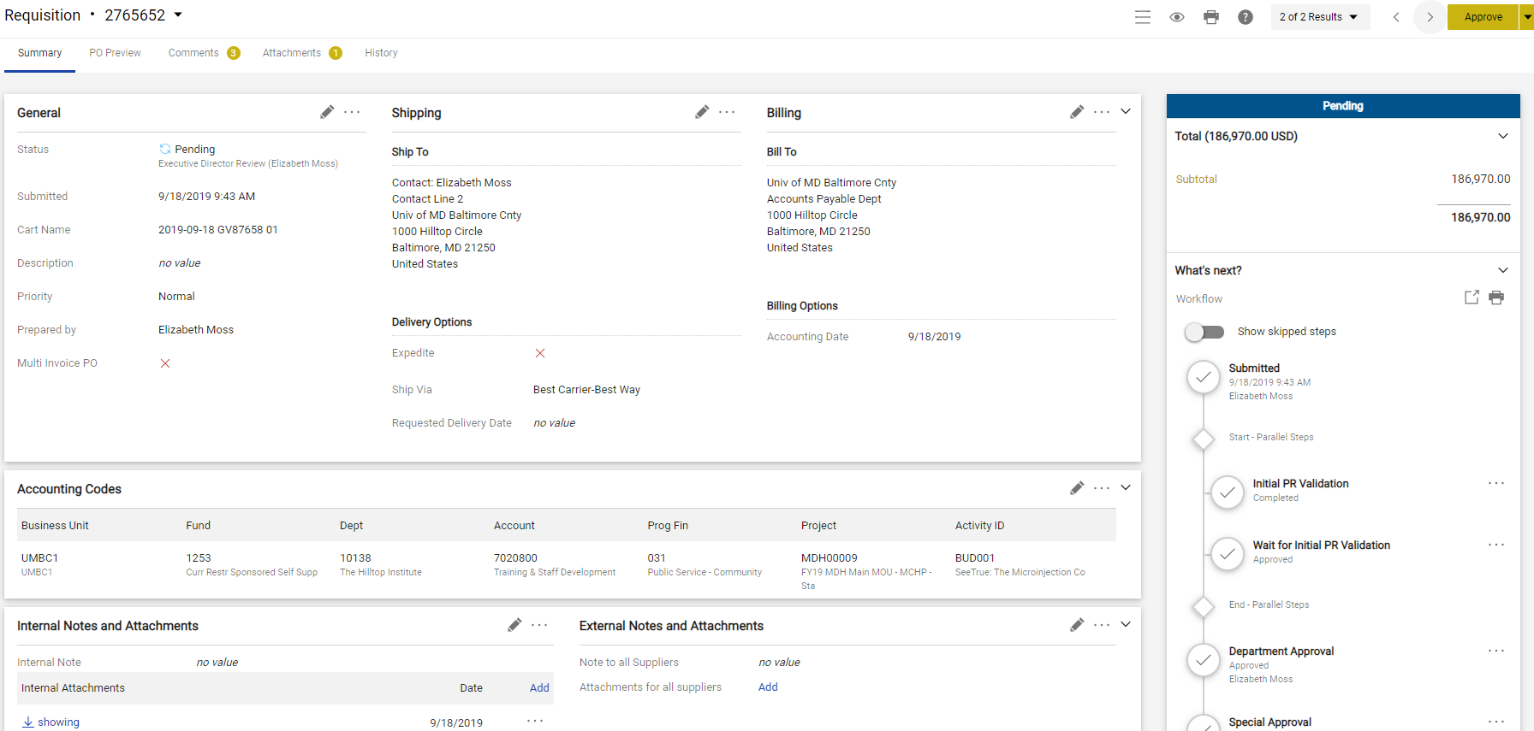
34

Slide 35
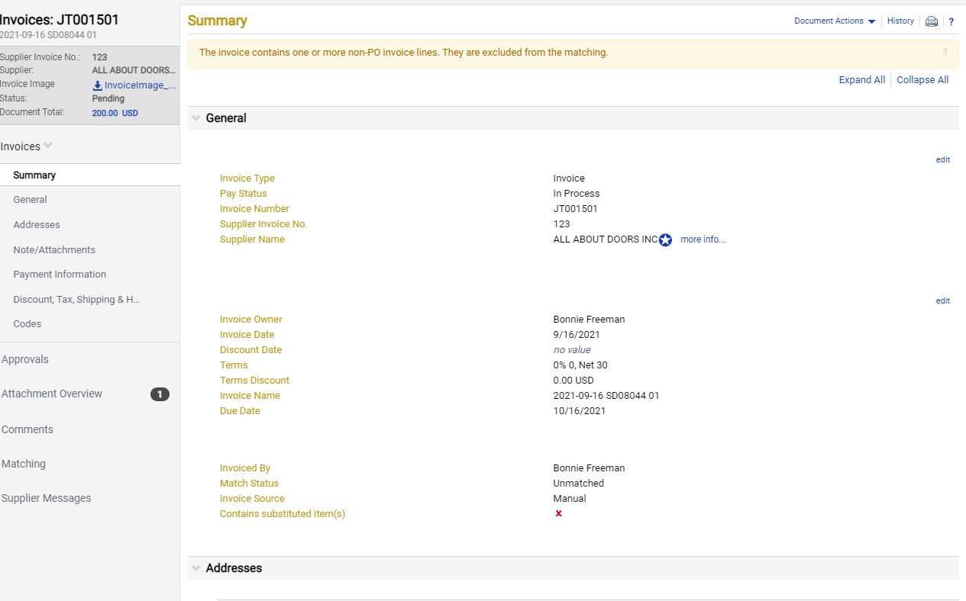
35

Slide 36
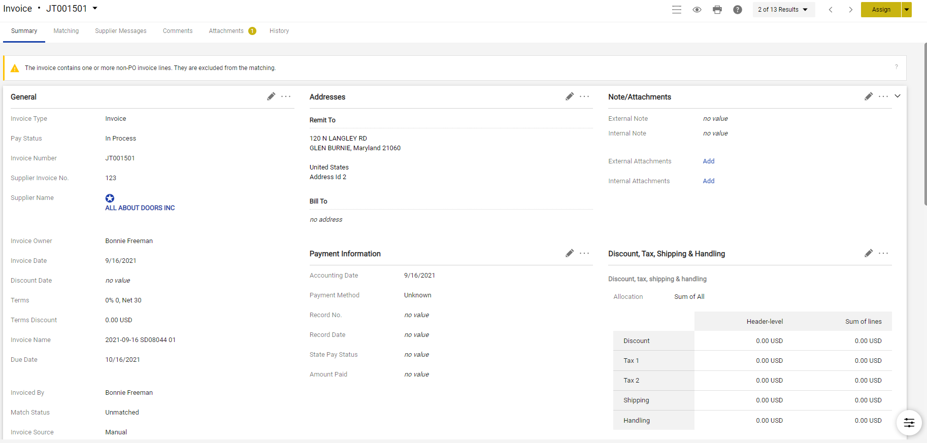
36

Slide 37
Training
Op
Training will be provided in October, November, and December
User training guides will be updated
Drop in hours
37

Slide 38
Additional reminders
All authorized campus delivery addresses are again available in the system
Be sure to indicate the building and room number
Keep addresses short and clear
38

Slide 39
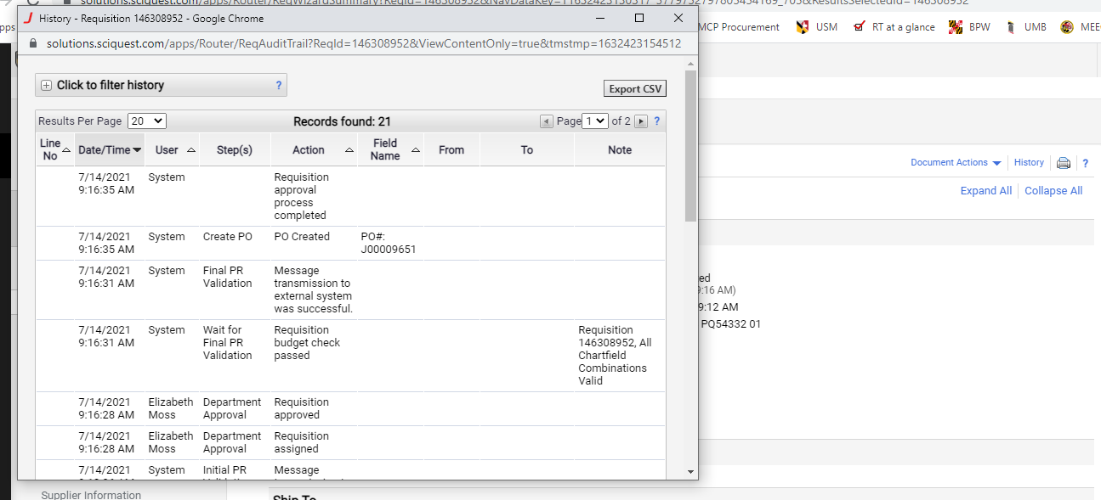
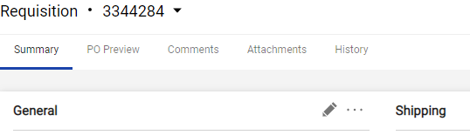
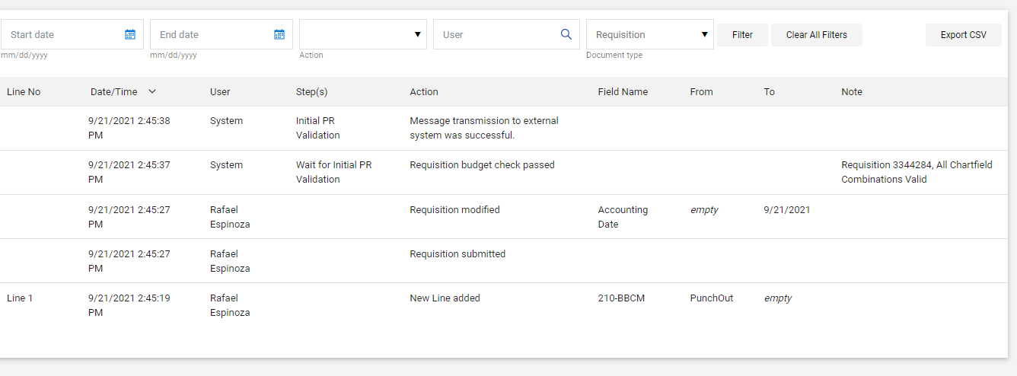
Additional reminders
Check history of transaction
Classic Interface
New Interface
39

Slide 40
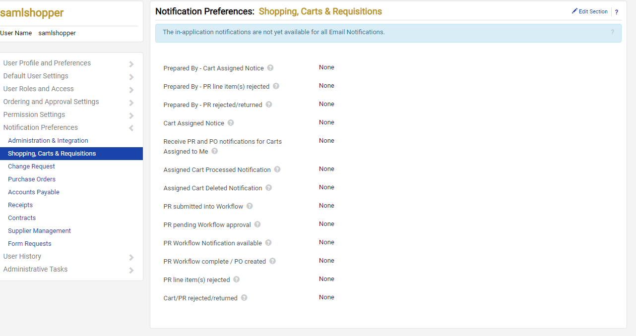
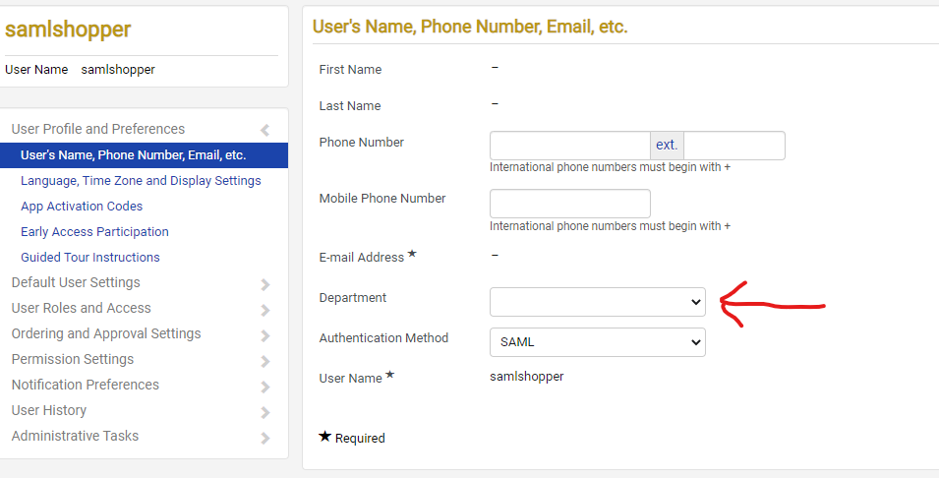
Additional reminders
Department name
Notification preferences
40

Slide 41
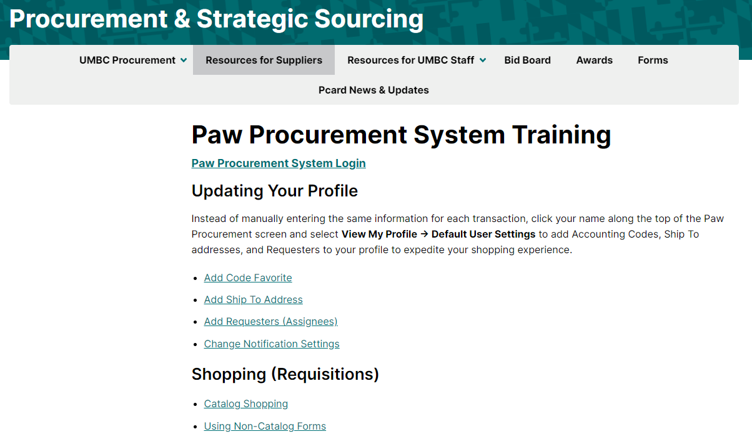
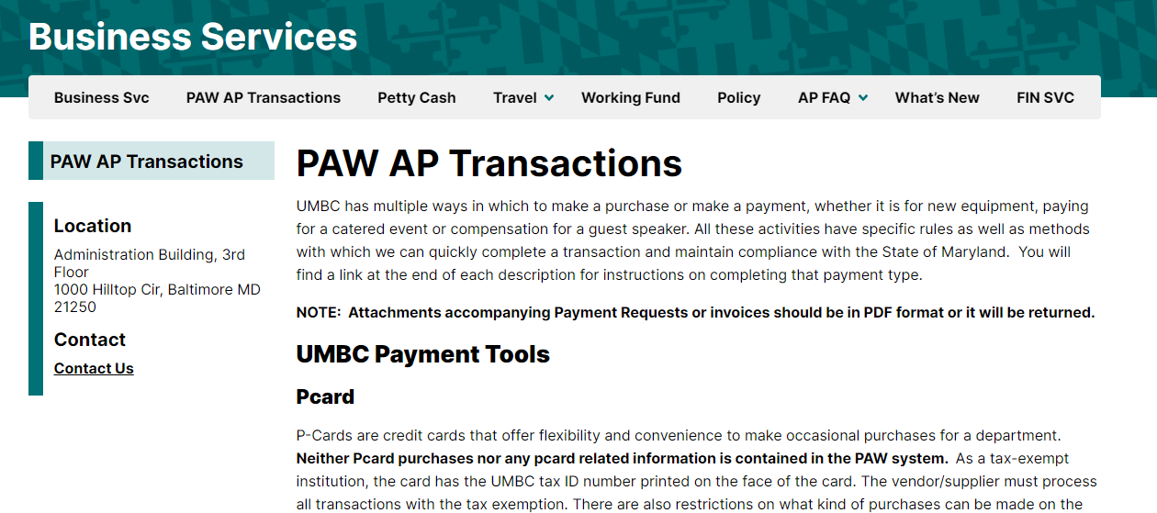
Paw Resources
41

Slide 42
Human Resources Updates
      Hybrid Workplace Training Series: Jill Wardell
      Lunch with HR: Valerie Thomas
      Staff announcements/introductions
42

Slide 43

The Hybrid Workplace
Why? New skills & tools are needed success in hybrid work
How? Partnership with DoIT & HR
What? Two summer live boot camps offered
Asynchronous video courses now available on Panopto for viewing 24/7!
43

Slide 44
Two Options
The Hybrid Workplace
Foundations of the Hybrid Workplace
Target Audience: Individual Contributors
Webex Messaging & Calling
Webex Meetings
Google Sheets
Gmail & Calendar
Google Slides
Google Docs
Take 5 of the 6 and earn a digital badge!
Foundations: Course Folder Access
Strategic Planning Series
Target Audience: Individuals who manage or coordinate the work of others
Webex Messaging & Calling Part II
Webex Meetings Part II
Facilitating Hybrid Meetings
Leading Hybrid Teams
Surveys with Google Forms & Qualtrics
Docusign
Take 5 of the 6 and earn a digital badge!
Strategic Planning: Course Folder Access
44

Slide 45
Lunch With HR
Our chance to get to know what matters to YOU during this time of transition - what you care about, what keeps you up at night, your hopes and dreams, etc.
Series of monthly lunch chats with us and other leaders in the community
Our Goal? Help support you and to help inform us as to the pulse of our community so that we can do our best to make informed and inspired choices that lead to a thriving workplace culture.
Submit your questions in advance for each of our sessions:
9/29
10/27
11/17
12/15
45

Slide 46

Supports For Health & Well-Being
Program Facilitated Virtually On Hopin
Sessions and program activities for Monday-Friday
Offered by EAP ComPsych Facilitators
6 75-minute interactive sessions. Topics likely to include:
  Managing Worry & Anxiety
  Mindfulness & Presence
  Dealing with Change
  Healthy Food Choices on the Go
  Stress management
  Relaxation techniques
  Mental Health Awareness etc.
  Stay tuned for registration information on myUMBC!
46

Slide 47
Human Resources New Staff
Department of Human Resources – New Staff Hired as of 1/1/21
Nadah Ali, HRIS Analyst/Specialist – January
Ayana Thompson, Benefits Manager – April
Joseph Michelizzi, Employment Specialist – May
Susan Harkins, Classification & Compensation Manager – June
Carolina Ethridge, Payroll Manager, September 27, 2021
Michale Sheckleford Tallon, Director of Employee & Labor Relations, September 27, 2021
Retirees: Elmer Falconer, Employee & Labor Relations and Rochelle Sanders, Benefits and Class/Comp will continue to work with HR until the end of the fiscal year.
47

Slide 48
Human Resources Staff Vacancies
Department of Human Resources
Staff Vacancies/Position Searches
Director of Employment, Classification/Compensation & Benefits – Search in Progress
HR Specialist I, HRIS – Position Posted (Denise Rollins)
Executive Administrative Assistant I – Position Posted (Michele Kimery)
Human Resources Talent Acquisition Specialist – Position Posted (Rosemarie Mahoney)
Payroll Processing Associate – Position to be Posted (Samantha Sutton)
48

Slide 49

Questions
Questions
49

