Slide 1
Business Administrators Meeting (BAM)
Wednesday, March 16, 2022

Slide 2
Agenda
12:30pm Welcome: Kathy Dettloff
12:40am Signature Authority Policy: Terry Cook
12:55pm AssetWorks: Anna Gosden
1:10pm Financial Services Updates
PAW Procurement Punch Out Back Log: Gayle Chapman & Bryan Casey
Reporting Initiative: Jared Fincke
1:30pm Human Resources New Staff: Valerie Thomas
1:45pm Questions
2

Slide 3
Welcome
Welcome
Kathy Dettloff
3

Slide 4
Signature Authority Policy
Signature Authority Policy
Terry Cook
4

Slide 5
Signature Authority Policy
Joint Initiative between
Division of Administration & Finance
and
Office of the General Counsel
Business Administrators Meeting
March 16, 2022
5

Slide 6
Background
UMBC did not have a signature authority policy
Signing on behalf of UMBC binds the institution to specific commitments and is a serious responsibility with legal implications
People do not necessarily know who does have the authority to sign contracts
6

Slide 7
Background
Such a policy is also an internal control mechanism
It is also a risk prevention measure to ensure UMBC is appropriately protected in the execution of contracts
Administration & Finance and the Office of General Counsel elected to pursue a joint initiative for a UMBC signature authority policy
7

Slide 8
Summary Notes
“Contract” is defined as any written document that binds UMBC and commits its funds, personnel, equipment, property and/or facilities. Types of contracts include an agreement, memorandum of agreement, letter of intent, sponsorship agreement, purchase order, appointment letters, and employment contracts
The President retains the authority to sign all Contracts
The President may designate persons authorized to approve and sign contracts on his behalf
This policy provides for the delegation of this authority by the President and the process for sub-delegation
8

Slide 9
Summary Notes
The President retains exclusive authority to sign contracts related to (a) specific real property transactions such as acquisitions and disposal of property and (b) employment of the Athletic Director and Athletic Head Coaches
In the President’s absence,
- the Provost is authorized to sign for the President
- the Vice President of Administration & Finance is authorized to sign for the President when a contract requires both the President and Provost
Review and approval of contracts by the Office of General Counsel is described in the policy
9

Slide 10
Signature Authority Delegation
Provost: (a) Academic agreements,(b) agreements for internships, externships and other training purposes for students, (c) DPS income generating offerings, (d) gallery exhibit agreements for the library, and (e) personnel contracts associated with faculty.
Provost or applicable Dean or Vice President with oversight responsibilities on fee for services over $25K
Vice President for Administration & Finance: (a) affiliation and incubator agreements for bwtech South and Columbus Center, (b) facilities rentals, (c) gallery exhibits (excluding library), (d) contracts as a result of procurement action, (e) specific real property items, (f) sponsorships, and (g) miscellaneous agreement such as entertainment contracts and non-research MOUs
4
10
Notes:
MSRPS - Maryland State Retirement and Pension System- no findings.
Americorp Background testing- 1 finding that was "self reported".
MHEC OSFA- no findings.
MHEC Student Enrollment- ongoing.

Slide 11
Signature Authority Delegation
Vice President for Institutional Advancement: (a) UMBC marks, (b) corporate relationships, (c) gifts/donations, and (d) personnel contracts with Associate and Assistant coaches in Athletics
Vice President for Research: (a) sponsored research, (b) intellectual property matters, and (c) unfunded research and data sharing
Applicable Vice President, Dean and/or Department Head: (a) fee for services at $25K or below, (b) mutual aid agreements, and (c) teleworking
Athletic Director: Intercollegiate games and Athletics activities (with prior sign off by Vice President for Administration and Finance)
11
Notes:
MSRPS - Maryland State Retirement and Pension System- no findings.
Americorp Background testing- 1 finding that was "self reported".
MHEC OSFA- no findings.
MHEC Student Enrollment- ongoing.

Slide 12
Signature Authority Policy
Joint Initiative between
Division of Administration & Finance
and
Office of the General Counsel
Business Administrators Meeting
March 16, 2022
12

Slide 13
AssetWorks
AssetWorks
Anna Gosden
13

Slide 14
AssetWorks
Facilities Management
and
Residential Life
are working together
to implement an updated
Integrated Work Management System
Anticipate “go live” Summer 2022
Training materials/video will be provided
AiM ~ used by our Facilities and Work Control staff to manage and track maintenance work
ReADY ~ used by our campus customers to report maintenance issues and to request work
Go ~ used by our Facilities technicians to receive and complete maintenance requests
14

Slide 15
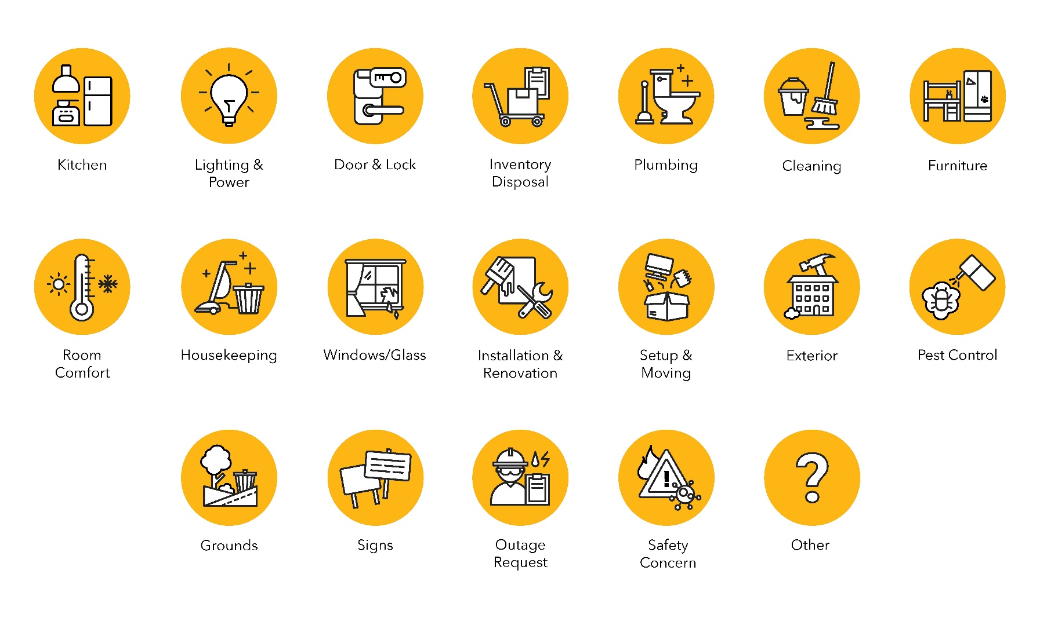
AssetWorks
Anyone with a UMBC log-on will be able to request services ~ uses SSO technology
Customer will provide contact and location information
Tiles will offer selection of available services
Requests will route through the system to become a work order assigned to a facilities shop
Some requests for services will incur a charge to the department
customers will select a chart string from a pull-down list
validated chart strings are auto-populated through integration with PS (only unrestricted funds available)
chargeable requests will route to the PS departmental approver before a work order is created
Customers will receive email notifications and be able to monitor status of requests through ReADY
ReADY Request Tiles
Not all tiles will be available to all users
15

Slide 16
AssetWorks
Requests for chargeable services will route to the department for financial approval
We are working with Procurement and Financial Services to obtain the list of departmental approvers
We need your help!
Requests for keys will route to the department’s key coordinator
Please provide: your department name(s) + name and email for primary and alternate Key Coordinators
Building Managers will receive notifications
Please provide: building name(s) + name and email for building manager(s
If you did not respond to our survey this past Fall, please email this information to workorder@umbc.edu
SUBJ: Building Manager and/or Key Coordinator + department number
before COB Thursday, March 31
16

Slide 17
PAW Procurement Punch Out Back Log
PAW Punchout Back Log
Gayle Chapman & Bryan Casey
17

Slide 18
PAW Punchout Back Log
18

Slide 19
PAW Punchout Back Log
Punch Out Vendor Back Log Aging
19

Slide 20
PAW Punchout Back Log
85 items over 60 days old
66 of these items are related to only 4 invoice owners
Please continue to monitor your open punch out vendor orders and process receipts as soon as possible.
20

Slide 21
PAW Punchout Back Log
Liability Offset
If a vendor owes money to the State of Maryland or Federal Government, the General Accounting Department (GAD) may use the proceeds of a payment to offset that liability.
21

Slide 22
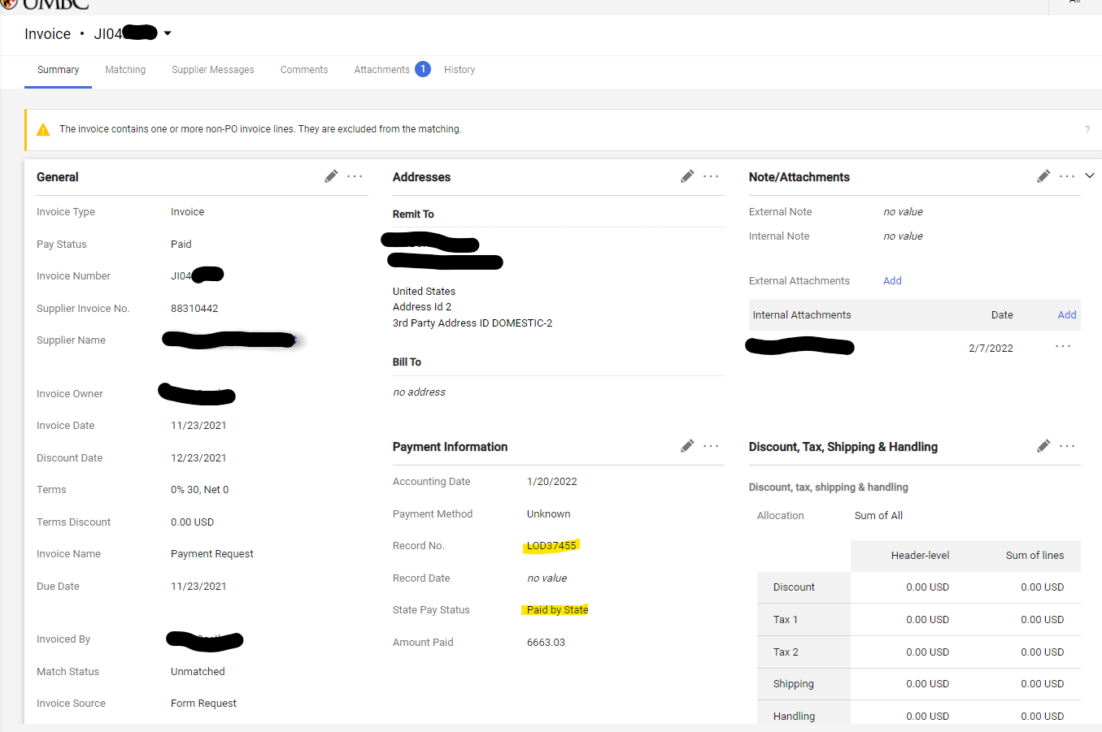
PAW Punchout Back Log
How can I tell if a payment has been taken as a liability offset?
22

Slide 23
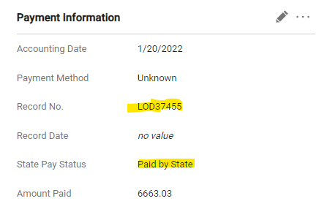
PAW Punchout Back Log
23

Slide 24
PAW Punchout Back Log
Vendor Instructions
Call the State Of Maryland Compliance Division
410-767-1642 or 410-767-1648
Refer to the Liability Offset number.
The Compliance Division should be able to assist the vendor in resolving their issue.
24

Slide 25
PAW Punchout Back Log
Payment Request Guidance
What are payment request? When are they used?
Invoices less than $600, that are *NOT* recurring
Miscellaneous reimbursements (out of pocket expenses that are *NOT* Travel)
R*Stars Payments
Honorariums
Stipends
Refunds of Revenue
Memberships/Registrations (where the P-Card is not accepted)
25

Slide 26
PAW Punchout Back Log
What actually get’s processed?
All the above plus
Legal Services
Repairs
Vehicle Repair
Security Services
Expired Contracts
Much more
26

Slide 27
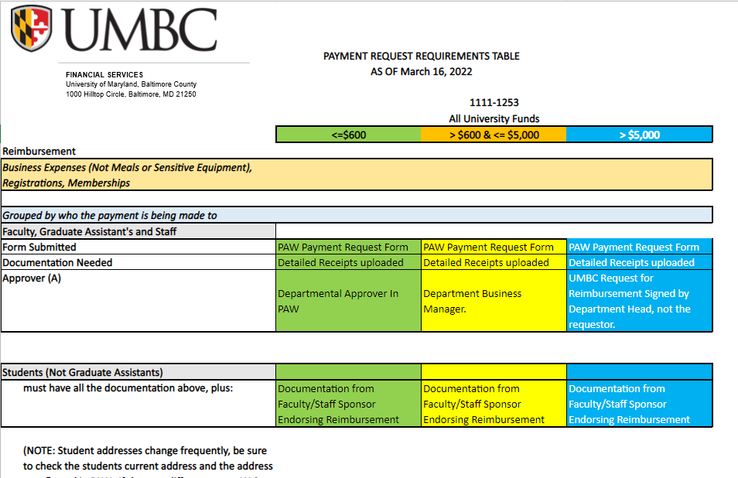
PAW Punchout Back Log
Payment Request Guidance
27

Slide 28
PAW Punchout Back Log
The Guidance Includes
Reimbursements
Meals
Invoices
Honorariums
Stipends
Sensitive Equipment
Moving Expenses
Tuition Reimbursement
Study Participants
28

Slide 29
PAW Punchout Back Log
Additional Resources
Frequently Asked Questions (FAQ’s)
Forms Over View
Updated Forms
29

Slide 30
PAW Punchout Back Log
Next Steps
Training – sessions open to everyone to review the guidance
Updating all forms
Moving forms to DocuSign
Target to implement by May 1st
30

Slide 31
Financial Reporting Initiative Update
Financial Reporting Initiative
Jared Fincke
31

Slide 32
Reporting Initiative Update
Goal: To have one “single source of truth.” Reports that have parameter flexibility to allow end-users the ability to run reports to manage operations. Reports should be user friendly.
We have met with users around campus and received feedback and ideas on how to improve from our current Rex reports
We are working with external consultants to identify the technical and functional requirements from this feedback
HelioCampus will be creating and maintaining the data warehouse and data models
The reports will be designed by external consultants using the Tableau visualization software
32

Slide 33
Reporting Initiative Next Steps
Using Tableau we aim to deliver
Clean downloadable Reports
Options to expand/collapse to display more or less detail
More flexible filters with the ability to select multiple funds, departments, projects and more
Additional detail for Encumbrances and HR data
Ability to show budgets at a point in time
Reports that are accurate and tie to the general ledger
We are currently developing a timeline and project plan for implementation
33

Slide 34
Human Resources New Staff
Human Resources New Staff
Valerie Thomas
34

Slide 35
Classification/Compensation
Human Resources New Staff
Brett Sanders
Manager
35

Slide 36
Talent Acquisitions/Employment
Human Resources New Staff
Annie Byrd
Talent Acquisition Specialist
36

Slide 37
Employee Relations
Human Resources New Staff
Michale Sheckleford Tallon
Director
37

Slide 38
Payroll
Human Resources New Staff
Carolina Etheridge
Manager
Valentina Berterman
Payroll Processing Associate
38

Slide 39
HRIS
Human Resources New Staff
Nadah Ali
Specialist
Crystal LaBeau
HR Specialist
39

Slide 40
Workplace Learning, OD and Wellness
Human Resources New Staff
Melody Wright
Coordinator
40

Slide 41
Support Staff
Human Resources New Staff
Catherine Myers
Executive Administrative Assistant
Andrea Phimphanh
HR Associate
41

Slide 42
Questions
Questions
42

