Slide 1
Business Administrators Meeting (BAM)
Thursday, November 7, 2024

Slide 2
Agenda
9:05am Welcome
9:10am Budget Update
9:25am Procurement Update
9:40 am Auxiliary Services Update
9:50 am Contract and Grant Accounting Update
10:00 am Travel Update
10:10 am Business Services Update
10:20 am Facilities Management Update
10:30 am HRSTM Update

Slide 3
Welcome
Welcome
Kristy Michel
Associate Vice President
Administration and Finance

Slide 4
FY 2025 Budget Presentation
Budget and Resource Analysis
Kristy Michel,
Associate Vice President, Administration and Finance
and
Jared Fincke, Director
Budget and Resource Analysis

Slide 5
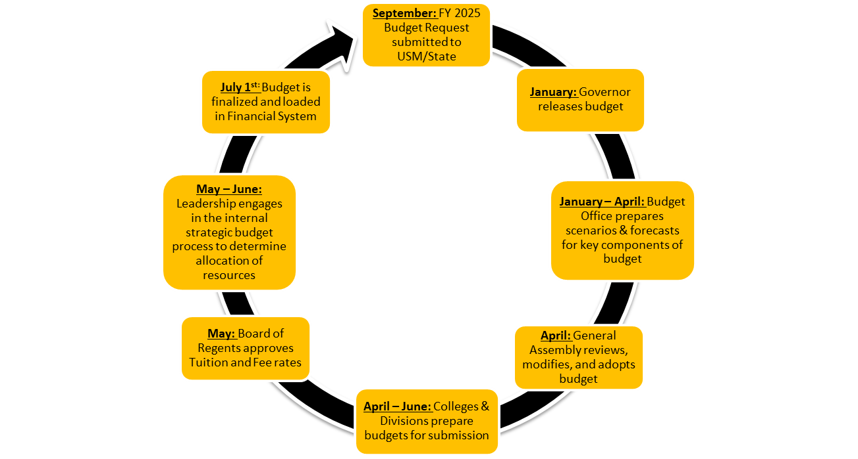
Annual Operating Budget Cycle
Annual Operating Budget Cycle

Slide 6
UMBC Budget Overview
UMBC Budget Overview
UMBC’s budget is comprised of two fund groups:
Unrestricted revenues are resources provided to the institution with no restrictions on their use. These resources are separated into three categories:
State Support - Comprised primarily of tuition revenue and funding from the State. This makes up the largest share of the budget and is used to support the primary academic and instructional mission of the campus.
Auxiliary - Captures non-academic operations that are self-supporting or self-funded that do not rely on allocations from the State Supported budget to operate. Residential Life, Dining Services, and the Bookstore are all examples of auxiliary units on campus.
Self Support – Includes academic programs that generate their own revenue to support their operation. Examples of programs in the Self Support budget include Summer and Winter programs, professional programs offered through DPS, and Faculty Start-Up costs supported with DRIF.
Restricted revenues are sponsored by outside entities such as the federal government, state, or the private sector that can only be used for very specific purposes. This includes grants we receive for research projects, Pell grants and other designated scholarships.

Slide 7
State Support Budget:
Divisions - Incremental Budget Model
  Starting point for each division’s budget is the prior year’s budget amount
  Adjustments are made for mandatory costs
  Additional resources may be provided, if revenue is available, for strategic priorities or new initiatives
  Leadership decides how to allocate additional resources
  Departments receive a control number that is net of revenue and expenditures
Three Colleges - Resource Allocation Model
  Multiple data points are used to guide the decision on how to allocate resources between the three college.
  This includes college enrollment, credit hours taught, cost of salaries and wages and other expenses, etc.
  Each college will use the allocation to cover all State Support expenses (excluding fringes which will continue to be covered centrally).
Other funds (Auxiliary, Self-Support, and Restricted):
Each college and division is responsible for determining revenue and expense budget for the other funds.

Slide 8
Key Budget Drivers
Key Budget Drivers
Revenues | Expenses
Enrollment (Tuition and Fees) | Salaries and Fringes
State Appropriation | Financial Aid
Research Activity | Campus Operations (utilities, debt service, etc.)
Tuition and Fee Rates | Contractual Services (housekeeping, IT, etc.)
4

Slide 9
Total Revenue: $696,535,890
FY2025 University Revenue
FY 2025 University Revenue

Slide 10
Where does it come from?
Where does it come from?
Total $696,535,890

Slide 11
Total $691,116,210
Where does it go?
Where does it go?
Contractual Services Includes:
Building Maintenance
Dining Contract
Research Contracts
Housekeeping
IT Contracts
Legal Fees
Other Contracts
Other Operating Includes:
Utilities
Office/Building Supplies
Infrastructure
Travel
Library Serials
Equipment
Instructional/Lab Supplies
Stipends/Prof. Dev.
Bookstore Inventory
Other

Slide 12
FY2025 State Support Budget - Revenues
FY 2025 State Support Budget - Revenues
Changes in State Support Revenue | $ Change
State Appropriation | $13,487,289
Undergraduate Tuition | $1,606,300
Graduate Tuition | ($1,542,580)
Fees | $605,049
Investment Income | $3,000,000
Indirect Cost Recovery | $900,000
Other Sources | ($188,201)
Total | $17,867,857

Slide 13
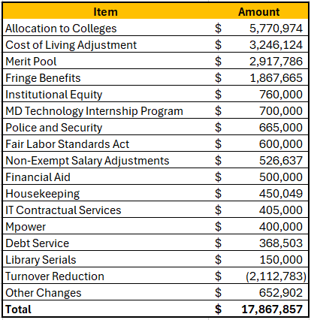
FY2025 State Support Budget Allocations
FY 2025 State Support Budget Allocations

Slide 14
FY2025 State Support Revenues by Category
FY25 State Support Revenues by Category
Total - $380,034,709

Slide 15
FY2025 State Support Expenses by Category
FY25 State Support Expenses by Category
Total - $380,034,709

Slide 16
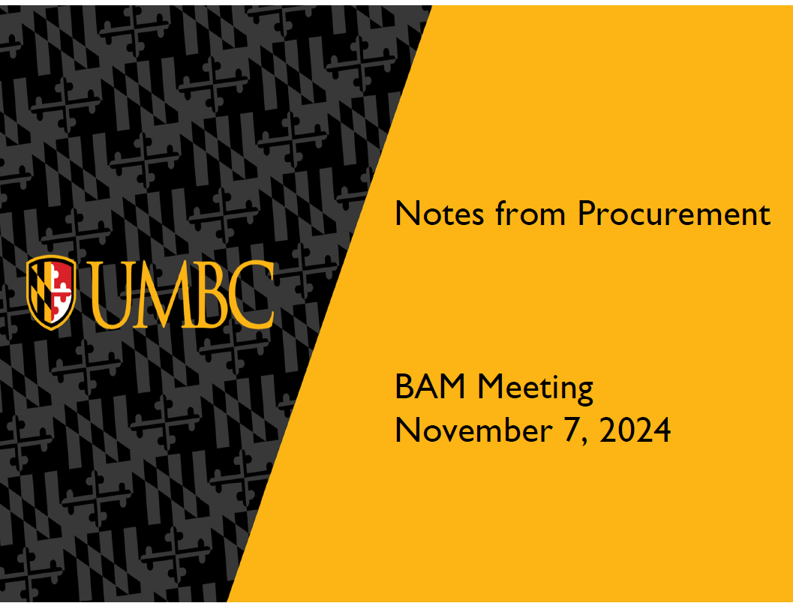

Slide 17
Purchasing Card (p-card)
Procurement
1. P-Card reconciliations are due every month, (within 30 days after the end of the
billing cycle) even when there is no activity.
2. Ensure that documentation is included for every charge and credit transaction.
3. Failure to complete monthly tasks in a timely manner may result in card suspension
for 30 days or until all documentation is completed, whichever is longer.
4. Monthly credit limits are set in multiples of $5,000 ($10,000, $15,000, $20,000,
etc.). When requesting a change in credit limits through a Maintenance Request,
please use one of those amounts.
5. Cardholders are not to split charges to get under the per transaction limit ($5,000).
If a purchase totals more than $5,000 the department is required to submit a
requisition in PAW to create a purchase order.

Slide 18
Purchasing Card (p-card)
Procurement
6. When ordering from one of UMBC’s approved caterers, if the amount is less than
$5,000, payment should be made on p-card.
7. P-Cards cannot be used for:
personal purchases/services
alcohol and restaurants
entertainment/movie theaters
split and stringing of purchases
gift cards, gifts, flowers
sales tax
8. Expenses to be reimbursed by Foundation funds should not be paid for with the p-
card. Follow the USMF Policies and Procedures guide for reimbursement.
9. When purchasing software with the p-card it must first be reviewed by the UMBC
cloud/software committee before the purchase is made.
catering of routine meetings
office decorations
trains/airlines
travel agents
furniture (except MCE)
money orders/wire transfers

Slide 19
PAW
Procurement
We are working with DoIT to streamline the supplier sheet process, a new supplier sheet will be available soon. A new training document will be shared.
All supplier updates (addresses, emails, etc.) need to be submitted through a new supplier sheet with an updated/current W-9.
You are still able to access the PAW test system at https://usertest.sciquest.com/apps/Router/SAMLAuth/UMDBC

Slide 20
PAW
Procurement
Choosing Contract versus Purchase order:
Purchase orders are usually a one-time incident or one-time purchase that are usually below $25k
Contracts are used for services that are ongoing and multiple payments are made throughout the life of the contract and allow for modification (purchase orders do not have that allowance). Contracts tend to be higher than $25k, though not always.

Slide 21
PAW
Procurement
Will modifications be needed during a time period? – choose contract
Does the service involve multiple years? – choose contract
Would additional terms be needed to protect the University – choose contract
Work is limited in scope, is for a set value that will not need to be changed – choose purchase order
FAQs: https://wiki.umbc.edu/display/faq/Paw+Procurement+System

Slide 22
Signatures on Contracts & Agreements
Procurement
Only the following have signature authority for UMBC:
Procurement
Sr. Associate Vice President, Administrative Services
Office of General Counsel (for legal sufficiency)
Do not sign any agreements or contracts as you will be held personally liable
Requests that need software and/or legal review take time

Slide 23
Quotes & Proposals
Procurement
When submitting a quote with a requisition, please check for the following:
Your quote is still valid (most expire in 30 days)
UMBC is shown as the customer and the address for shipment is correct. We often see quotes for UMB or University of Maryland and have to ask for clarification.
Look for payment terms - anything less than Net 30 will have to be discussed with Procurement.
Add a line for shipping costs when amount is known
When submitting a proposal in a contract request, in addition to the items above, please confirm the following:
The supplier has provided a concise statement of work with clearly defined deliverables
The total contract cost or agreed to hourly rate is included
The specific term (how long this will be in place) is stated

Slide 24
Consulting Agreements
Procurement
Dates of service (start & stop dates)
Rate of pay: (i.e. hourly rate/monthly rate/daily rate)
If the amount is over $25,000 are they named in a grant? (send a copy of the page of the grant where they are named.)
If not named in a grant we need a Sole Source Form as to “how they are uniquely qualified to perform these services”.
Dollar amount, “Not to Exceed”
Are there any renewal options? If so, how many?
Include a “Scope of Work” for the services to be provided
Are they providing the University with any deliverables (reports, etc.)?
Current mailing and contact information of the supplier, including email address
Supplier to complete Information form on Procurement’s website. https://procurement.umbc.edu/vendors/

Slide 25
Amazon
Procurement
Our office is aware of delivery issues since late-September; the problem was identified and a solution has been implemented
Please share delivery concerns directly with David Clurman at clurman@umbc.edu; sharing clear photos of the shipping label (if available) is very helpful for tracking purposes
An alternative for office supplies is RGH, the diversity supplier for Staples

Slide 26
Amazon
Procurement
When filling out building, there is a 26 character limit on each line, this may require abbreviations.
Instead of Use
Math/Psychology Building Math/Psych
Performing Arts and Humanities Building PAHB
Information Technology & Engineering ITE
Interdisciplinary Life Science Building ILSB

Slide 27
4imprint
Procurement
If changes are made to what was submitted in the punchout in PAW, such as change in:
item product number
item quantity
shipping cost
The PO will need to be cancelled and a new punchout order submitted. The buyer will need to communicate with the 4imprint representative to ensure there is not a duplicate order.

Slide 28
Staffing Updates
Procurement
New Executive Director of Procurement & Strategic Sourcing
Rosetta (Rose) Butler
18 Nov

Slide 29
Auxiliary Services updates
Michael Clemons
Executive Director

Slide 30
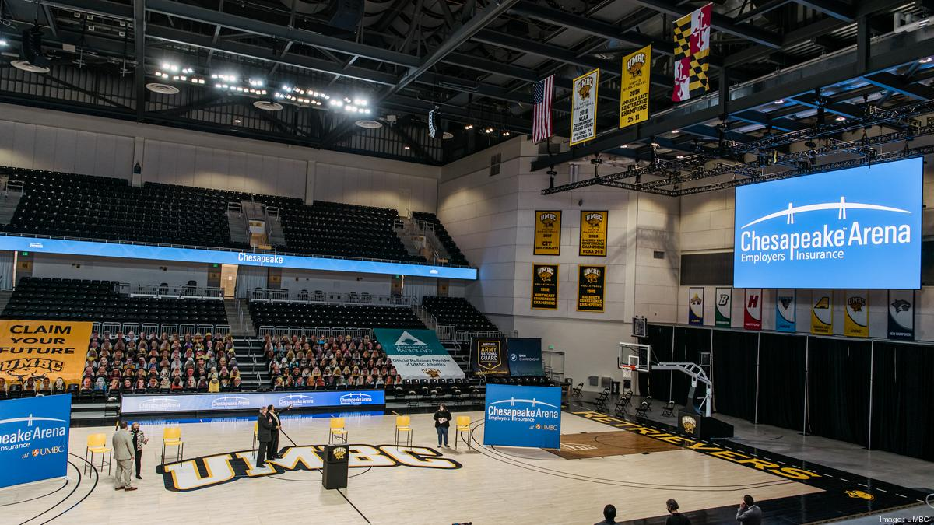
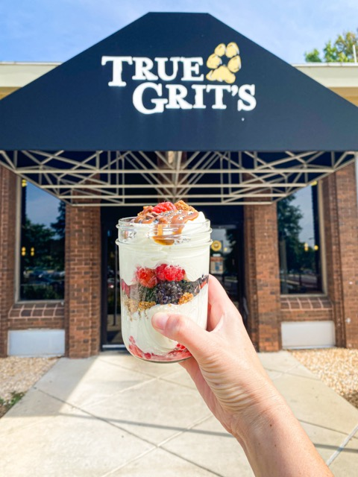
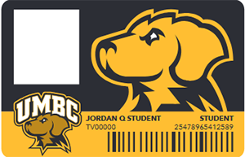
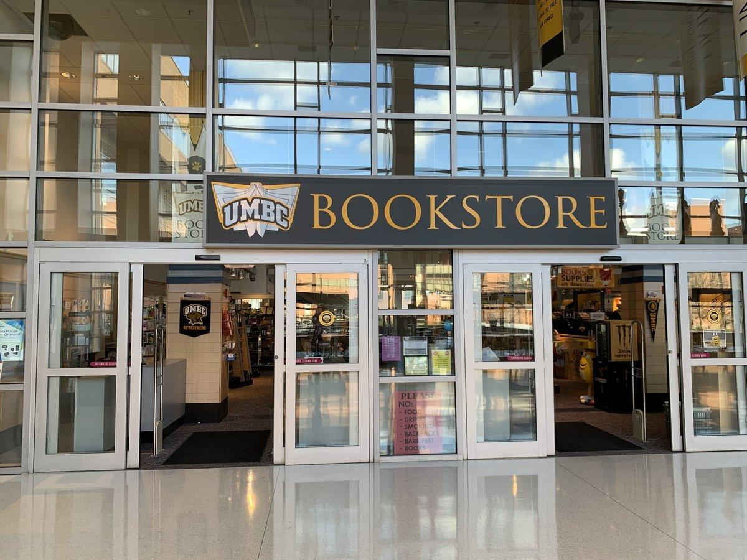

Proudly Serving UMBC
Auxiliary Services

Slide 31
Auxiliary units
Auxiliary Services
Bookstore
Chesapeake Employers Insurance (CEI) Arena
Dining Services
Retriever Card Center (including Mail Services)

Slide 32
Bookstore
Auxiliary Services
Department charges with chartstring. Approved staff list or one-time authorizations.
Professional wear for staff.
Special orders for promotional items, clothing, and gifts through Club Colors.
Staff & Faculty Appreciation Sale: Friday, December 13!

Slide 33
CEI Arena
Auxiliary Services
Retriever Room available to reserve for department meetings and events.
Sponsorship opportunities.
Staff & Faculty appreciation games.

Slide 34
Dining Services
Auxiliary Services
Department events: Catering and Skylight Room.
Faculty & Staff Meal Plans – Payroll deduction and prorated options.
Catering RFP – Spring 2025.

Slide 35
Retriever Card Center
Auxiliary Services
Mail, Meals, and More!
Notary service, Passport photos, Personal Mail Boxes.
Department Card (D-Card) Administration.
Daily FedEx pick-up.
Department mail (via USPS or FedEx) shipped with chartstring.

Slide 36

Thank you!
Auxiliary Services

Slide 37
Sponsored Projects
Manual Payroll Request
New DocuSign Form
Joanna Napoli, Director
Contract and Grant Accounting
and
Amy Steinly-Marks, Assistant Director
Cost Accounting and Analysis

Slide 38
Background
Contract and Grant Accounting
Payroll is entered into the PeopleSoft HR module
If there is a need for a payroll cost transfer, it is submitted through the retro process, which updates the PeopleSoft HR module
When a manual payroll adjustment is submitted, that is processed through a journal entry, which updates the PeopleSoft Finance module, not the HR module

Slide 39
Background
Contract and Grant Accounting
PeopleSoft Effort Reporting is updated from the HR module only. Transactions from sources other than HR do not update the effort.
Effort report certification is mandated by the federal gov’t regulations and all transactions must be reflected in order to provide after the fact distribution of effort on sponsored awards.
Manual salary journal entries should be rare exception and documented within the Effort certification process.
  Discussion: What are reasons for submitting manual payroll journals?

Slide 40
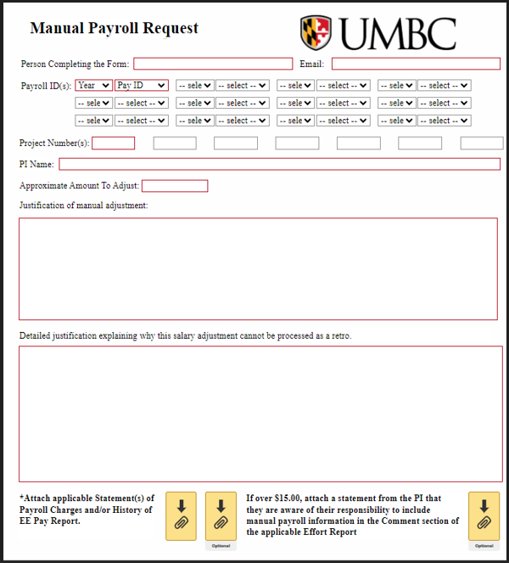
Sponsored Projects Manual Payroll Request Form
Contract and Grant Accounting

Slide 41
Manual Payroll Request Form Instructions
Contract and Grant Accounting
Start the process by completing and submitting the Manual Payroll Request DocuSign form, including applicable attachments.
Name and email of person completing the form
Payroll ID of the payroll(s) affected, ex: 2025006
Project numbers
Name of the PI
Approximate amount to adjust, this can be exact or rounded

Slide 42
Manual Payroll Request Form Instructions
6. Justification of manual adjustment.
  Remember a payroll adjustment that affects sponsored funds is a cost transfer and must adhere to Cost Transfer Policy requirements
  Ex: A manual payroll adjustment is needed because we received an extension with a new PO therefore an additional project was created and funds are moving from Project #1 to Project #2
7. Detailed justification explaining why the salary adjustment cannot be processed as a retro.
  Ex: A retro is not able to be processed due to system constraints per Justin Hopkins.
8. Attach applicable Statement of Payroll Charges and/or History of EE Pay Report.
9. If over $15.00, attach a statement from the PI that they are aware of their
responsibility to include manual payroll information in the Comment section of the
applicable Effort Report.

Slide 43
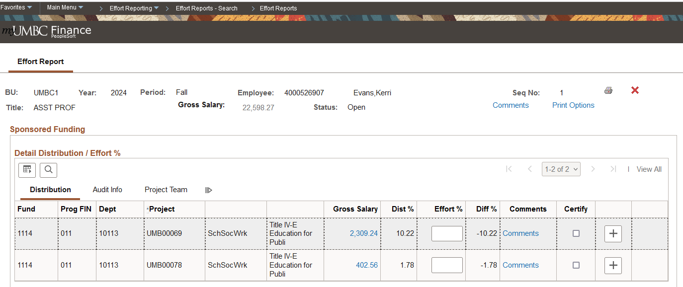
PI responsibility: Comment section of the applicable Effort Report
Contract and Grant Accounting
Click on ‘Comments’ in the Effort report of each employee affected, selecting the appropriate project.

Slide 44
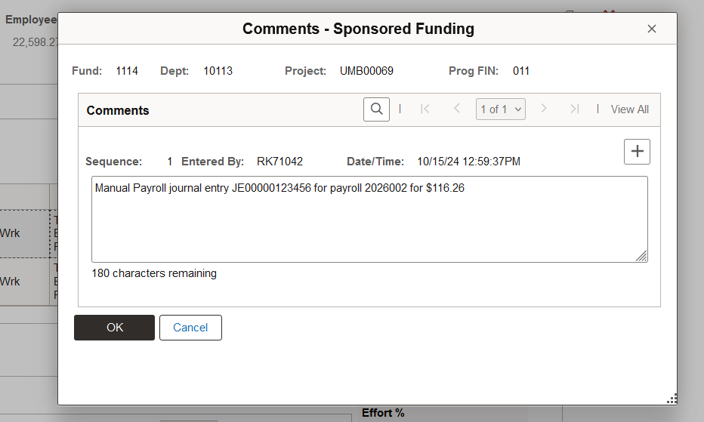
PI responsibility: Comment section of the applicable Effort Report
A pop-up box will appear where the PI will type in the amount of the manual payroll entry. This will be viewable to auditors, as needed.

Slide 45
When to use the form
Contract and Grant Accounting
Salary adjustments should be processed through a retro (payroll cost transfer).
The use of the manual payroll journal for sponsored funds, in lieu of a retro, will only be approved on rare occasions. They may include:
  PeopleSoft not allowing a retro to process due to system constraints
  A salary only award which requires an adjustment under $15.00

Slide 46
Authorization
Contract and Grant Accounting
The DocuSign form will route from
the Requestor to
the PI(s) listed to
the Assistant Director for Cost Accounting and Analysis (Amy Steinly-Marks).

Slide 47
Next Steps
Contract and Grant Accounting
Once the form is fully authorized,
  Create the manual payroll journal entry
  Attach the approved manual payroll request form to the journal entry
  Submit the journal entry as normal with required attachments related to cost transfers

Slide 48

Travel System
Adam Drutz-Hannahs
Travel Specialist
Business Services

Slide 49
Earlier this semester
Travel
We surveyed the campus to gather area of improvement with the current travel process.

Slide 50
What we heard
Travel
The Travel process and system are not user-friendly and not easily
understood.
The current system does not enforce travel policy
Issues with corrections to travel requests
The Pre-Approval and Reimbursement processes should be aligned
Challenges with role-based visibility and communications issues
…and more!

Slide 51


We hear you!
Travel

Slide 52
Travel Service Updates
Travel

Slide 53
Most common reasons for rejections:
Travel
Personal + Business
Missing start and end times.
Missing and/or incorrect documentation

Slide 54
Personal + Business
Travel
Combining Business and Personal Travel: If personal travel is added to a business itinerary, you will be required to include documentation of comparable itinerary and quotes, which will show the costs of business only travel as compared to business with personal travel. The least expensive itinerary will be reimbursed. (UMBC Travel Policy Page 21)

Slide 55
How?
Travel
Globetrotter
Manually
Call 1-800-322-7032
Explain exactly what you would like to do.
  Business only dates vs. Actual Dates
Traveler can pay any difference directly to Globetrotter after request is approved.
Provide two quotes from the same source.
  Business only dates vs. Actual Dates
Traveler will be reimbursed for the least expensive option.

Slide 56
Other Updates:
Travel
Please do not upload:
  --Maps
  --Department of State meal rates. Rates are now integrated directly into the Travel System.
  --Irrelevant pages (Spam, adds, blank
  pages)
Travel W9/W8-BEN requests should go
through businessservices.umbc.edu
IMPORTANT NOTICE:
Please email all inquires to TravelServicesAP@umbc.edu
Please do not email Adam directly.

Slide 57
PAW CREDIT MEMOS and What to Do About Them!
Business Services
Linda Rothfus
Manager
Business Services

Slide 58
You get this email message from AP
Business Services
Hello, we have a credit memo for this closed PO. In order to process it, we need you to please request that Procurement reopen the PO, then enter a returned receipt. Thank you.
What does this mean? What do I do?

Slide 59
What is a Credit Memo (CM)?
Business Services
A credit memo is an invoice from the supplier with a negative amount.
Credit memos are issued by the supplier when you return an item, or if
you never received the item and you contact them for the credit.
Credit memos from most Punchout suppliers (i.e., Amazon, Dell, Apple,
etc.) are entered into the PAW system by the supplier. You do not upload
it yourself.
If you get a credit memo from a non-punchout supplier, such as BWM
Global, or EESCO Pump & Valve, you need to “create” the CM in PAW.
More about that in a moment.

Slide 60
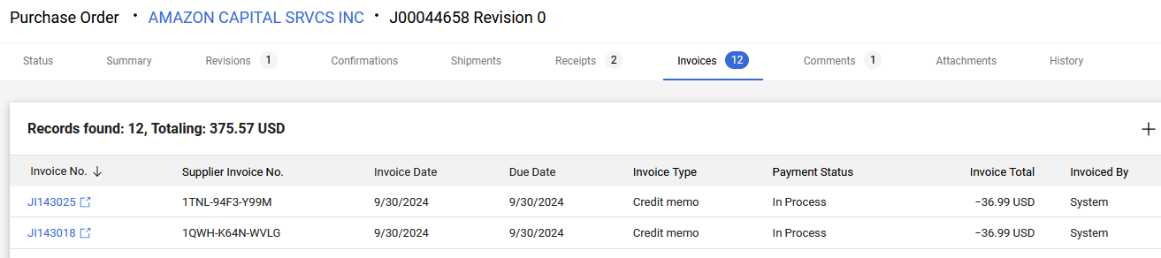
Example of System Credit Memos
Business Services
This is an excerpt of 2 invoices, which are CMs, of 12 for this PO.
Amounts are -36.99 each, invoiced by the System.
The Supplier is a Punchout.

Slide 61
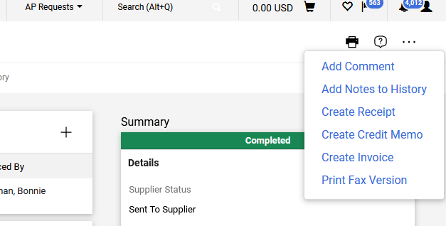
How to create a credit memo for a Non-Punchout Supplier
Business Services
Instructions for creating invoices for Purchase Orders can be found at: https://procurement.umbc.edu/paw-procurement-training/
Creating a Credit Memo is very much the same.
1. Go to the 3 horizontal dots at the top right of the PO and choose “Create Credit Memo.”

Slide 62
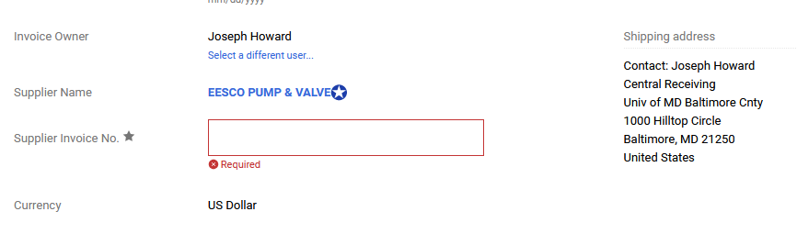
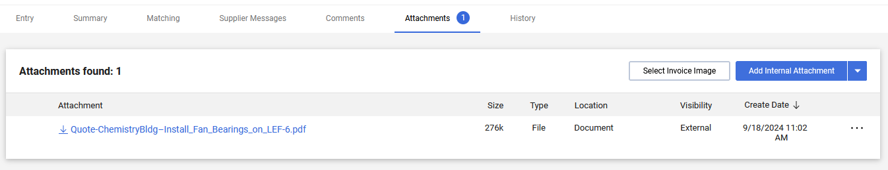
Business Services
2. Enter the Supplier’s invoice/Credit Memo number
3. Go to the Attachments Tab, and add/upload the PDF of the Credit Memo

Slide 63
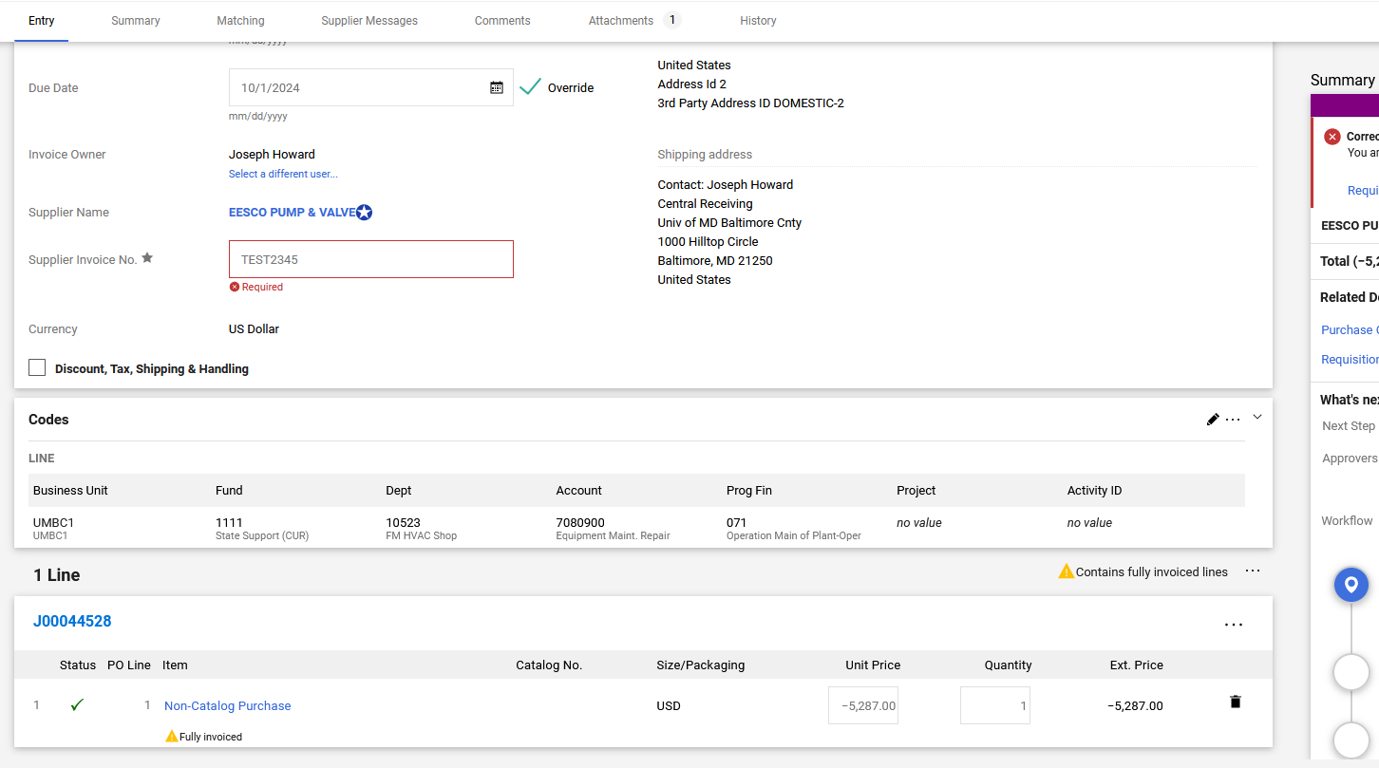
Business Services
4. Go back to the Entry tab and enter the “Unit Price” (negative) and “quantity”. Make sure the quantity is not zero.
Shipping?

Slide 64
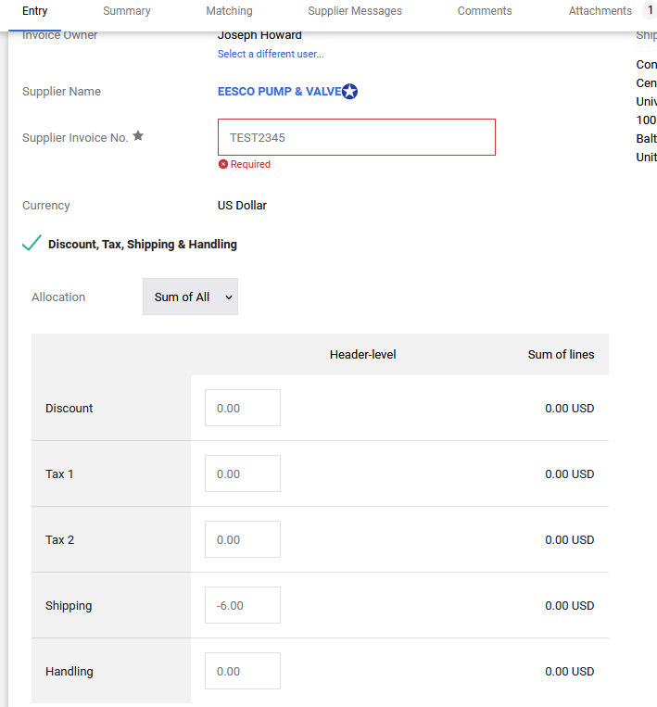

If Shipping is included on the Credit Memo
Business Services
You need to separate the shipping credit from the item price credit when creating the credit memo. Only the negative item price (even if it is partial) is included in Step 4.
5. If there is shipping, click the Discount, Tax, Shipping & Handling Box. Enter the shipping amount as a negative in the box. The item price plus shipping should equal the total CM amount.
6. To complete the CM, click Complete in the upper right corner:

Slide 65
What to do if the PO is closed
Business Services
AP cannot process an invoice or credit memo if the PO is
closed. Do not request that Procurement close a PO if there
is an outstanding invoice or CM. Also, you cannot create a
CM or enter receipts if the PO is closed.
If the PO is closed, please submit an RT ticket in the
Procurement queue and request that it be re-opened. AP
cannot re-open a PO.

Slide 66
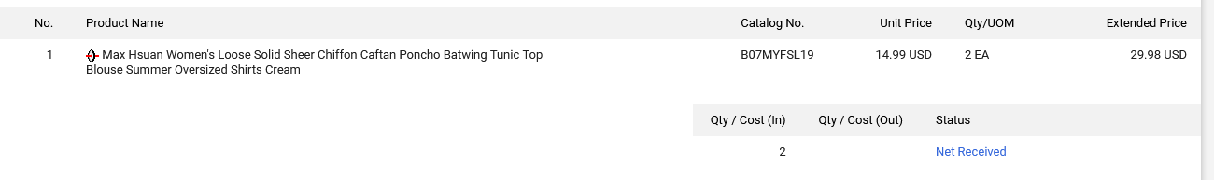
When to add received, returned or canceled receipts
Business Services
AP sees a credit memo attached to a PO and needs to process it. We look to see what receipts have been entered in the PO…
In this example, we have a credit memo for -$29.98. The items are showing as Net Received. We are going to submit a comment that we need you to enter a returned receipt. We are assuming that because you received the item already, that you must have returned it to get a credit memo from the supplier. Enter a returned receipt.

Slide 67
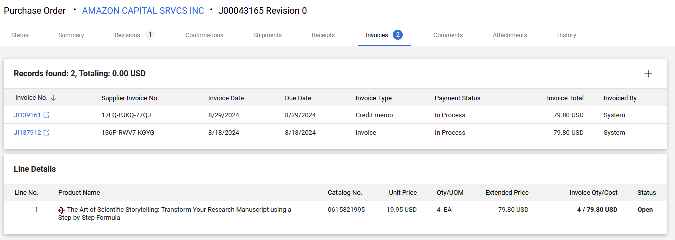
In this example, we have an invoice and a credit memo and no receipts. If you received the item and returned it, enter a received receipt, then enter a returned receipt (you cannot return an item you haven’t received). If you never received the item, enter a canceled receipt.
Business Services

Slide 68
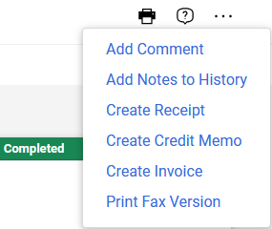
Entering Quantity Receipts
Business Services
PLEASE DO NOT ENTER COST RECEIPTS when receiving items that can be returned. Cost receipts only have the choice of received and canceled. PAW will get confused if someone enters first a cost received, then either cost canceled, or quantity returned. There is no fixing those scenarios in PAW!! USE QUANTITY RECEIPTS!!
Steps for entering quantity receipts: Received, returned and cancelled receipts are created the same way, as the choice is a drop down menu.
1. Go to the three horizontal dots on the upper right, and choose Create Receipt.

Slide 69
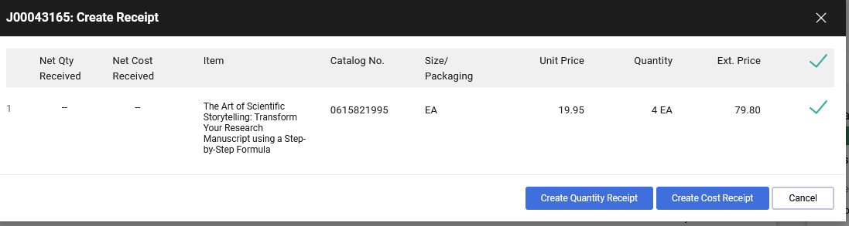
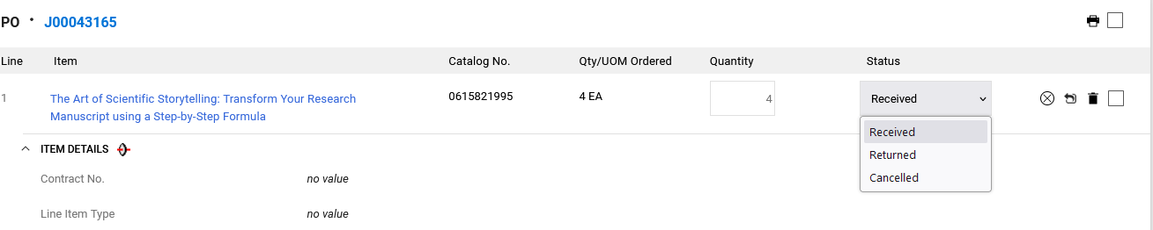

2. Choose Create Quantity Receipt.
Business Services
3. Enter the quantity and click on the drop down menu. It defaults to Received and often the quantity defaults to zero, so please enter the correct quantity! (If it is zero, nothing will change.)
4. Click Complete in the upper right corner.

Slide 70
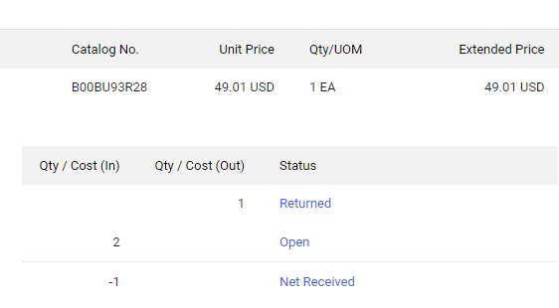
Check the Results!!
Business Services
It is always good to check your results after you submit anything in PAW. You can check your receipt by going to the summary page of the PO, and clicking on the Receipts Tab. It will show you if you successfully entered the receipt that you intended. If you don’t see the item returned or canceled, check the quantity of the receipt and make sure it is not zero.
If you get this result, where the item ordered is 1, but the open item says 2, you put in a returned receipt without a received receipt. Correct it by entering a received receipt.

Slide 71

Business Services
In conclusion
When we need to process a credit memo, AP looks for the correct receipts – received, returned or canceled.
We do not need you to supply any verbiage from the supplier unless we are working with you to resolve a problem and ask you for it.
If you need assistance, please ask us!! Best to enter an RT ticket in the AP queue!

Slide 72




Business
Administrators Meeting
November 7, 2024
Human Resources
& Strategic Talent Management
Notes:
Kelly

Slide 73
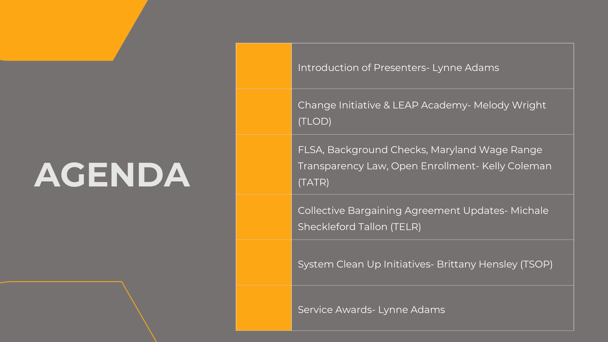

Slide 74
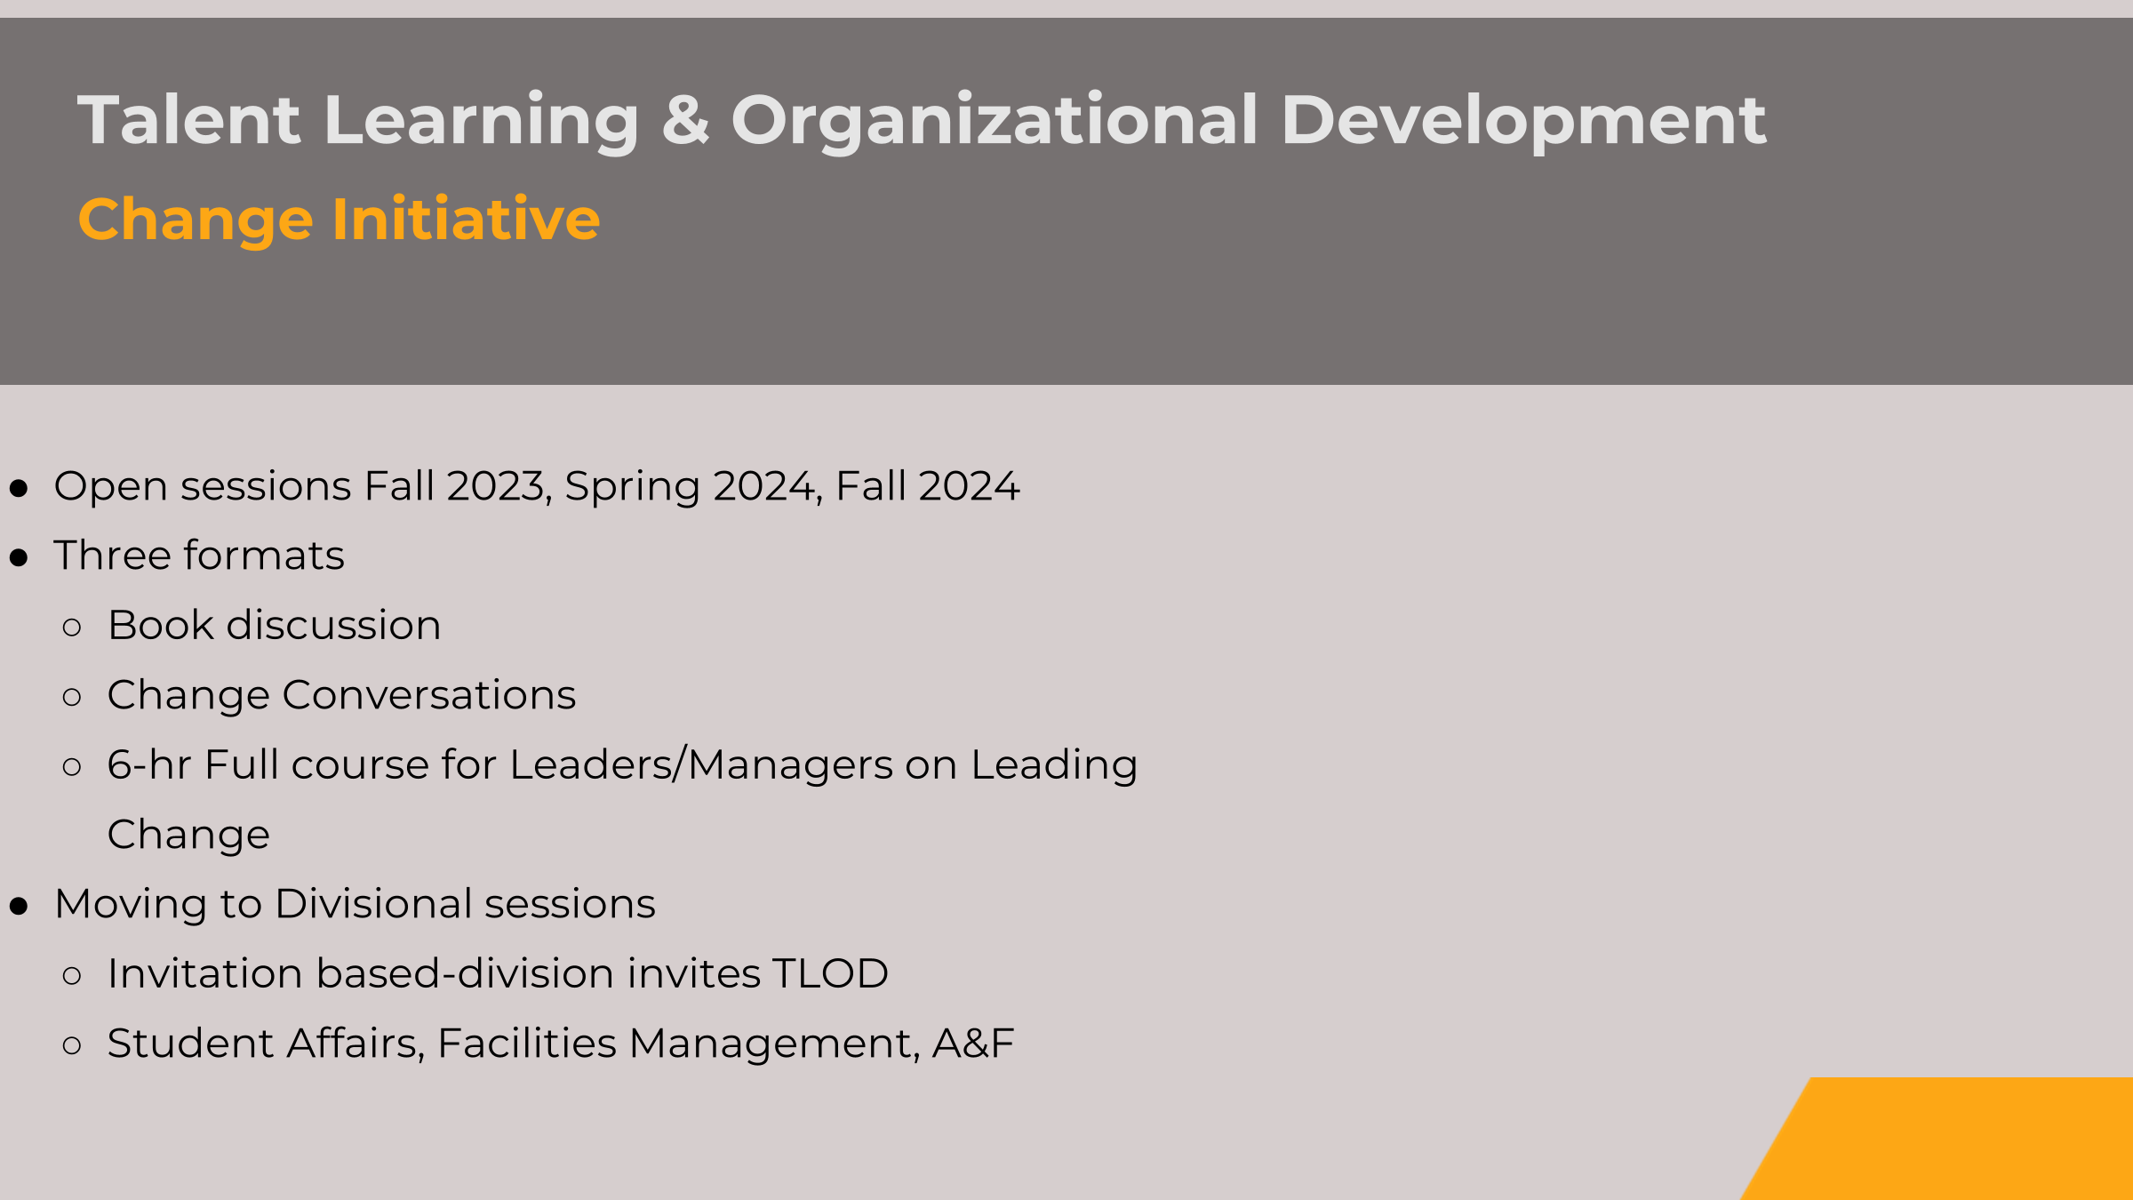

 | Introduction of Presenters- Lynne Adams
 | Change Initiative & LEAP Academy- Melody Wright (TLOD)
 | FLSA, Background Checks, Maryland Wage Range Transparency Law, Open Enrollment- Kelly Coleman (TATR)
 | Collective Bargaining Agreement Updates- Michale Sheckleford Tallon (TELR)
 | System Clean Up Initiatives- Brittany Hensley (TSOP)
 | Service Awards- Lynne Adams
AGENDA
Notes:
Kelly

Slide 75
Talent Learning & Organizational Development
LEADS Academy
Multi-year project focusing on each level of leadership from those aspiring to be leaders to those at the top-most leadership levels.
ASPIRE
LAUNCH
LEAP
RISE
PEAK
Leadership academy for individual contributors curious about the path to leadership. This cohort is appropriate
for employees at any level who are interested in harnessing practices to successfully lead self and others.
Coming Fall 2025
Required self-paced academy for new managers or new-to-UMBC managers
at any level to understand the basic yet critical HR aspects of supervision expected of UMBC managers.
Coming late Fall 2024
New manager academy that focuses on the critical skills that people managers need to support individual contributors and teams. Appropriate for new managers transitioning from individual contributor to manager roles or existing supervisors who desire a tune-up.
In progress: 3 simultaneous cohorts
Mid-level to executive-level academy for department and/or functional leaders who lead leaders. Appropriate for Assistant Directors, Directors,
Department Chairs, Associate Vice Presidents, Associate Vice Provosts, etc.
est. Coming Fall 2026
Curated leadership development experiences for leaders at the most senior level (Dean, VP, Provost, etc.) who strategically lead their divisions
and the broader organization for impact.
TBD
Notes:
Melody
In addition, Skillsoft asynchronous, self paced, self guided learning that can be patterned after the same topics covered here.

Slide 76
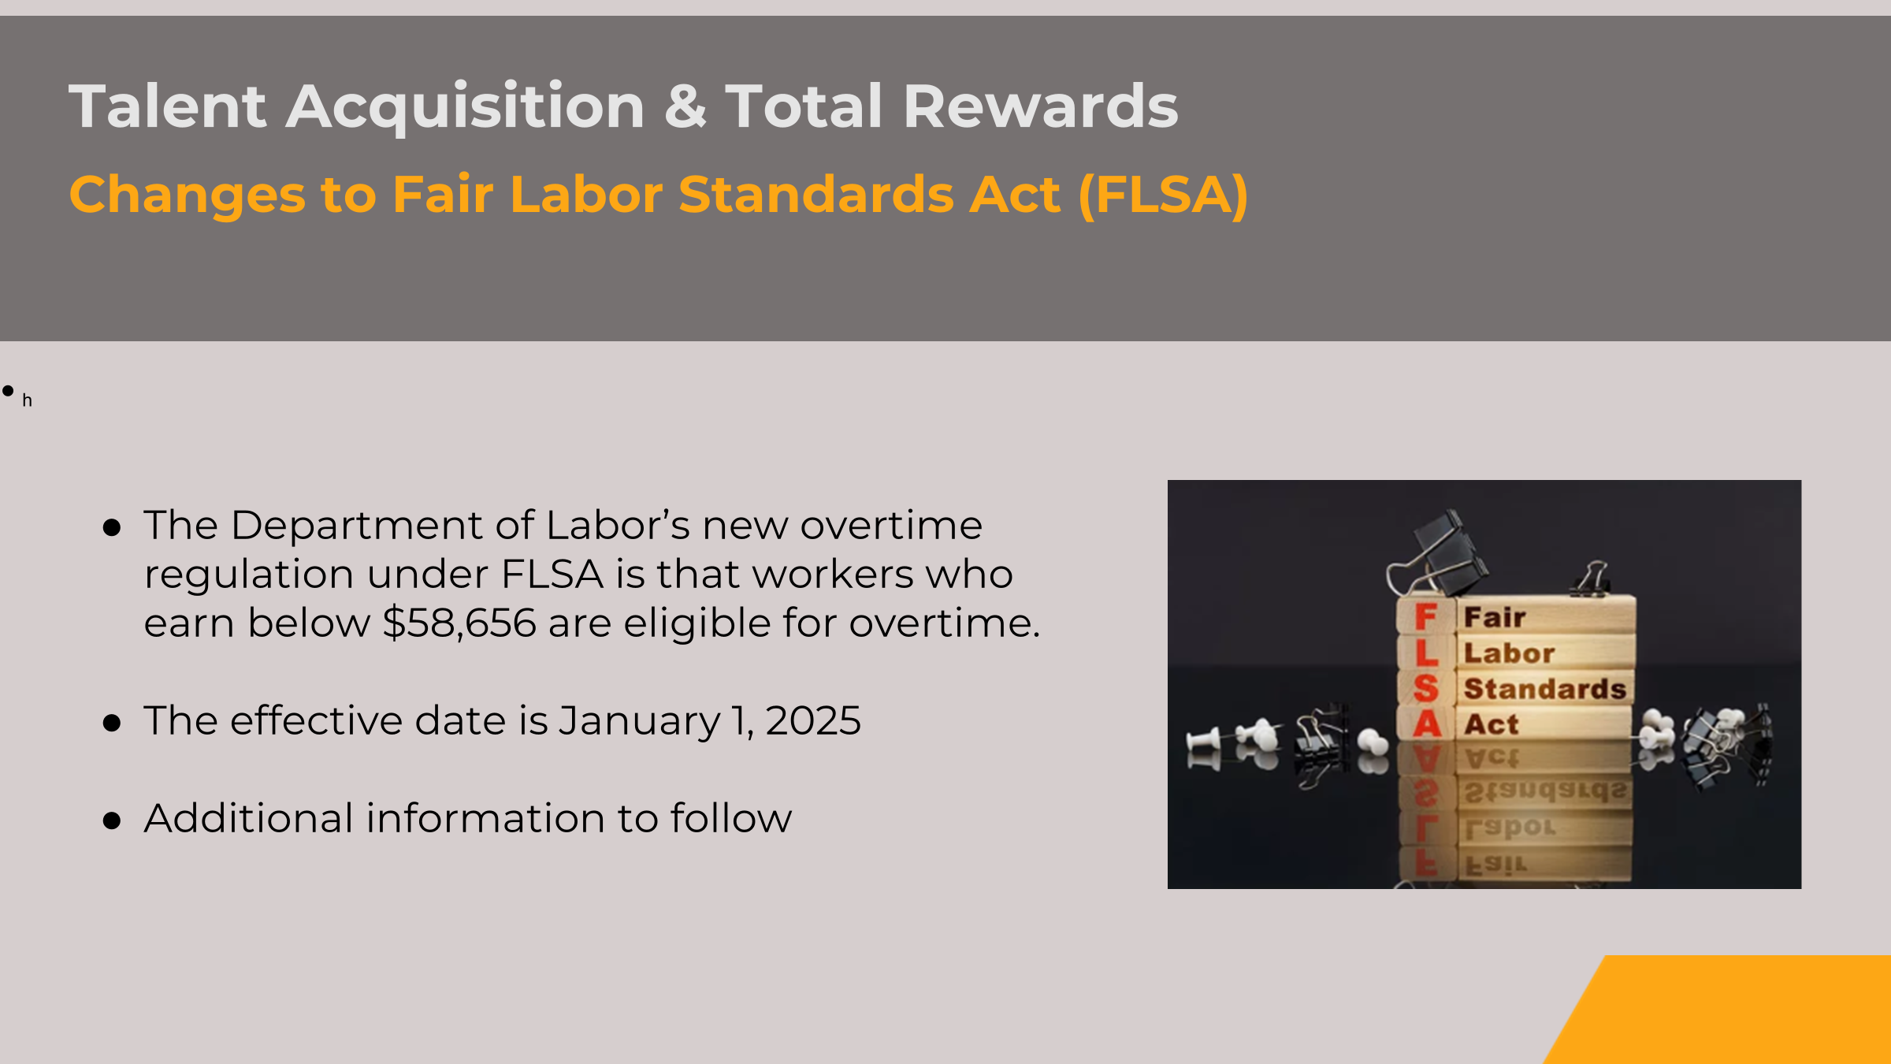

Slide 77
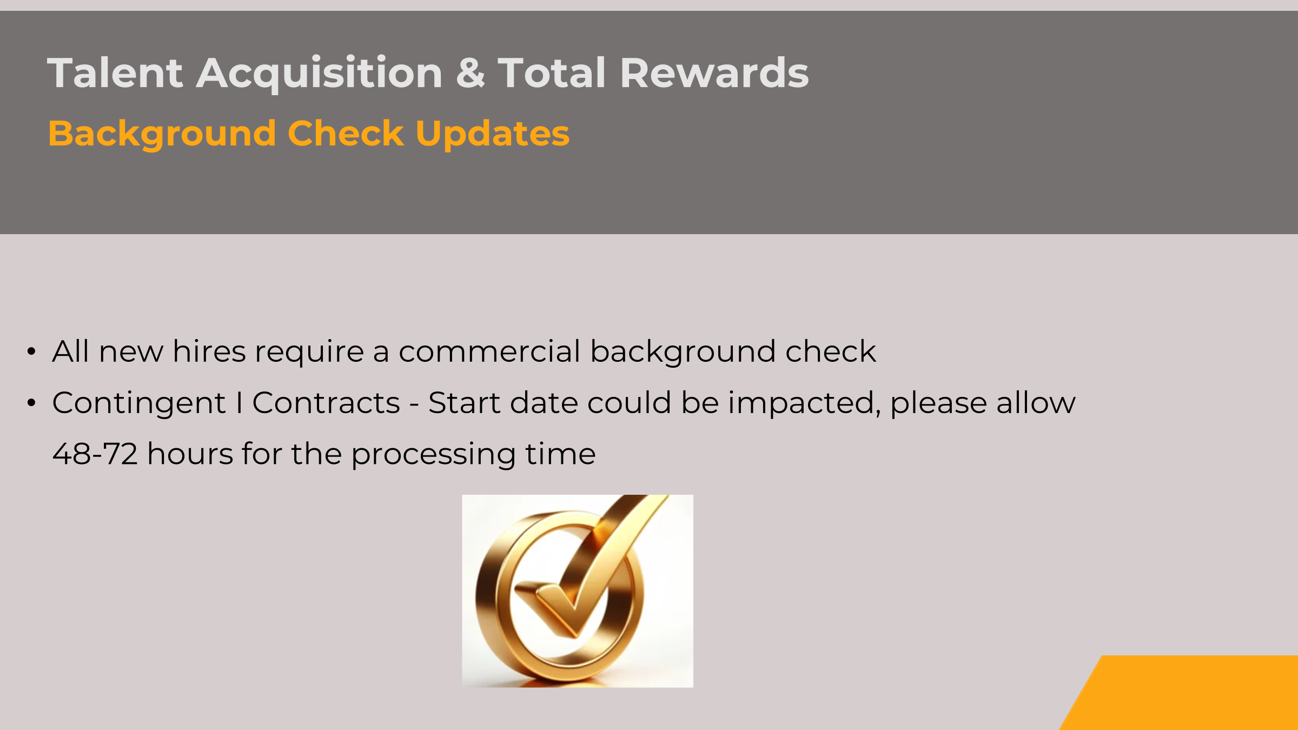

Slide 78
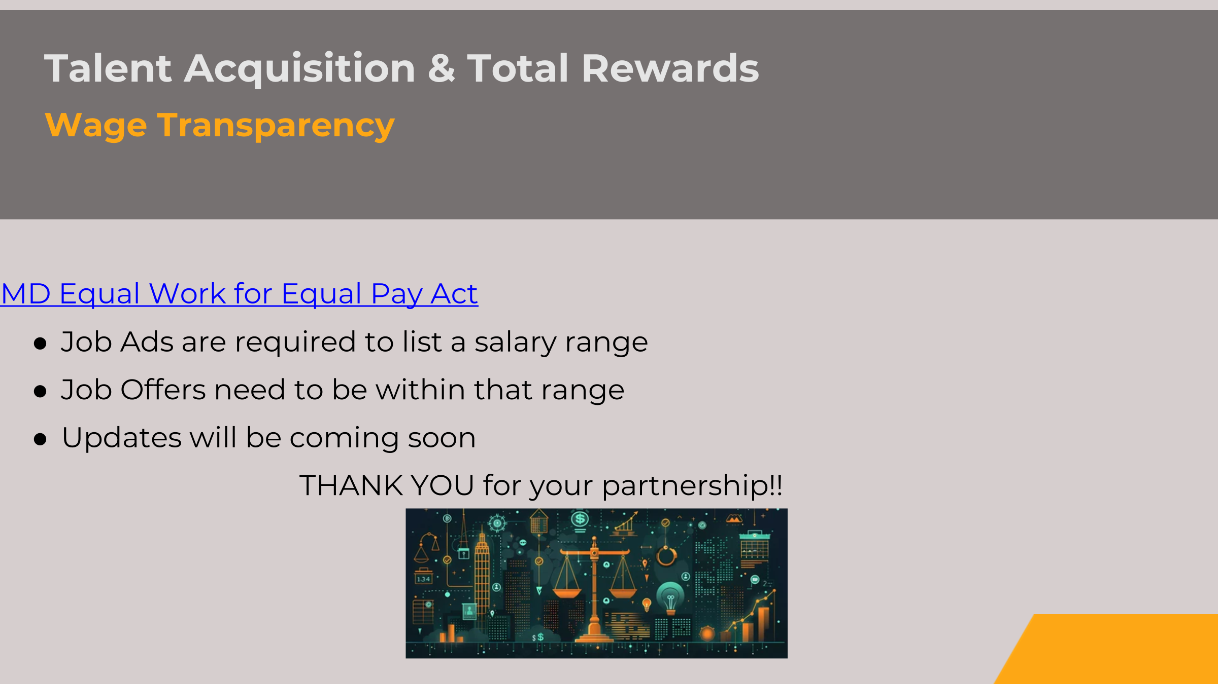

Slide 79

Talent Acquisition & Total Rewards
Open Enrollment ends TOMORROW (11/8) at 5 pm
Notes:
Kelly

Slide 80
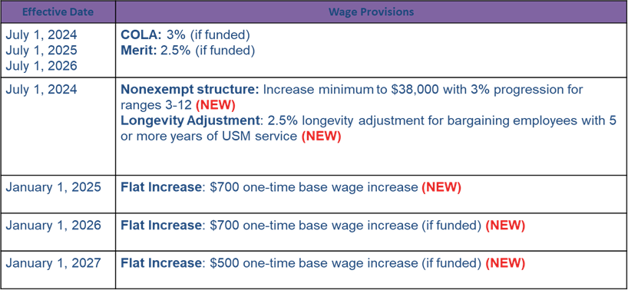
Employee & Labor Relations
Collective Bargaining Agreement Updates
Adjustments to Wages & Salaries
Notes:
Kelly

Slide 81
Employee & Labor Relations
Collective Bargaining Agreement Updates
Adjustments to Leave Accruals
●14 days upon hire through completion of first year
●15 days beginning the 2nd year
●16 days beginning the 3rd year
●17 days beginning the 4th year
●18 days the 5th - 10th year
●20 days 11th - 20th year
●25 days 21st year and after
Notes:
Kelly

Slide 82
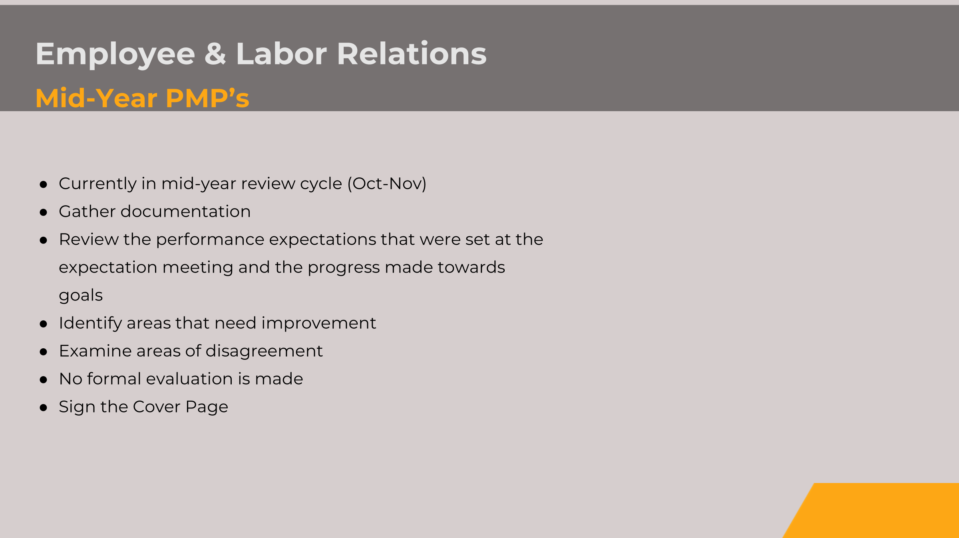

Slide 83
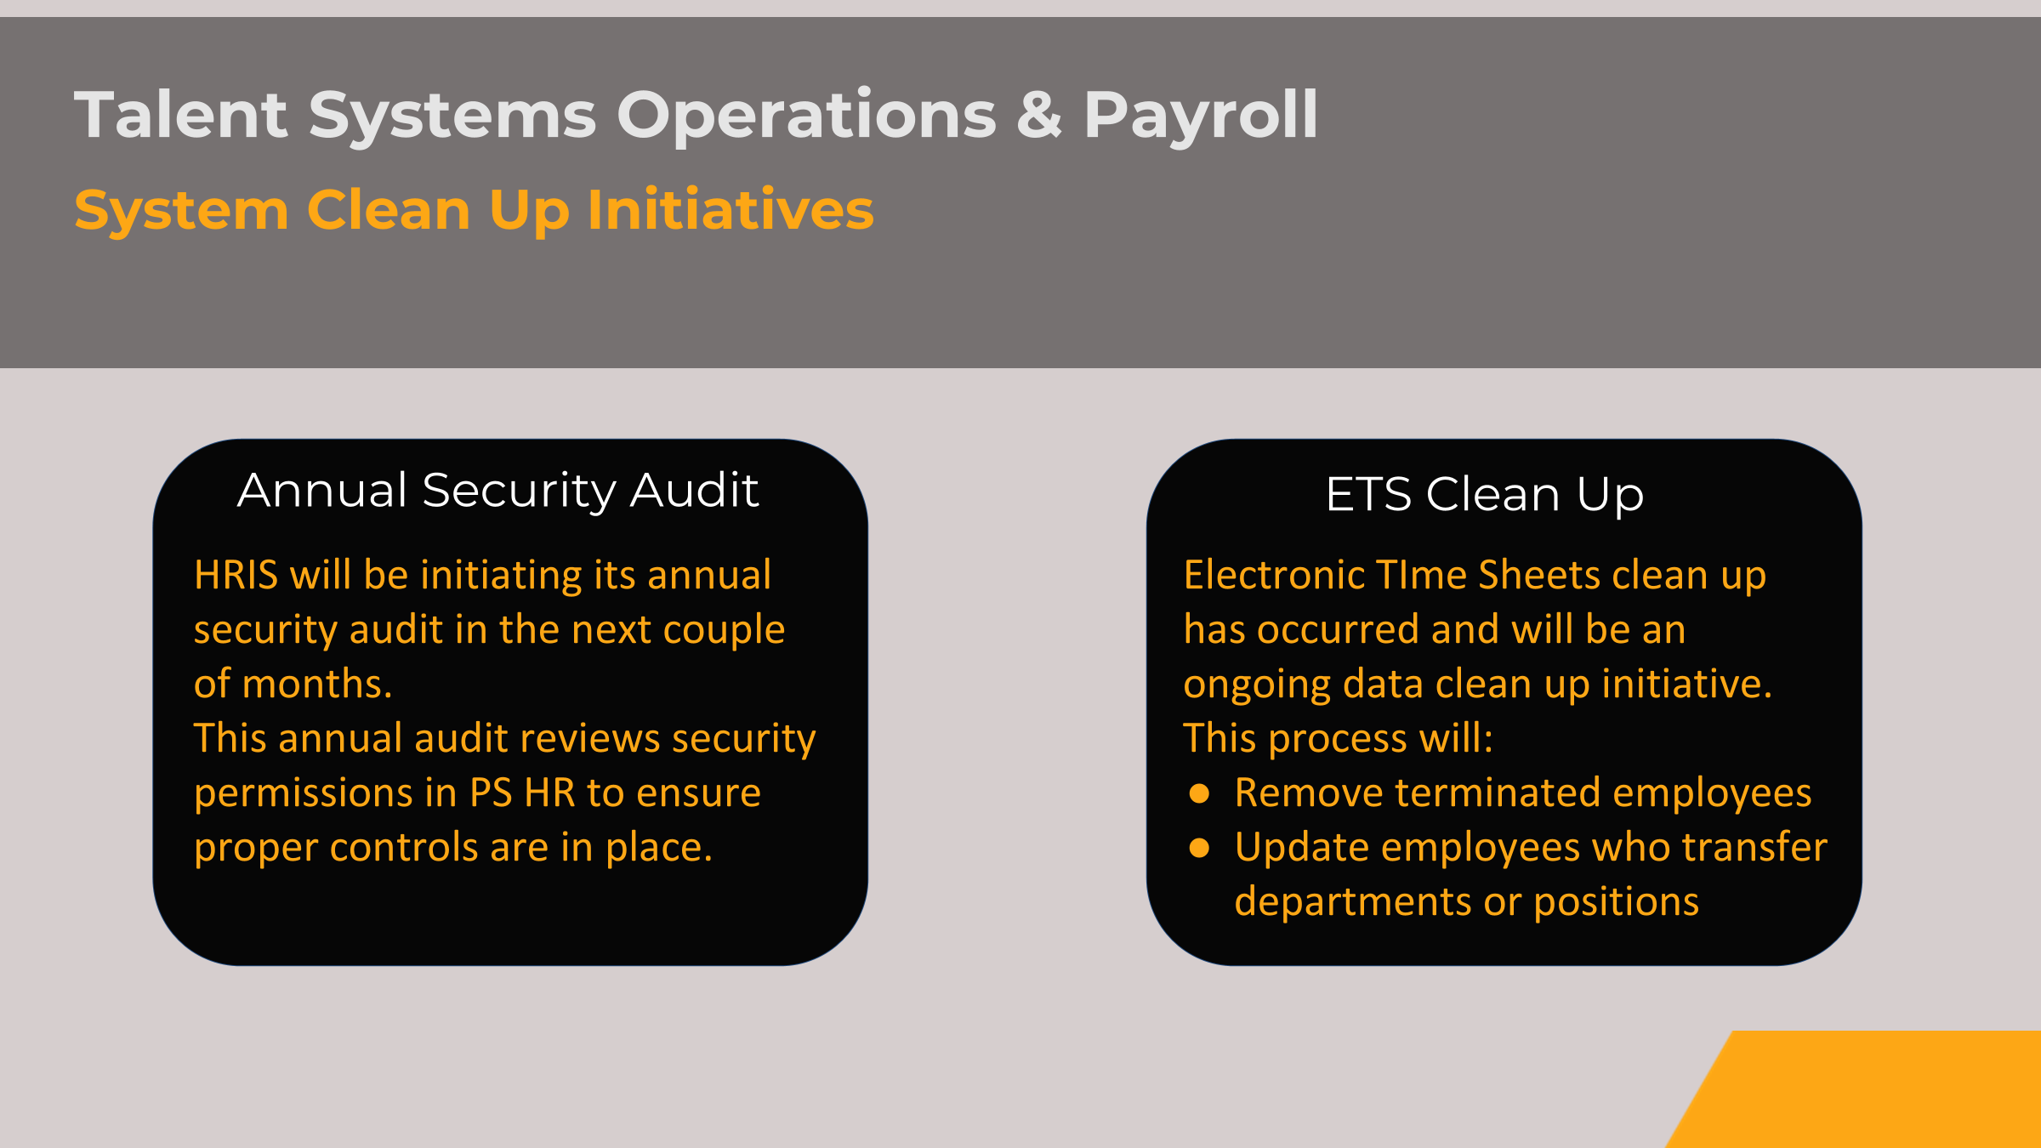

Slide 84
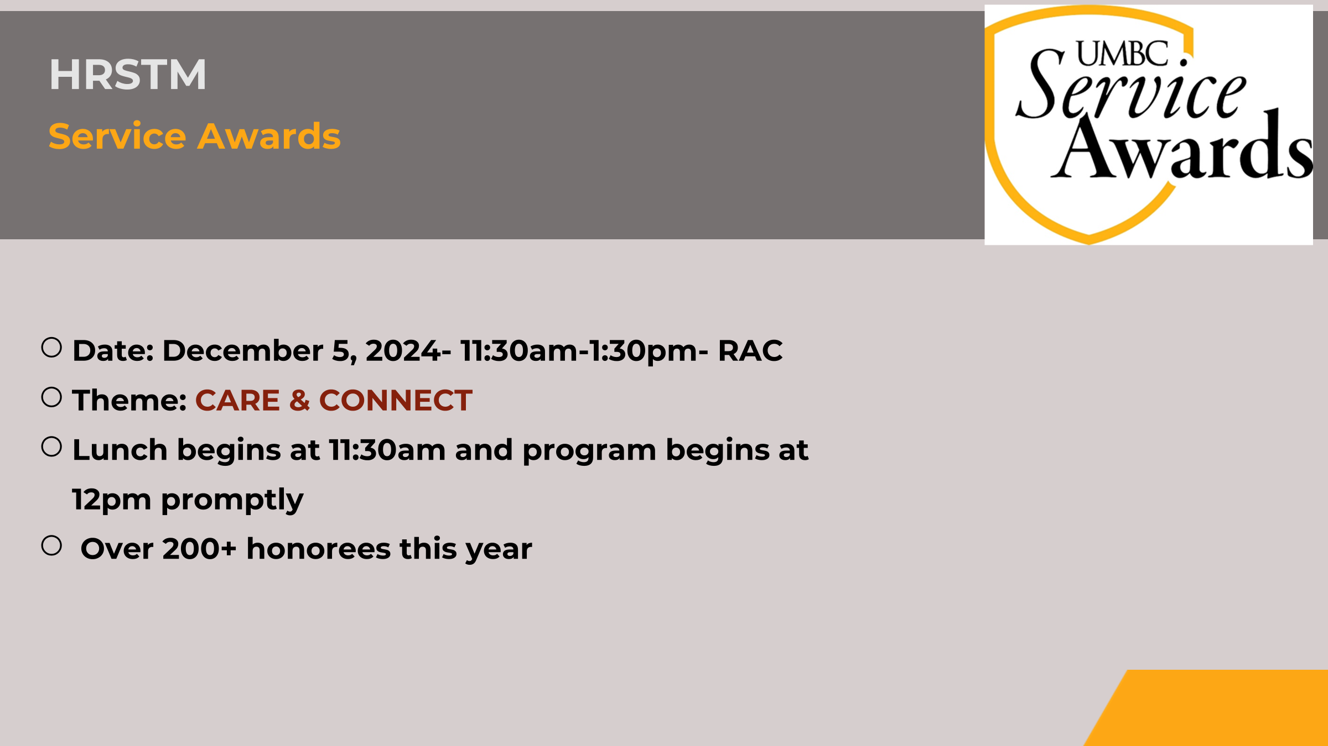

Slide 85


HRSTM Team

