Slide 1
Business Administrators Meeting (BAM)
Wednesday, May 14, 2025

Slide 2
Agenda
8:50 am Welcome
9:00 am Invoice and PAW Receipting Reminders
9:15 am HRSTM Update
9:35 am Auxiliary Services Update
9:45 am Office of Contracts & Grants (OCGA) Update
9:50 am Inventory Control Updates
10:05 am Financial Accounting & Reporting (FAR) Update
10:15 am Travel Update

Slide 3
Welcome
Welcome
Dan Petree
Interim Vice President,
Administration & Finance

Slide 4

PAW Invoice Reminders
PAW Invoice Reminders
Gayle Chapman, Assistant Controller

Slide 5

PAW Invoice Reminders
Please ensure all invoices meet the following requirements to avoid processing delays:
Invoices must be billed to UMBC and include our complete address.
Invoices must include a complete remit address, including the payee name (who the check should be made payable to).
Clearly state the Purchase Order (PO) Number or Contract Number on the invoice.
Include an invoice number, invoice date, and a detailed, itemized description of the goods or services being billed.

Slide 6

PAW Invoice Reminders
Remember!
Do not submit or process an invoice before its invoice date.
UMBC cannot pay more than the invoiced amount.
If the invoice amount exceeds the PO amount, and the department approves the overage, you must attach written approval from both the department head and the Procurement Department for Accounts Payable to process the payment.
The State of Maryland will not pay from a quote or a pro forma invoice.

Slide 7

PAW TIPS AND TRICKS:
PAW RECEIPT REMINDERS
CREDITS AND RECEIPTS
PAW Tips and Tricks
Gayle Chapman, Assistant Controller
chapman@umbc.edu
Business Services

Slide 8
WHY ENTER RECEIPTS INTO PAW?
PAW Tips and Tricks
Enter a received receipt IMMEDIATELY upon receiving a shipment related to a purchase order (PO) so that we can pay the invoice.
UMBC requires a 3 way match to pay a PO invoice – they all must match: PO, Receipt, Invoice
We MUST pay all invoices ASAP, to avoid credit-holds, supplier cut-offs, and issues with the State of Maryland.
Do NOT request that Procurement close a PO that has outstanding invoices or credit memos. We STILL OWE the invoice!!
When a PO owner leaves UMBC or the position – reassign the duty to monitor the PO!! Especially with STUDENTS!!

Slide 9
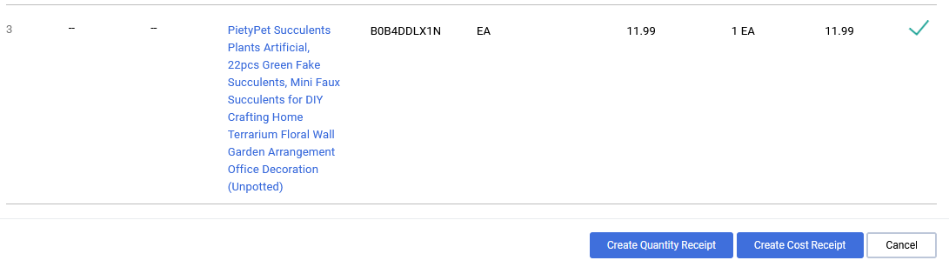
QUANTITY VS COST RECEIPT
PAW Tips and Tricks
What kind of received receipt do I enter? Quantity or Cost?
?
?

Slide 10

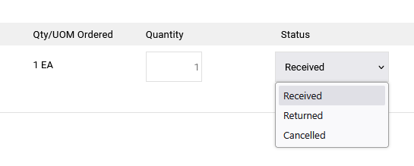
QUANTITY VS COST RECEIPT cont.
PAW Tips and Tricks
Ask the question – can I physically return the item to the supplier? Use a QUANTITY receipt
Drop down
Item received – received receipt
Item returned – received then returned receipt (2 receipts)
Item never received – cancelled receipt
Be sure to enter a quantity!!! 0 = nothing!

Slide 11

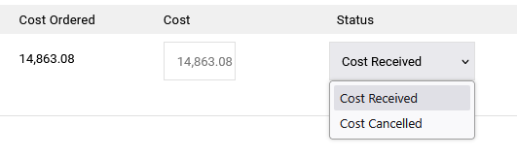
QUANTITY VS COST RECEIPT cont.
PAW Tips and Tricks
Use a cost receipt when the items CANNOT be physically returned:
Not to Exceed
Note that there is no option to return

Slide 12
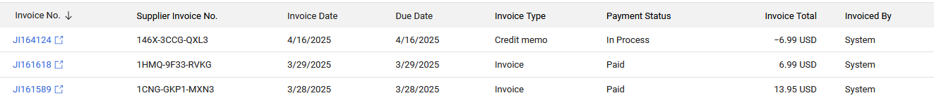

CREDITS AND RECEIPTS
PAW Tips and Tricks
When a supplier accepts a return or cancels a shipment, they will issue a credit memo (CM) – a negative invoice.
AP needs to see a received receipt and returned receipt, if the item was received and then returned.
If the item was never received, we need to see a cancelled receipt.
Do NOT mix cost and quantity receipts in the same PO - PAW gets terribly confused!!

Slide 13
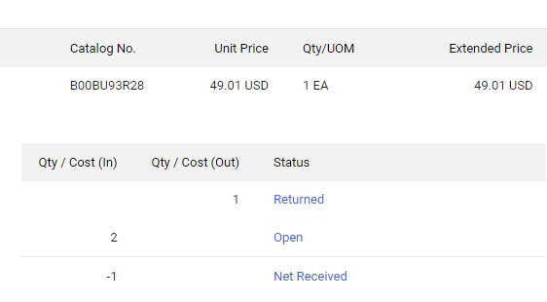
Check the Results!!
PAW Tips and Tricks
It is always good to check your results after you submit anything in PAW. You can check your receipt by going to the summary page of the PO, and clicking on the Receipts Tab. It will show you if you successfully entered the receipt that you intended. If you don’t see the item received, returned or cancelled, check the quantity of the receipt and make sure it is not zero.
If you get this result, where the item ordered is 1, but the open item says 2, you put in a returned receipt without a received receipt. Correct it by entering a received receipt.

Slide 14
What to do if the PO is closed
PAW Tips and Tricks
AP cannot process an invoice or credit memo if the PO is closed. Do not request that Procurement close a PO if there is an outstanding invoice or CM. Also, you cannot enter receipts if the PO is closed.
If the PO is closed, please submit an RT ticket in the Procurement queue and request that it be re-opened. AP cannot re-open a PO.

Slide 15

PAW Tips and Tricks
Thank you!!
If you need assistance, please ask us!! Best to enter an RT ticket in the AP queue!

Slide 16
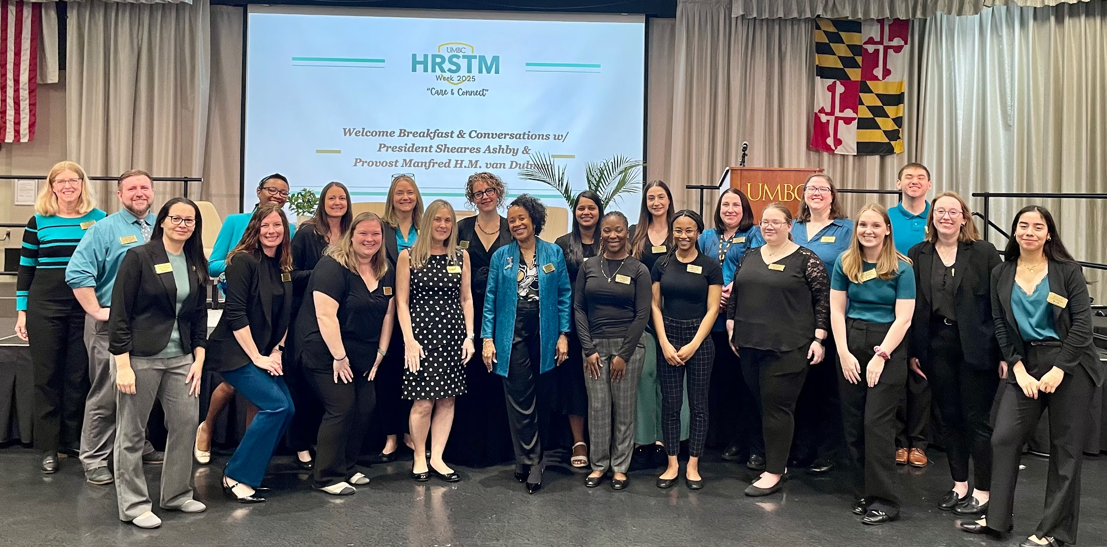


Business
Administrators Meeting
May 14, 2025
Human Resources
& Strategic Talent Management

Slide 17


 | New HRSTM Team Members- Lynne
 | Legislative Updates-Michale
 | UMBC Leads Academy: LAUNCH and ASPIRE-Jill
 | New UMBC Skillsoft Percipio Learning Tracks-Jill
 | You're Invited: 6/6 Campus L & D Needs Assessment Results-Jill
 | HCM/ERP Discovery-Lynne
AGENDA

Slide 18

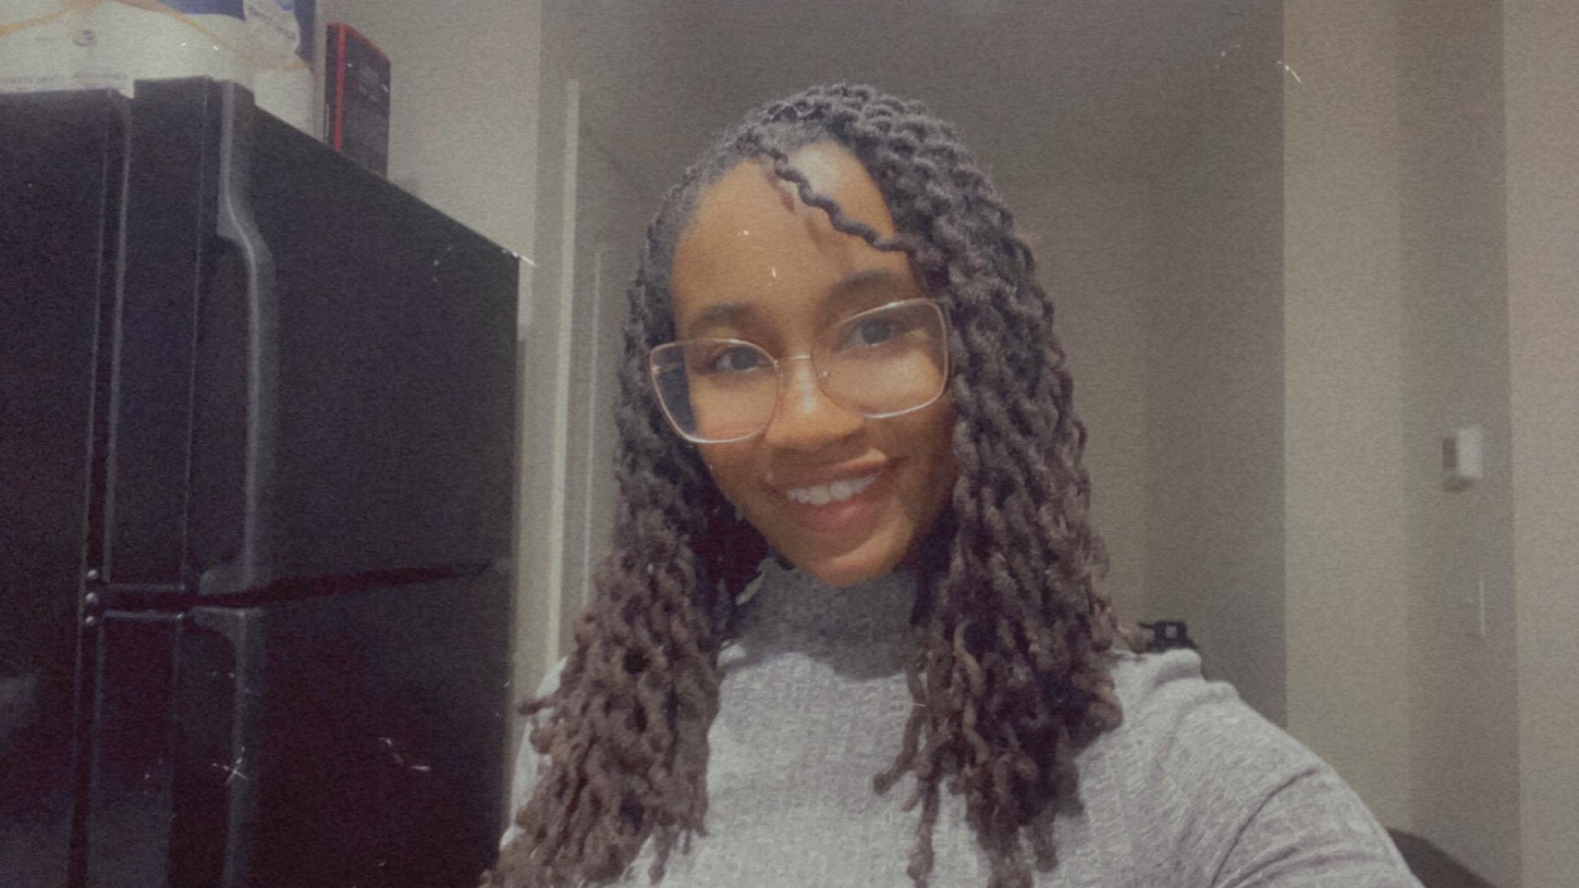
New Talent in HRSTM
2025
Anthony Oughton
HR Specialist I
Benefits & Wellness
Sydney Smith
HR Associate I
Front Desk

Slide 19


New Talent in HRSTM
2025
Ana Zamora
HR Specialist
Talent Acquisition/Classification & Compensation
John Nguyen
Sr. Human Resource Specialist
Classification & Compensation

Slide 20

Legislative Updates 2025
What’s new?
HB 1503/SB 225 - Paid Family & Medical Leave
Applies to all employees
Leave is paid at the employee’s regular rate of pay
Broader definition of who constitutes a family member
Effective July 1, 2026

Slide 21

Legislative Updates 2025
What’s new?
HB HB 176/SB 26 - Public Employees’ Safety & Health Unit
Administered by the MD Dept of Labor
Effective October 1, 2025

Slide 22

Talent Learning & OD Updates
LEADS
  LEAP - Fall 2024
  LAUNCH - Now in Blackboard
  ASPIRE - Fall 2025
  RISE - Fall 2026
Notes:
We had our first cohort of 52 supervisors complete the LEAP program last fall. LAUNCH is also a program for new managers or those new to UMBC and helps us to partner with these new leaders on a variety of HR related topics. All supervisors at UMBC will be loaded into the Blackboard site later this week. This e-learning system, while development with the new leader in mind, is a great resource for any supervisor at UMBC to stay current. We will be adding learning modules to this organization folder as we go along and as things are updated.
Next up is ASPIRE coming this fall 2025. Melody and Monique are nearing the final design phase of this program aimed at those wanting to expand their skills and increase their promotability into supervisory roles. This will be a ground up approach to leadership development. We anticipate a cohort of 30 participants over the fall semester. A self nomination form will come out in early June with the cohort selected by mid-July. The program will start with a kick off in late August and the first learning session in September.

Slide 23
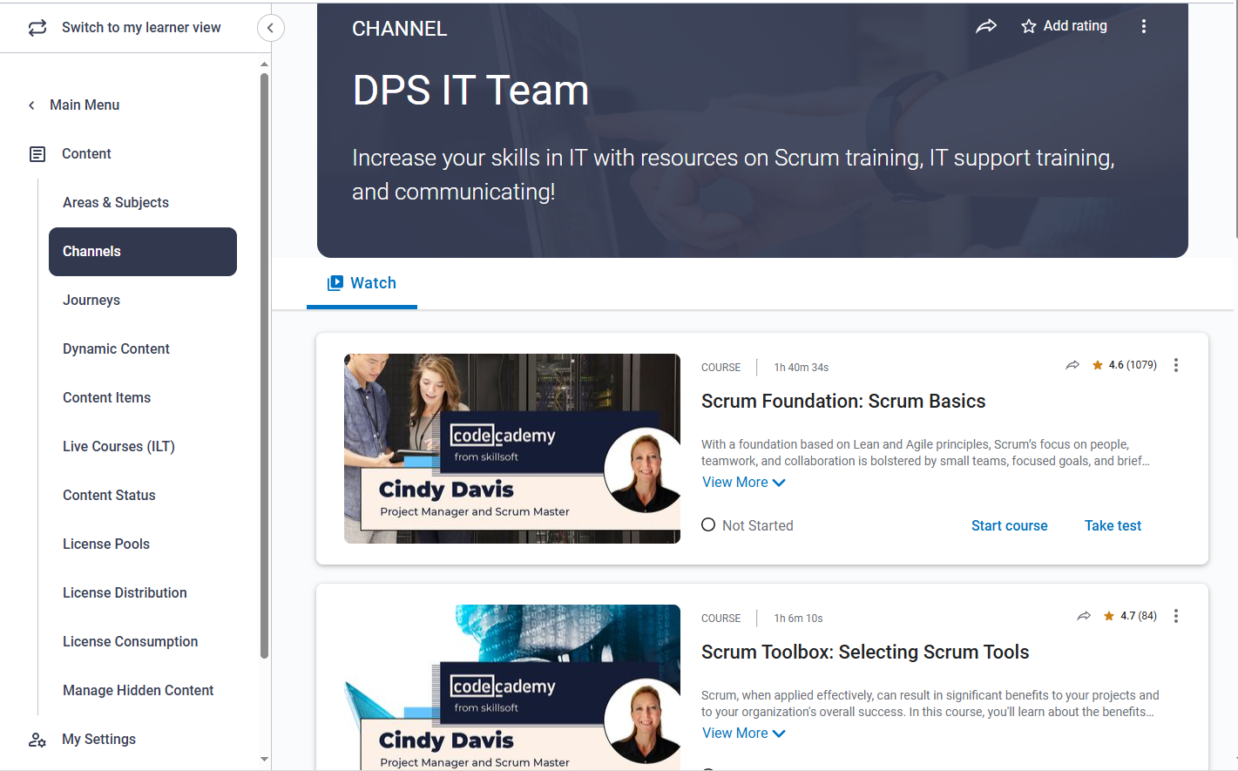
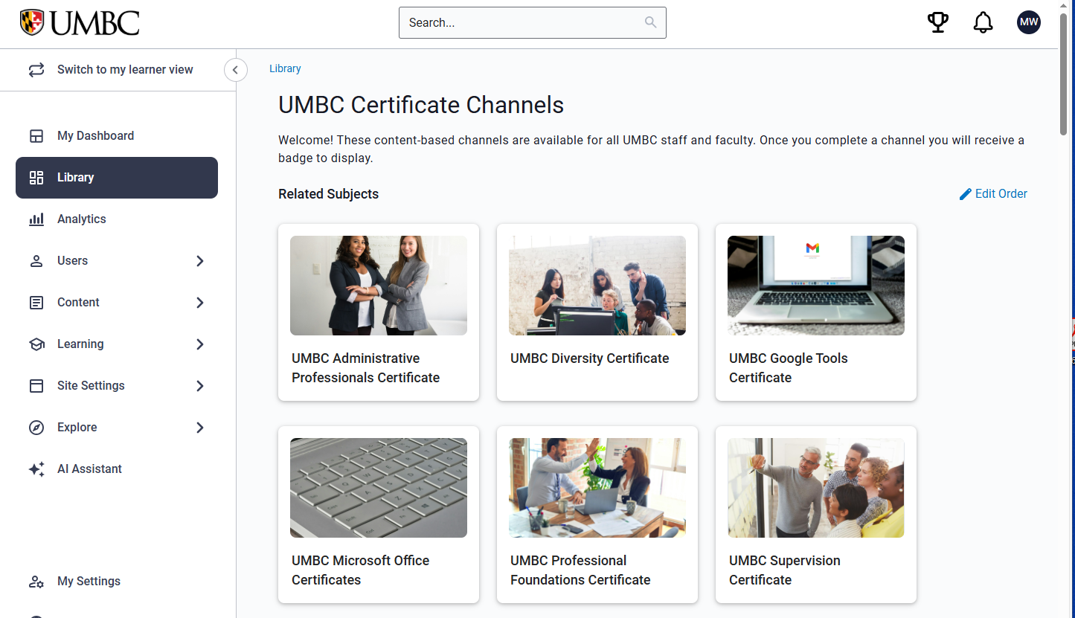
Talent Learning & OD Updates
Skillsoft Percipio
  UMBC Custom Channels
  Division Specific Channels
Notes:
As many of you know, we have a 24/7 asynchronous e-learning system where we tap into experts across the business spectrum. While we have had this system for many years, we have recently customized the experience to include UMBC specific learning. We have custom channels based on the certificates that learners could earn through the Talent Learning & OD unit. (click) And (click) we have created custom channels for individual divisions such as Student Affairs and the DPS IT Team. These custom channels are achieved by partnering with Melody Wright, letting her know what is needed and she can curate offerings that the leader can assign to their teams.

Slide 24

Talent Learning & OD Updates
You're Invited: 6/6 Campus Learning & Development Insights Session!
myUMBC Registration Link
Revealing Results of Spring Needs Assessment Efforts & Future Plans
Culminating Data:
  Campus survey
  4 focus groups with different campus groups
      Faculty
      Mixed Staff
      New Hires
      Managers/Leaders

Slide 25


Human Capital Management/Enterprise Resource Planning Systems Discovery
Demo visits
Continued discussions with potential vendors
Preparing extensive report for new CFO and CIO
Review workflows and will be leveraging key stakeholders to processes

Slide 26


HRSTM Team

Slide 27
Auxiliary Services Updates
Auxiliary Services Updates
Mike Clemons, Executive Director,
Auxiliary Services and
Sandy Mowbry, Director,
Retriever Card Center & Mail Services

Slide 28
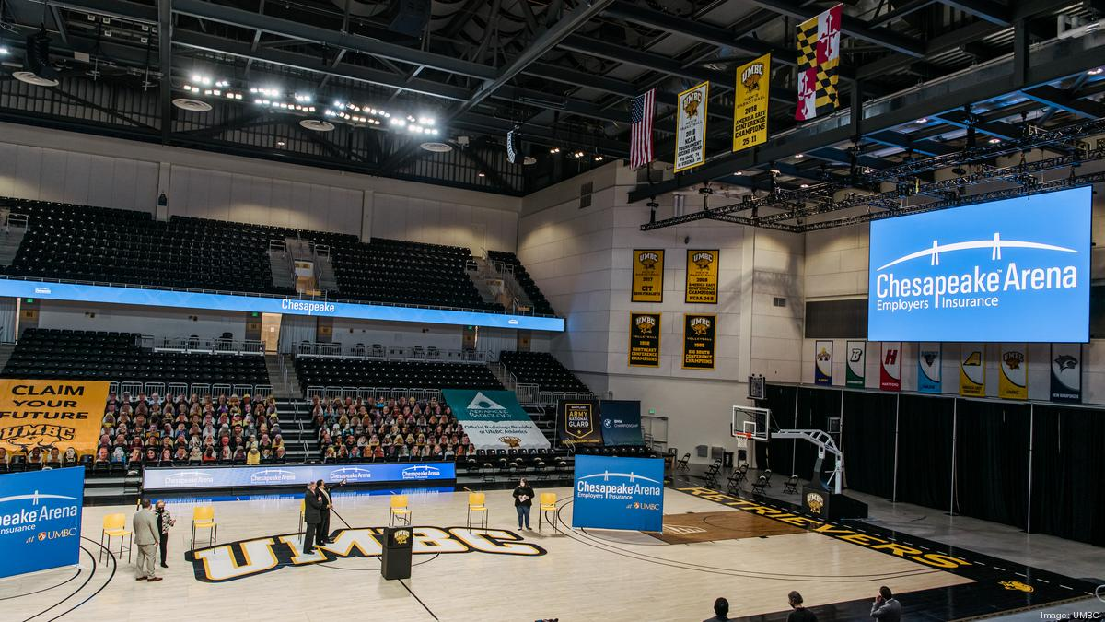
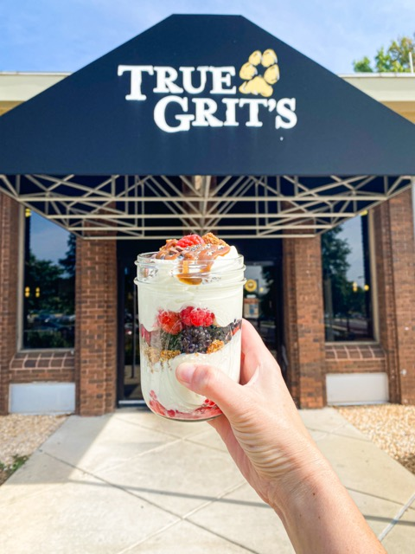
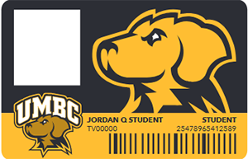
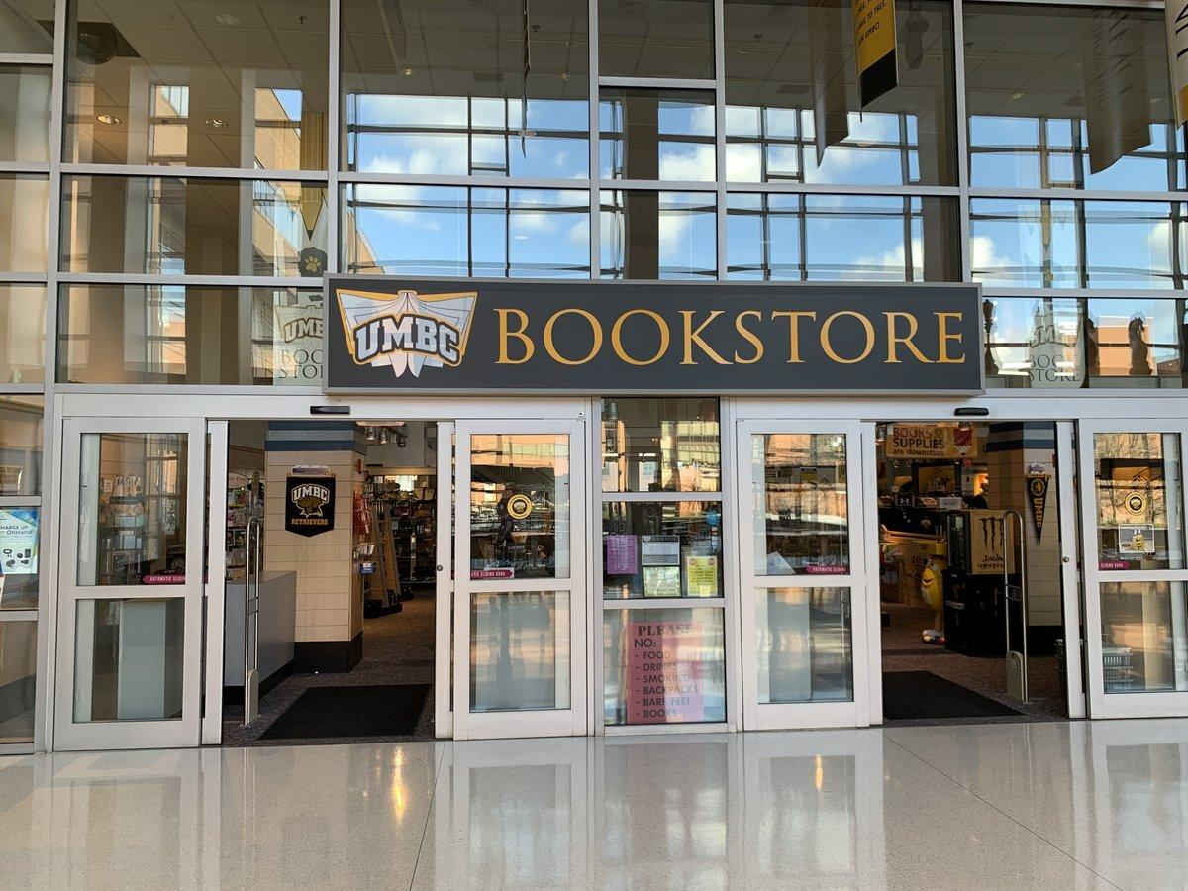

Proudly Serving UMBC
Auxiliary Services Updates

Slide 29
Auxiliary units
Auxiliary Services Updates
UMBC Bookstore
Chesapeake Employers Insurance (CEI) Arena
UMBC Dining
Retriever Card Center & Mail Services

Slide 30
Bookstore
Auxiliary Services Updates
PAW: Punch-out catalog for Club Colors and Bookstore website in quick-links section.
Closed for year-end inventory: 6/27, 6/30 – 7/1
End of Year Sale: 6/21 – 6/26, 40% Off (online and in-store)
Submit new dept. charge authorization forms for FY26.

Slide 31
CEI Arena
Auxiliary Services Updates
Retriever Room available to reserve for department meetings and events.
Graduation ceremonies: May 21 – June 12. Announcements to follow regarding campus traffic impacts.
Next season (Basketball): Faculty & Staff Appreciation games, family/group packs for tickets.

Slide 32
Dining Services
Auxiliary Services Updates
Faculty & Staff Meal Plans: Payroll deduction for FY26 available 7/1. Sign-up by 8/15 for 20 pays (pro-ration available)
Grubhub on Campus: Launching Fall 2025
Carved & Crafted Catering Menu: Launching Fall 2025

Slide 33
Retriever Card Center & Mail Services
Auxiliary Services Updates
Notary service, Passport photos, Personal Mail Boxes.
Department Card (D-Card) Administration: Training session(s) TBD
Campus delivery improvements: Amazon Direct Delivery and Deloitte Consulting LLP.

Slide 34

Thank you!
Auxiliary Services Updates

Slide 35
Office of Contract and Grant Accounting (OCGA)
Welcome new staff members!
OCGA Welcomes Staff
Bryan Casey
Assistant Vice President and Controller
and Cheryl Young, Director, OCGA

Slide 36
Procurement Updates
Procurement Updates
OCGA Welcomes Staff
Rosetta Butler,
Executive Director, Procurement
(Information presented by Bryan Casey)

Slide 37
End of Fiscal Year Close Out –
Below are the deadlines for 2025:
Procurement Updates
Pcard purchases cut-off date is June 13, 2025 – Pcard purchases for FY25 must be completed by the purchase deadline. Transactions made after the deadline may be posted to the FY26 budget.
Requisition cut-off date is June 9, 2025 – Requisitions or purchase orders submitted after the deadline, or those with unforeseen issues, may appear as an encumbrance.Ideally, this deadline allows enough time for items to be shipped and “received in PAW” to post as an expense in FY25, barring any unforeseen issues or missing items listed below:
Items not “received in PAW” by the “Receipt for Goods & Services Deadline” will be considered an encumbrance and will roll into the next fiscal year. The “receipt” date more closely determines which fiscal year the expense will appear in. See “Receipt for Goods & Services Deadline” below.
Note: Financial Services will include the above within their Year End Online Calendar.

Slide 38
Pcard Training
Procurement Updates
On behalf of the Procurement team, thank you to everyone who attended the recent P-Card training session.
If you have not yet completed the mandatory training, or if you would simply like a refresher, we have another session scheduled for May 29th from 1:00–3:00 PM.

Slide 39
Procurement Training
Procurement Updates
We are gearing up to host procurement training in August 2025. We will be discussing all procurement types, levels of approvals, terms and conditions, and other important topics. Joining us will be Accounts Payable, Auxiliary Services and others.

Slide 40
Inventory Updates
Inventory Updates
Britany Davis
Accounting Associate, Plant Fund Accounting/ Inventory Control

Slide 41


Scanners & Scan and Validate
Inventory Updates
New procedure for completing physical inventories for equipment.
Zebra TC72 Mobile Scanner
Zebra TC73 Mobile Scanner

Slide 42
Scanners & Scan and Validate
Inventory Updates
In February, departments were given the opportunity to purchase their own scanners to complete the physical inventory.
Scanners have arrived and been configured and registered.
Departments who requested scanners will receive training and their scanners by the end of the Month.

Slide 43
Why Scanners????
Inventory Updates
Scanners & Scan and Validate
Better tracking of Missing/ Lost assets (especially of those in shared spaces)
Real time asset tracking (scanner syncs w/ the database every 30 secs on a steady WIFI)
Time Saving & Efficient
More modern approach to Inventory Reporting

Slide 44
FY2026 Capital / Sensitive Equipment Inventory
Inventory Updates
The FY2026 combined Capital and Sensitive Equipment Inventory will begin in July.
Departments who did not purchase a scanner will need to request the use of one of the six (6) scanners Inventory Control has available.
Training dates will be posted on the Trainings page for custodians to register.

Slide 45

FY2026 Capital / Sensitive Equipment Inventory
Inventory Updates
WE ASK
Department Heads, Chairs, Directors, and Managers …
Please support your custodian in making inventory a priority during the loan period they are borrowing a scanner. Inventory Control has 6 scanners to loan to service the campus community.
We appreciate your understanding and support.

Slide 46
E-Cycle Event
Inventory Updates
The next E-Cycle event will be held the first week of June, at the Administrative drive Circle. Property Custodians will be notified via the listserv of the exact date of the Event and campus wide notification will be shared as well.
Only electronic items will be accepted.
No refrigerators or portable air conditioners.
A Property Disposition form must be submitted by Friday, May 30, 2025, to Inventory Control via DocuSign for all equipment that has a property tag affixed.

Slide 47
Inventory Training
Inventory Updates
Inventory training is available for all UMBC employees on the 2nd Wednesday of each month. Register by searching Asset Management Training/ Inventory Control at https://my3.my.umbc.edu/groups/training
If the 2nd Wednesday is not convenient, we offer individual training.
To schedule individual training, please contact Britany Davis at ext. 51716 or bdavis12@umbc.edu

Slide 48
Property Custodian Group
Inventory Updates
All Property Custodians are notified of any policy and procedure changes via email to our Property Custodian Group.
If you would like to be included in this group, please contact Tina Carter-Brown at ext. 58078 or tcbrown@umbc.edu

Slide 49
Financial Accounting & Reporting
(BAM)
Financial Accounting & Reporting
John Alfano
Manager, FAR

Slide 50

June 30 2025
Financial Accounting & Reporting

Slide 51
Year End Planning and Reminders
Financial Accounting & Reporting
A Fiscal Year End Memo and Calendar
Expect It in Your Email/Financial Services Website
alfanoj@umbc.edu

Slide 52
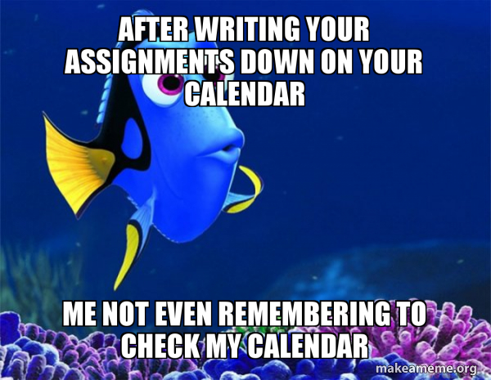
Subscribe to: Deadline Calendar on Google
Financial Accounting & Reporting

Slide 53
Year End Planning and Reminders
Financial Accounting & Reporting
Budget Amendment Adjustments for FY25 (by June 6)
  Budget Office – Jared Fincke jfincke@umbc.edu
Travel Reimbursement for FY25 (by June 13)
  Expenses received after the deadline will be recorded in next FY
Payment Request for FY25 (by June 13)
  approved by Department Approver COB
Pcard Purchase for FY25 (by June 13)
  Expenses received after the deadline will be recorded in next FY
Payroll Retros for FY25 – 2025-25 Payroll (by June 16)
  The next payroll allowing retros 2026-02 (see Payroll Calendar)
Pcard Reallocation (by June 27)

Slide 54
Year End Planning and Reminders
Financial Accounting & Reporting
Foundation Reimbursement Requests for FY25 (by June 18)
  Visit the USM Foundation website
  last wire batch run for UMBC June 23
RSTARS Interagency Payments for FY25 (by June 20)
  approved by Department Approver COB
Restricted Journals for FY25 (by June 23)
  approved by Department Approver COB
Cash Receipts/Deposits for FY25 (by June 30)
  Everything must be received by 12:00 Noon
Unrestricted Journals for FY25 (by June 30)
  Journal Date dictates the Fiscal Year – June 30 posts to FY25

Slide 55
Year End Planning and Reminders
Financial Accounting & Reporting
Contact Financial Accounting and Reporting w/ Questions
    Bryan Casey, Controller, bcasey3@umbc.edu
    Gayle Chapman, Assistant Controller, chapman@umbc.edu John Alfano, Manager, alfanoj@umbc.edu
Journal Entry Training Every Month
    May 29, 10:00am (next virtual class)
Training for Year End Assistance – send a Request

Slide 56

Financial Accounting & Reporting

Slide 57
BAM! Here comes Concur!
Travel Services Update
Adam Drutz-Hannahs,
Assistant Manager, Business Services

Slide 58
What’s the travel itinerary?
Travel Services Update
Design and Implementation: February - May 2025
User Acceptance Testing: May - July 2025
Initial Beta Rollout: July 2025
Production Rollout: August 2025
User Training: July - October 2025
Travel System 2.0 Freeze: Mid-Late Fall 2025
Notes:
Ken

Slide 59
What’s staying the same?
Travel Services Update
State of Maryland Payment Processing (GAD)
Pre-approval requirements (Out of state or in-state overnight)
What’s reimbursable and not reimbursable
Comparison quotes for adding Personal travel
Notes:
Adam - Group travel should be arranged directly with Altour.

Slide 60
What’s changing?
Travel Services Update
Some terminology
All Concur Expense Reports will be submitted after a trip, even if you’re not seeking reimbursement
You can now self-book or prepare arrangements via Concur Travel
Self-book fees will be $3.50/booking when using Concur Travel
Notes:
Adam - Self-Book = Online via Concur Travel, Calling in will cost $24/$26

Slide 61
Old → New
Travel Services Update
Travel System 2.0 | SAP Concur
Pre-Approval | Request
Reimbursement (sort of) | Expense Report
Per Diem | Travel Allowance
Many travel agencies | ALTOUR (formerly Travel Leaders)
Notes:
Adam

Slide 62
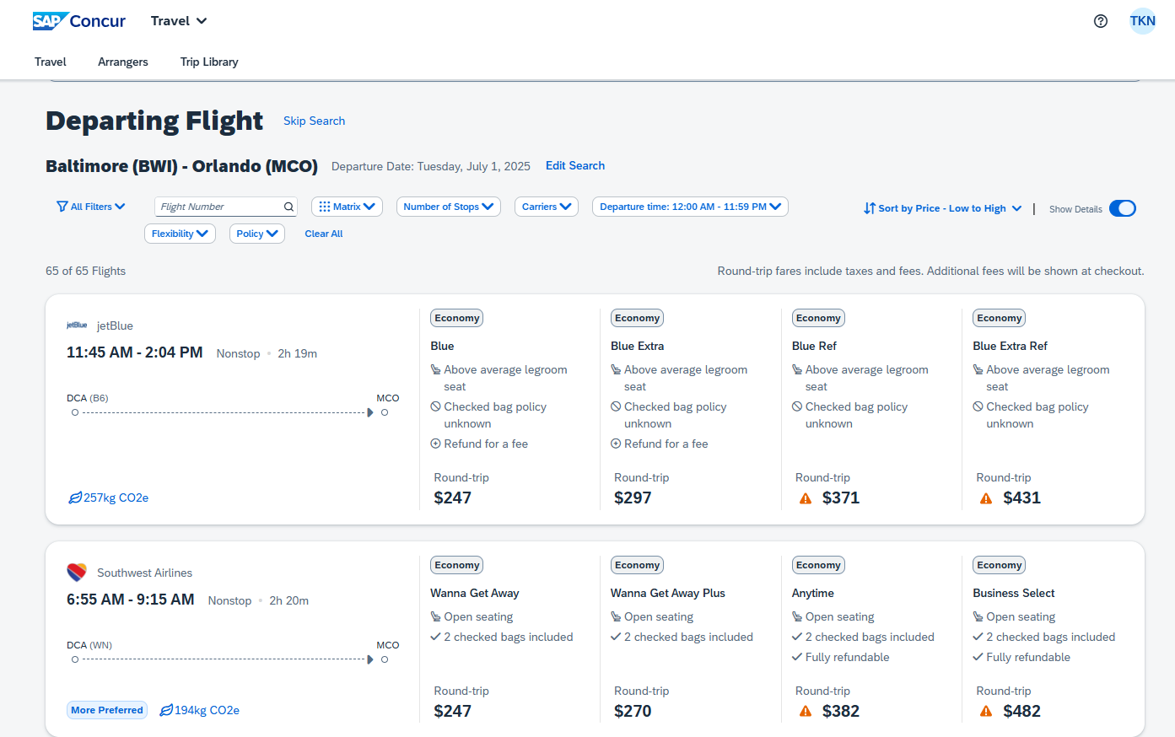
Travel Services Update

Slide 63
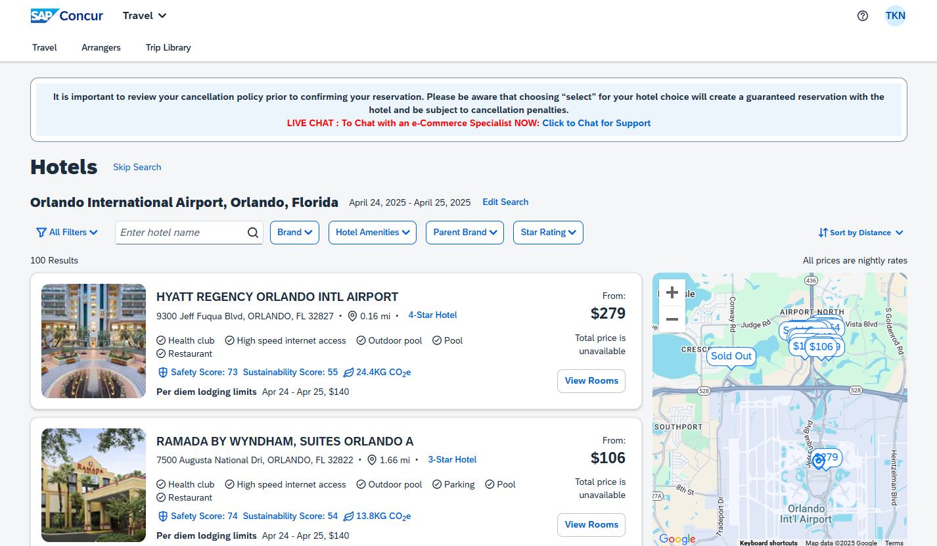
Travel Services Update

Slide 64
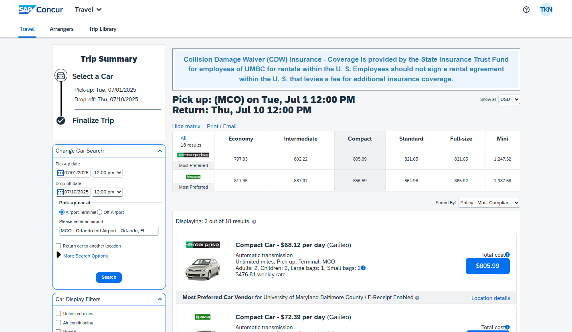
Travel Services Update

Slide 65
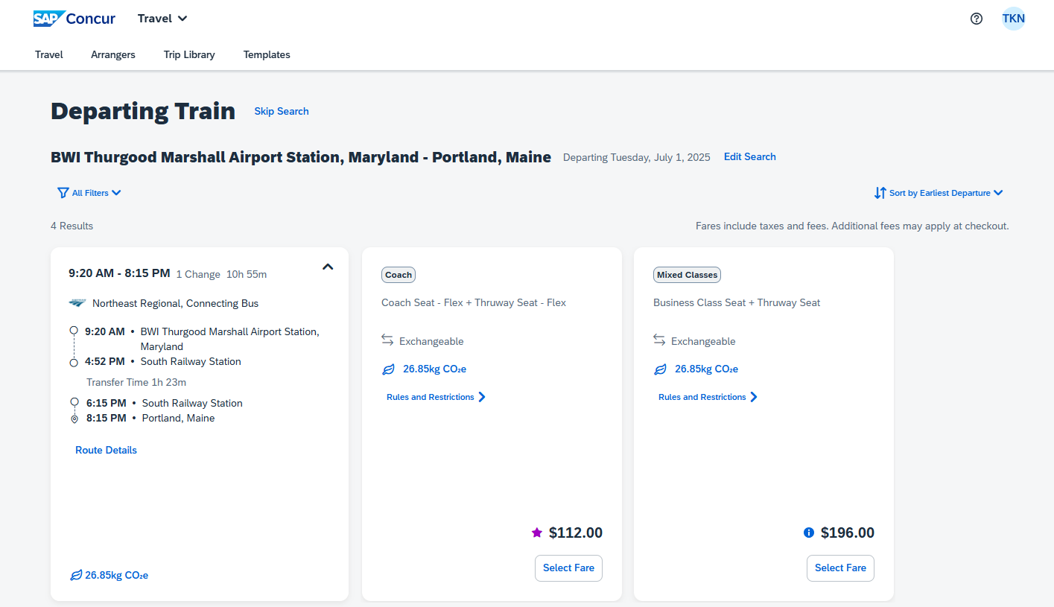
Travel Services Update

Slide 66
Concur Travel Benefits
Travel Services Update
Automatic Ticketing
Shows Fly America Act Compliance
Integration with Terradotta International Travel Registry
Link your Frequent Flyer & Loyalty Accounts
Notes:
Ken

Slide 67
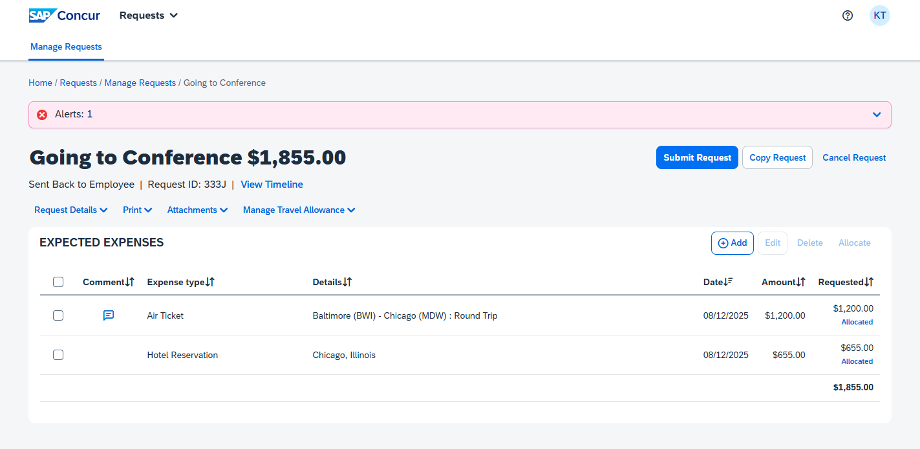
Travel Services Update
Notes:
Ken

Slide 68
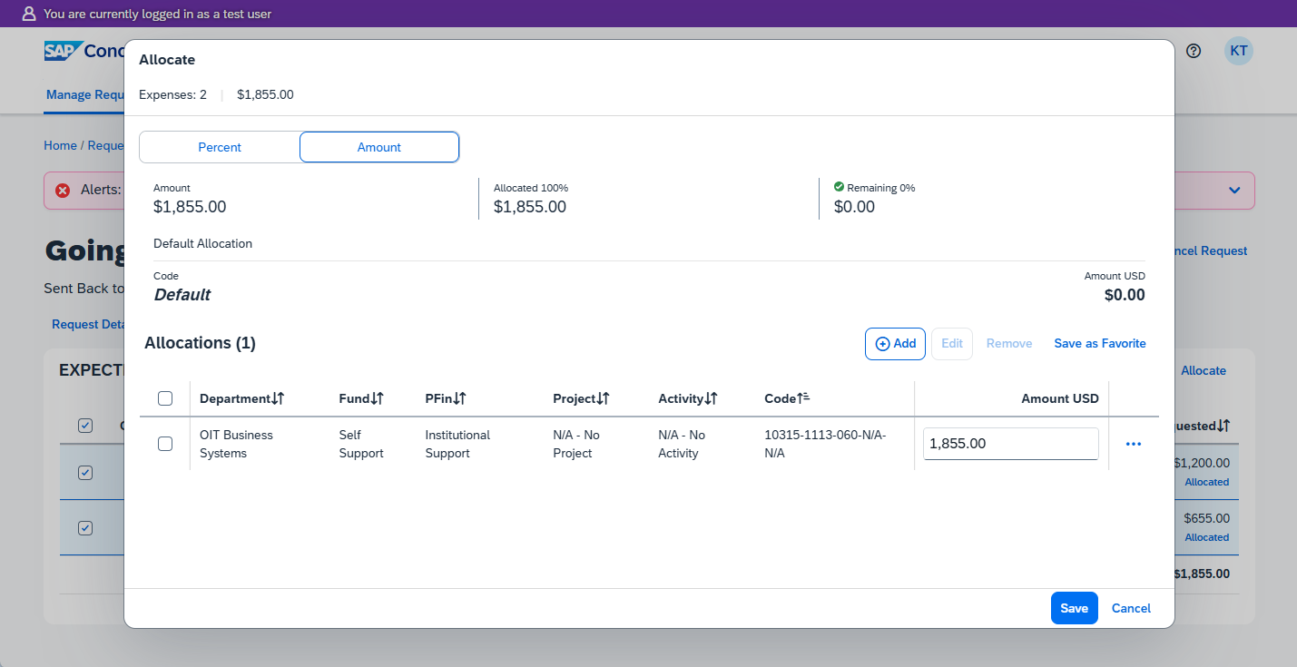
Travel Services Update
Notes:
Ken

Slide 69
Travel Advisory Board (TAB)
Travel Services Update
Chair: Bryan Casey, Asst Vice President and Controller, Financial Services
David Di Maria, Asst Vice Provost for International Education
Adam Drutz-Hannahs, Assistant Manager, Financial Services
Catherine Manalansan, Administrative Assistant, JCET
Charles Nicholas, Professor, CSEE
Ken Schreihofer, Director, Business Systems, DoIT
Desiree Stonesifer, Business Manager, Administrative SSC
Margo Young, Director, Earth & Space Research Administration (ESRA)
Notes:
Adam

Slide 70
What can you do in the meantime?
Travel Services Update
Follow Travel Group on myUMBC
  my.umbc.edu/groups/travel
Read the launch post and watch the video about Concur
  my.umbc.edu/posts/147583
Talk with Implementation or TAB members!
Notes:
Adam

Slide 71
Thanks for joining us!
Thank you!
Make sure you’re signed up for
the BAM myUMBC group. See you
in the fall.

