Slide 1
Department of Human Resources
Notes:
Welcome
Introductions

Slide 2
PageUp Higher Ed Clients
Notes:
PageUp is an Australian firm - providing talent management software solutions
Established in 1997, In the U.S. since 2013
Largest base of customers is higher education
Here are a few of the highered clients in the United States. We have spoken with several universities regarding their set up.

Slide 3
Project TimeLine
PageUp Project Kick-Off September 7, 2016
Configuration of System September – February 2017
User Testing March - April 2017
Go LIVE – Phase 1 – Nonexempt Staff May 1, 2017
Go LIVE – Phase 2 – Exempt Staff June 1, 2017
Training for campus users April – August 2017
Notes:
This is our project time line. We have been working on this since September
Nonexempt positions went Live on May 1st.
Exempt positions will go live on June 1st.
This includes new recruitments only. Positions that have already been posted will continue in the current paper process.

Slide 4
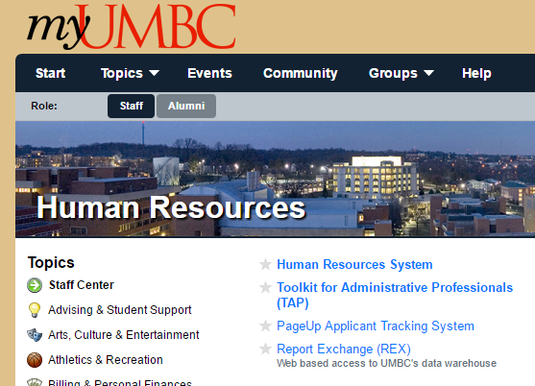
Where to Find the PageUp Login Link
From myUMBC
Click on Topics
Click on Human Resources
Select PageUp
Notes:
The PageUp login uses Single Sign on.
The login link is located on the MyUMBC Topics page.

Slide 5
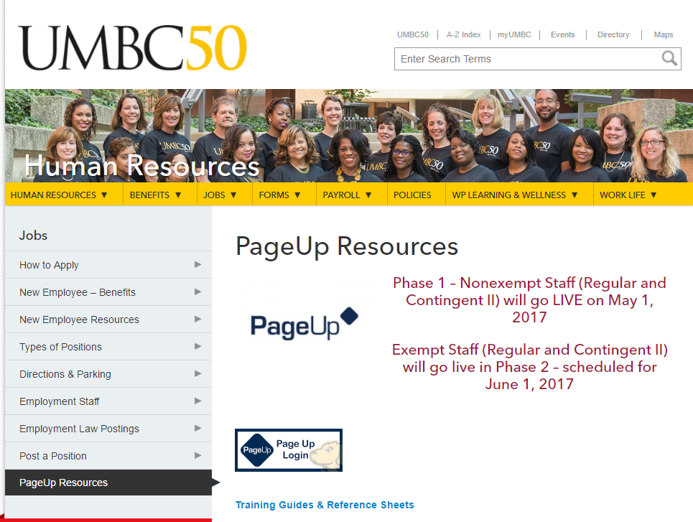
Navigation
Human Resources Website
Jobs
PageUp Resources
PageUp login button
Notes:
PageUp log-in is also available on the Human Resources website on the new PageUp Resources webpage.
In addition to the log-in button, there are training guides and resource document links.

Slide 6
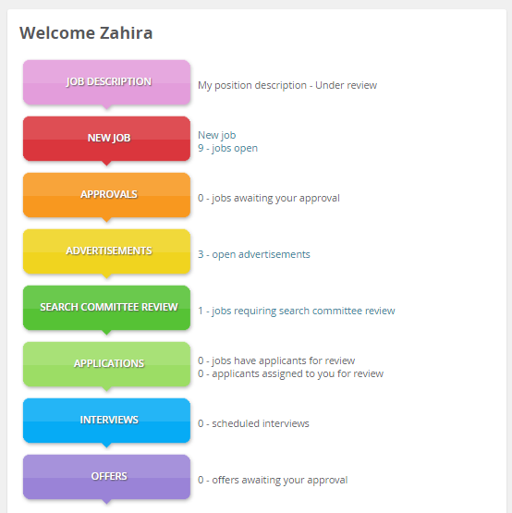
Dashboard
Hiring Manager View
Notes:
This is called the dashboard. The bubbles show the various stages in recruitment and help with navigation. This is the view for hiring managers/supervisors and search committee members. Some users may have a different dashboard based on their role.

Slide 7
Recruitment Process
Position already establish and Hiring Exception approval obtained
Complete Requisition in PageUp
Route for approvals to begin search (same signatures as required currently)
HR will review and edit job posting if needed
HR will post the ad on the HR website, HERC & Highered jobs
Applicants will apply on-line (both nonexempt and exempt)
Hiring Department/Search Committee view applications in PageUp
Notes:
The overall recruitment process is basically the same. What is changing is how we accomplish the tasks associated with recruitment.
Hiring Exception approval is still required.
The requisition will be created in PageUp and routed electronically for approvals.
Applicants will apply on-line. This includes both nonexempt and exempt positions.
Hiring Managers and Search Committees will view the applications in the system.
Selection approval will be routed electronically.
The Offer letter will be uploaded to the candidate’s account in PageUp. The candidate will view the offer and formally accept or decline.

Slide 8
Current Recruitment Process

Slide 9
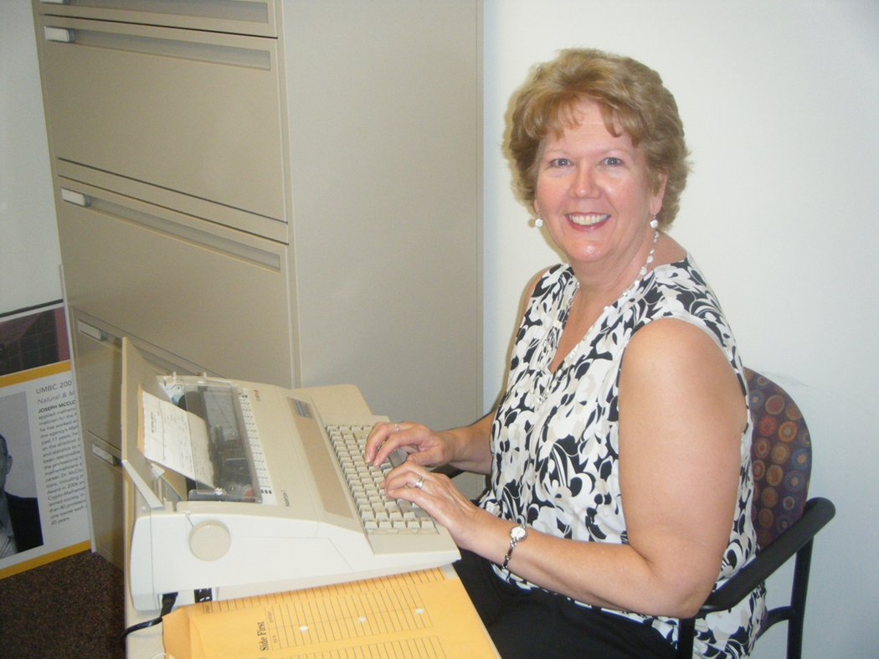
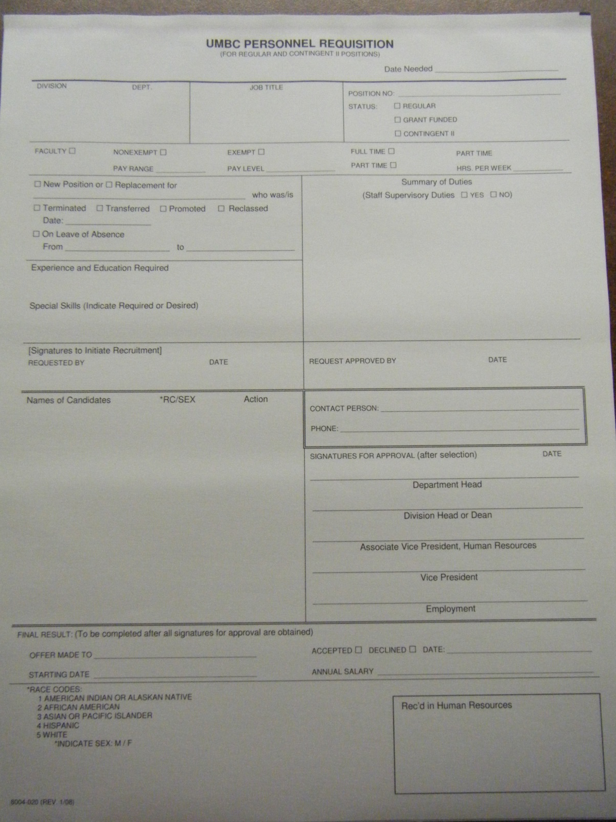
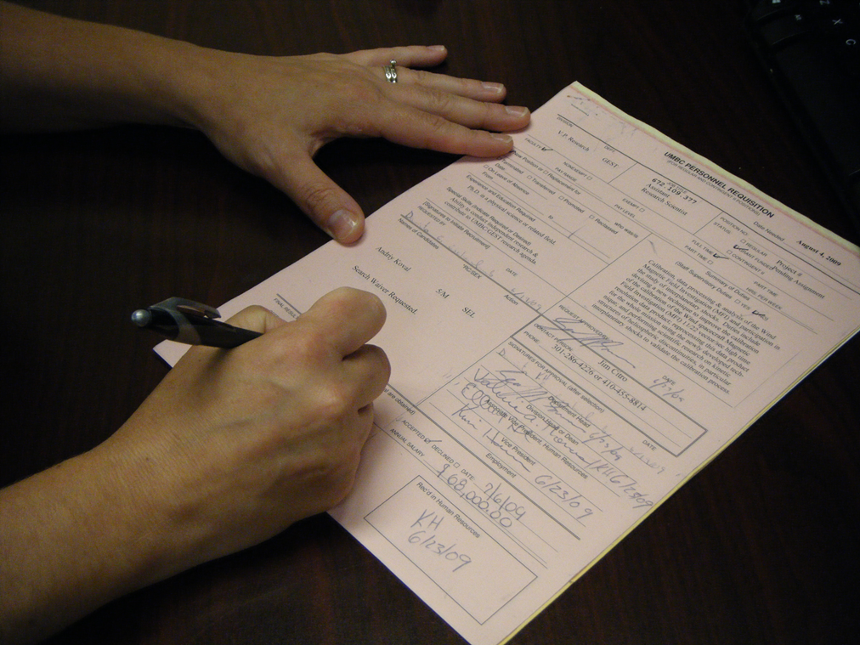
Or complete by hand
Find a typewriter
Get the carbon form

Slide 10
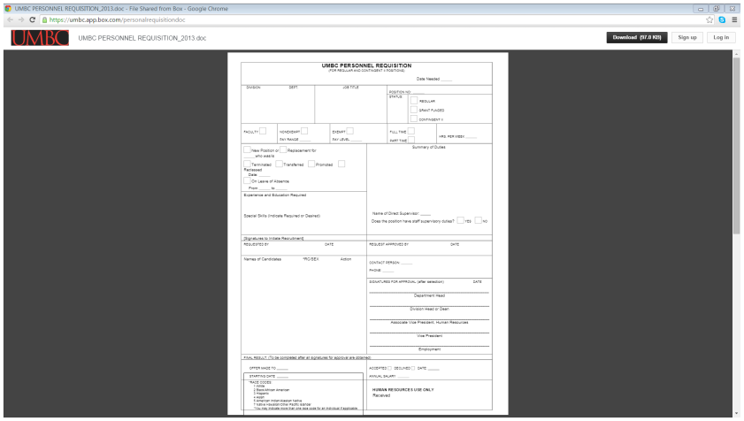
Or get the form off the HR website and complete

Slide 11
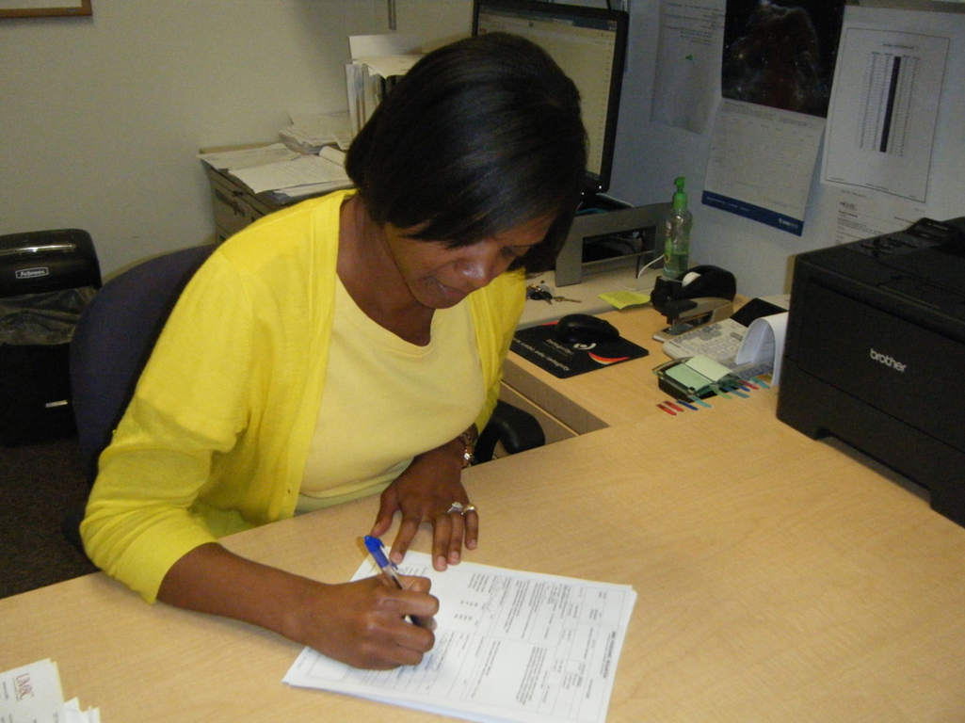
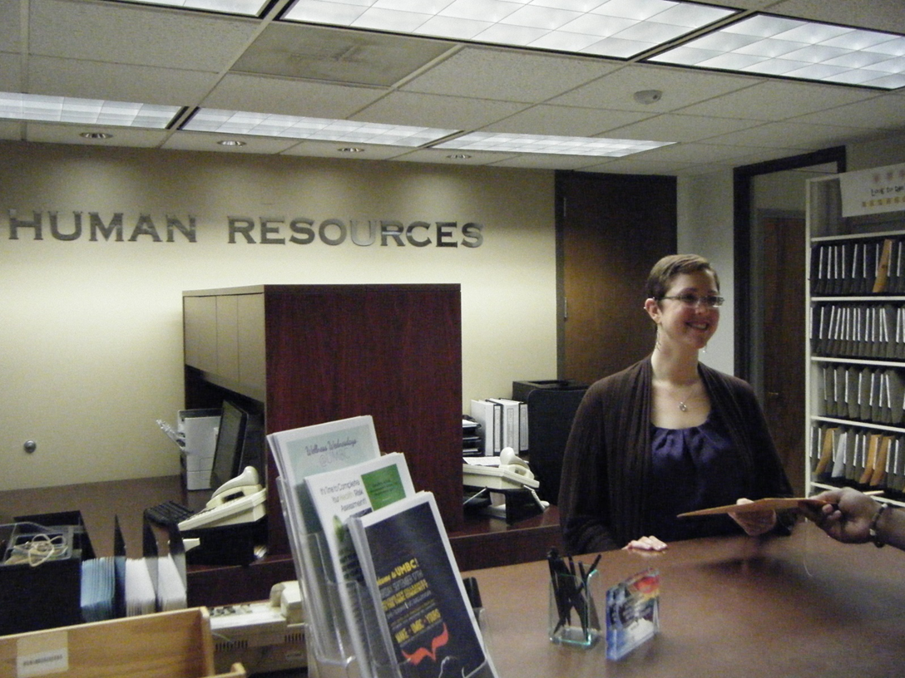
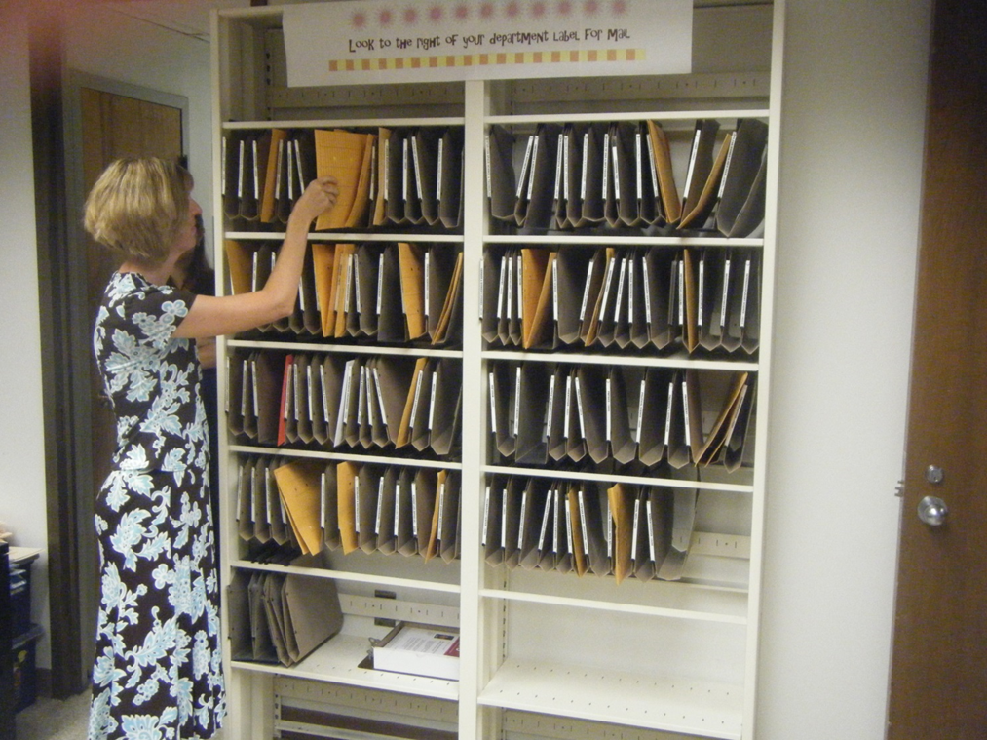
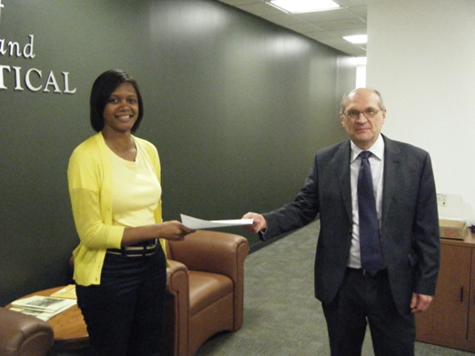
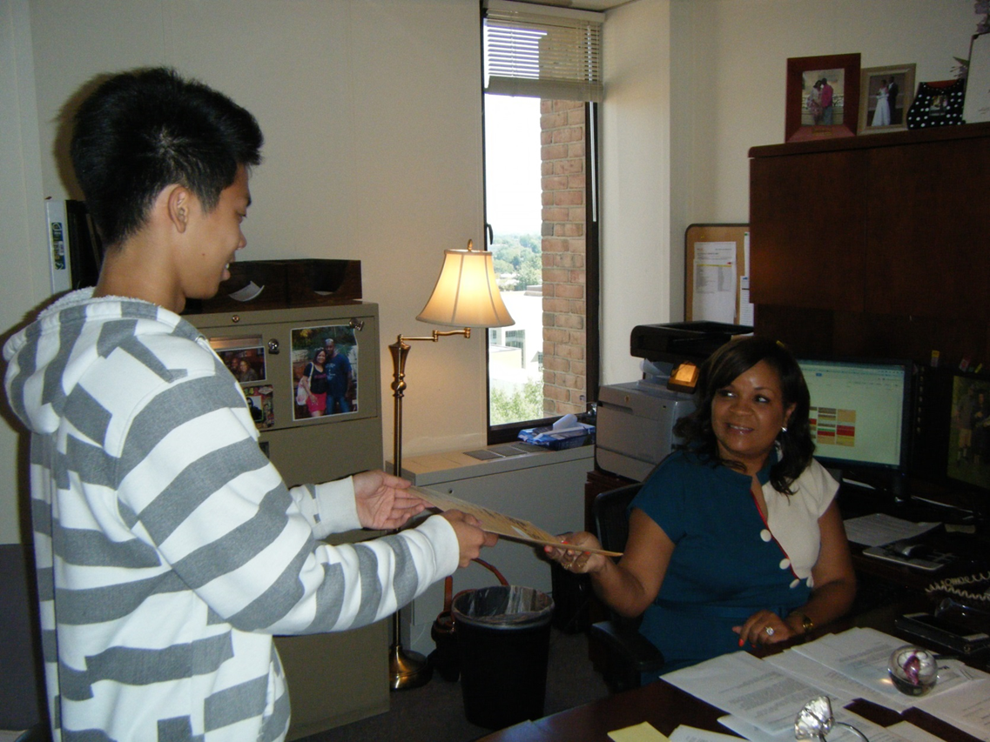
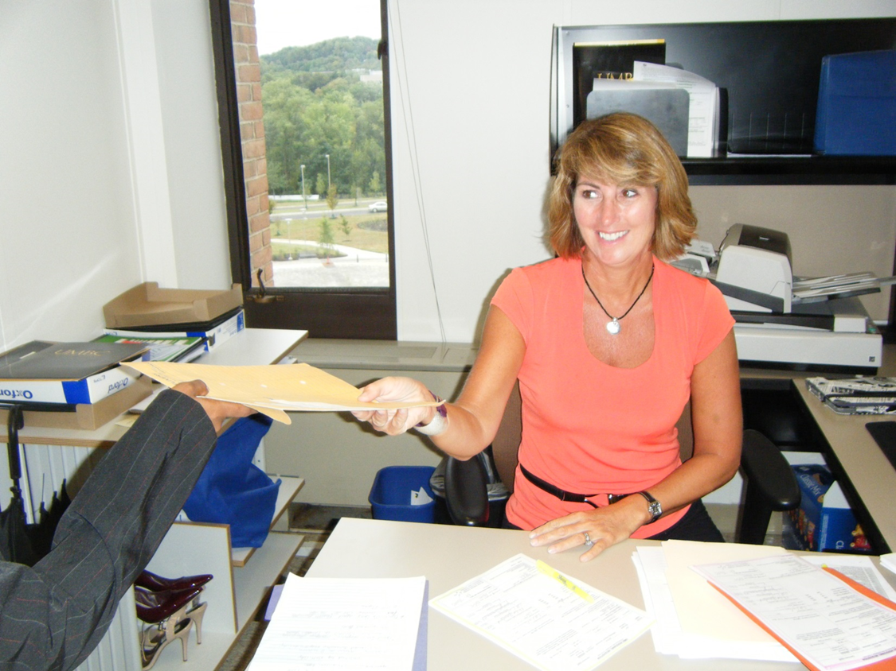
Run around the campus and obtain signatures.

Slide 12
New PageUp Recruitment Process
Notes:
& Now the New PageUp Process

Slide 13
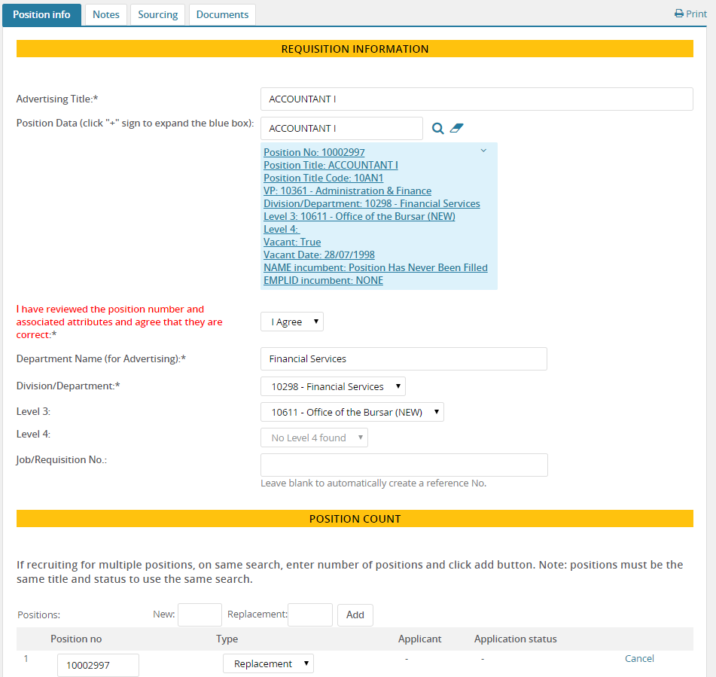
Notes:
Complete the Requisition form in the PageUp system and route for approvals.
Easy!!!

Slide 14
Electronic Approval Process
Notes:
Approvals show at the bottom of the Requisition form. You can track the status as it moved through the various approvers.

Slide 15
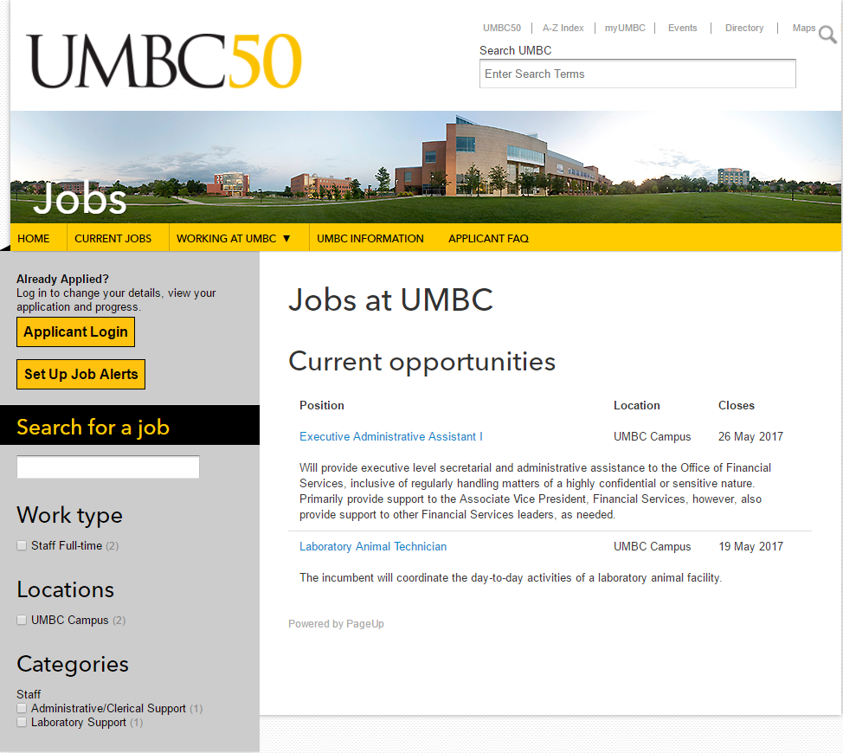
Jobs Website
http://listings.umbc.edu/cw/en-us/listing/
Notes:
This is our new Jobs website.
Show job title with brief description. Click title to open to full description.
Applicant clicks Apply Now button.
Applicants create a PageUp account the first time. This account is used to track the status of the application, receive notifications and to receive the offer.
Applicants can sign up for job alerts to be notified of similar types of positions.
Example: Looking for an academic advisor position at UMBC

Slide 16
Additional Features
Interview Scheduling
Mass Communications to Applicants
Status Tracking of Requisitions & Offer Approvals
Reporting
Compliance for EEO
Notes:
PageUp has additional features including:
Interview Scheduling – applicants can self-schedule from a list of dates and times
Ability to send out communication emails to one or more applicants
Ability to tell the status of your job and selection approval
Reporting features
Better compliance for required government reporting such as EEO data. The data will be collected during the application process. Departments will no longer have to type labels for exempt positions!!!!

Slide 17
PageUp Training
HR Hiring Liaison & Hiring Manager training – designed for individuals that will be responsible for coordinating the hiring process from start (requisition) to finish (offer approval).
Reviewing and Managing Applications training: designed for individuals that will be reviewing and managing applications such as a Hiring Managers and/or a Search Committee Chairs/Members.
PageUp Help Labs – Hands on help with PageUp
Notes:
Two different training classes are being offered.
One if for HR Hiring Liaisons and Hiring Managers
The other is for Managers, Search Committee Chairs and Search Committee Members
We are also offering PageUp Help Labs – walk-in lab for immediate help

Slide 18
Schedule and Sign-up
http://my.umbc.edu/groups/training
Notes:
Schedule and sign-up is located on the training website at:

Slide 19
Notes:
Please be patient as this is a new system for all of us.

