Slide 1
Business Administrators Meeting (BAM)
Tuesday, February 2, 2021

Slide 2
Agenda

Slide 3
Welcome
Welcome
Kathy Dettloff

Slide 4
Facilities Update
Facilities Update
Lenn Caron

Slide 5
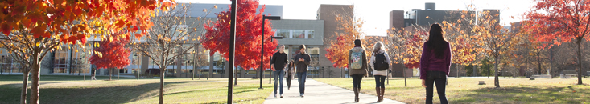
Business Administrators Meeting
Spring 2021 Construction Update

Slide 6
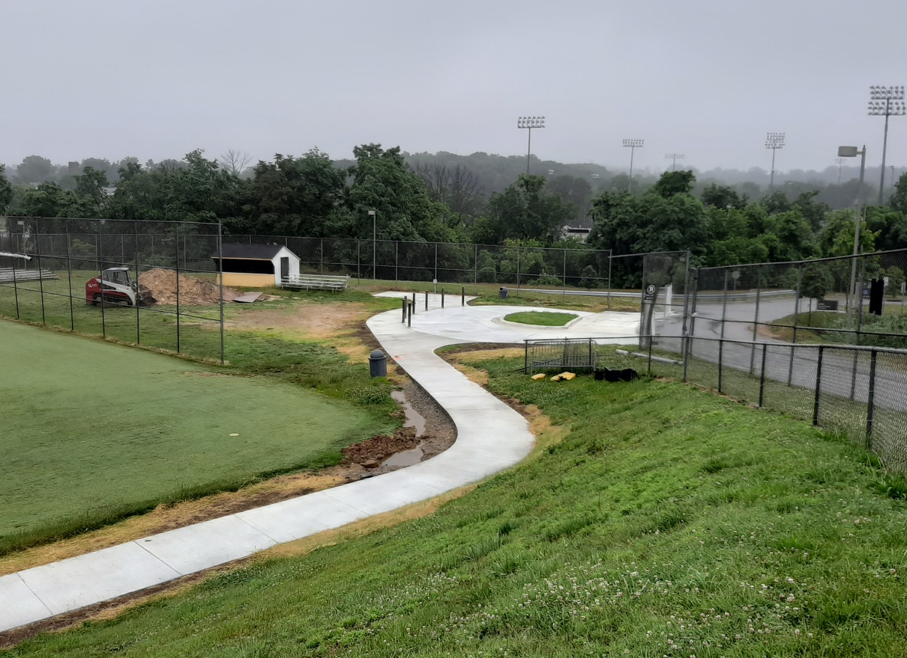
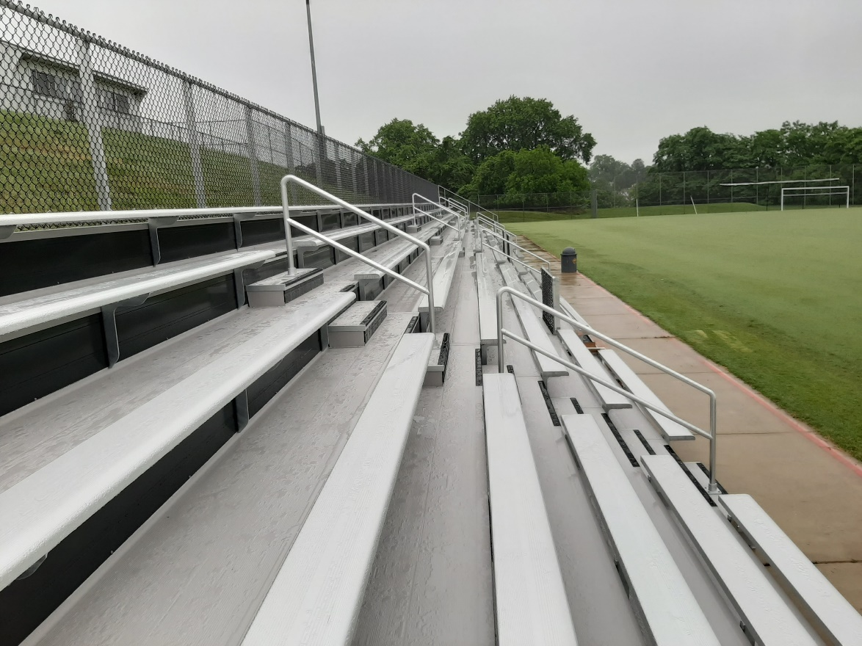
Recent Successes
Retriever Soccer Park
Completed in Fall of 2020
  improvements to ticketing, seating and access
Notes:
The Physics Building is the recipient of a new roof to be completed in time for summer. After twenty years of withstanding the elements on Hilltop Circle, the building will receive a state-of-the art single ply membrane roof assembly. It includes increased insulation to meet the current energy code and a light grey reflective surface to make the building more sustainable. There will also be a new platform to hold the myriad of science experiments created by the Physics faculty and students, providing a safer environment for this important work.

Slide 7
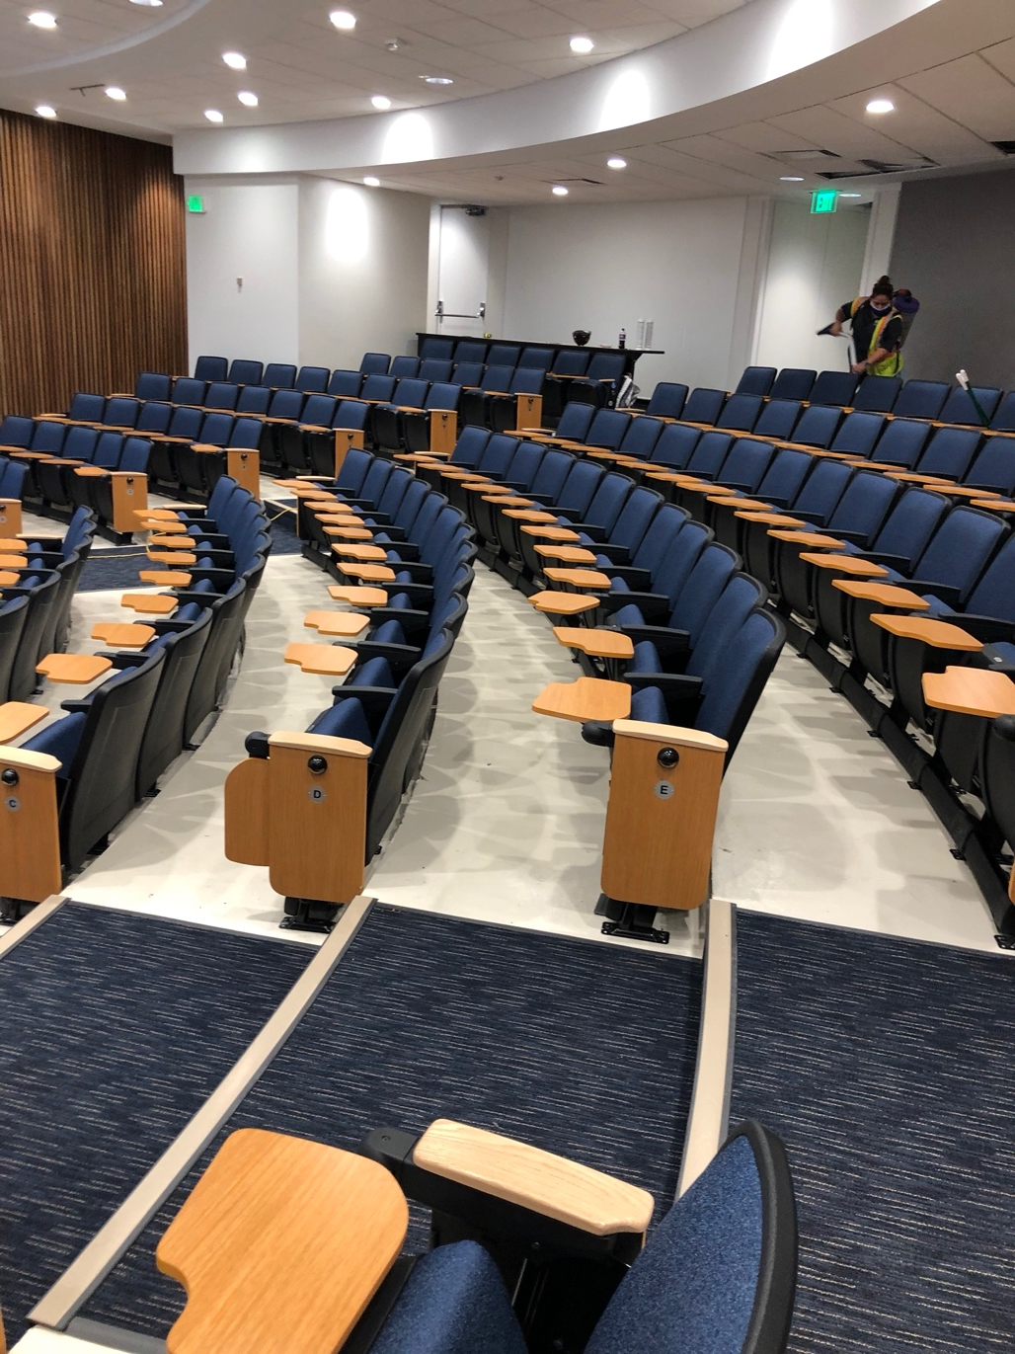
Recent Successes
Administration Building Lecture Hall Renovation
  improvements to lighting, finishes, seating, projection and sound, and technology for lecture capture and remote learning
  emphasis on supporting students with visual and hearing challenges by providing assisted listening, screen capture and multiple displays at rear of hall
Notes:
The Physics Building is the recipient of a new roof to be completed in time for summer. After twenty years of withstanding the elements on Hilltop Circle, the building will receive a state-of-the art single ply membrane roof assembly. It includes increased insulation to meet the current energy code and a light grey reflective surface to make the building more sustainable. There will also be a new platform to hold the myriad of science experiments created by the Physics faculty and students, providing a safer environment for this important work.

Slide 8
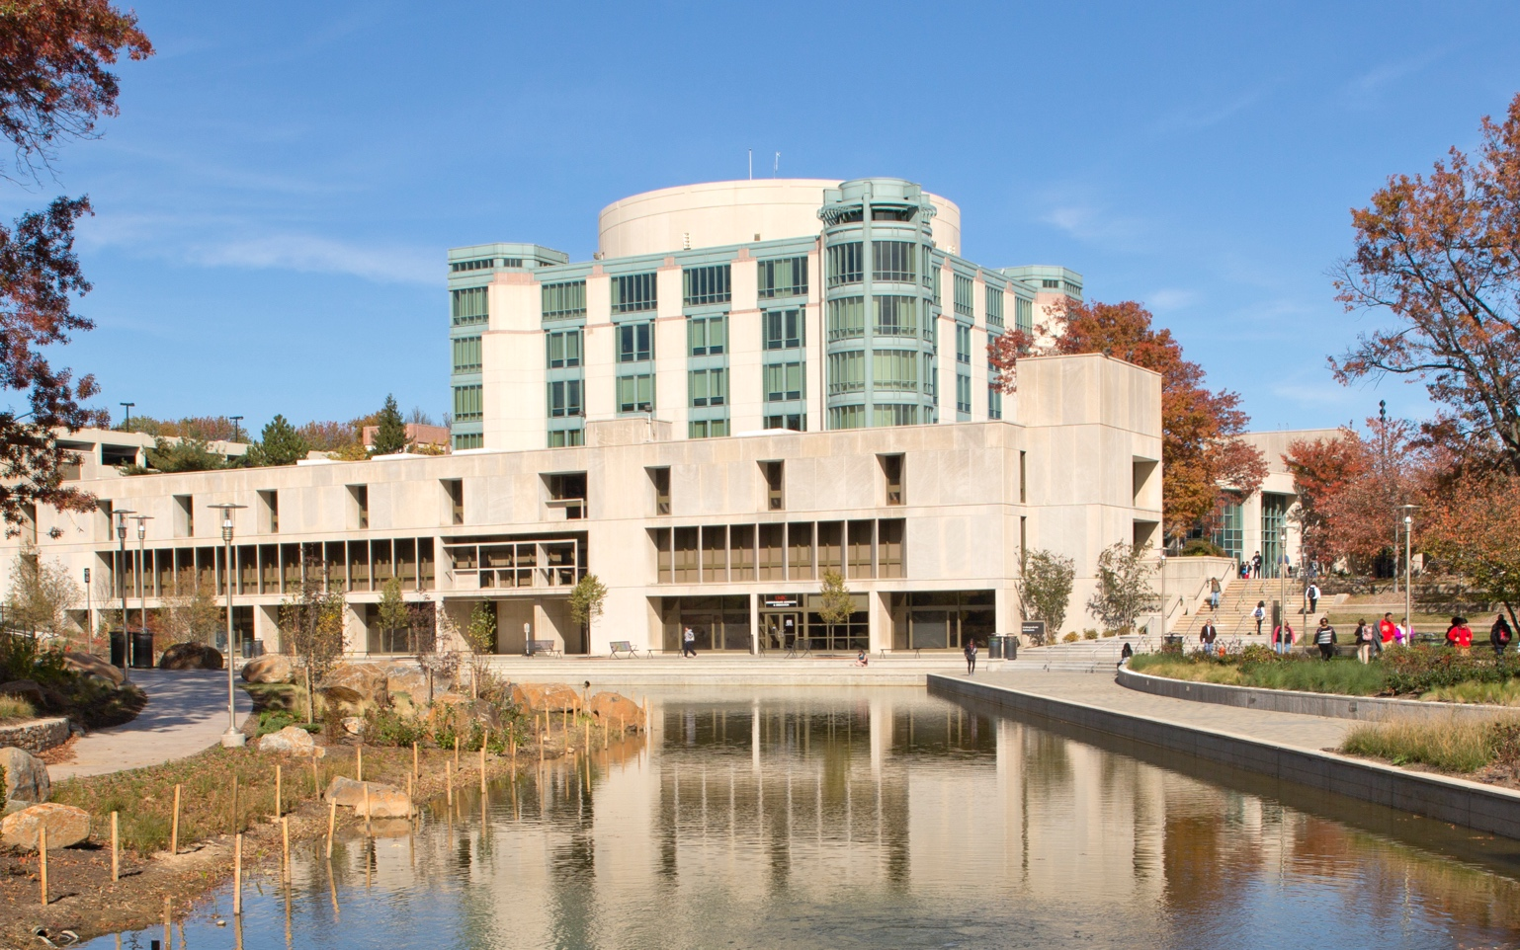
Recent Successes
AOK Library Service Elevator
Completed in January of 2021
Notes:
The Physics Building is the recipient of a new roof to be completed in time for summer. After twenty years of withstanding the elements on Hilltop Circle, the building will receive a state-of-the art single ply membrane roof assembly. It includes increased insulation to meet the current energy code and a light grey reflective surface to make the building more sustainable. There will also be a new platform to hold the myriad of science experiments created by the Physics faculty and students, providing a safer environment for this important work.

Slide 9
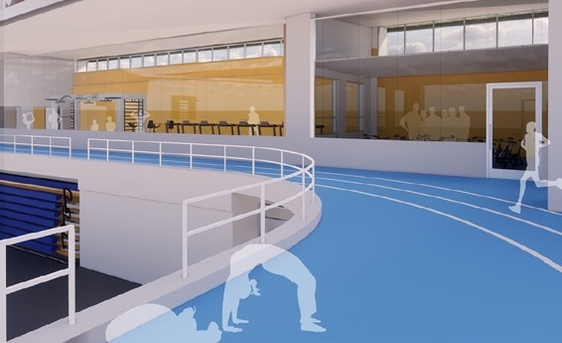
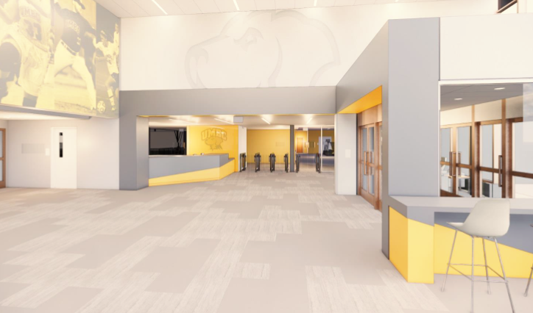
Current Construction
Retriever Activities Center Renewal
On-going through March 2021
  Phased improvements to facilities and spaces to enhance access and improve opportunities for wellness and student recreation

Slide 10
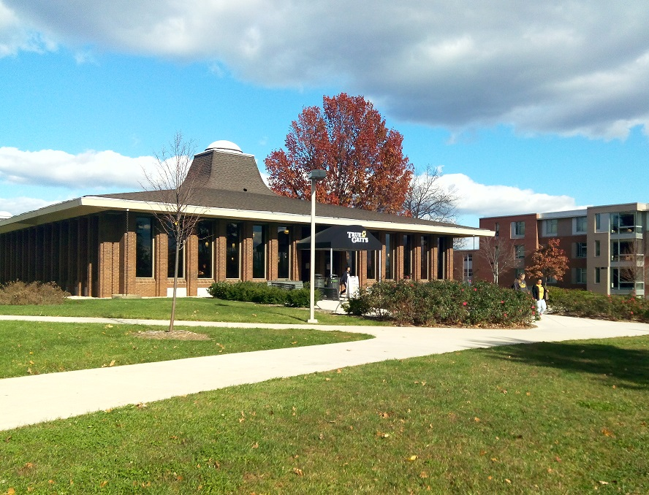
Current Construction
True Grit Roof Replacement
On-going through May 2021
  Scope includes:
  new roof
  ductwork insulation
  new roof-top HVAC unit

Slide 11
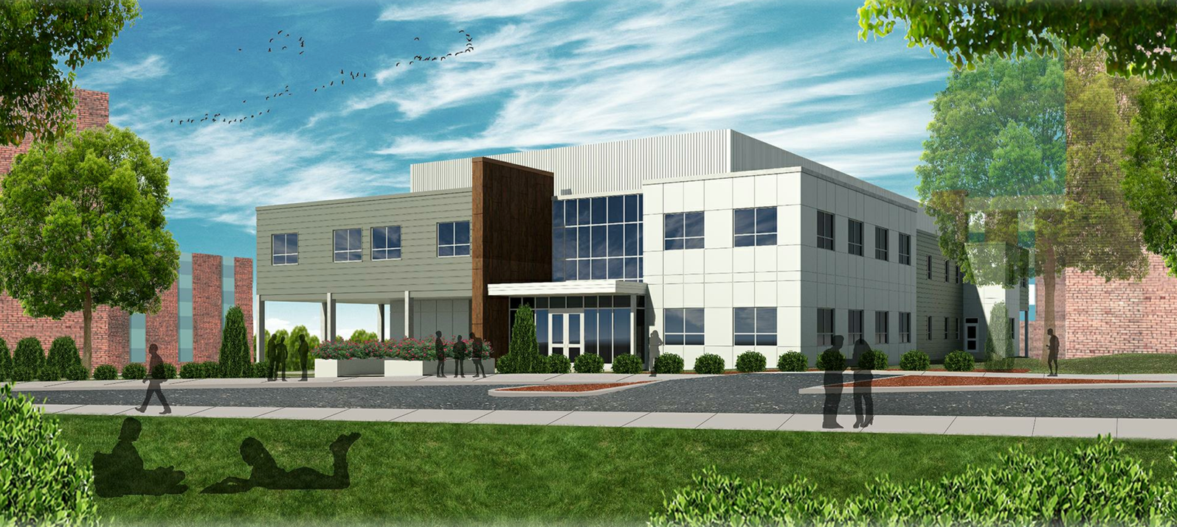
Current Construction
Health Services and Counseling Building
On-going through August 2021
Features fast-track delivery of new building for University Health Services, the Counseling Center, Student Conduct and Community Standards, and Interfaith Center

Slide 12
Current Construction
Biological Sciences Building Accessibility Upgrades
On-going through July 2021
Accessibility improvements to lower-level of building include:
Construction of a new ADA compliant all-gender restroom (completed)
Conversion of existing service elevator to accommodate passengers and wheelchairs (begins March 2021)

Slide 13
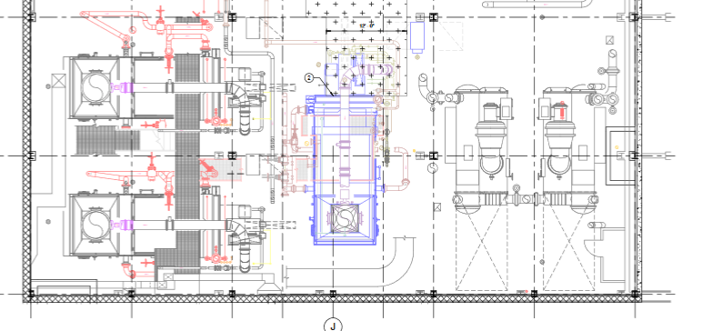
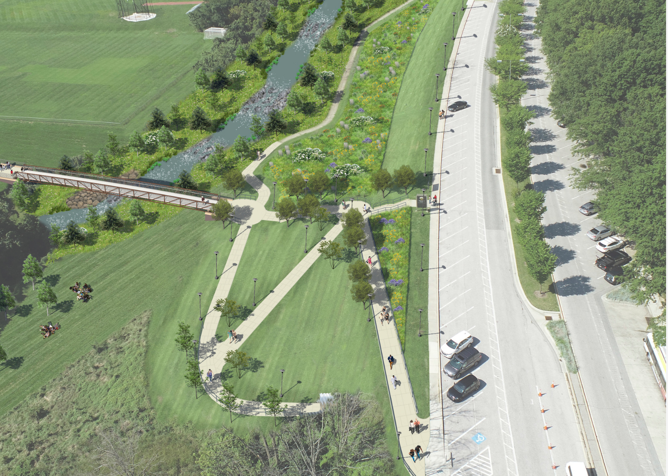
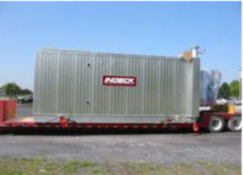
Current Construction
Utility Upgrades and Site Improvements
On-going through April 2022
Improvements to campus infrastructure including:
Replacing boiler at the Central Plant
Replacing 5 electric distribution feeders and 4 building transformers (Mar-Aug 21)
Chilled water and High Temp Hot water repairs
Retrofitting pedestrian lighting with LED fixtures
Stream Restoration and Stormwater Management Improvements
Utility Tunnel repairs

Slide 14
Upcoming Construction
Spring through Summer Construction
Fine Arts and Sondheim Elevator Replacements
Mar – Sep 2021
Phased construction
Central Plant Roof Replacement
UC Roof Replacement
Bio Roof Replacement

Slide 15
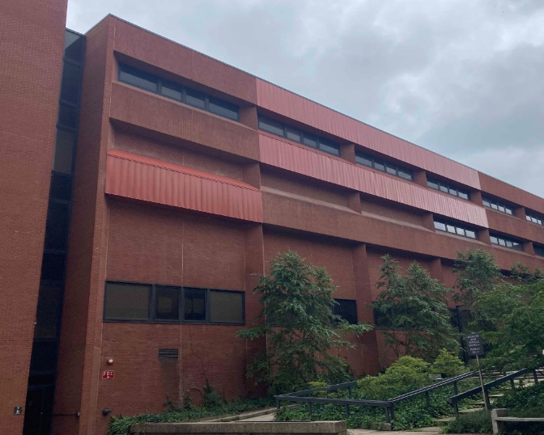
Upcoming Construction
Sherman Hall Façade Repair
Construction scheduled for May through August 2021
  Third phase of repairs focused on removing failing prefabricated brick panels and installing temporary panels to ensure pedestrian safety and prevent water infiltration

Slide 16
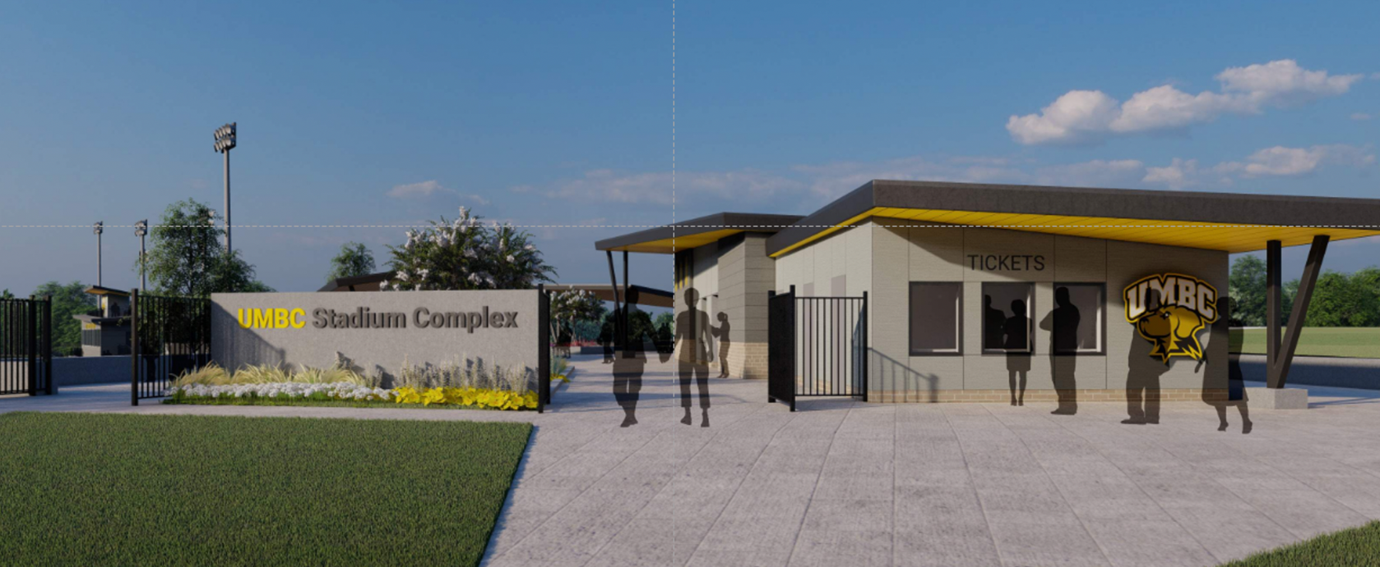
Upcoming Construction
UMBC Stadium Complex Upgrades
Construction June 2021 through August 2022
new press box
new lighting for Softball Stadium
new fan amenities building with
accessible restrooms
new stadium accessible seating
improved security and access

Slide 17
Future Projects
TRC Accessibility Upgrades
  Improving accessibility of the Technology Research Center is planned by providing:
  New accessible entrance, route and parking area
  Renovated restroom and drinking fountain on ground level
  Mar – Jun 2021

Slide 18
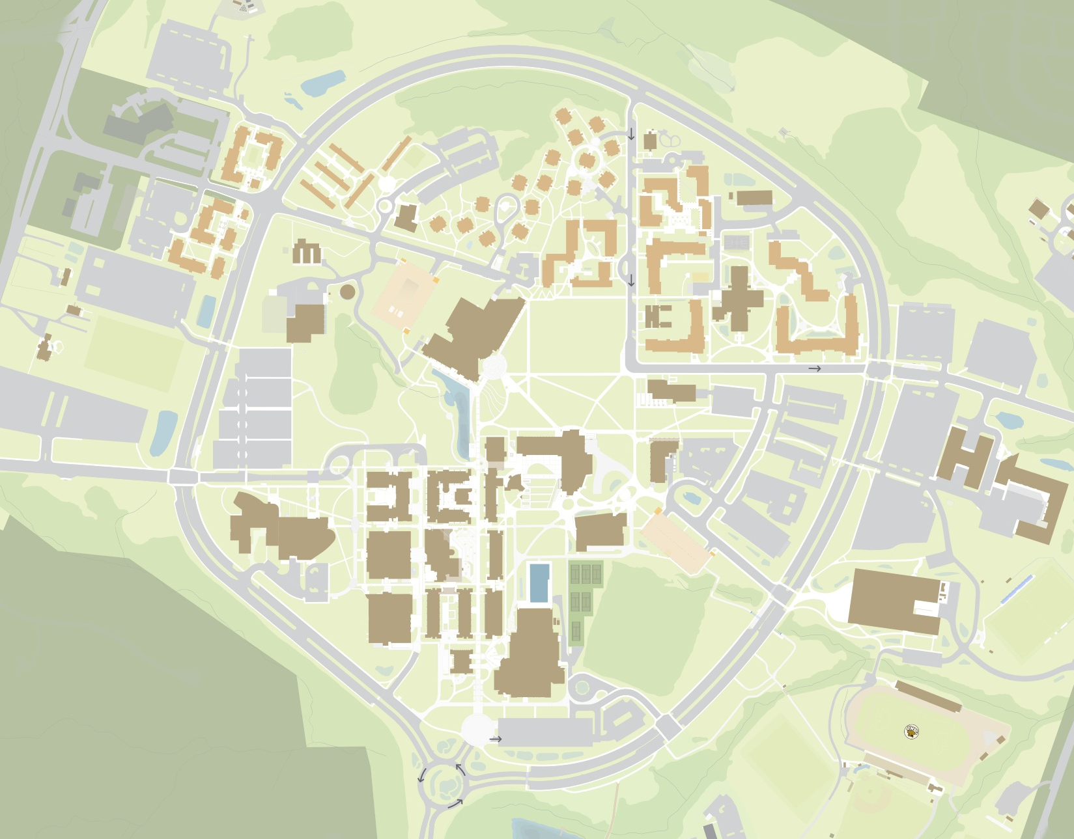
RAC renewal
Biological Sciences accessibility upgrades
New Health Services and Counseling Bldg
Sherman Hall façade repairs
UMBC Stadium Complex upgrades
True Grits roof replacement and equipment upgrades
Central Plant, University Center, and Biological Sciences Bldg roof replacements
Sondheim and Fine Arts elevator upgrades

Slide 19
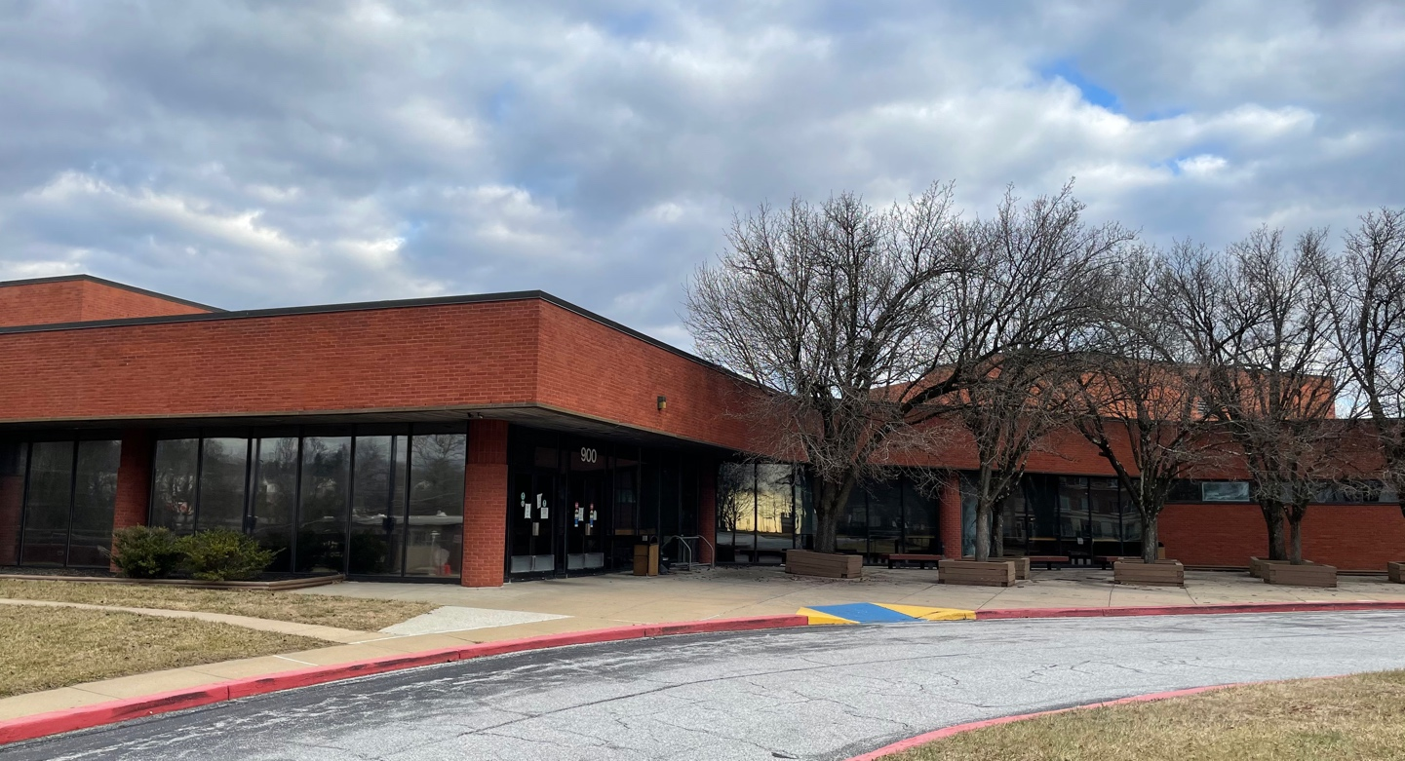
New Facility
Courthouse
  Prepare recently acquired Baltimore County Courthouse for new uses by:
  Establishing best use of building with priority given to plans that expand our capacity in high-demand academic programs
  Evaluating condition of building systems
  Upgrading finishes, completing repairs and making modifications for new uses

Slide 20
Questions
For more information
Facilities Management website
https://fm.umbc.edu
Join the Facilities Management Group
https://my3.my.umbc.edu/groups/fm

Slide 21
Campus COVID Update
Campus COVID Update
Chief Paul Dillon

Slide 22
Contact Response Team (CRT)
Paul Dillon
pdillon@umbc.edu
410-707-6012

Slide 23
Introduction
Campus COVID Update
The CRT was designated by the University to respond to COVID-19 related cases.
The team was formed in August of 2020.
The team operates under the Incident Command Structure (ICS).

Slide 24
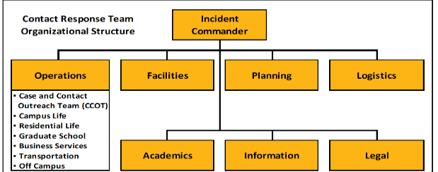
CRT Structure
Campus COVID Update

Slide 25
CRT “Triggers”
Campus COVID Update
COVID Intake Form-public facing.
Daily Symptom Monitoring Form-UMBC only.
Verbal or email notification from an individual.
Notification from the Health Department.

Slide 26

Prioritization
Campus COVID Update

Slide 27
Timeliness
Campus COVID Update
Key to success of team.
No community spread identified in fall.
Acting before contact tracers from the County Health Department can.

Slide 28
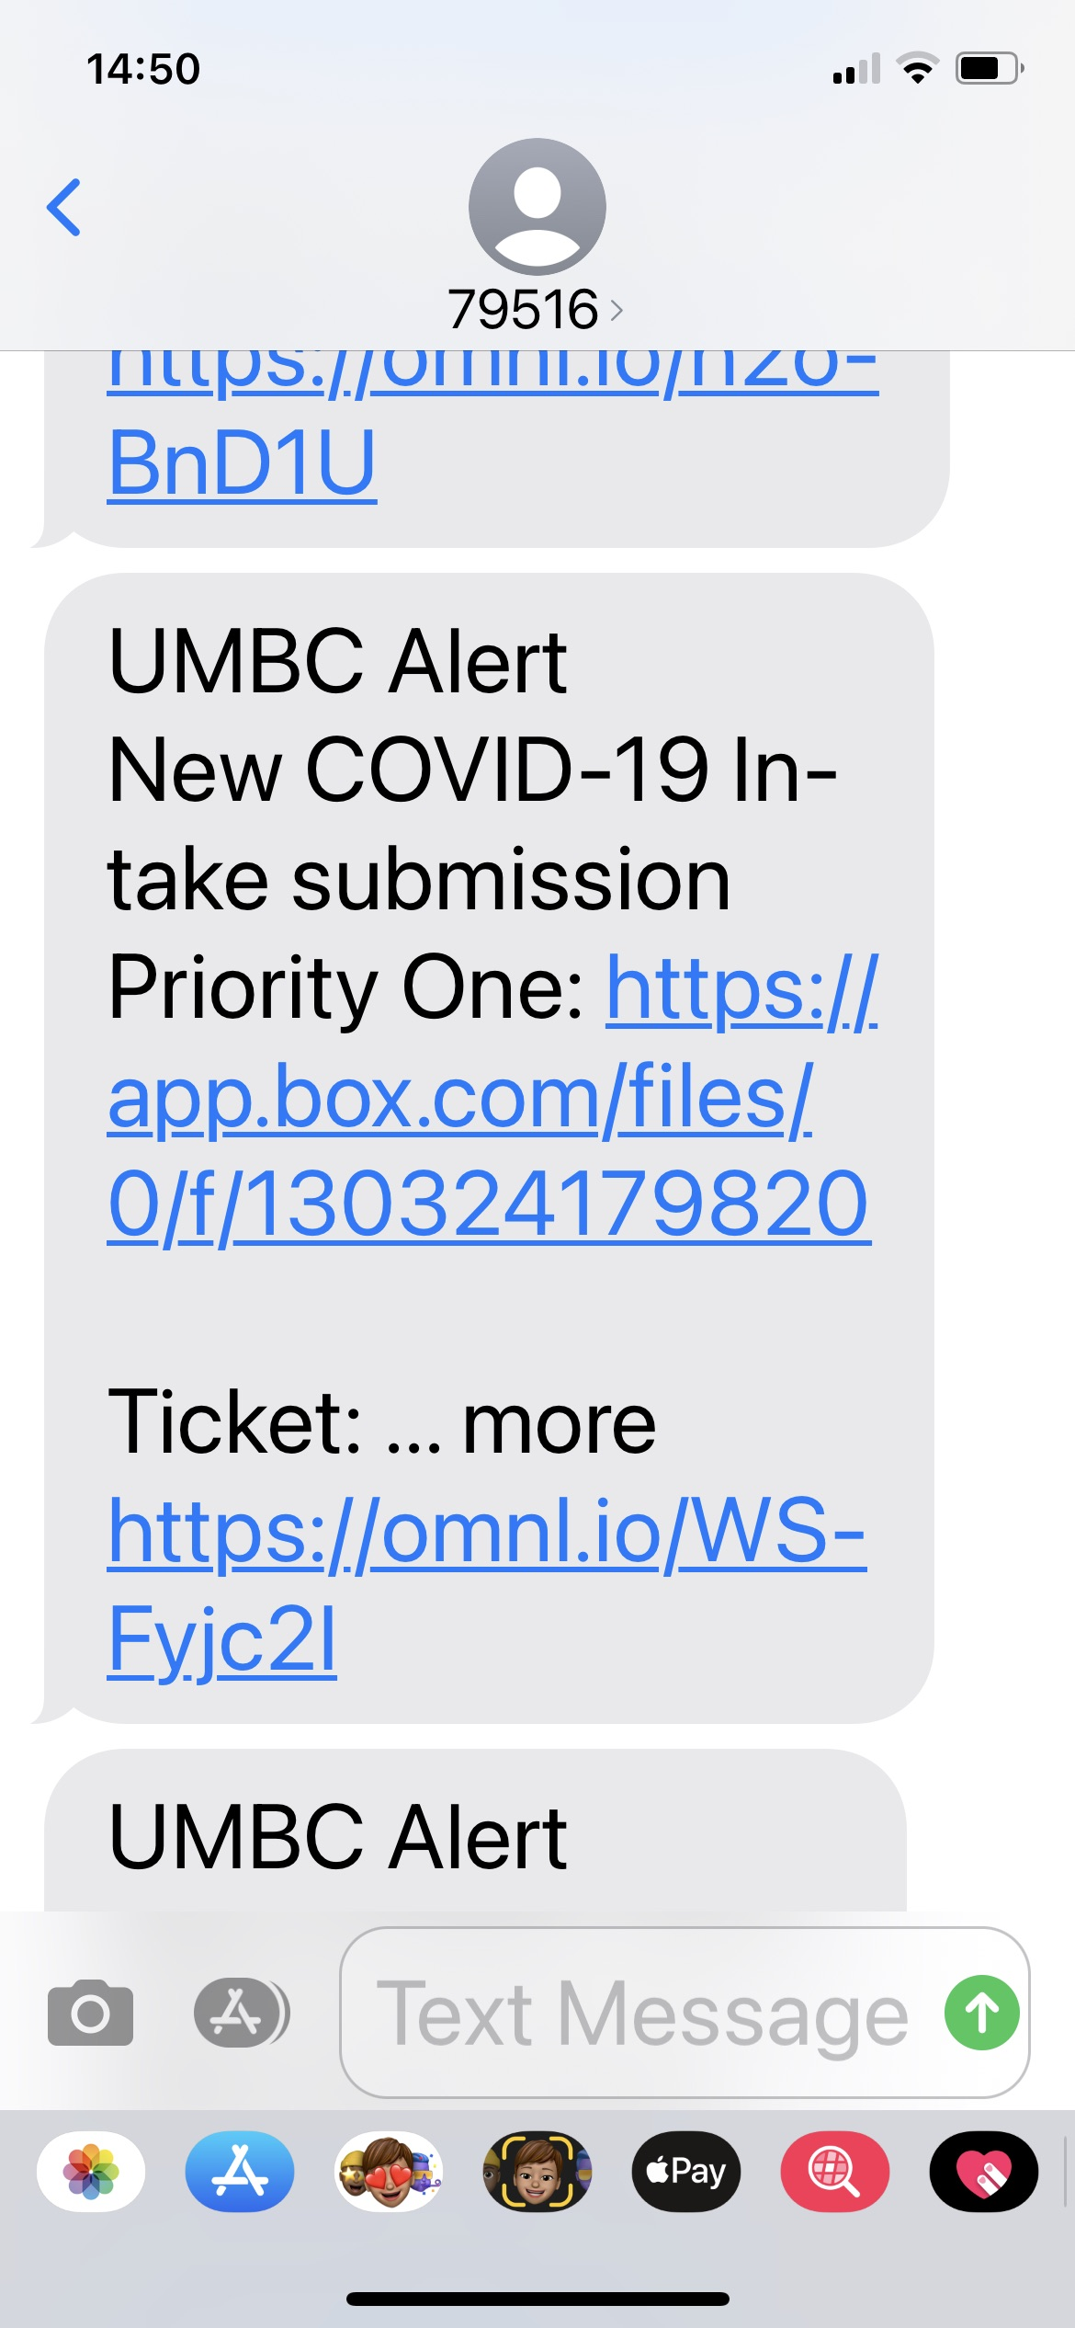
Text Alerts
Campus COVID Update

Slide 29
Response
Campus COVID Update
UHS team contacts reporter to conduct interview.
Close contacts are identified and contacted.
Appropriate advice is given from the health professionals.
If positive and on campus, locations they visited are determined.
Facilities and Logistics sections coordinate for mitigation.
Residential Students moved to isolation or quarantine.
Operations supports students who are in isolation of quarantine.
UHS follows up with individuals daily.

Slide 30
Budget Overview and Outlook
Budget Overview & Outlook
Kristy Michel

Slide 31
FY21 and FY22 Budget Update
BAM
February 2, 2021

Slide 32
FY 2021 Budget Update
Preliminary FY 2021 planning indicated a budget shortfall totaling $65 million.
State Support shortfall - $23 million
Auxiliary shortfall - $42 million
2

Slide 33
State Support budget balancing strategies included:
Elimination of vacant positions
Temporary hiring freeze
Temporary salary reductions
Reduction in operating expenses (utilities, facility renewal, travel, supplies, etc.)
Elimination of planned budget enhancements
USM authorized reduction in debt service payments and fund balance goal
3

Slide 34
Auxiliary budget strategies:
Temporary hiring freeze
Temporary salary reductions
Reduction in operating expenses
Shift of expenses from operating budget to Plant Fund
Deferral of planned revenue transfers from operating budget to Plant Fund
Remaining Auxiliary deficit totals $18.3 million.
4

Slide 35
Working Budget includes $18 million use of unrestricted fund balance, primarily to balance Auxiliary Budget.
Updated Auxiliary projection indicates FY 2021 deficit closer to $34.5 million.
Changes include:
  Reduced mandatory fees in Fall AND Spring semesters
  Housing occupancy does not increase in spring semester
  Further reductions in dining sales
Auxiliary budget projections also assume additional savings in salaries and operating expenses, beyond what was included in the Working Budget.
This amount will need to be offset with further savings in State and Self Support operating budgets.
5

Slide 36
FY 2021 State Appropriation
FY 2021 State Appropriation = $145.0 million
Our State Appropriation includes two funding sources from the State:
  State General Funds - $137.9 million
  Higher Education Investment Funds - $7.1 million
6

Slide 37
FY 2022 – Governor’s Budget
Governor Hogan introduced his FY 2022 Budget on January 20, 2021.
The Governor’s Allowance includes $144.5 million for UMBC
  State General Funds - $137.0 million
  Higher Education Investment Funds - $7.4 million
7

Slide 38
FY 2022 – State Funding Adjustments
FY 2022 Adjustments to our State Appropriation:
  Reinstatement of Unemployment Insurance - $352,710
  Health Insurance and other Fringes - $325,893
  Second Year of Mpower funding - $400,000
  Reduction - $1.6 million
8

Slide 39
Governor's FY 2022 Budget
In total, our appropriation is $539,466 less than the adjusted FY 2021 appropriation.
However, $1.6M less is available for FY 2022 budget planning compared to the adjusted FY 2021 appropriation (after accounting for offsetting increased costs in unemployment insurance, health insurance, and Mpower).
9

Slide 40
10

Slide 41
Potential Risks
The introduction of the Governor’s Budget is the starting point for the State Budget process. The General Assembly will deliberate and pass a final budget in April. The General Assembly is only allowed to reduce the budget.
The State is required to maintain a balanced budget → if actual revenues fall short of current projections our budget could be cut.
Over the last year, there have been significant fluctuations in corporate income tax returns and projections. If revenue falls short of current estimates, the State is not required to backfill any losses in the HEIF with other State funds.
Funding for the 2% COLA, effective January 1, has not been allocated.
The other largest component of the State Support budget is tuition revenue → Enrollment and tuition rates will also have an impact on the bottom line.
11

Slide 42
Other FY 2022 Considerations
FY 2021 budget balancing plan included temporary salary reductions and the hiring freeze. Colleges and Divisions will need to identify base reductions beginning in FY 2022 to cover these one-time reduction amounts.
The FY 2021 State Support budget is trending better than anticipated. This is in part because we are seeing more pandemic related savings than projected in areas such as personnel, travel, office supplies, and utilities.
Many of these costs will return in FY 2022 → Opportunity to re-think pre-pandemic practices and generate these savings in FY 2022 and beyond.
12

Slide 43
Capital Budget
The FY 2022 capital budget includes $6.9 million for utility upgrades on campus.
The Governor also announced $21.2 million will be made available in FY 2021 for “shovel ready "capital maintenance projects at USM institutions.
Allocation of the $21.2 million is forthcoming.
13

Slide 44
Financial Services Highlights
Financial Services Highlights
Gayle Chapman
Rebecca Struckmeier
Jared Fincke

Slide 45
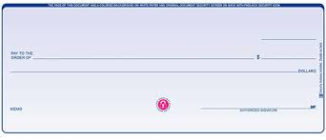
What is EFT/ACH direct deposit?
EFT/ACH Initiative
EFT = Electronic Funds Transfer, an electronic deposit to a payee’s bank account
ACH = Automated Clearing House, an electronic network for financial transactions
Essentially, we request the State to make payment to a vendor on an invoice, and the payment is deposited directly into the vendor’s bank account.
NO PAPER CHECKS!

Slide 46
Benefits of EFT/ACH payments over
EFT/ACH Initiative
Eliminate delays due to the Postal Service
Prevent a check being mailed to an incorrect or incomplete address
Allow for the opportunity for vendors to receive greater payment detail relating to each payment

Slide 47
EFT/ACH Initiative
The State mailed over 15,000 checks to vendors this past year, compared to 9,000 EFT payments.
10,500 checks were mailed to vendors who received 20 or more checks per year, an increase of 7,300 checks over the prior year.
Of these checks, 8000 were mailed to “punch-out” suppliers, an increase of 7,200 over the prior year.
Goal of the EFT/ACH initiative: For all vendors receiving 20 or more checks per year to switch from checks to direct deposit.

Slide 48
EFT/ACH Initiative
Phase I: Market to punch out suppliers
Procurement assisted in reaching out to punch out suppliers. Target new vendors when joining.
5 of 7 suppliers receiving checks already responded positively = 7,200 fewer checks per year, nearly 100% of increase, 50% of total checks issued.
Phase II: Market to remaining vendors receiving 20 or more checks per year
Target new vendors when joining, target existing vendors through email and website marketing and assistance from campus partners
Success = <5,000 checks, >20,000 EFT/ACH!!

Slide 49
Chart of Accounts
Chart of Accounts
  Review Policy & Procedures
    Current Accounting Practices
    Define Existing Accounts / Create New Accounts
    Leverage Chart of Accounts for Reporting and Decision Making
  Future Communications
    Training
    Email Notifications
    Financial Services Website

Slide 50
HelioCampus Update
HelioCampus
What is it?
  HelioCampus integrates our data warehouse (Rex) with Tableau reporting tool
Where are we at?
  Student data reports are being created and tested now
  Finance side is just beginning the process of putting together a project plan
More information to come

Slide 51
Human Resources Updates
Human Resources Updates
Lisa Drouillard

Slide 52
Human Resources
Human Resources Updates
Business Processes Updates
eContract Expanded to all departments (Spring 2020)
https://my3.my.umbc.edu/groups/payroll/posts/94533
Automated Termination Process (Fall 2020)
  https://my3.my.umbc.edu/groups/payroll/posts/97613
Glacier for NRA/RA (Fall 2020)
Automated Concurrent Job Templates (Spring 2021)
Training
Retriever Recharge https://www.youtube.com/c/UMBCRecTV/videos
Audit (Leave & Payroll)
Leave Audit Acknowledgement
  https://my3.my.umbc.edu/groups/payroll/posts/98262
HR Partner Meetings Quarterly
HR Staff Update

Slide 53
Procurement Update
Procurement Update
Elizabeth Moss

Slide 54
Changes to P-card Processes Summary
Procurement Update
Reduced Paperwork for Initial P-card Request. It eliminates the need for extra departmental memos from person of next authority above the p-card supervisor.
Monthly Reconciliation- UMBC is moving from paper-based certification (i.e., wet signatures on required documents) to an all electronic format via DocuSign. P-cardholders will now be able to send their monthly p-card packages to their p-card supervisors for review and certification electronically. Procurement has arranged for all p-card users to gain access to their e-statement via US Bank's website instead of using paper statements. Procurement has also created new BOX folders for all p-cardholders to allow secure and centralized access/storage of their electronic monthly reconciliation packages.
Quarterly Supervisor and Dean/VP Certification Forms. UMBC has merged two quarterly forms (i.e., the supervisor certification to the Dean/VP and the Dean/VP’s certification to the PCPA) into one single form.
New P-card Training. P-card training is transitioning to Blackboard and will be available On-Demand. It is expected that the training will be available by the end of February.

Slide 55
Changes to P-card Processes Summary
Procurement Update
All Monthly Reconciliation changes go into effect on 2/1/21.
A link for the new Monthly DocuSign form and quick guidelines with how-to screenshots will be available on the Procurement website by 2/1/21.
A link for the new Quarterly DocuSign form and quick guidelines with how-to screenshots will be available on the Procurement website by the end of February/early March. This combined form does not go in effect until April, 2021.

Slide 56
Paw Fiscal Year to Date Snapshot
Procurement Update
2580 purchase orders have been issued of which 70% were processed within less than 1 day, and 98% within 5 days.
$9.5 million in purchase orders
62% of Contracts were created and fully executed within 7 days (just over 180 contracts)
8,720 invoices have been processed
$57.6 million has been invoiced, $31.1 million from a contract

Slide 57
Other Procurement Questions
Procurement Update
Temporary logistics
Reminders about Paw platform
Upcoming Paw roadmap

Slide 58

Questions
Questions
32

