Slide 1
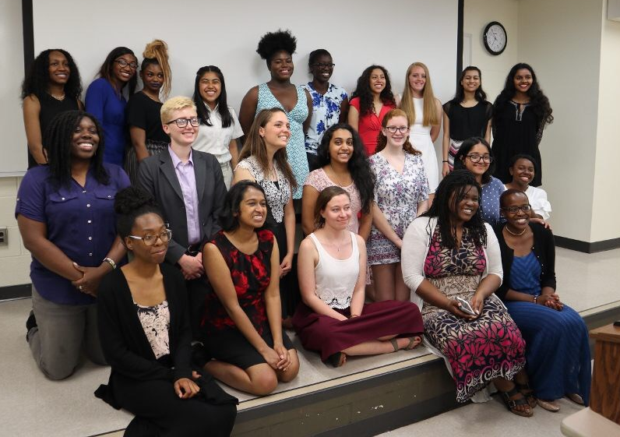
The REACH Initiative at UMBC
REACH promotes young middle and high school women interested in a career in STEM
Volunteers work closely with / mentor students once a week
Discuss issues that face women in STEM
Expose students to the different STEM fields through hands on projects
You can get PRAC 096 credit
One year commitment
Must complete a short application: https://docs.google.com/forms/d/1t3c1HmpVYrYec8yMyMJZ4nfXPS8nWlP4XeYcP2a4d0M

Slide 2
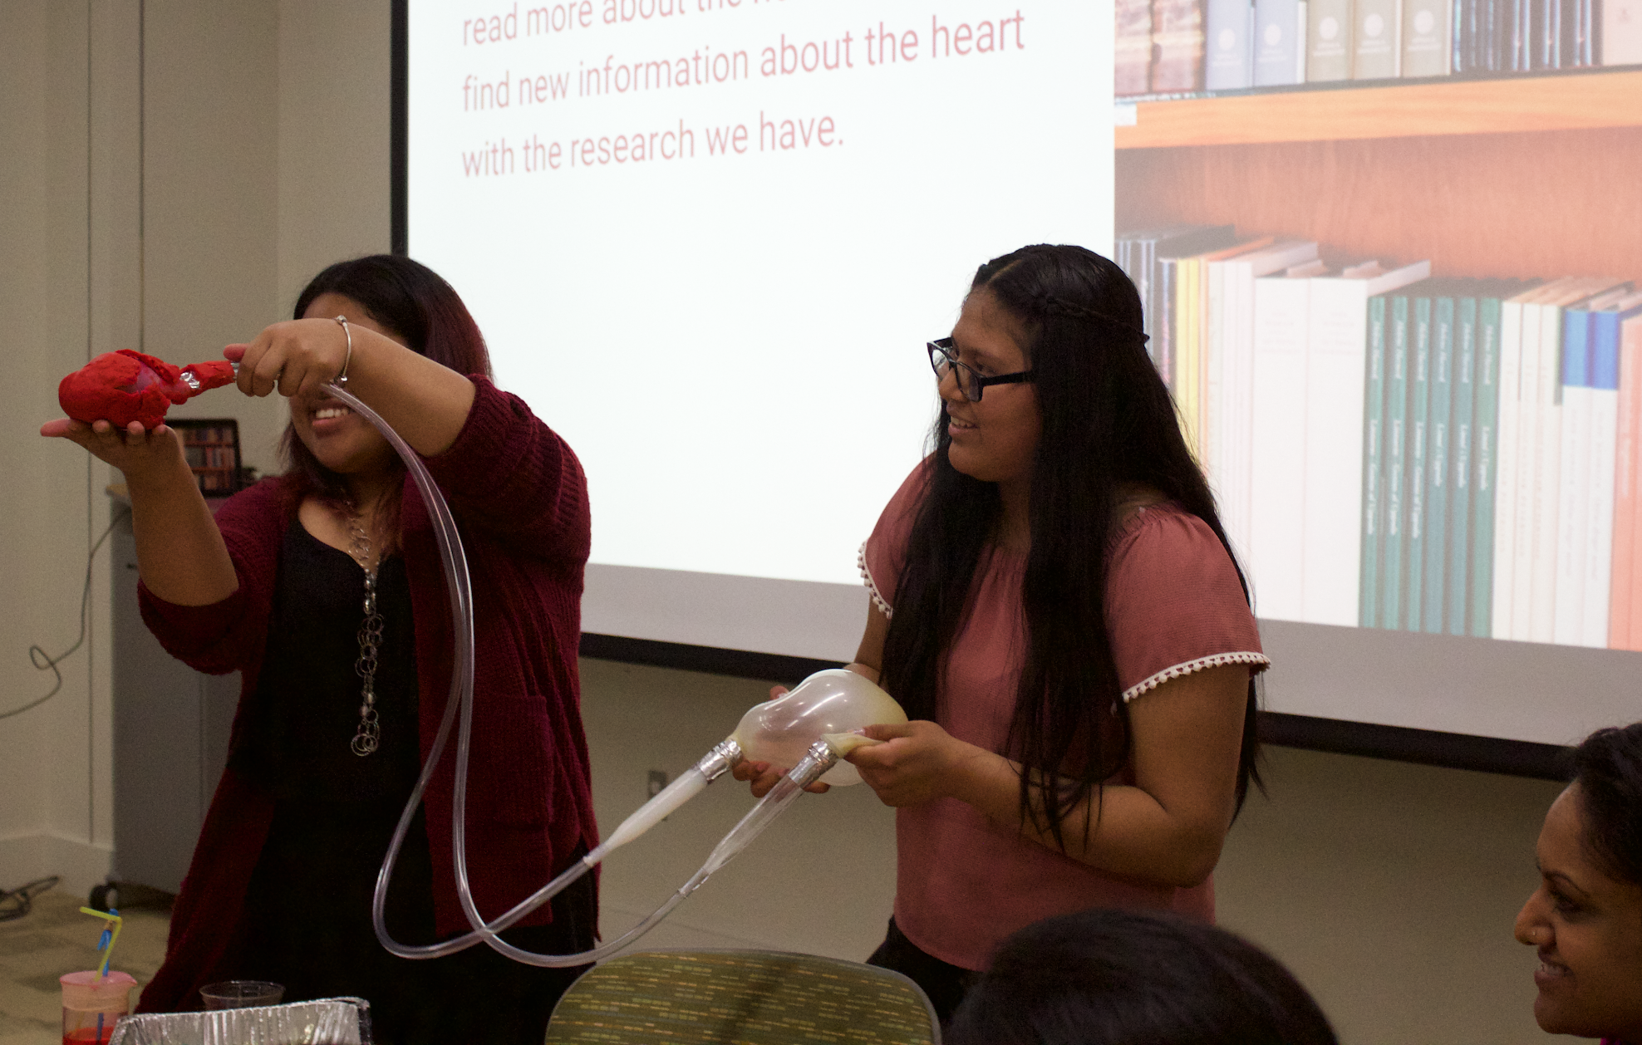
Schedule
Mentor Application due this Friday
Interviews take place the following week
Sessions are from Sundays from 2-5pm
Start date: Sunday, October 5

Slide 3
How You Can Get Involved
Be a Mentor!
Work weekly with mentees on workshops designed by the committees
PRAC credit
Join a Committee!
Plan out the workshops for the weekly mentoring sessions
No PRAC credit
Do both!

Slide 4
PRAC 096
3 hours per week
Listed on your transcript! (Pass/Fail)
Weekly discussion questions

Slide 5
Benefits of Joining Reach
Foster relationships with high school students
Conduct research with your mentee
Fine tune your mentorship skills
Service shown on your transcript
Leadership experience
Add a meaningful experience to your resume

Slide 6
Contact Info
Director: Chetana Jadhav (kl98735@umbc.edu)
Assistant Director: Sadia Rahman (rsadia1@umbc.edu)
Gender Empowerment Committee Chairs: Taylor Stephen and Malaysia McGinnis (taylor24@umbc.edu / mal6@umbc.edu)
STEM Committee Chairs: Shandon Amos and Nidhi Naik (shan21@umbc.edu / nnaik2@umbc.edu)
Fundraising Chair: Anastasiya Golikova(golikov1@umbc.edu)
Social Media: Like us on Facebook, instagram, myUMBC at The UMBC Reach Initiative!

