Slide 1
Introduction to the
UMBC Career Center
Susan Hindle
Assistant Director, Internships & Employment

Slide 2
Overview
UMBC Career Center Staff/Campus Location
Snapshot of Services
Introduction to UMBCworks
Employer Connections/Networking Events
Key Events (Spring 2019)
Next steps…

Slide 3
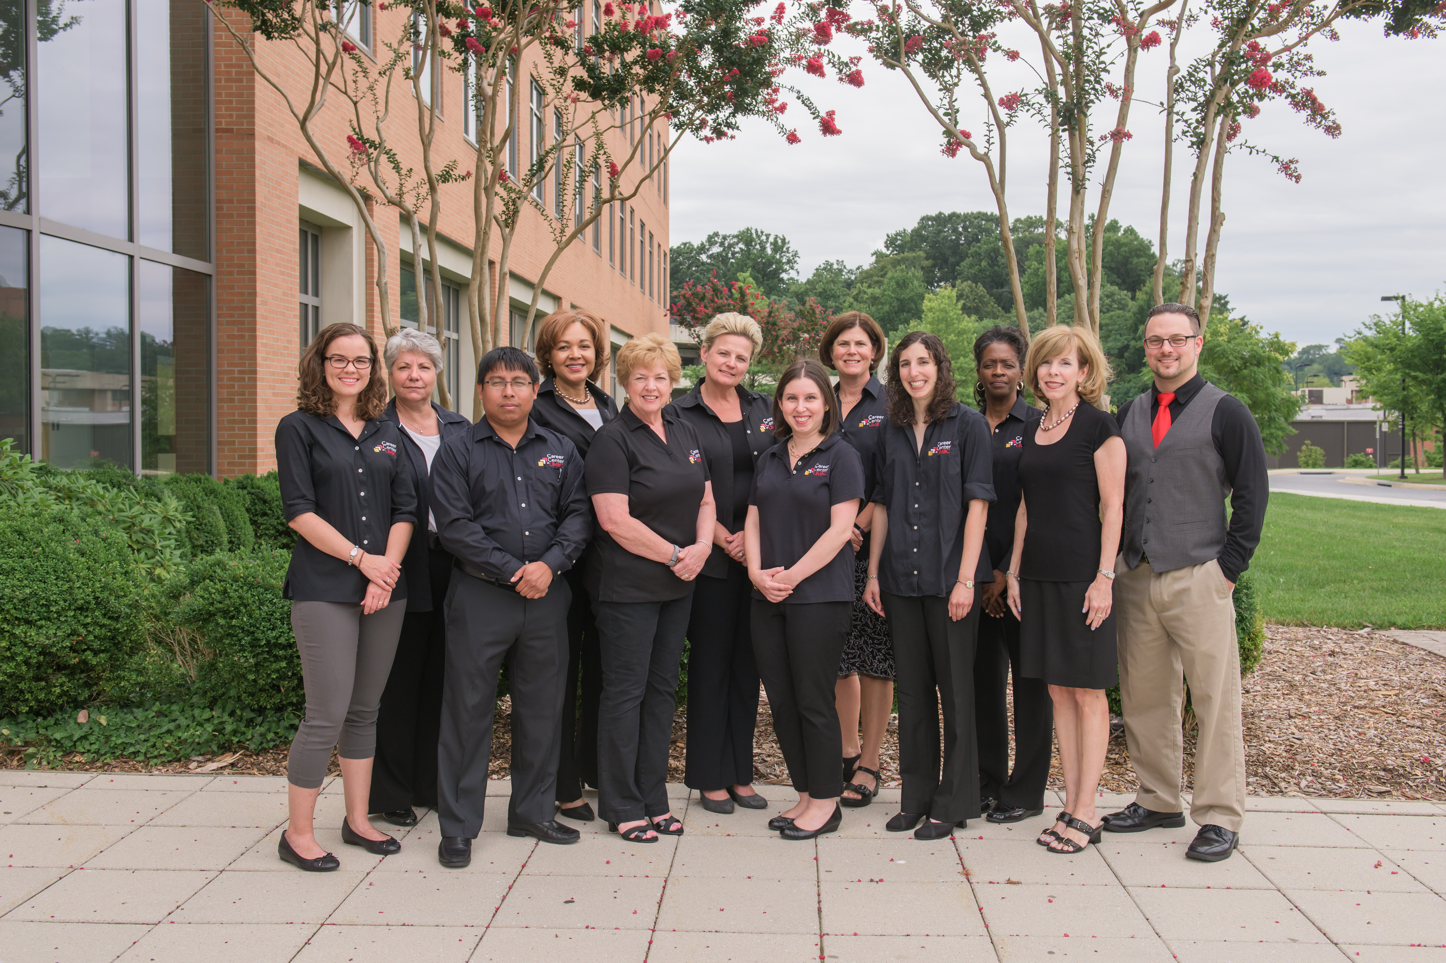
UMBC Career Center Staff
The UMBC Career Center aims to empower all students and graduates to create their own success stories.

Slide 4
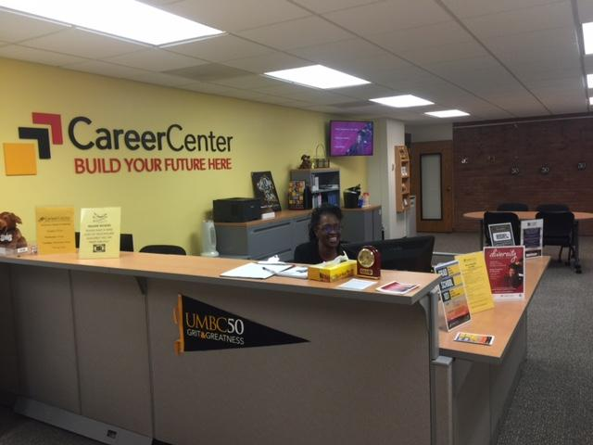
UMBC Career Center reception
Campus Location: Math/Psych. Bldg. – 2nd Floor
Hours: 8:30AM - 5:00 PM (M-F)
Website: careers.umbc.edu

Slide 5
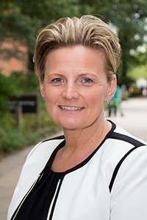
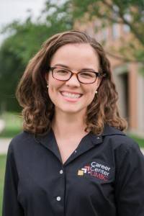
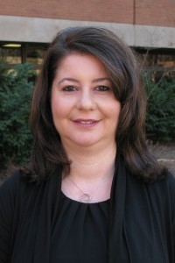
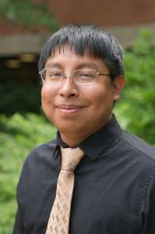
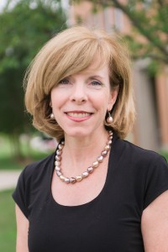
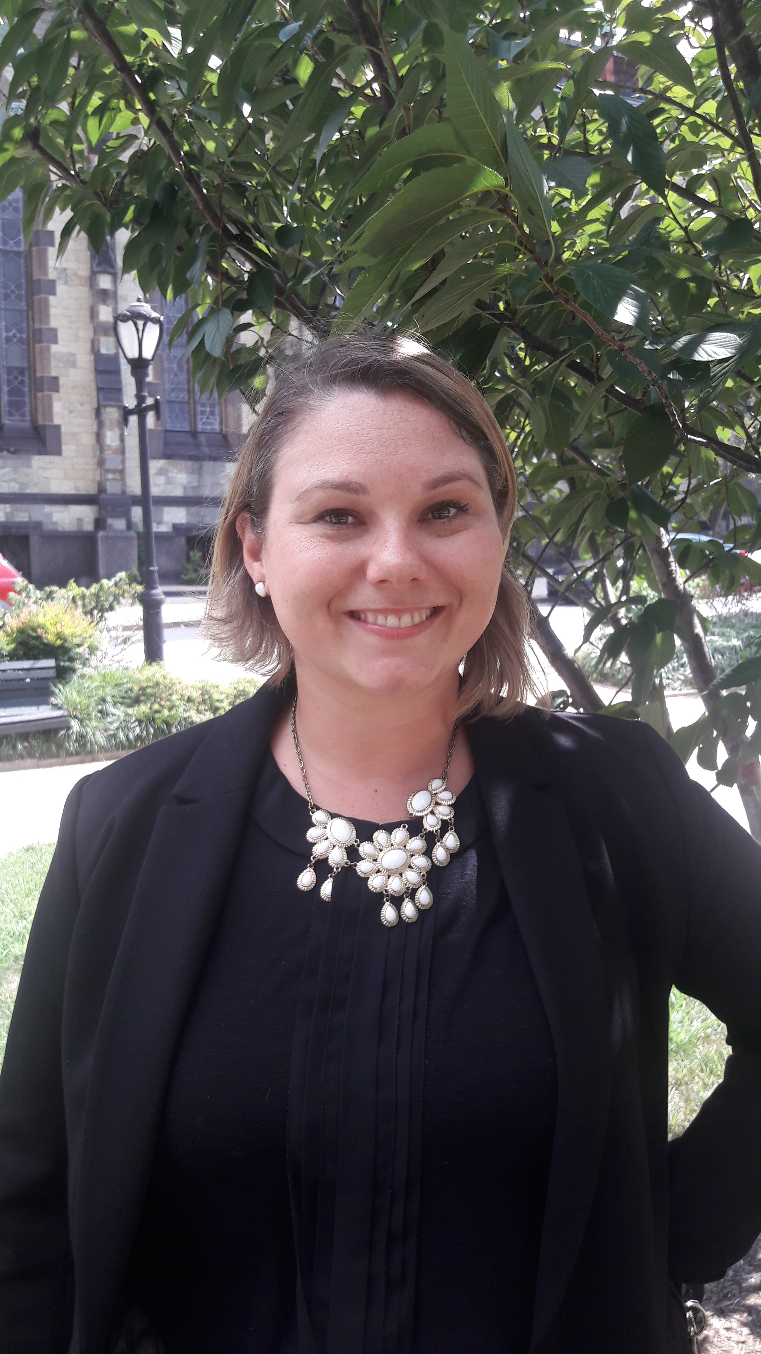
Internship & Employment Team
Christine
(Director)
Economics, BTA
Kacie
(Team Lead)
Arts & Hum.
Chrisi Engineering
Jeremiah
Social Sciences
Jen
Tech/IT
Susan
Sciences

Slide 6
Snapshot of Services
Document Preparation
(resumes/CVs, personal statements, cover letters)
Internship/Research/Job search assistance
Interview preparation service
Career workshops
Employer connections
Database of jobs, internships & research opportunities

Slide 7
UMBCworks
Database of internships/jobs
20K+ employers registered
Search/apply to positions 24/7
All students have personal accounts
Sign up for on-campus interviews
Schedule appointments with Career Center (online)
* IMPORTANT *
Must have an approved resume to apply to positions!

Slide 8
Positions Posted in UMBCworks
(2016-2017)
8,500+
Jobs, Internships & Research positions posted
By
2,228 unique employers

Slide 9
Career Center Events/Programs
UMBC Connects – (Wed., 11am-2 pm)
Meet with recruiters interested in recruiting UMBC talent
Employer Networking & Information Sessions
Held (mostly) in the evenings - 5-6:30 PM
Career Corners - (Thurs.10AM-2 PM) – Main Street
Get the Inside Scoop Series (Mon., 12-1 PM)
Industry-specific panels
Career and Internship Fairs (Fall & Spring)
On the Road Series – Fridays, 8:30-1 PM (Fall/Spring)

Slide 10
Employer Connections
697
Employer visits to connect with students
(2016 – 2017)

Slide 11
* Key Events for STEM majors*
Spring 2019
From Scientist to Serial Entrepreneur: An Unlikely Journey –
3/13 – 12-1 PM – UC Center
UMBC Connects: Employers in the Sciences – April 10
On the Road Series: (Friday – Off campus field trips)
  Chesapeake Bay Foundation – 3/8 – 8:30 AM – 1 PM
  Campbell & Company, Inc. – 4/12 – 11AM – 4 PM
  Oceaneering Int’l., Inc. – 4/19 – 9-12N
Mid-Atlantic Technology Showcase – 3/27 – 12:30-7:30 PM
(Biotech/Pharmaceutical Conference) – Off campus
Biotech Industry Day – 4/11 PM – 5 PM – 7 PM - Off campus

Slide 12
* Key Events - All Majors*
Spring 2019
Tips on Mastering the Job Search – 3/4 – 12-1 PM
Career Paths for Graduate Students – 4/3
UMBC Suits You: Clothing Closet – 4/3
Sweeten Up Your Network: Alumni-Student Networking – 4/4
What I Wish I Knew In College – 4/8
Intern to Full-Time – 4/22 – 12-1 PM
Relocating for Internships & Jobs – 4/25 – 12-1 PM
Grad School 101 – 4/30

Slide 13
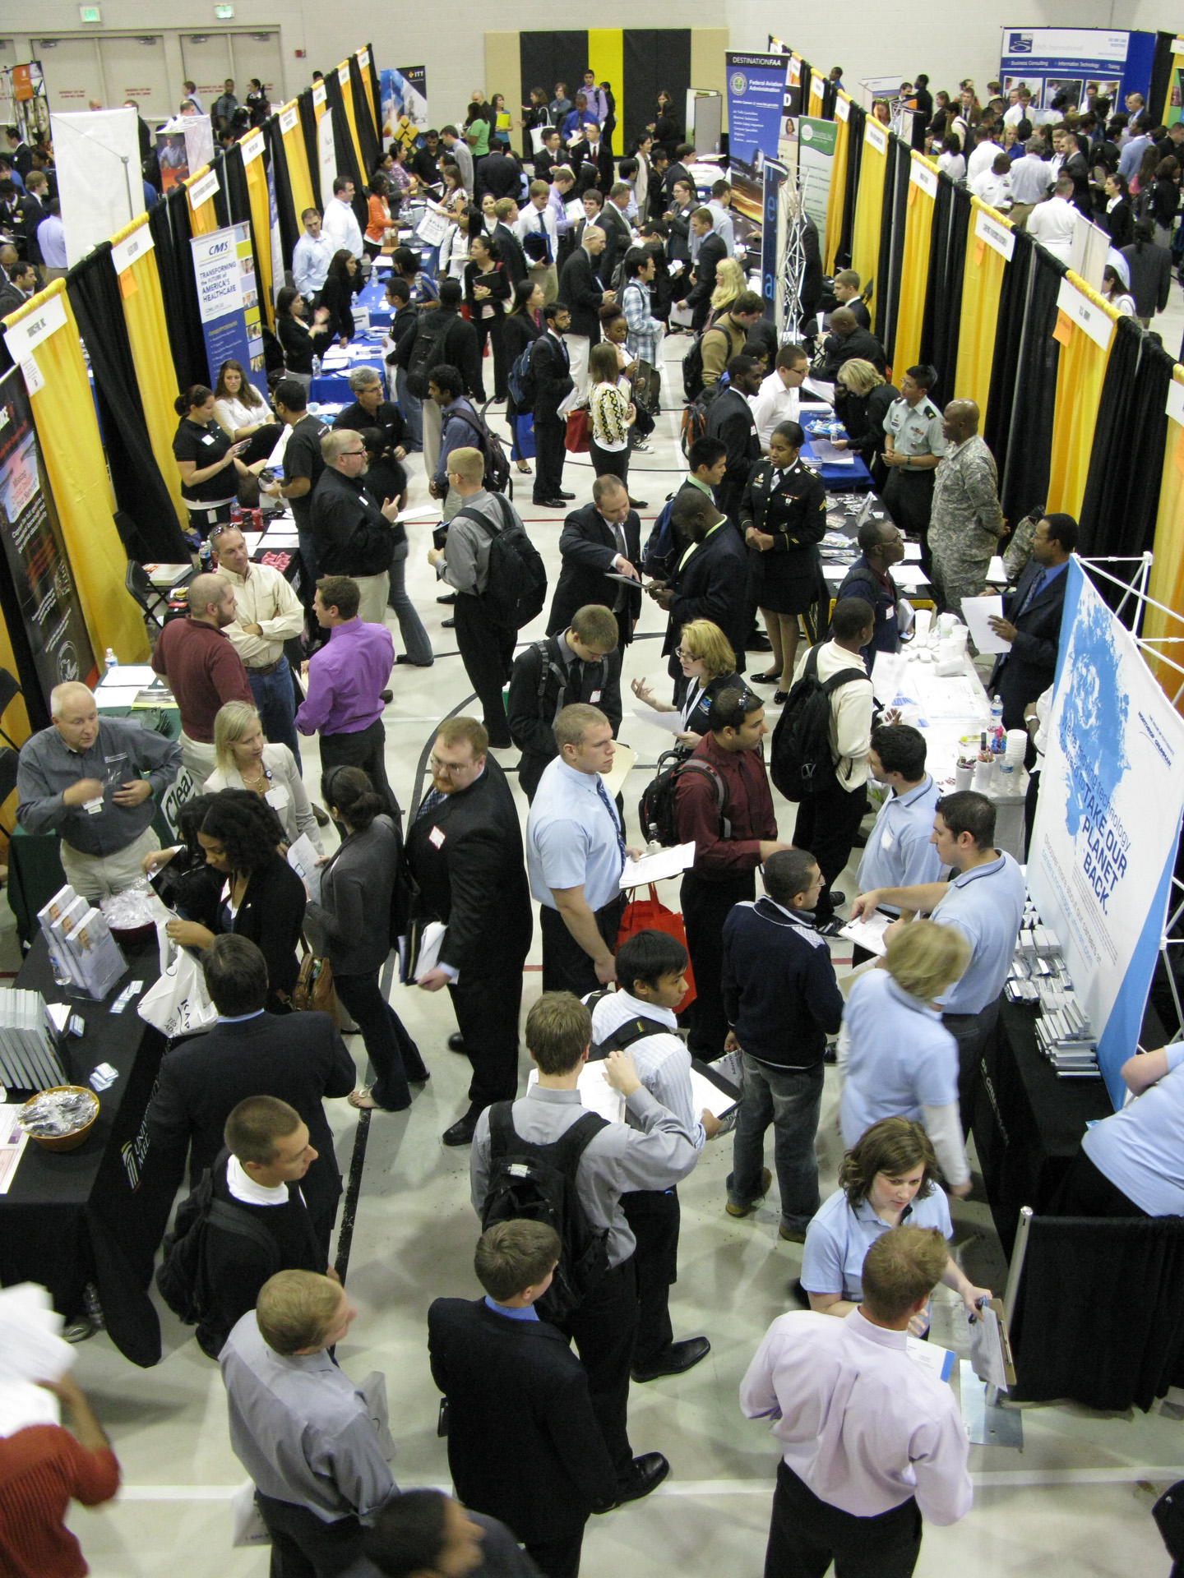
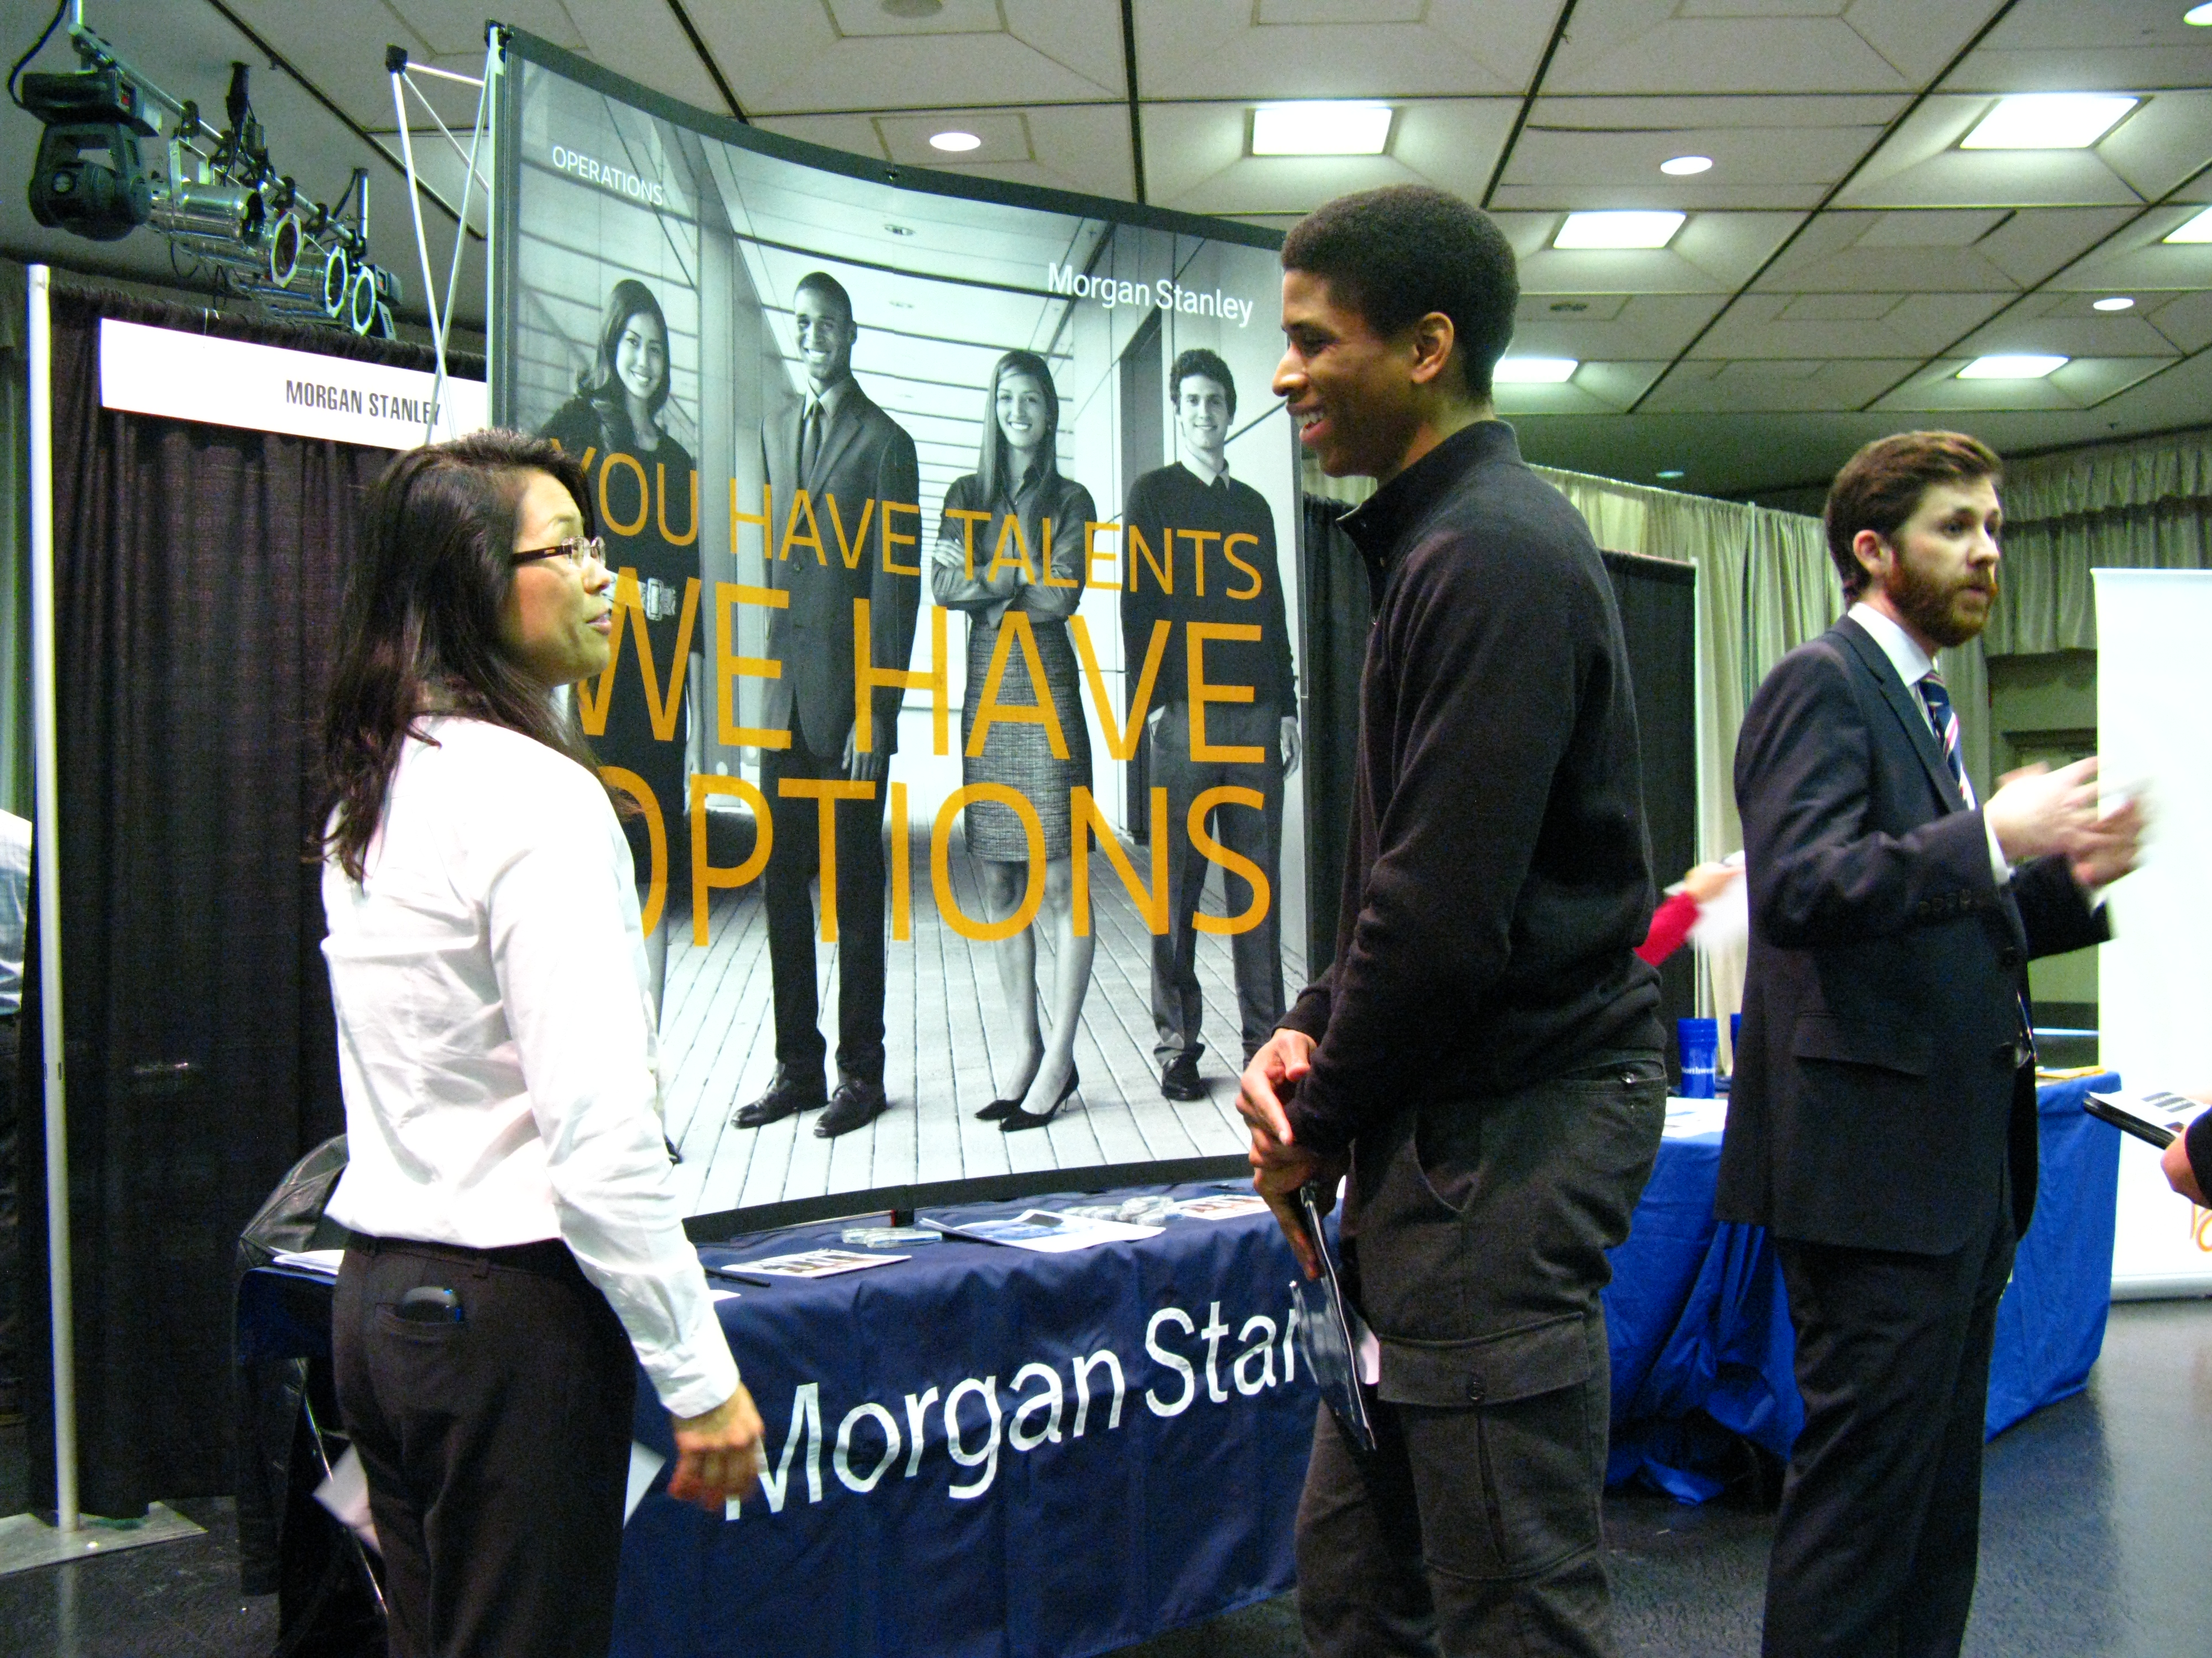
Networking Events/Career Fairs

Slide 14
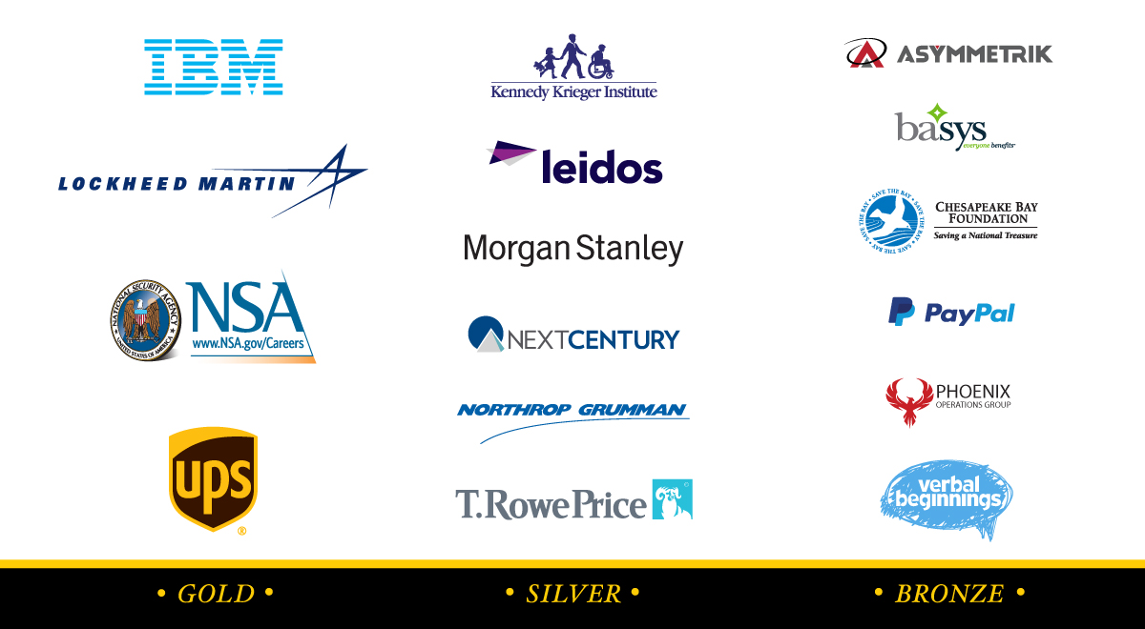

Slide 15
On-Campus Interviews
715
Employer on-campus interviews conducted
(2016 – 2017)

Slide 16
Virtual Interview preparation
* Big Interview *
(Virtual interview practice tool)
LEARN * PRACTICE * ANALYZE
Videotape your responses to pre-recorded questions
Review/rate your responses
Share them (professors/mentors, family, friends)
Forward them to Career Center staff and request a review
careers.umbc.edu/tools/big-interview

Slide 17
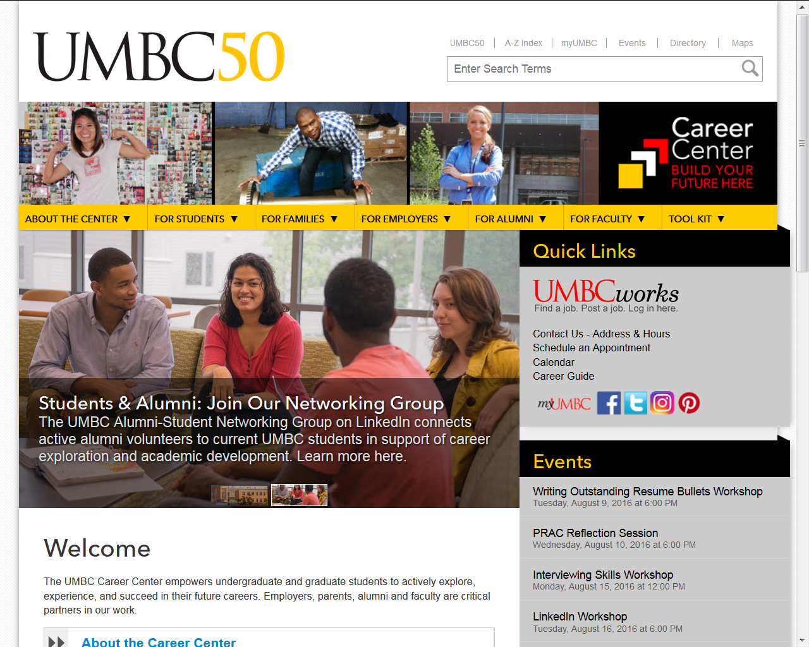
Career Center Website
careers.umbc.edu

Slide 18
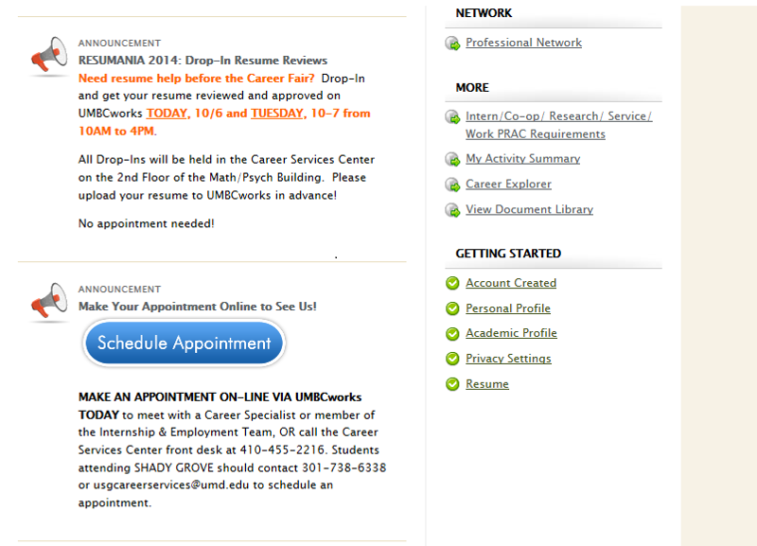
Schedule an appointment via UMBCworks
Login to UMBCworks
Click “Schedule Appointment”
OR
Call Career Center at 410-455-2216
Notes:
Susan look at this slide

Slide 19
Thank you!
Susan Hindle
Assistant Director, Internship & Employment
shindle@umbc.edu

