Slide 1
Biology Council of Majors GBM
12/2/19

Slide 2
Announcements
Christmas families
  “We have the gift drop off set up at the Social Work department, which is located on the third floor of Sherman Hall wing B. We ask that all the gifts be wrapped and labeled. Also, when you arrive just let Ms. Bridget the administrative assistant know who you are and the name of the family/students you bought presents for.” Adriane Coles is the guardian for our family, please deliver gifts by Monday, December 9th.
Dr. Wagner Lab Event
MBIO Courses (slide 3) https://my3.my.umbc.edu/groups/biol/posts/88590
Georgetown School of Medicine: Information on 2020 ARCHES Fellowship (slide 4)
Summer Research (slide 5)
BioEthics Debate Topic (slide 6)
If you want to run for an officer position for next year in BioCOM, you must attend at least 5 meetings/events
Don’t forget to do Course Evaluations!

Slide 3
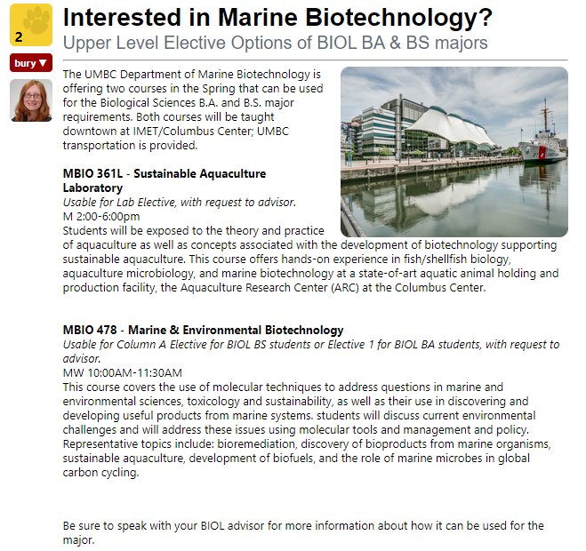
MBIO Courses

Slide 4
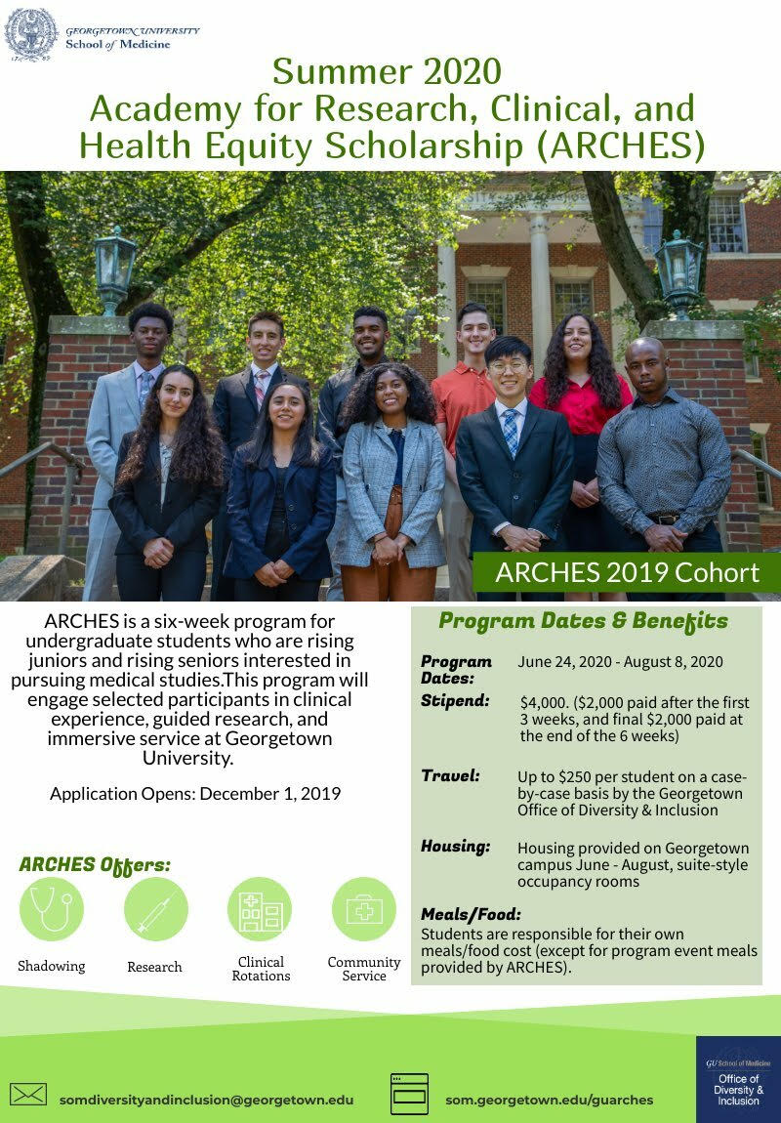
Georgetown School of Medicine: Information on 2020 ARCHES Fellowship

Slide 5
Summer Research
Interested in Summer Research?
Most summer programs have Jan. & Feb. application deadlines
Are you interested in applying for a Summer 2020 research experience? Many programs have January and February deadlines. Check with your advisor or the Career Center for assistance finding a program that is right for you.
A couple programs of interest:
  University of Buffalo's CLIMB UP: https://www.buffalo.edu/climb/climb-up/climb-up-details.html
  Cornell University's NSF-funded Microbial Friends & Foes Research Experience for Undergraduates (REU Summer Program: bit.ly/REU-CIHMID.
https://my3.my.umbc.edu/groups/biol/posts/88704

Slide 6
BioEthics Debate Topic
Personalized Medicine
Euthanasia (Death and Dying)
Nanotechnology
Environmental Pollution
Organ Donations
Genetically Modified Organisms/Genetic Engineering
Big Data and Privacy Rights
More?

Slide 7
Now for the Trivia!

Slide 8
Q: We start with the humble cell, the 'unit of life'. To which process of programmed cell death, often recognized by blebbing and DNA fragmentation, does the average human lose around 50 billion cells a day?
A: Apoptosis

Slide 9
Q: Which scientist was the first person to see bacteria?
A: Anton van Leeuwenhoek

Slide 10
Q: Which of these is a multi-cellular animal with no circulatory system, and hence no heart?
Amoeba
Paramecium
Butterfly
Jellyfish
A: Jellyfish

Slide 11
Q: What is the tubelike elongated mouthpart of a butterfly called?
A: Proboscis

Slide 12
Q: Ants have a hard outer shell on their bodies which acts as an exoskeleton and enables them to do what that seems remarkable to humans?
A: Lift 20 times their weight

Slide 13
Q: What type of skeleton do humans and most vertebrates have?
A: Endoskeleton

Slide 14
Q: Which part of the human eye contains receptors that detect light?
A: Retina

Slide 15
Q: Charles Darwin's process of natural selection is often described as being equivalent to which type of process, although he never used it himself?
A: Survival of the fittest

Slide 16
Q: Born in Sweden, he is known as the "father of taxonomy". Who is he?
A: Carolus Linnaeus

Slide 17
Q: Which pair of compounds can be classified as inorganic?
A: Water and Salts

Slide 18
Q: Water is the key to life, without it we simply wouldn't exist. It has certain properties that make the molecule so essential to biology such as its polarity and composition. What is responsible for water molecules having a higher boiling point than other molecules of a similar molecular weight?
A: Hydrogen Bonding

Slide 19
Q: What can children with the rare genetic disease phenylketonuria not eat?
A: Foods high in protein

Slide 20
Q: An _________ organism does not require oxygen for growth.
A: Anaerobic

Slide 21
Q: What is the substance cells use as an immediate source of energy for themselves?
A: Adenosine Triphosphate (ATP)

Slide 22
Q: What is the name of the pigment-containing organelles in autotrophs that collect light energy?
A: Chloroplasts

Slide 23
Q: All carbohydrates contain carbon, hydrogen and oxygen. All proteins contain carbon, hydrogen, oxygen and what other element?
A: Nitrogen

Slide 24
Q: In a human being, the organ of the body which carries out most of the digestion is which of these?
Stomach
Liver
Large Intestine
Small Intestine
A: Small Intestine

Slide 25
Q: What is the life process used by cells to produce energy (in the form of adenosine triphosphate, or ATP) for cellular activities called?
A: Cellular Respiration

Slide 26
Q: A second type of programmed cell death literally translates as 'self-devouring'. What is this process, the discovery of the mechanism of which won the Nobel Prize for Medicine in 2016?
A: Autophagy

