Slide 1
BioCOM Meeting 4/12
How to Read a Scientific Paper

Slide 2
Upcoming Events
April 16th (this Friday) - Bioethics Panel! 7-9 pm
April 26th - Next GBM: elections
Notes:
Why do we care? Science has created the tools through which we conduct chemical, nuclear, and biological warfare.
How do we fight? Dr. Hilleman offers the engagement of biological sciences to detect, avert, prevent, and treat.

Slide 3
Elections
Google form with position descriptions will be sent out later today. Submit by 4/25
Must give speech at next meeting or send a video beforehand
Notes:
Why do we care? Science has created the tools through which we conduct chemical, nuclear, and biological warfare.
How do we fight? Dr. Hilleman offers the engagement of biological sciences to detect, avert, prevent, and treat.

Slide 4
Introduction
Biowarfare - the direction of bioweapons against the military
Bioterrorism - the direction of bioweapons against civilians
Why should scientists care about either?
How do we fight these weapons?
Notes:
Why do we care? Science has created the tools through which we conduct chemical, nuclear, and biological warfare.
How do we fight? Dr. Hilleman offers the engagement of biological sciences to detect, avert, prevent, and treat.

Slide 5
Historical Overview: WWI
Most prominent use of biological weapons in WWI was by Germany against livestock and animal feed, but not against people.
After WWI, the League of Nations produced the Geneva Protocol which banned the use of biological weapons in warfare.
However, this was a weak treaty since it never expelled the stockpiling and research of biological weapons.
During their military campaign in China in 1932, Japan extensively used bioterrorism and biowarfare to:
Infect water and food supplies
Release plague-infected bugs
Deliver infectious agents by aircraft

Slide 6
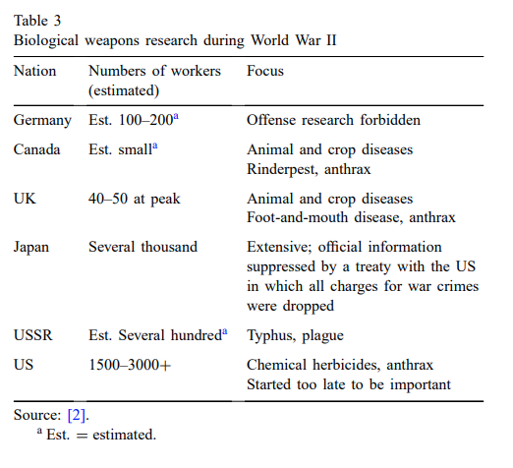
Historical Overview: WWII
Japan continued its extensive use of biological weaponry, which began in 1932. The initiative was “huge” as it had thousands of workers.
Japanese biological weapons included the delivery of plage, cholera, typhoid, anthrax and other pathogens.
Exact figures are suppressed.
United States performed biological weapons research with thousands of workers.
“Importantly, the available intelligence information collected during World War II was unreliable and often dubious”.

Slide 7
Historical Overview: Post WWII
The Biological Weapons Convention treaty prohibited the stockpiling of biological weapons, their production and their development.
However, it did not provide criteria which separates defensive and offensive biological weapons research.
It also does not have provisions for on-site inspections.
It was “toothless” in terms of enforcement.
The USSR had a massive biological weapons initiative with about 60,000 workers.
They developed 10-12 biological agents.
An incident occured at the weapons site of Sverdlovsk, causing the release of anthrax into the surrounding area. The death toll likely numbered into the hundreds.

Slide 8
Historical Overview: Post WWII
Iraq was also a major developer of biological weapons and could still be pursuing such research.
After the Persian Gulf War, the United Nations performed inspections for biological weapons. But, in 2002, these inspections were deterred.
The implementation of a “toothful” BWC has brought complications:
In 1992, the UK, US and Russia entered into a trilateral agreement which allowed representatives from the participating countries to visit each other’s plants.
This resulted in fake accusations by a Russian reports that a Pfizer plant in Indiana was undertaking biological weapons research. This was coupled with intrusive inspections of the plant.
Notes:
Quote source: https://en.wikipedia.org/wiki/Biological_Weapons_Convention#Implementation_Support_Unit

Slide 9
Genetic Modification of Microorganisms
Genetic modifications to existing microorganisms create limitless possibilities for biological weapons, and has been in pursuit since before 1993 by the USSR.
Modification of these microorganisms can lead to strains of viruses that affect even previously resistant individuals, as well as increasing their lethality.
Notes:
Many biological weapons stem from pre existing viruses and microorganisms. Research going into creating

Slide 10
Tools for Defense Against Bioweapons
Bioweapon defense consists of both scientific and diplomatic methods.
Scientific means include:
Prophylactic and Therapeutic Vaccines
Antibiotics and Antivirals
Antibodies
Biodetection/elimination of bioweapon pursuits
Diplomatic efforts:
International espionage
Instrumentation for detection and analysis
World community negotiations

Slide 11
Assessments for Comparative Lethality and Relative Importance of Bioweapons Agents
WHO ranked killing capacity for bioweapons agents: anthrax and tularemia most deadly
Treatment methods:
Antibiotics - problems with antibiotic resistance and purposeful engineering
Antivirals - not effective
Antiviral vaccines - focus on polyvalency and ease of distribution
Passive therapy by antitoxins - immediate therapy after exposure
Neglected opportunity: stimulation of innate immune system

Slide 12
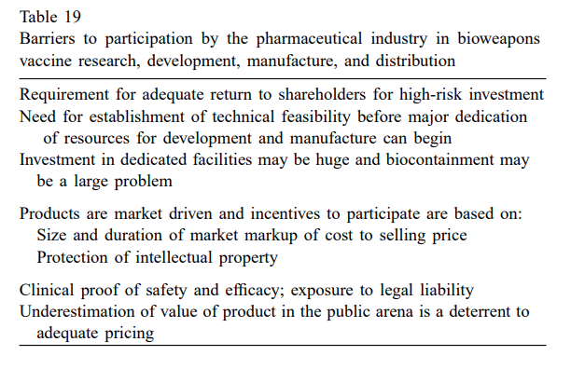
Venues for Vaccine Development
In terms of vaccine development, public pharmaceutical companies might seem a logical source. However, there are barriers that prevent their participation in the fight against bioweapons.
One being that they require a return for their stockholders for such high-risk investments. The public may also not want to buy a vaccine against an infectious agent that they may never be exposed to.
A solution to this may be that government should develop its own facility dedicated to research, development and production of vaccines for military needs.

Slide 13
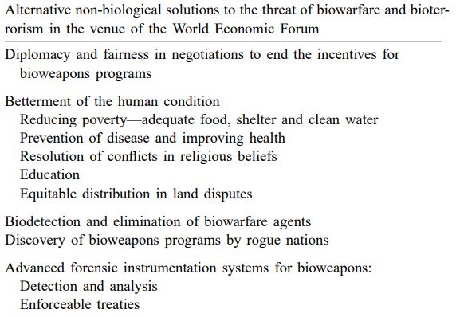
A View to the Future
Warfare, the weapons by which we conduct it, and the diplomacy by which we avert it are often outdated. Instead of focusing on war, the narrative is shifting towards its prevention.
The World Economic Forum proposed three causes of biowarefare and terrorism:
Poverty, health and hunger.
Division of belief systems.
Inadequacy of microbial detection.
World Economic Forum
Notes:
Warfare in particular is outdated due to the low benefit to cost ratio, and the use of diplomacy itself to end conflict is outdated.
The World Economic Forum, founded in 1971, brings together business leaders, political leaders, economists, celebrities, and journalists each year to discuss global issues. Following the September 11th attacks on the World Trade Center, this forum gathered to discuss biowarfare and the root causes of terrorism.

Slide 14
A View to the Future
A call for biodetection initiatives, focusing on the identification of bioweapons through:
PCR Analysis
Immunologic identification
Phenotype and genotype analysis
“...the Nation remains unprepared for bioterrorism and biological warfare with catastrophic consequences. Worse, current efforts to develop needed technology to detect the biological threat are insufficient and going in the wrong direction.” - Dr. Asha M. George, Executive Director of the Bipartisan Commission on Biodefense (2019)
Bipartisan Commission on Biodefense
Notes:
Our largest deterrent to detecting the use of bioweapons has been our lack of ability to enforce treaties such as the Biological Weapons Convention.
This article was published in the summer of 2002. 17 years later, the Bipartisan Commission on Biodefense, a committee composed of former high-ranking government officials, called the development of technology "insufficient and going in the wrong direction"
Wrap up by mentioning the BioEthics panel this Friday

