Slide 1
Welcome to BioCOM!!
Fall 2020
Please put your email in the chat for sign-in

Slide 2
Executive Board Introductions
President:
Faith Wobbeking
faith3@umbc.edu
Secretary:
Mia Joseph
miaj1@umbc.edu
Lab Tours Chair
Jon Sikora
jonsik1@umbc.edu
Treasurer:
Sarah Jang
sjang2@umbc.edu
Events Chair:
Dante Washington
dantew1@umbc.edu
Public Relations Chair:
Zakarya Wahed
zakaryw1@umbc.edu
Vice President:
Abigail Kennedy
akenned1@umbc.edu
Bioethics Chair:
Heer Patel
heerp1@umbc.edu

Slide 3
BioCOM Goals
Form a tight network within BioCOM
Central hub for course help/studies
Organize exam review sessions
Book sales, rents, course material suggestions, etc.
Be a source of information about any topic
Internships/Research
Graduate school
Course recommendations + tips
Host events
Bioethics Panel
Virtual community building events

Slide 4
Panel Discussion on Success in Online Learning
Briefly describe your experiences with online learning

Slide 5
Panel Discussion on Success in Online Learning
Briefly describe your experiences with online learning
How do you avoid distractions when working from home?

Slide 6
Panel Discussion on Success in Online Learning
Briefly describe your experiences with online learning
How do you avoid distractions when working from home?
How do you stay motivated in an online environment?

Slide 7
Panel Discussion on Success in Online Learning
Briefly describe your experiences with online learning
How do you avoid distractions when working from home?
How do you stay motivated in an online environment?
Do you use any apps or other tools to help you learn online?

Slide 8
Panel Discussion on Success in Online Learning
Briefly describe your experiences with online learning
How do you avoid distractions when working from home?
How do you stay motivated in an online environment?
Do you use any apps or other tools to help you learn online?
Other questions about online learning?

Slide 9
Bioethics Panel Potential Topics
Organ donation
CRISPR/GMOs/genetic engineering
Personalized medicine
Euthanasia
Nanotechnology
Environmental pollution
Big data and privacy rights
Other suggestions? Email Heer Patel (heerp1@umbc.edu) by Wednesday

Slide 10
GroupMe
GroupMe is the group messaging system BioCOM uses for communication. It has both a desktop site and a mobile app. Use this link to join: https://groupme.com/join_group/34632829/BL3rAu

Slide 11
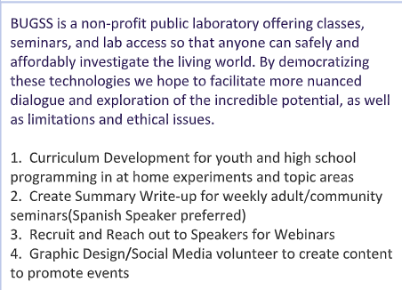
Volunteer Opportunity
" This summer I volunteered at the Baltimore Underground Science Space (BUGSS). This was a virtual experience arranged through the UMBC Shriver Center. At BUGSS, I applied what I learned in my biology classes at UMBC to design experiments for high school students.” – Arushi Dalal, BioCOM member
Questions: adalal1@umbc.edu
Get involved: Eloise Grose at the Shriver Center elgrose1@umbc.edu
Shriver Center opportunities FA20: https://drive.google.com/file/d/1kZk1-L3eR4wGJWduv9nM2hmMRWzxhPYE/view?usp=sharing

Slide 12
Study Group Formation
We have created a BioCOM Discord server with channels for a variety of BIOL classes! Use this link https://discord.gg/QuajZD to join and form study groups with others in your classes!

Slide 13
Thanks for attending!
Any questions?

