Slide 1
BioCOM GBM
October 26, 2020
Class Scheduling

Slide 2
Upcoming Events
Check out the “Upcoming Events” document on our myUMBC page!
Nov 9 – GBM on summer internships/research
Nov 11 – Biomedical research presentation – collab with Pre-Med society
Nov 20 – Bioethics Panel on Personalized Medicine!
Dec 7 – Last GBM

Slide 3
Today’s Meeting
Degree Audit, 4-year Plan, Schedule Builder, Member Q&A

Slide 4
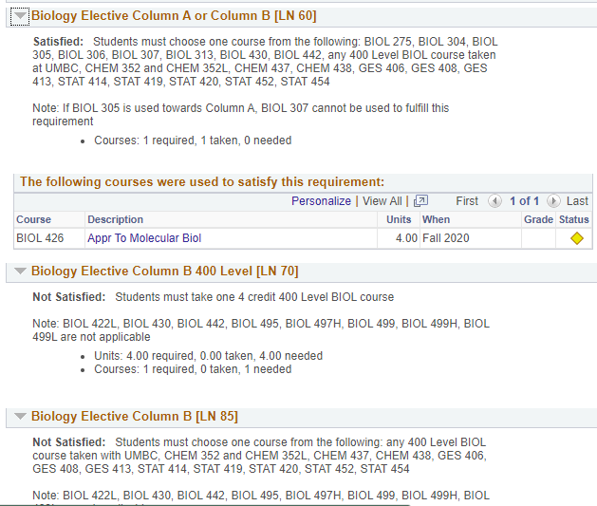
Degree Audit
In myUMBC: Guide -> Degree -> Degree Audit
Check how your classes are being applied!

Slide 5
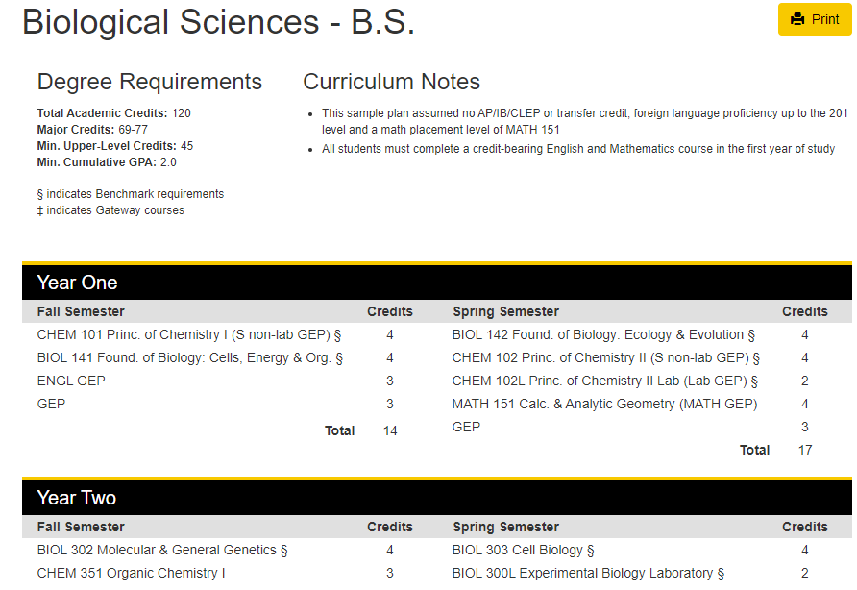
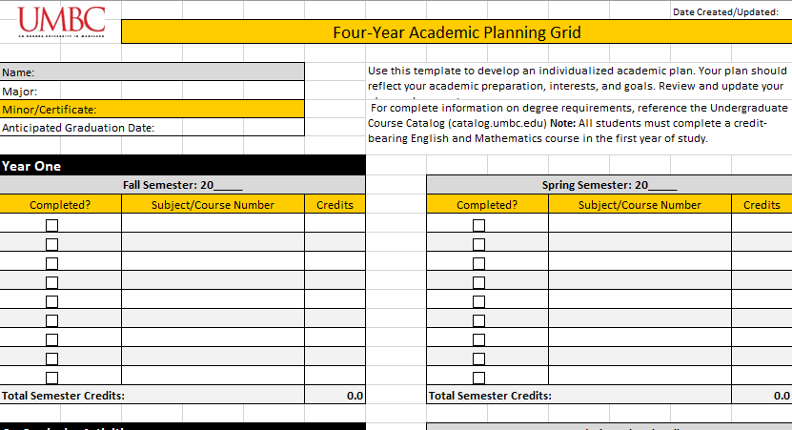
4-Year Plan
https://apps.my.umbc.edu/pathways/

Slide 6
Schedule Builder
In myUMBC: Guide → Classes & Grades → Schedule Builder → Open Schedule Builder

Slide 7
Member Q&A
https://docs.google.com/document/d/1KwxEoHLp61O3qRnsjn4Ei8oOnuSbOaPebClLUM_pa3A/edit?usp=sharing

Slide 8
Questions?
Thanks for joining us today!
Thought of a question after the meeting?
faith3@umbc.edu

