Slide 1
Welcome to BioCOM!
February 8, 2021

Slide 2
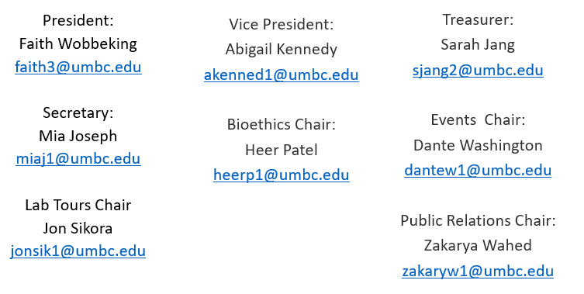
BioCOM Executive Board

Slide 3
BioCOM Goals
Form a tight network within BioCOM
Central hub for course help/studies
Organize exam review sessions
Book sales, rents, course material suggestions, etc.
Be a source of information about any topic
Internships/Research
Graduate school
Course recommendations + tips
Host events
Bioethics Panel
Lab tours
Virtual community building events

Slide 4
BioCOM Communications
GroupMe is the group messaging system BioCOM uses for communication. It has both a desktop site and a mobile app. Use this link to join: https://groupme.com/join_group/34632829/BL3rAu
We have created a BioCOM Discord server with channels for a variety of biology and chemistry classes! Use this link https://discord.gg/QuajZD to join and form study groups with others in your classes!
Our myUMBC page has our upcoming events and links for meeting recordings.
Visit our Instagram and Twitter pages:
Instagram: @ubiocom
Twitter: @UBiocom

Slide 5
Bioethics Panel
Time to choose a topic!! Please complete this form by next Monday. https://forms.gle/codVvnRapsjXJdKg9

Slide 6
UMBC Academic Resources
Appointment tutoring
Variety of subjects
Individual appointments
Can schedule weekly appointments
https://lrc.umbc.edu/tutor/
SI PASS
Regular sessions held twice a week and before exams
Group sessions help you learn material and study strategies
Writing Center
Appointments and drop-in help
https://lrc.umbc.edu/tutor/writing-center/

Slide 7
Study Tips - During Lecture
Take notes like you would if you were physically in class
Stick to a schedule if lectures are asynchronous
Don’t count on watching recordings later
Close any other tabs

Slide 8
Study Tips - Outside of Lecture
Make a schedule and stick to it
Write down everything you want to accomplish today
Use schedule gaps to your advantage
Work for a set amount of time and then have a short break. Repeat.

Slide 9
Study Tips - Exam Prep
Study a little each day
Sleep the night before an exam!
Form virtual study groups
Study by asking yourself questions

Slide 10
BIOL-141 and BIOL-142
Before exams:
Always read the relative textbooks sections prior to class.
Always use the textbook for pre-class quizzes.
Go to every lecture.
Make RELEVANT notes (do not waste your own time writing something down that would not be on an exam).
When studying for exams:
Utilize the practice problems in the textbook readings for that exam.
Reread textbook sections if necessary.
Start reviewing your notes every day for week prior to the exam.
Utilize the practice problems in the recorded lectures (if there are any).
Try to put at least 10 hours of pure study-time for an exam.

Slide 11
CHEM-101 and CHEM-102
Before exams:
Use learning objectives when taking notes prior to every class.
Do EVERY Worked Example in the relevant sections of the textbook.
Attend every synchronous lecture (or watch any asynchronous lectures), the practice problems in Dr. Carpenter’s and Dr. Bass’s lectures are very helpful.
Studying for exams:
Try to answer every learning objective for the unit.
Redo some clicker (in-class) questions. Questions like this are on the exam.
If the exams are open-book, study like they are closed-book exams. You would not have to rummage through the textbook for many questions if you do this.
Listen to Dr. Bass’s and Dr. Carpenter’s advice throughout the semester. They offer a myriad of tips and 95% of their advice is very helpful.

Slide 12
Some GEPs
PSYC-100:
Read every relevant textbook chapter. Use the guided notes when reading them, they tell what part of the reading to pay attention to.
CALC-150 or CALC-151:
Always read the textbook prior to coming to class. It has some great practice problems that allow you to master the content.
SOCY-101:
Review notes every day for seven days before every exam.

Slide 13
What are your study tips?
Do you have study tips for a specific class?

