Slide 1
Graduate School 101
Biology Council of Majors
Susan Hindle
Assistant Director, liaison to the sciences

Slide 2
Overview
Is grad school for you?
Types of graduate degrees
Selecting the best program
Timeline
Appling to grad school: elements of a strong application
Letters of reference
Funding grad school
Grad School 101: Fall 2021
Next steps…

Slide 3
Is graduate school for you?
What are my career goals?
Do I need a graduate degree to pursue this career?
How will it benefit me? (In some fields, a bachelor’s degrees provides adequate training to enter the workforce. In others, a graduate degree is needed for entry and/or advancement.)
What types of degrees do most people hold?

Slide 4
How can you find out more?
Research your industry of interest
The Vault
Conduct informational interviews
Professors, Research Mentors/PI, grad students
Connect with UMBC alumni
Retrievers Connect (NEW!)
LinkedIn Alumni Search

Slide 5
Not clear? Consider taking a Gap Year!
Time (12-36 months) to work in your field
Opportunity to assess your strengths
Clarify your career interests
Gain and/or advance industry specific skills/expertise that are transferable to the workplace and/or grad school
Earn money
Network with professionals in your field of interest

Slide 6
Types of gap year experiences
Research
Travel abroad
Teaching
Volunteer
Peace Corps
Post-graduate service programs

Slide 7
Types of grad degrees
Master’s degree – most commonly, Master of Arts (M.A.) or Master of Science (M.S.) – provides in-depth knowledge in one or more area. A master’s thesis is sometimes required.
Doctoral degree – Ph.D. (Doctor of Philosophy) – provides understanding of how to do structured research. You will complete a dissertation and contribute new knowledge to your field of study.
Professional degree – such as J.D. (Juris Doctor), M.D. (Medical Doctor), M.S.W. (Master of Social Work) – provides specialized training for employment in a specific profession (law, medicine, social work)

Slide 8
Selecting a program: factors to consider
Will this institution and location be a good fit for me?
How senior are the professors from my area of study? What are their interests and availability?
Will this program give me an opportunity for hands-on experience, either as a professional practitioner or researcher?
Is financial support available (teaching and/or research assistantships)?
What are the class sizes and what is the student/faculty ratio?
How active is the faculty in my field?
What is the program’s reputation versus the university’s reputation?

Slide 9
Sources for further exploration
GraduateGuide: http://www.graduateguide.com Search directory of graduate schools and programs by subject, school name and geographic area. Hard copy versions of this directory (updated annually) are also available in the Career Center.
Gradschools.com: https://www.gradschools.com Search by subject and geographic area for graduate programs in your field.
Petersons: https://www.petersons.com Identify colleges by location, major, tuition, sports and more.
U.S. News best schools-education rankings: https://www.usnews.com/best-graduate-schools
Relocation Resources:https://www.myperfectresume.com/how-to/career-resources/relocate/

Slide 10
Timeline for applying
By your junior year, you should be clear about your career goals and begin post-graduate plans.
Serious discussions with your faculty advisor and mentors should begin, during which you seek advice about graduate programs to investigate and potential mentors for graduate study and research.
The summer after your junior year is the time to begin the application process.

Slide 11
Applying to grad school: Elements of a strong application
Strong academic record (transcript should show successful completion of challenging courses)
Research experience (significant)
Leadership experience
Part-time jobs
Volunteer experience
Solid GRE scores
Well-written, detailed resume
Personal statement/essay
Personalized/persuasive letters of recommendation

Slide 12
Noteworthy accomplishments that should always be highlighted:
Laboratory research experience, particularly if it is supported by grants, such as the UMBC Undergraduate Research Award
Participation in professional
conferences, on campus and
elsewhere (e.g., UMBC
Undergraduate Research and
Creative Achievement Day), etc.

Slide 13
Noteworthy Accomplishments (cont’d.)
Leadership positions (e.g., President, Secretary, Vice President, Treasurer)
Study abroad experiences
Contributions to publications

Slide 14
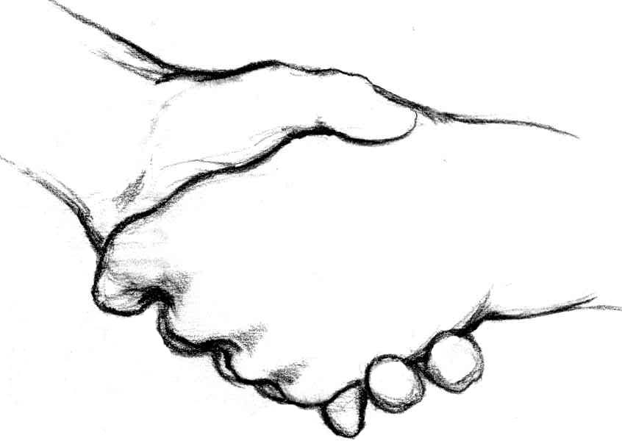
Preparing for graduate school
Establish strong relationships with faculty mentors
Undergraduate advisor coordinators
Building on your strengths

Slide 15
Obtaining Letters of Reference
Make sure the recommender:
Has a high opinion of you and your potential
Has had you in class (preferably on more than one occasion) and is familiar with your work and/or supervised you in a research or creative project
The writer should know you on a personal as well as academic level
Is aware of the program you are applying for

Slide 16
Obtaining letters of recommendation
Can be seen as an objective judge of you by an admissions committee
Is reliable in submitting
your material on time
Knows the elements of your background
that you want highlighted

Slide 17
Provide to the Recommender
A copy of your academic and extracurricular record
A copy of your personal statement
A description of the program for which you are applying
Very clear directions about the logistics—any form that needs to be completed and attached, where and how the letters need to be sent, relevant deadlines, etc.

Slide 18
Personal statements and essays
Be yourself and say what you think, not what you think admissions officials want to hear
Talk about your motivations as well as aspirations
Highlight what makes you a unique candidate
Talk about work/research experience you have
Personal accomplishments and triumphs

Slide 19
Personal statements and essays
After researching the program, faculty and their areas of research, address how your areas of interest are compatible
Use positive, confident and upbeat language
Sell yourself; discuss how you'll be an asset to the program/school
Proofread and ask faculty and a Career Center professional to proofread your statement.

Slide 20
Personal statements and essays
Has a central theme
Is well organized
Describes your goals
Following directions/prompts
carefully, especially those relating to length
Answer all questions asked
Is tailored to the program

Slide 21
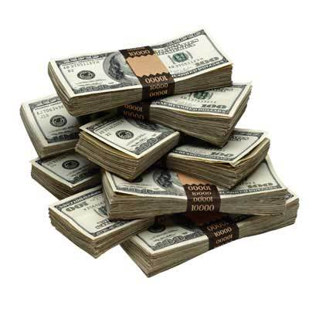
Estimating costs
You should budget for:
Tuition
Fees
Housing and costs of living (food, utilities, etc.)
Books and academic materials
Lab costs
Transportation

Slide 22
Funding your grad degree
Assistantships—research, teaching, and other
Fellowships, scholarships, and traineeships
Student loans
UMBC campus career partners offering graduate school application assistance

Slide 23
Assistantships
Graduate Assistants perform services for a university to reduce the out-of-pocket expenses of their education.
Includes a financial stipend, tuition remission (waiver or reduction in tuition) and health benefits.

Slide 24
Funding your Graduate Education
Federal and state financial aid
Tuition benefits for military personnel and veterans
Employer tuition benefits
Internships/cooperative education

Slide 25
Additional funding sources
Prestigious Scholarships and Fellowships:
Highly competitive, either nationally internationally,
Provide financial support and other benefits to limited numbers of highly qualified candidates.

Slide 26
Prestigious Scholarships & Fellowships:
Typically, scholarships support 1-3 years of study after a bachelor's degree at universities in the United States or abroad.
See Graduate School Guide on our website:
http://careers.umbc.edu/students/gradschool/funding/

Slide 27
Interfolio
Interfolio is online credentials management system, Dossier, is available to UMBC students and alumni.
An easy and affordable way for students to send confidential letters of recommendation to a potential employer; application materials to graduate and professional schools; teachers to apply for a new position; or a PhDs to send academic credentials to a search committee.

Slide 28
Career Center Services
Resume/CV writing
Personal statement review
Interview prep resources
Interview prep appointment

Slide 29
Next steps…
Schedule an appointment with the UMBC Career Center for assistance with:
Resume review
Personal statement review
Mock interviews

Slide 30
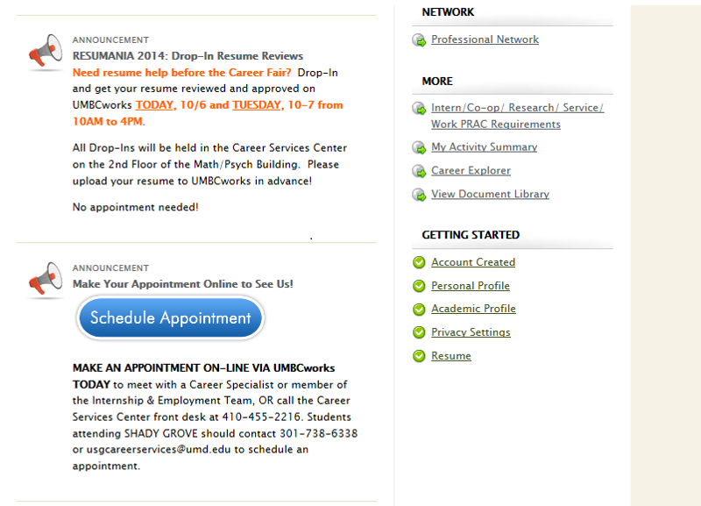
Schedule an appointment via UMBCworks
Login to UMBCworks
Click “Schedule Appointment”
OR
Call Career Center at 410-455-2216
Notes:
Susan look at this slide

Slide 31
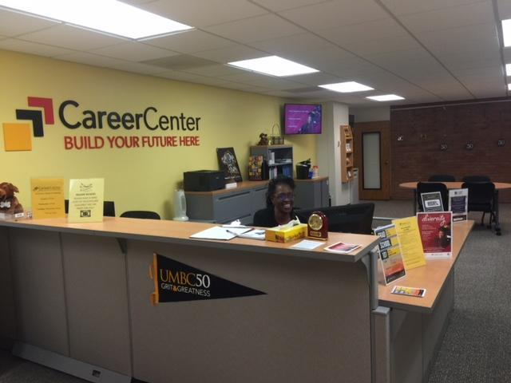
UMBC Career Center reception
Campus Location: Math/Psych. Building
Hours: 8:30 – 5 PM – M-F
Careers.umbc.edu

Slide 32
Questions

Slide 33
Thank you!
Susan Hindle
Assistant Director, Internship & Employment
shindle@umbc.edu

