Slide 1
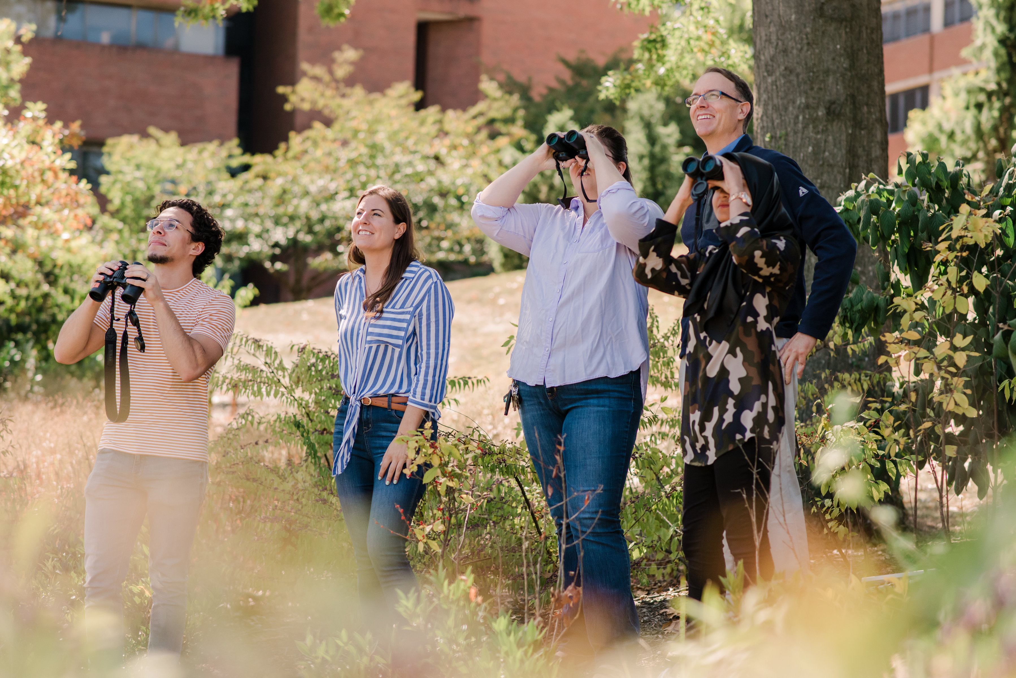
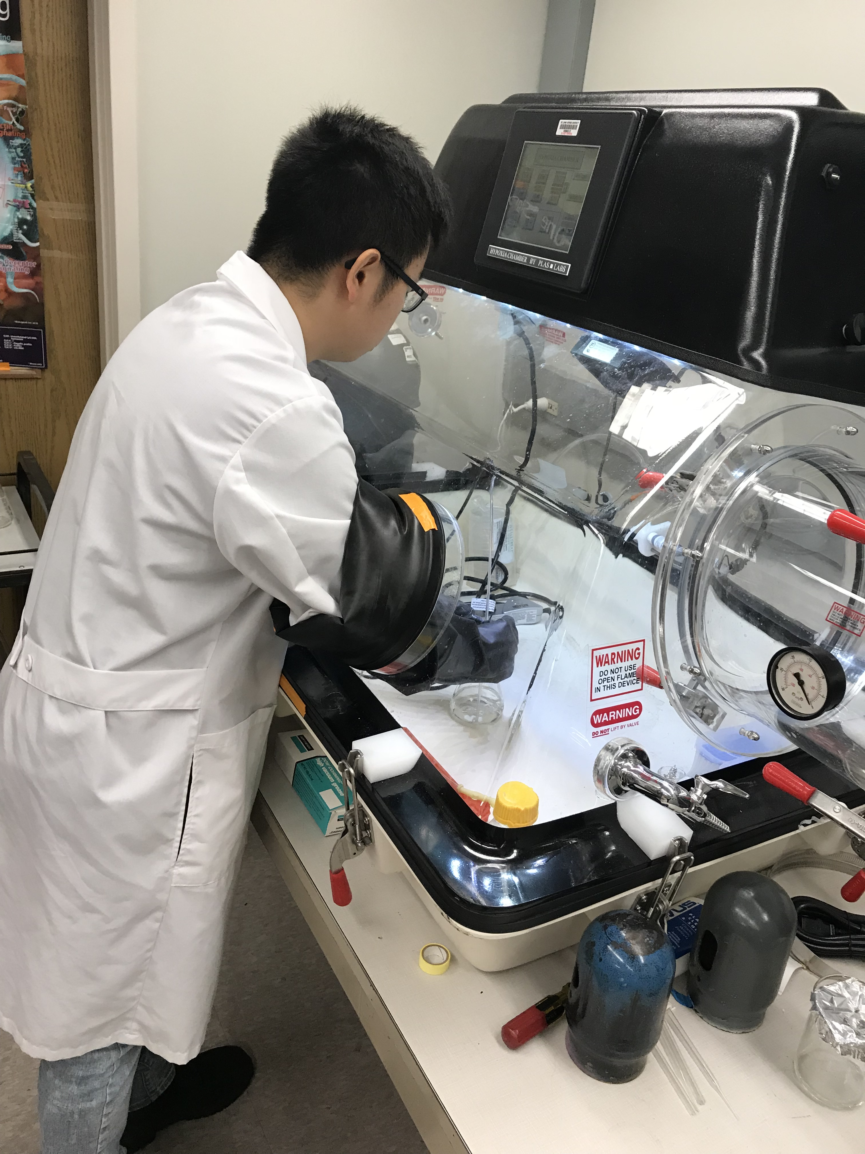
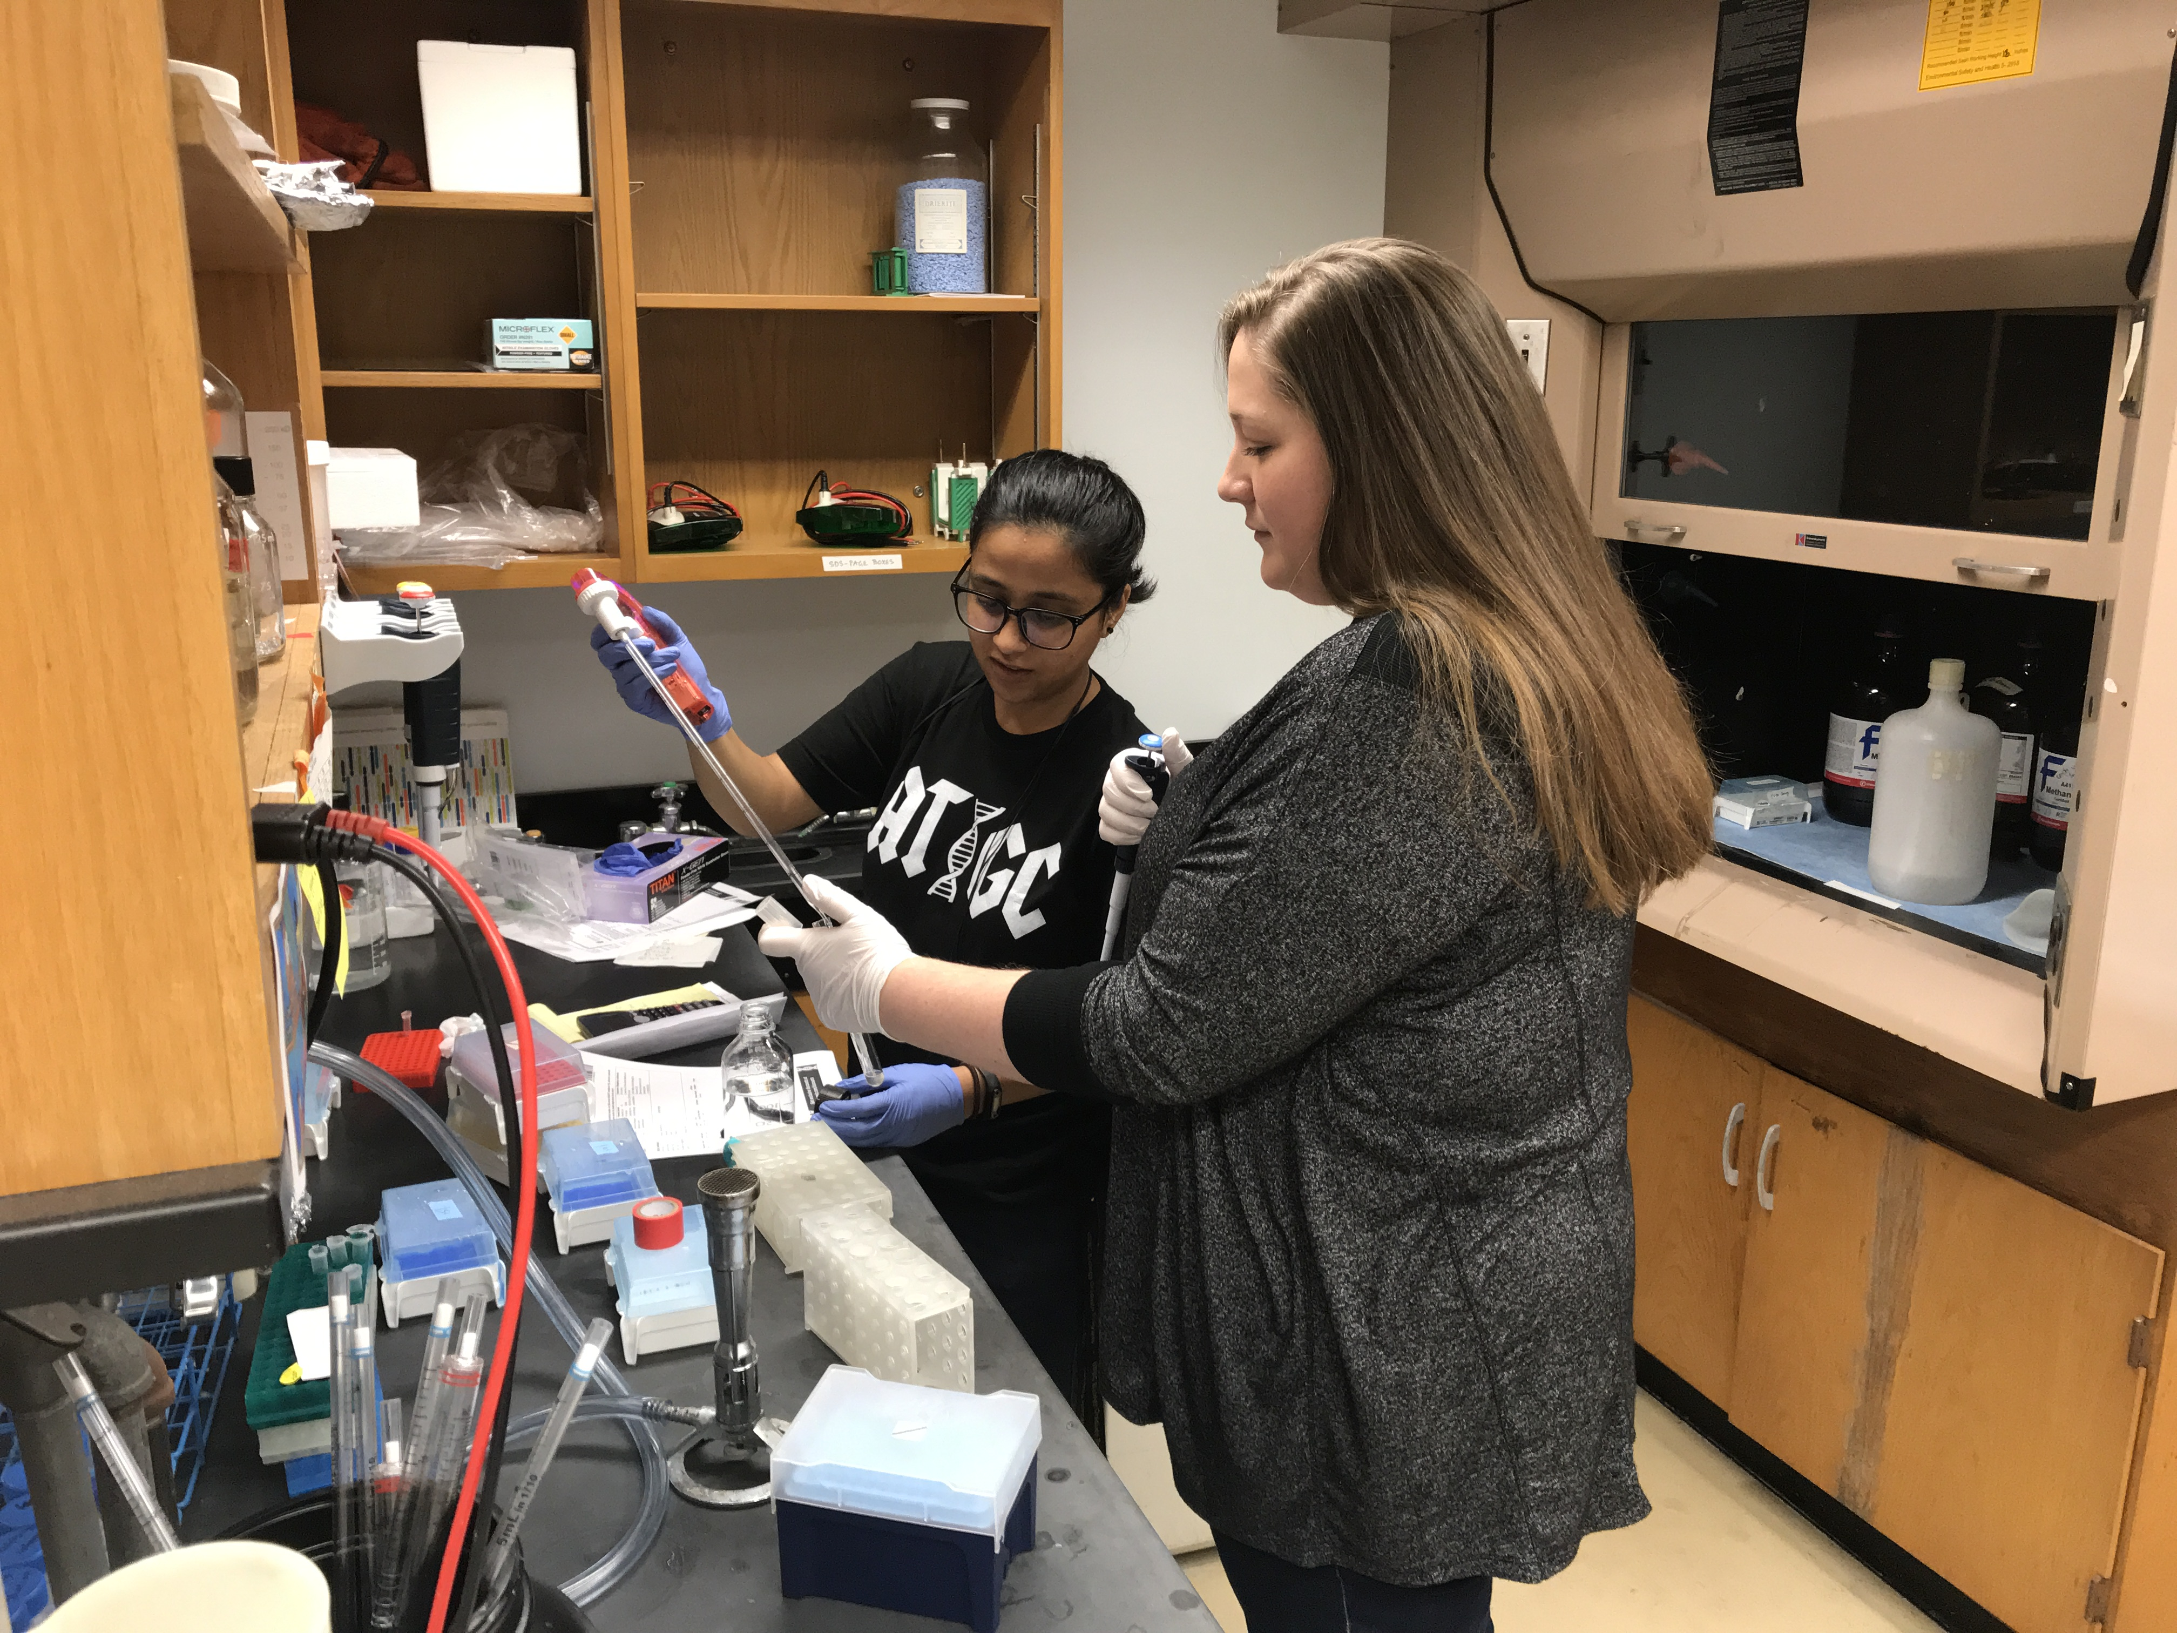
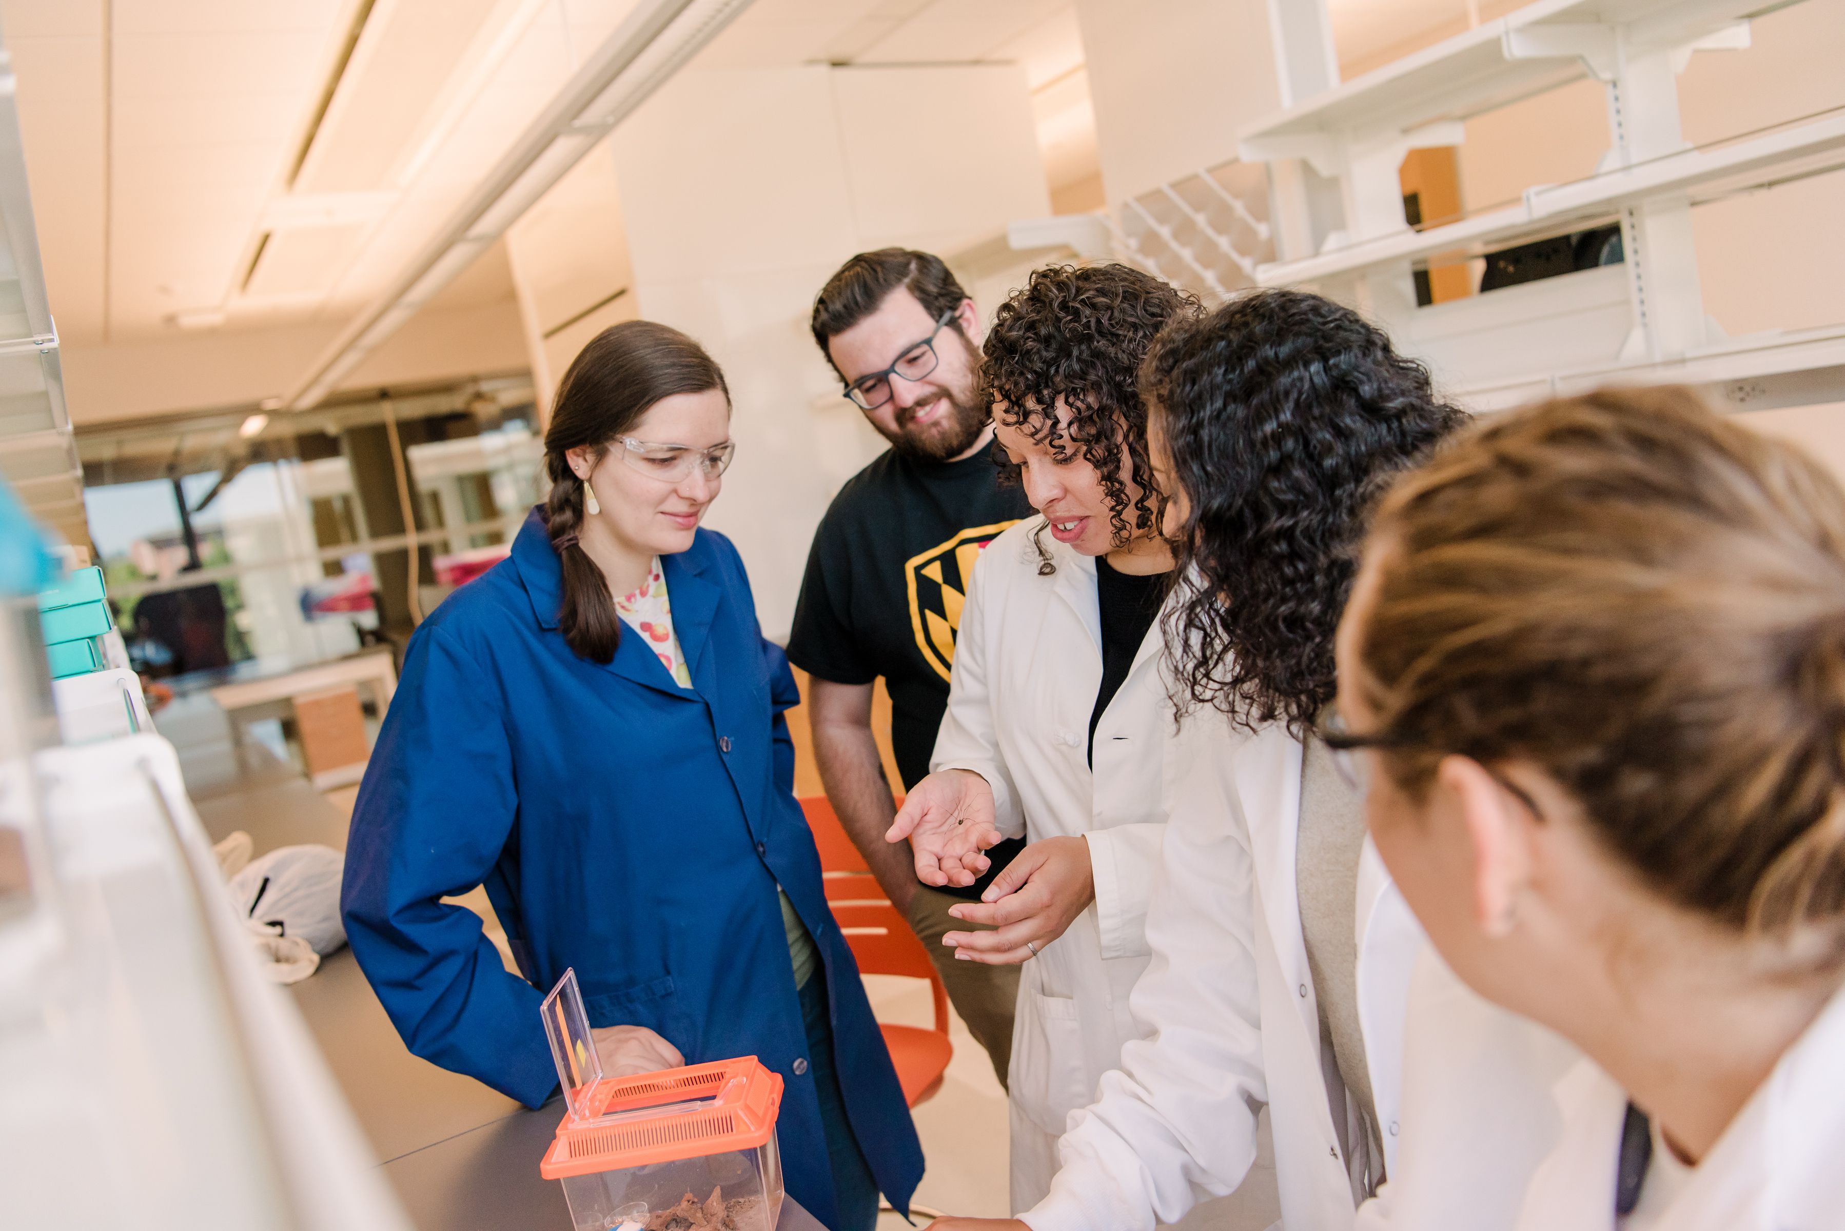
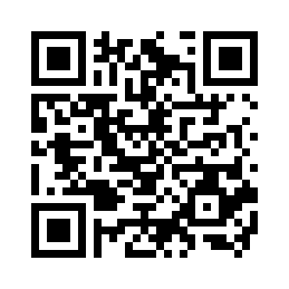
ARE YOU THINKING ABOUT GRADUATE SCHOOL???
Bring your lunch and join the Biological Sciences Graduate Committee on:
Monday, November 16, 2020
Time: 12:30-2:00 pm
Place: WebEx
Join us for a Q&A session and receive tips for applying.
We offer six graduate programs in the Department of Biological Sciences:
Masters
-Biological Sciences, 1-2 year program
- New track in Biomathematics
-Applied Molecular Biology, 9 month accelerated OR part time, 2 years.
-NEW ICARE – Interdisciplinary Program
Engaged Environmental Sciences- 2 year program
Ph.D. – Stipend, Tuition Remission, and Health Insurance
-Biological Sciences
-Neurosciences and Cognitive Sciences
-Molecular and Cell Biology

