Slide 1
NSA Student Programs:
__________________________
Exploring Future Pathways
Career Opportunities at the National Security Agency

Slide 2



The NSA Mission
The National Security Agency is responsible for:
Signals Intelligence
U.S. Cybersecurity
Providing our nation’s policy makers and military commanders with foreign intelligence to gain a decisive advantage.
Protecting and defending sensitive information systems and networks critical to national security and infrastructure.
Notes:
When people who are unfamiliar with the agency ask what we do, the typical response is “signals intelligence.”
A longer answer is that we defend information networks – which is called cybersecuity – and we produce foreign intelligence, which is done through signals intelligence.
But to what end? What’s the bigger picture?
The most simple, concise answer is that we are here to SAVE LIVES. We never want another 9/11.
If we can save even one human life, whether a civilian here in America or one of our soldiers overseas, we will have done our job.
That’s our biggest, most important, most vital mission.

Slide 3




How Might Your Skills Fit at NSA?
Legal and
Law Enforcement
Business and
Support Services
STEM
IA and Languages
Computer Science
Cyber
Engineering and Physical Sciences
Mathematical Sciences
Medical and Occupational Health
Network & Telecommunications
Inspection, Investigation and Compliance
Security and
Law Enforcement
Law and Legal Services
Intelligence Analysis
Intelligence Collection
Foreign Language Analysis
Business, Accounting
and Budget
Human Resources
Communication and
Public Affairs
General Admin Support
Education and Training
Infrastructure and Logistics
PLUS, paid internships, scholarships and Co-op Program!
Notes:
NSA relies on many, many different types of professionals to do the things we’ve been talking about today. We have career opportunities in all of these fields. To apply for any position at NSA, you must be a U.S. citizen.
[READ LIST]
If you would like to talk more specifically about any of these career fields, please let me know after the presentation. You can also find detailed information on our website, IntelligenceCareers.gov/NSA.

Slide 4
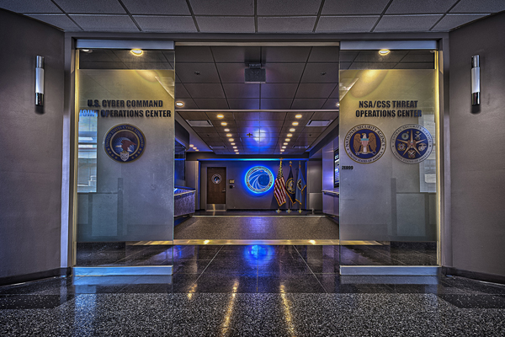
Hiring Requirements
Must be a U.S. citizen
Must be 16 years age during processing
Background investigation
Polygraph interview
Psychological assessment
NSA is an Equal Opportunity Employer and abides by applicable employment laws and regulations. All applicants for employment are considered without regard to age, color, disability, genetic information, national origin, race, religion, sex, sexual orientation, marital status, or status as a parent.

Slide 5
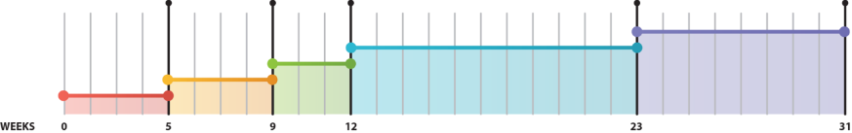
Application Timeline
HR Screening, Conditional Job Offer Extended
Security Forms Completion
Background Investigation
Psychological Testing and Polygraph
Hiring Authority Approval, Final Job Offer Extended

Slide 6



Applicant Security Clearance Process
All NSA employees have a TS/SCI level security clearance
1
2
3
Full Background
Investigation (BI)
Full Scope Polygraph
(Poly or PG)
Psychological Evaluation
(Psych Eval)
Notes:
After receiving a Conditional Job Offer from your recruiter, you’ll be asked to:
Complete security forms.
Inform contacts (family members, neighbors, former employers, roommates, etc.) listed on your security forms they may be contacted by the background investigator reviewing your case.
Successfully complete the required polygraph and psychological evaluations.
Submit documentation and information as requested by your recruiter, NSA Security and/or NSA Psychological Services, including but not limited to transcripts, diplomas, travel information and medical documentation, if applicable.

Slide 7
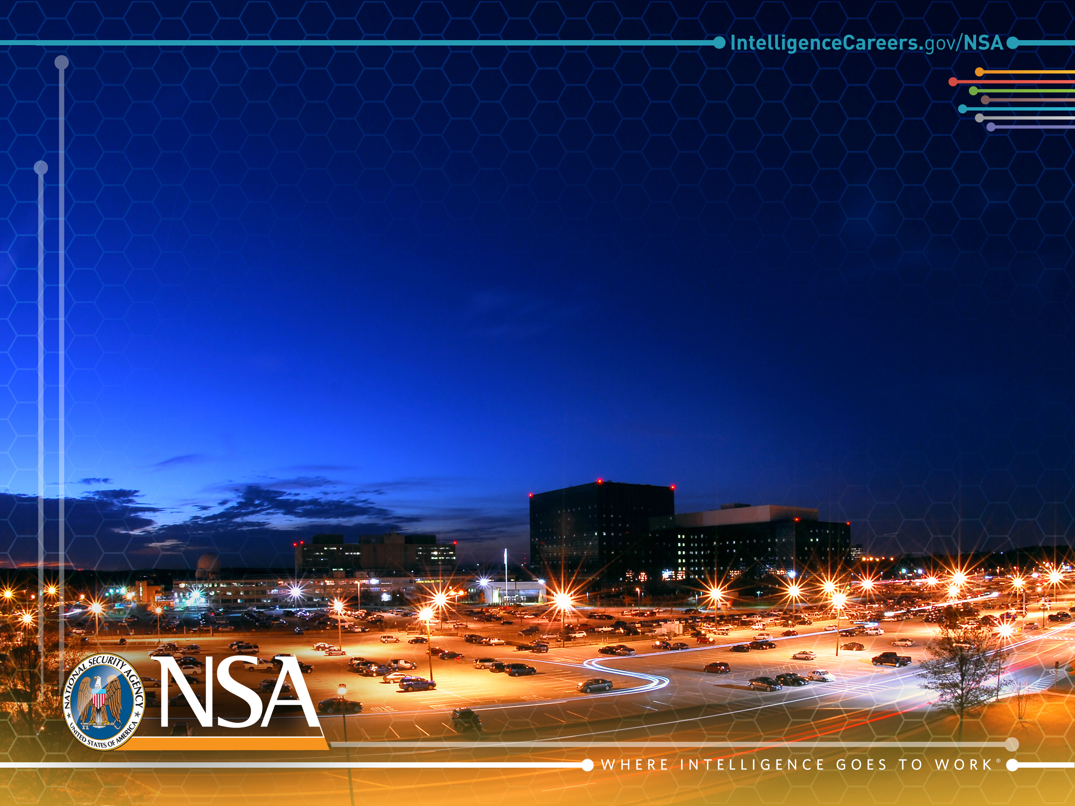
Summer Internship
Programs @ NSA
V090117
Where Intelligence Goes to Work

Slide 8














Student Programs: Internships
Paid summer tours for undergrad, grad students and Ph.D. candidates
20+ PROGRAMS
for College Undergrads,
Graduates and
Doctoral Students
Work at NSA
12 WEEKS
Over the Summer
Real-World
EXPERIENCE
Fields (Plus Many More)
Internship Benefits
STEM &
Cyber
Business
Language
Competitive
Pay
Paid
Time Off
Housing
Assistance*
Travel
Reimbursement*
Access to
National
Cryptologic
School
Courses
Holiday &
Sick Leave
Mentorship
Programs
Extracurricular
Activities
*If eligible. See our website for more information.
Notes:
We have more than 20 different paid internships available. Interns love the work and the opportunity to network and make friends with their peers from all over the country. Many of our interns return for full-time jobs following graduation.

Slide 9
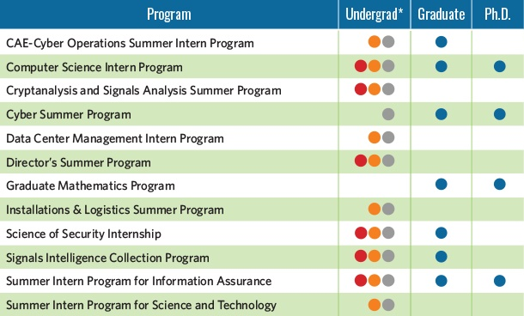
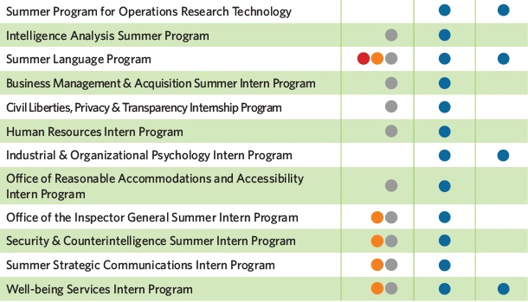
2020 Summer Internships
20+ programs in STEM, business and more
The application deadline for all internships is 31 October 2020!
Visit our Student Programs page for details about each program and to apply:
https://apply.intelligencecareers.gov/student-programs
Notes:
We offer a wide variety of student programs, which offer real-world experience, a real-world paycheck, and the chance to be a part of something that you’ve never even dreamed about – plus, it could lead to a full-time career after you graduate.
Internships at NSA provide exciting work and compensation commensurate with academic level.
If you are working toward an undergraduate, graduate or post-graduate degree in a field critical to NSA’s mission, we can help you gain real-world experience.
Opportunities exist in many of our most challenging job categories for college students willing to dedicate their time to national security.
The application period for most internships has been moved up to start on Aug. 1 this year, and it will end on Oct. 15.
For details about each program, including application deadlines and eligibility requirements, visit our Student Programs page on IntelligenceCareers.gov/NSA.

Slide 10
Summer Program Opportunities
Director’s Summer Program (DSP)
Cryptanalysis/Signals Analysis Summer Program (CASA SP)
Graduate Mathematics Program (GMP)
Computer Science Intern Program (CSIP)
CAE in Cyber Operations Summer Intern Program
Cyber Summer Program
Data Center Management (DCM)
Installations & Logistics Intern Program
Signals Intelligence Collection Program
  Summer Intern Program for Information Assurance
  Summer Intern Program for Science and Technology
  Summer Program for Operations Research Technology
  **NSA Colorado Summer Intern Program
  **NSA Georgia Summer Intern Program
  **NSA Hawaii Summer Intern Program
  **NSA Texas Summer Intern Program
  The application deadline for all internships is 31 October 2020!
  Visit our Student Programs page for details about each program and to apply:
  https://apply.intelligencecareers.gov/student-programs

Slide 11
Non Technical Summer Program Opportunities
  Intelligence Analysis Intern Program
  Summer Language Program
  Civil Liberties, Privacy and Transparency (CLPT) Summer Intern Program
  Business Management & Acquisition Intern Program
  Office of Reasonable Accommodations Internship (Graduate level)
  Occupational Health Environmental and Safety Services Intern
  Inspector General Summer Program
  Health Promotion and Wellness Intern Program
  Summer Strategic Communications Intern Program (SSCIP)
  Security and Counterintelligence Intern Program
  Human Resources Intern Program
  Industrial and Organizational Psychology Intern Program
  The application deadline for all internships is 31 October 2020!
  Visit our Student Programs page for details about each program and to apply:
  https://apply.intelligencecareers.gov/student-programs

Slide 12
Cooperative Education Program @ NSA
Where Intelligence Goes to Work

Slide 13
Co-Op Program Requirements
Rotational Program
2nd semester freshman, sophomore
Computer Science, Computer Engineering, Electrical Engineering, Cyber Security (technical track only), Qualifying Language-related major
Full-time Student
Prefer GPA of 3.0 or higher
Transcripts every semester
Complete at least 52 weeks of work prior to graduation
  Application Periods-
  1 September- 31 October
  1 February- 31 March
  Visit our webpage for details about each program and to apply:
  https://apply.intelligencecareers.gov/

Slide 14
Benefits
Full-time salary while working (~$33K-~$45K annually), annual promotions based on degree progress (milestones)
Reimbursement for one technical course while at school
Real, hands-on experience
  Design, development, testing and evaluation of electronic communications systems.
  Object-oriented methodology, multi-media, data warehousing.
  Defense against Cyber adversaries.
Potential full-time employment upon graduation
Competitive
Pay
Paid
Time Off
Housing
Assistance*
Travel
Reimbursement*
Access to
National
Cryptologic
School
Courses
Holiday &
Sick Leave
Mentorship
Programs
Extracurricular
Activities
*If eligible. See our website for more information.

Slide 15
Co-Op Program Opportunities
Computer Science majors explore high-tech opportunities such as object-oriented methodology, multimedia, data warehousing/data mining, design/analysis development of software and systems, client/server development, networking, and Internet technology.
Students in the Computer or Electrical Engineering fields will be involved in the design, development, testing, and evaluation of electronic communications systems.
Participate in multi-disciplinary assignments will reach to such rapidly advancing areas as optics, lasers, acoustics, and microprocessors.
  Visit our webpage for details about each program and to apply:
  https://apply.intelligencecareers.gov/

Slide 16
Development Programs
@ NSA
Where Intelligence Goes to Work

Slide 17
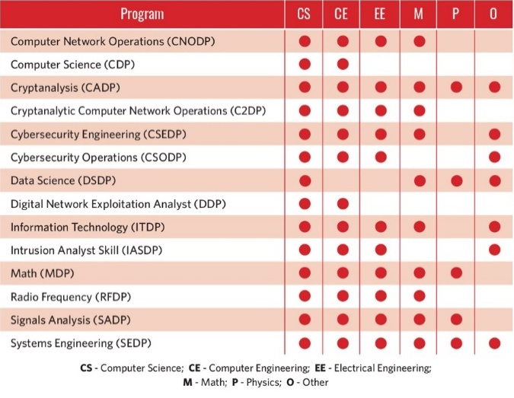
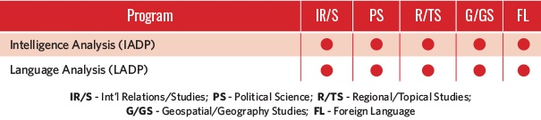
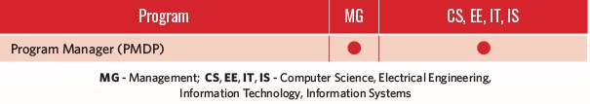
Employee Development Programs
Full-time jobs with full-on benefits
Entry-level, mid-career and senior-level programs
(in STEM, Intelligence & Language Analysis, and Business) designed to:
  Improve understanding
  of specific disciplines
  Enhance skills and professional networks
  Cross-train into new
  career fields
Most programs are 3 years in length, with rotational tours
Applications are open on a rolling basis
STEM
Intelligence & Language Analysis
Business
  Visit our webpage for details about each program and to apply:
  https://apply.intelligencecareers.gov/
Notes:
At NSA, career development begins on day one and continues throughout your career.
We offer a variety of entry-level, mid-career and senior-level programs to help employees grow professionally.
Most programs are three years in length, with rotational tours.

Slide 18
Apply online:
https://apply.intelligencecareers.gov/student-programs

