Slide 1
Interview like a pro!
Presented by:
Susan Hindle, Assistant Director

Slide 2
Overview
Purpose of the interview
How to prepare
Stages of the interview
Types of interviews
Build your confidence: Interview prep services
Next steps

Slide 3
The good news!
If you have been invited for an interview the employer believes you possess the minimum qualifications necessary to do the job.
The interview is to help the employer assess whether you are a “good fit”.

Slide 4

Your reaction

Slide 5
Get focused
STEP 1

Slide 6

Channel your inner puppy!

Slide 7
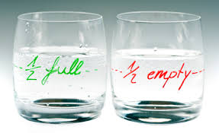
Your attitude is a huge factor!

Slide 8
Clarify your direction
STEP 2
Notes:
This is crucial. You must present yourself authentically, even more so because of LinkedIn and other social media that proclaim your identify and career goals.

Slide 9

Know what you want
Notes:
Have an idea(s) about what you want! You can’t sell what you don’t have.
Cannot enter this phase of preparation/selling posture if you are unclear/vague. It all builds from clarity about what you want.
Aimlessness: procrastination, hesitance, boredom, sloth

Slide 10
Prepare
STEP 3
Notes:
This is crucial. You must present yourself authentically, even more so because of LinkedIn and other social media that proclaim your identify and career goals.

Slide 11
How to prepare
Know what you offer– strengths/skills/abilities
(And how they relate to position/employer!)
Know the position - what the employer wants
Know interview details:
  Names/titles of interviewer(s)
  Length/location of interview
Know the employer…

Slide 12
Research the employer
View company website
  locations
  products/services
  financial standing/annual revenue
Know competitors
Know how position fits w/in grand scheme
Notes:
Consult online resources, trade journals, newspapers, professional organizations, professionals you know

Slide 13
Types of interviews
Screening Interview (30-minutes)
Phone/Skype Interview (30-minutes)
On-site Interview (2-3 hours)
Technical Interview
Series Interview (for advanced positions)
Case Interview

Slide 14
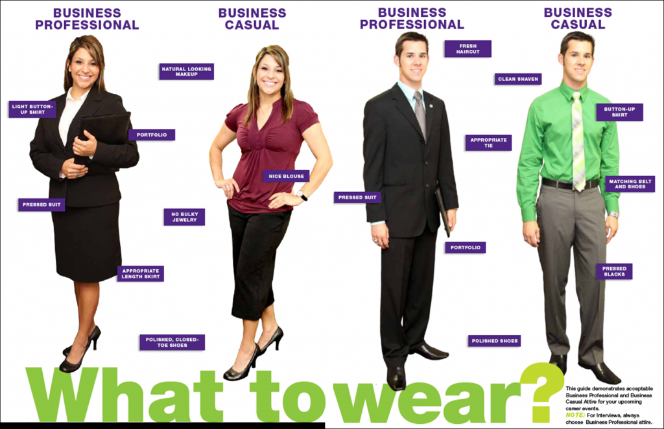
What to wear
Notes:
Nothing demonstrates outward professionalism than how one is dressed; it communicates how you think of yourself and your environment
Radiates competence, impeccable taste or ignorance and lack of confidence.
Men:
No pastels, or cotton pants. Wool is your friend. Shoes, belt, watch make or break the outfit; invest in quality products. No wing-tips! Aim for single color palattes. No cologne, bracelets, or rings beyond a wedding ring. Do well to hire a consultant at Nordstroms for yearly check-ups.
Women:
Aim for well-dressed professional; never sexy
Nothing faded, stretched or studded
Never wears jewelry on her lapel – ever.
Never groom in public – ever.
Never wear flip-flops, sandals, faded jeans, beads of any kind or leggings.
Balance make-up; light touch.

Slide 15

What NOT to wear

Slide 16
What to take
Resume (extra copies)
Padfolio w/ pen and paper
Examples of your work (portfolio/e-portfolio)
List of questions
Breath mints (consume in advance!)

Slide 17

What NOT to take

Slide 18
Showtime
STEP 4
Notes:
This is crucial. You must present yourself authentically, even more so because of LinkedIn and other social media that proclaim your identify and career goals.

Slide 19
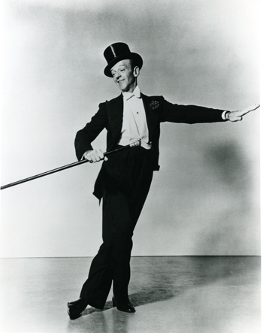
Time to bring it!

Slide 20
Interview stages
Stage 1: Introduction (2-3 minutes)
Stage 2: Q & A (longest stage)
Stage 3: Your chance to ask questions (3-5 min.)
Stage 4: Closing/wrap-up (2-3 minutes)

Slide 21
Stage 1: Introduction (2-3 min.)
Employers report the decision to hire occurs in the first 30 seconds of meeting a candidate.
* NEWSFLASH *
You have complete control over the
impression you make!

Slide 22
Elements of a good first impression
(US business culture)
Attire/Grooming
Punctuality
Handshake
Eye contact
Greeting
Posture

Slide 23
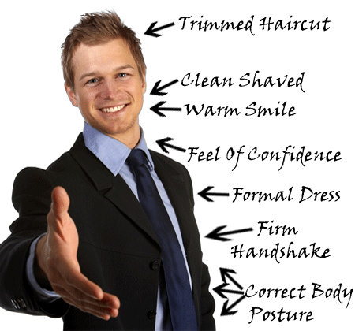
First impression in action

Slide 24

Stage 2: Q & A

Slide 25
Top 20 skills/qualities employers seek
(National Assoc. of Colleges & Employers Job Outlook 2013)
Leadership
Problem solving
Communication
Ability to work in a team
Analytical skills
Strong work ethic
Initiative
Computer/technical
Detail-oriented
Flexibility/
adaptability
Interpersonal
Organizational ability
Friendly/outgoing
Strategic planning
Creativity
Entrepreneurial skills
Tactfulness

Slide 26
Behavioral interview questions
S.T.A.R. Technique
Situation – setting (time/place), people
Task – Description of project/work
Action –Steps you took/rationale (why)
Result/Reflection - Outcome/what you learned

Slide 27
Typical interview questions
Tell me about yourself
What’s your greatest strength/weakness?
Why should we hire you?

Slide 28
Tips
Jot notes
Be in the moment
Smile; enjoy the process!
Take your time; pausing is good
If you blank out on a question, ask to skip to the next and come back to it

Slide 29
Stage 3: Your turn to ask questions
Ask open-ended questions:
(jot notes as you listen to responses!)
Ask about position/department
Ask about company (+/-)
Next steps…
Notes:
This is your opportunity to demonstrate you’ve been paying attention.
This is your opportunity to demonstrate you are prepared

Slide 30
Stage 4: Closing/wrap-up
Express your gratitude!
Express your interest
Gather business cards
Shake hands
Make your exit

Slide 31
After the interview
STEP 6

Slide 32
Closing the deal
Debrief – write down key points
Send tailored thank you e-mail(s)
(within 24 hours!)
Reiterate strongest qualifications
Revisit points/topics you want to clarify

Slide 33
Interview prep services
UMBC Career Center

Slide 34
Practice builds confidence!
* Big Interview *
(Virtual interview practice tool)
LEARN * PRACTICE * ANALYZE
Videotape your responses to pre-recorded questions
Review/rate your responses
Share them (professors/mentors, family, friends)
Forward them to Career Center staff and request a review
careers.umbc.edu/tools/big-interview

Slide 35
Tips
TAKE-AWAYS

Slide 36

Interview process is a two-way street

Slide 37

DON’T think “Perfection”
PERFECTION

Slide 38

Think “Connection”!

Slide 39
Next steps
STEP 7

Slide 40
To Do list
Update your resume
Gather your references
Explore “Big Interview”
Schedule a 1:1 practice interview session

Slide 41

Home stretch
Maximize UMBC Career Center’s services!

Slide 42

Parting words of inspiration
“Success is walking from failure to failure with
no loss of enthusiasm.”
Winston Churchill

Slide 43

Thank you!
Congratulations and best wishes!

