Slide 1
Intern Success Conference
Presented by
The Internships & Employment Team

Slide 2
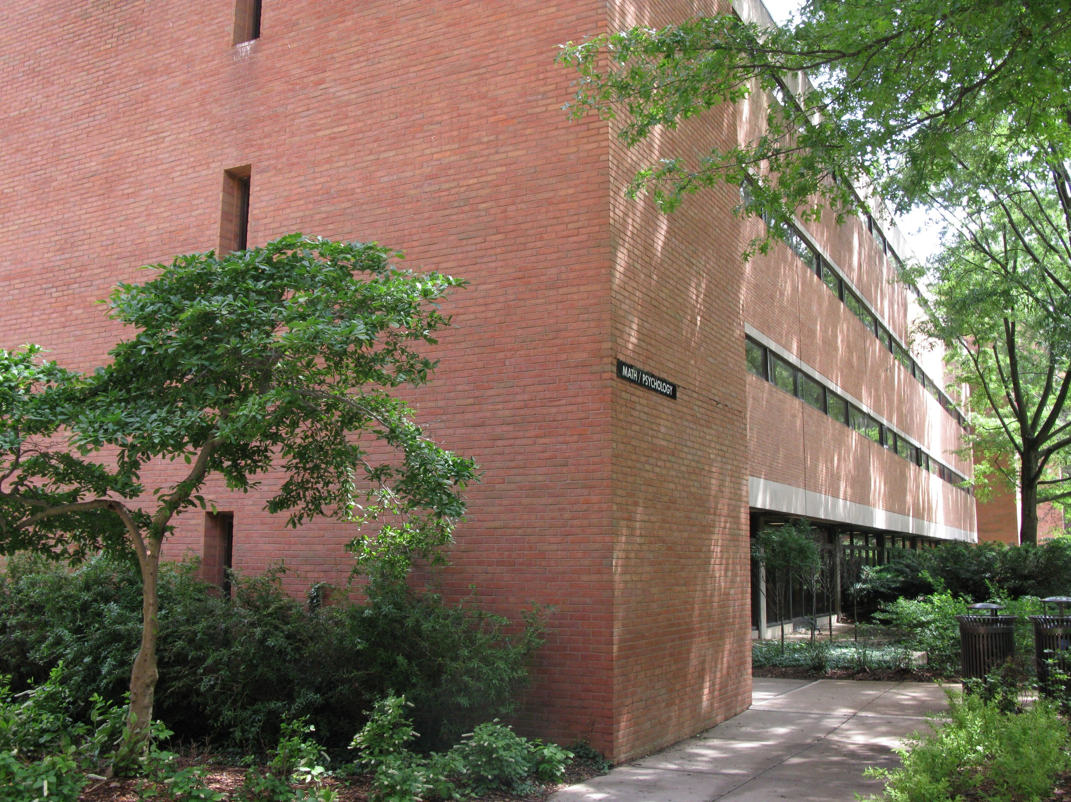
UMBC Career Center Campus Location
Campus Location: Math/Psych. Building

Slide 3
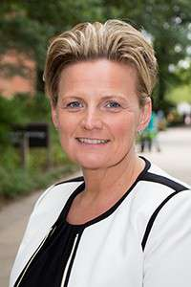
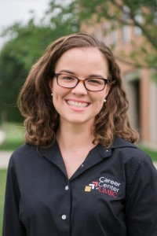
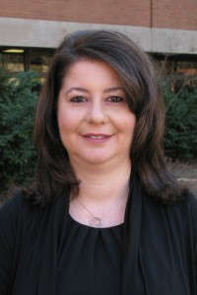
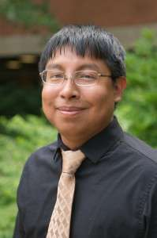
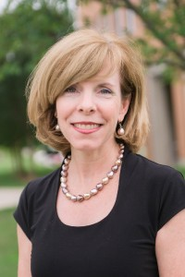
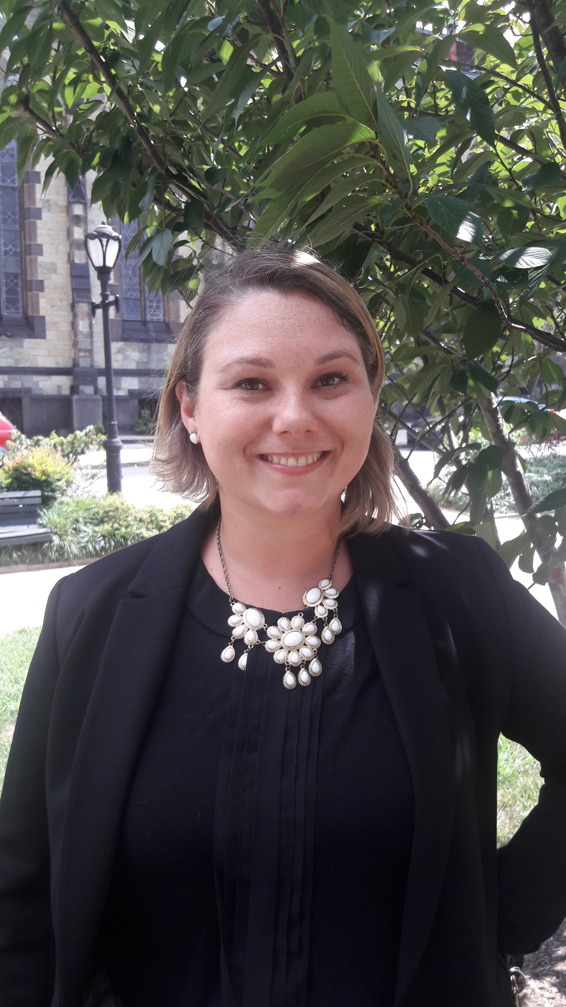
Internship & Employment Team
Christine (Director)
Economics
Kacie (Team Lead)
Arts & Hum.
Chrisi Engineering/Tech
Jeremiah
Social Sciences/ Humanities
Jen Tech/IT
Susan
Sciences

Slide 4
Operating Hours
Contact Us University of Maryland, Baltimore County Math/Psychology Bldg. Room 201 1000 Hilltop Circle Baltimore, MD 21250 Phone: (410) 455-2216 Email: internships@umbc.edu Hours Reception: Monday-Friday: 8:30am-5:00pm |  | Counseling Appointments: M-F: 9am-5pm Some Tuesday evenings by request Drop-In Appointments: 15-minutes M-Th, 2-4pm (last person taken at 3:45pm) F, 12-4pm (last person taken at 3:45pm) Evening Resume Critiques: By appointment only. Call (410) 455-2216

Slide 5
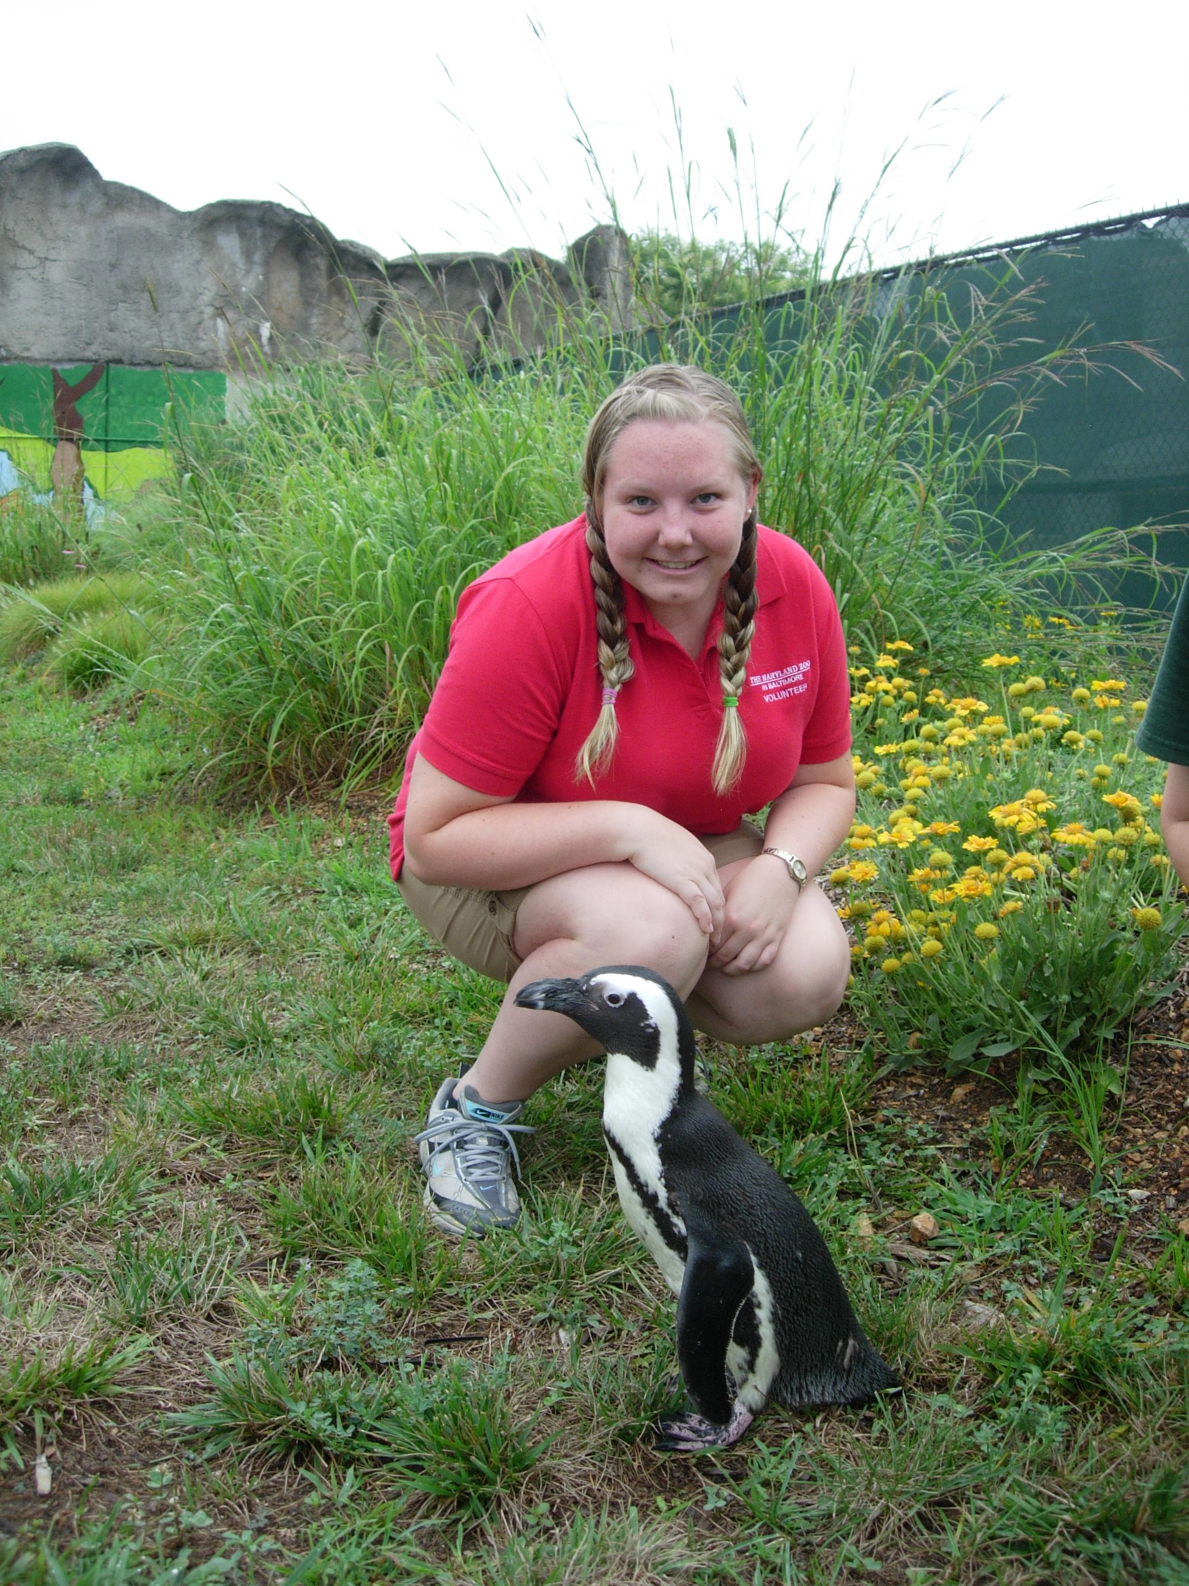
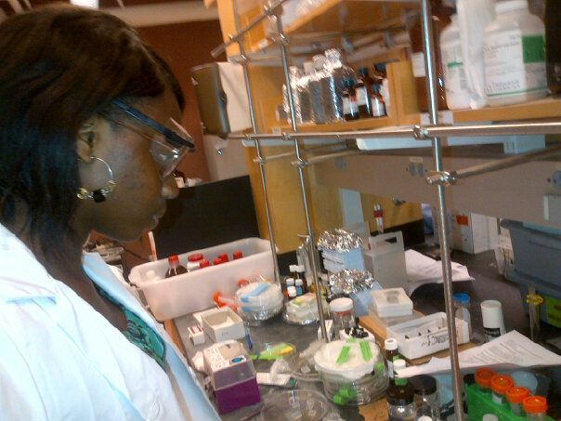
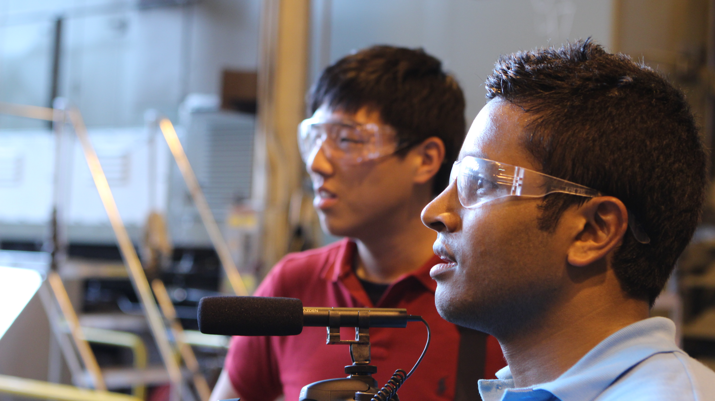
Internships, Co-Ops & Research
Notes:
1,852 - students engaged in applied learning
76% - paid
$16.60/hr. – average pay
17 hours – average # of hrs. worked per semester

Slide 6
Intern Success Practicum
Open to all undergraduate/graduate students
You must complete 120 hours in semester (8-10 hours/week on average)
The experience must be directly related to your academic major(s)
May be required by your department in order to earn academic credit

Slide 7
Intern Success Practicum
Support of a career professional
Goal setting
Professional development assignments designed to increase workplace competencies
Develop a professional network
Self-reflection/evaluation
Noted on your transcript
FREE!

Slide 8
Professional Edge Badge (K)
Benefits:
Digital badge
Invitations to speak
Meet employers
LinkedIn head shot
Can earn the USM “Professional” badge
Note: Creates a “pool” of students to tap for Career Center events.

Slide 9
Questions?
Internships@umbc.edu
Chrisi Engineering/Tech
Christine (Director)
Economics
Susan
Sciences
Jeremiah
Social Sciences/ Humanities
Kacie (Team Lead)
Arts & Hum.
Jen Tech/IT

