Slide 1
Welcome to the
1st Annual CNMS Careers Conference
ICEBREAKER QUESTIONS
As you wait, ask a partner at your table:
What’s your major, and why did you choose it?
What aspects of science do you enjoy the most?
Have you engaged in research yet?
Do you belong to any UMBC student organizations related to your major? If yes, which one?

Slide 2
Welcome to the
1st Annual CNMS Careers Conference
Welcoming Remarks
Dr. William LaCourse, Dean
College of Natural Mathematical Sciences (CNMS)

Slide 3
EMPLOYER PANELISTS
Joshua Hudson, Mathematician,
Johns Hopkins Applied Physics Laboratory (JHU/APL)
Megan Bannister, Point of Care Testing Coordinator, Mercy Medical Center
Olivia Farrow, Esq., Director of Community Dev. & Engagement, St. Agnes Healthcare
Dr. Russell Hill, Director, IMET
Dr. Cesar Perez-Gonzalez, Training Director, NIH
Christine Rueter, Sr. HR Generalist,
Space Telescope Science Institute

Slide 4

1ST Annual
CNMS Careers Conference
Preparing for Graduation & Beyond
Presented by: Susan Hindle

Slide 5
Top 20 skills/qualities employers seek
(National Assoc. of Colleges & Employers Job Outlook 2018)
Leadership
Problem solving
Communication
Ability to work in a team
Analytical skills
Strong work ethic
Initiative
Computer/technical
Detail-oriented
Flexibility/
adaptability
Interpersonal
Organizational ability
Friendly/outgoing
Strategic planning
Creativity
Entrepreneurial skills
Tactfulness

Slide 6
You are (MUCH) more Than Your Major
What are my skills?
What knowledge do I possess?
What experiences have I had?
What are my personal strengths?
What are my interests or passions?

Slide 7
30-Second Commercial/Pitch
Create your pitch
Pair with a partner
Share with audience

Slide 8
Where can you use this “pitch”?
EMPLOYERS IN THE SCIENCES
  Wednesday, April 1, 11 am - 2 pm
  Commons – Main Street
ON THE ROAD (Employer site visits)
Institute of Marine & Environmental Technology (IMET)
Friday, Feb. 21 – 8:30 am – 1 pm
University of Maryland Medical Center
Friday, April 24 – 8:30 am -1 pm
CAREER CORNER: Chesapeake Bay Foundation
Thursday, March 5 – 10:00 am - 2 pm

Slide 9
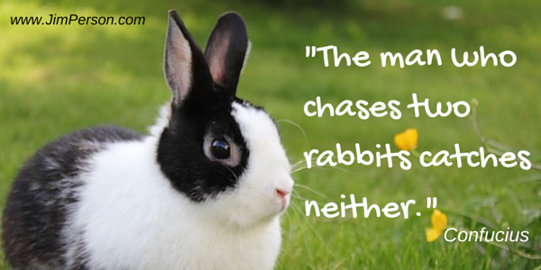
Know what you want
Notes:
Have an idea(s) about what you want! You can’t sell what you don’t have.
Cannot enter this phase of preparation/selling posture if you are unclear/vague. It all builds from clarity about what you want.
Aimlessness: procrastination, hesitance, boredom, sloth

Slide 10

Channel your inner puppy!

Slide 11
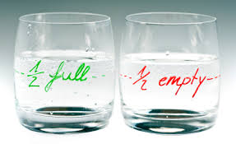
Your attitude is a huge factor.

Slide 12


RESEARCH career-related information (via careers.umbc.edu/tools/tools-for-exploring-majors-careers)

Slide 13

Gather additional career-related information through Informational Interviews
Great way to gather information about a career path/industry in a relaxed setting.
May lead to opportunity to job shadow/volunteer/internship.

Slide 14

Test the waters (your hypothesis) & gain experience
Complete an internship/research experience in a major-related field.
Schedule appointments with the Career Center to improve your interview techniques and how to conduct a job/internship search.

Slide 15

Intern Success Practicum (PRAC 95/98/99)
Professional Growth
Support of Career Center
Feedback
Zero Credit, pass/fail
FREE
Assignments online
Offered each semester

Slide 16
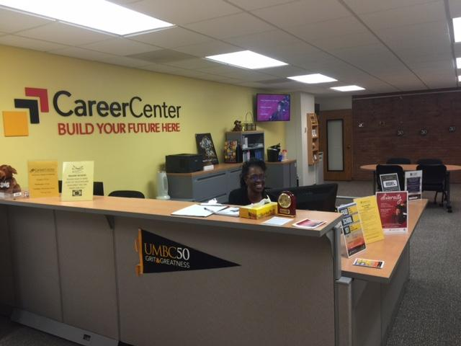
UMBC Career Center
Campus Location: Math/Psych. Bldg. – 2nd Floor
Hours: 8:30AM - 5:00 PM (M-F)
Website: careers.umbc.edu

Slide 17
Snapshot of Services
Document Preparation
(resumes/CVs, personal statements, cover letters)
Internship/Research/Job search assistance
Interview preparation service workshops
Employer connections (Events)
Database of jobs, internships & research opportunities (UMBCworks)

Slide 18
ALUMNI STORIES
Amanda Balog, Biological Sciences '15, Genetic Counselor, GeneDx
Bri’Anna Horne, Biological Sciences ‘17 Clinical Coordinator/Microbiologist, Adaptive Phage Technologies
Brian Koch, Physics '16 Quantitative Analyst, T. Rowe Price
Sarah Luttrell, PhD, Biological Sciences '17, Research Assistant, Smithsonian Institution, Feather Identification Lab, Natural Museum of Natural History
Rachel Schmitz, PhD, Chemistry '16, Consultant,
Latham BioPharm Group

Slide 19
RAFFLE!

Slide 20

What inspired you tonight?

Slide 21

Parting words of wisdom
“Don’t seek to make a living…
…..seek to make a difference.”
Denzel Washington, actor

