Slide 1
Graduate School 101
Navigating the Application Process: So you want to go to Graduate School?
K. Jill Barr, J.D., M.Ed.
Associate Vice Provost for Graduate Education, Senior Assistant Dean for Graduate Enrollment Management

Slide 2
Understanding the Process
Time
Management
Professionalism.
Taking the right standardized Test: GRE, GMAT, LSAT, MCAT, etc.
Financial Considerations.
Applying: Best Fit Schools.

Slide 3
Standardized Test
Usually Required
Graduate School
GRE General Test & GRE Subject Test
Professional School
MCAT – Medical and Dental Schools
GMAT – Business Schools
LSAT – Law Schools
GRE – Accepted by Some Business & Law Schools

Slide 4
Take Time to Prepare for Standardized Tests (check requirements)
Campus based prep
Commercial preparation
Software
Preparation in advance will result in a better score.

Slide 5
What Program? What School?
What subject(s) do you enjoy?
What are your skills?
What are your goals?
Where do you want to live?
To Learn More:
Website (individual schools as well as career related)
Career counseling (check out your schools’ center)
Professional Journals/Conferences
Consult professionals who are working in the field you are considering.

Slide 6
What Program? What School?
Compile a primary list of institutions; consider costs quality of program, and funding options
Maintain an activity log or calendar to stay on track
Create professional email addresses/social media
Enhance and update resume with information on summer internships, scholarly papers, research experience
Remove any social media info that is unprofessional

Slide 7
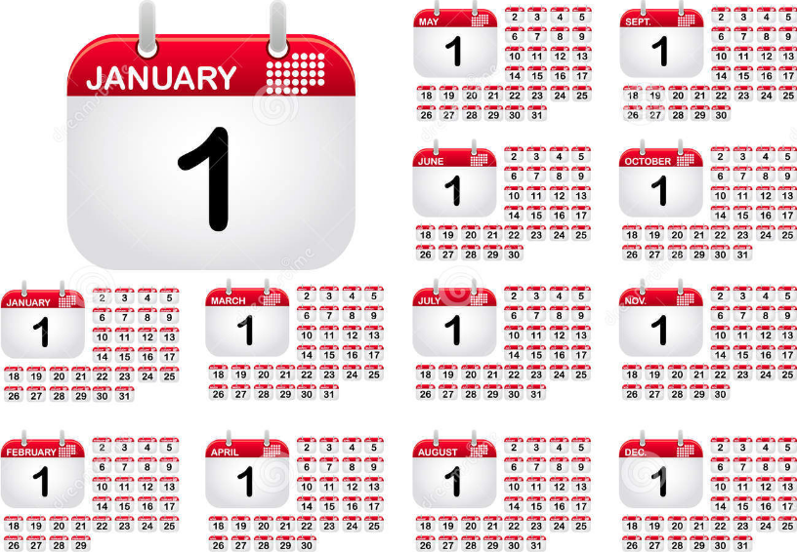
What Program? What School?
Steps to Take In the Year Before Applying:
Consult Faculty as Recommenders
ASK: Will you be able to give me a strong recommendation for Graduate School?
Make appointments with Recommenders and Advisors
Discuss your initial list of schools with them

Slide 8
Before Meeting the Recommender, Help Them Help you
Request unofficial copy of your transcript to give to your recommender.
Use the career center for resume assistance and resource materials.
Write a small summary of your activities.
Share your personal statement and your resume with your reviewer.

Slide 9
Before Meeting the Recommender, Help Them Help you
List the names of the institutions with the dates by which you would like forms emailed or uploaded to your institution.
Share your resume/CV and personal statement to your recommender.
Send a reminder email several days in advance.

Slide 10
Time to Apply
Take the required tests, GRE/Subject Tests – allow for time to retake the exam
Finalize Personal Statement/Statement of Purpose (consult others)
Request all required official transcripts

Slide 11
Time to Apply
Apply On-line.
Be consistent. Use the same legal name at all times (unless name has changed).
Double check for errors.
Become an informed applicant – speak to the program’s faculty/staff and the mentors with whom you wish to work.

Slide 12
Developing Professionalism: Identify Mentors
A mentor can help you to develop a deeper understanding of your chosen field and connect you with others in the field.
Finding potential mentors
Current professors
Authors of scholarly publications
Professors from summer research programs
Supervisors from summer/semester internships/jobs

Slide 13
In Summary
Find the Right School
Pay Attention to Deadlines
Develop a professional persona
Gain Knowledge of Your Chosen Field
Make it Happen
With efficiency and careful planning, the right university will say to you:
Welcome to Graduate School!

