Slide 1
For the Love of Research
Dr. April Householder
Director of Undergraduate Research and Prestigious Scholarships
aprilh@umbc.edu

Slide 2
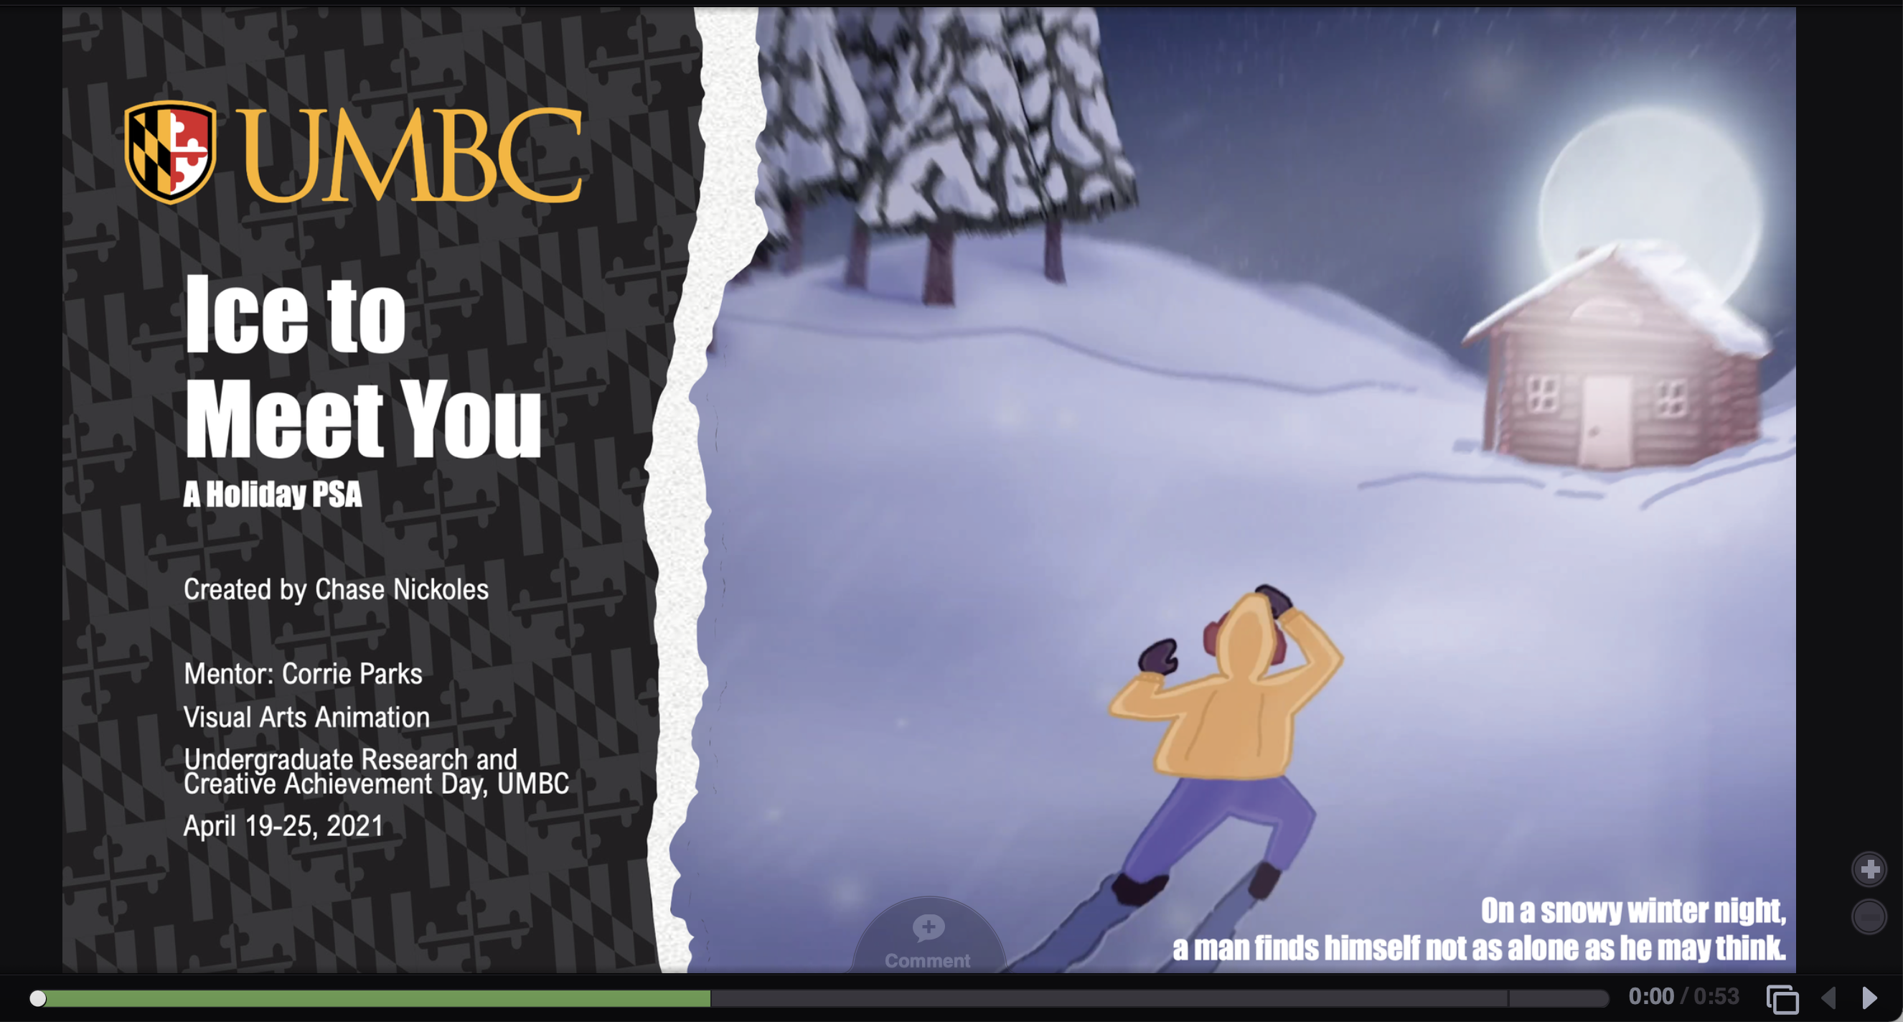
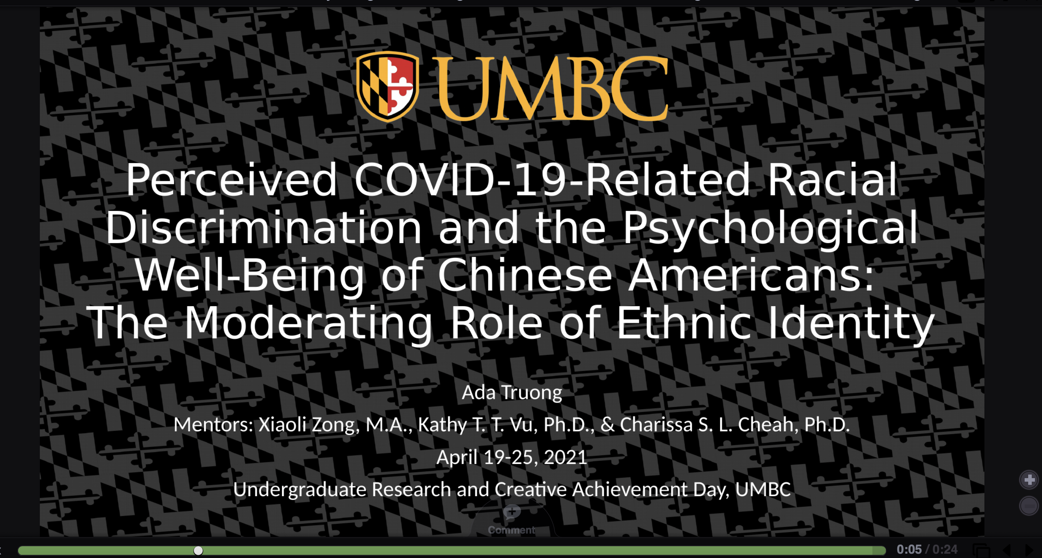
Research is boring. Why should I get involved?
“Research” means a lot of different things, depending on your field and your approach. Working in a lab is one thing, but you can also:
  Make art! Films, music, poetry, dance, theatre…
  Solve important social problems! BLM- Corona Virus
  Invent stuff! Video Game Developers Club, robotics
  See URCAD presentations: https://urcad.umbc.edu/departments/
Going to graduate school or planning to get a job?
strengthen your resume
network with people who work in your field- REUs
get a strong letter of recommendation
try out different career paths and decide what you like/don’t
improve your writing and public speaking- UMBC Review, URCAD
prepare to apply for a prestigious scholarship
Travel!
Research happens everywhere!
Get $$$$ for travel- URA program, Travel Awards

Slide 3
How Do I get started?
Prepare
What areas of study interest you? Find your passion!
What texts got you excited? Learn something about current topics in your field
Listen, read, ask questions!
Determine how much time you have each week, to devote to research
For the sake of grades and course loads, is it better to do summer or winter research?
Consider making research part of your study abroad experience
Transfer students should start now!!

Slide 4
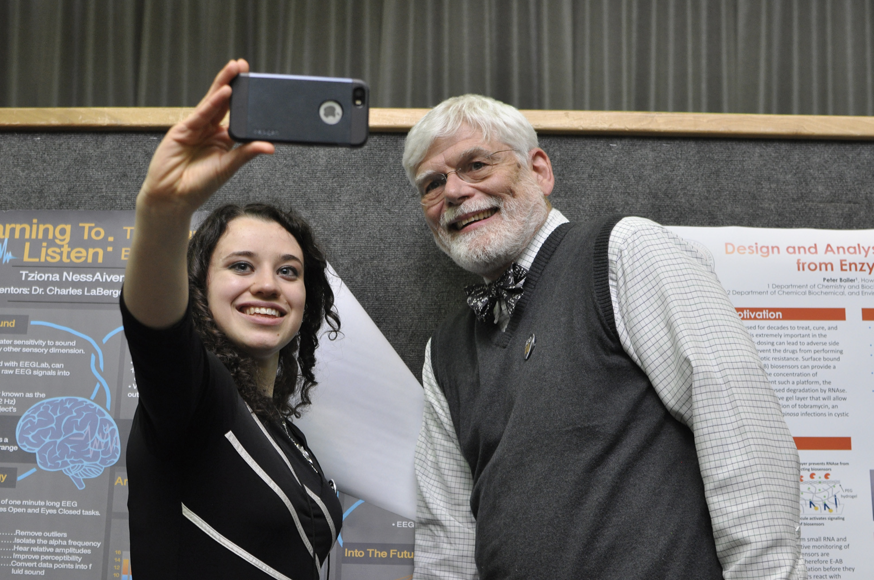
Identify potential mentors
Look at departmental websites
  Look over professors’ CVs, research interests, labs, publications,
  and teaching. Where did they go to school?
  Make an appointment to meet IN PERSON (or Zoom!)
  Send your resume/transcripts ahead of the meeting
  Read something they’ve written before meeting
  Don’t take it personally if the mentor is unavailable (make a list of 3-4)
  If you do interdisciplinary work, consider having more than one mentor
  Speak with grad students, advisors, and other professors
  Find out who regularly mentors undergraduates (see ur.umbc.edu)
  Look beyond the UMBC campus
  For summer REUs, see spreadsheet: ur.umbc.edu (fall deadlines)
Transfer students need to make connections fast!

Slide 5

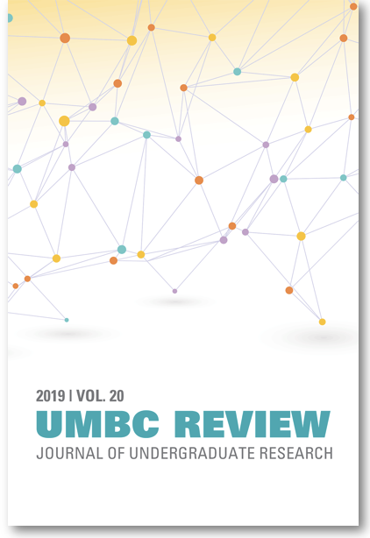
Once you start a research project
Take the work seriously and make it a priority in your schedule
Be reliable
Get results- you want to be able to talk about impacts
Remember, your mentor will be your primary letter writer for graduate school, job applications- nurture the relationship
Discuss what their mentoring style is- hands on? Regular deadlines/meetings? Find someone who is not only good on paper, but who is also the right fit
Discuss whether you can get paid for your work (See SURE program)
Discuss whether you can get credit for your work (either independent study in your department or PRAC- Career Center)
Begin your proposal for applying for a URA Award (May 3 deadline, $1500)
If you will have results by April, participate in URCAD Online, April 2022. (February application deadline) URCAD.umbc.edu
Submit your results for publication in the UMBC Review
Top-tier students should consider applying for prestigious scholarships

Slide 6
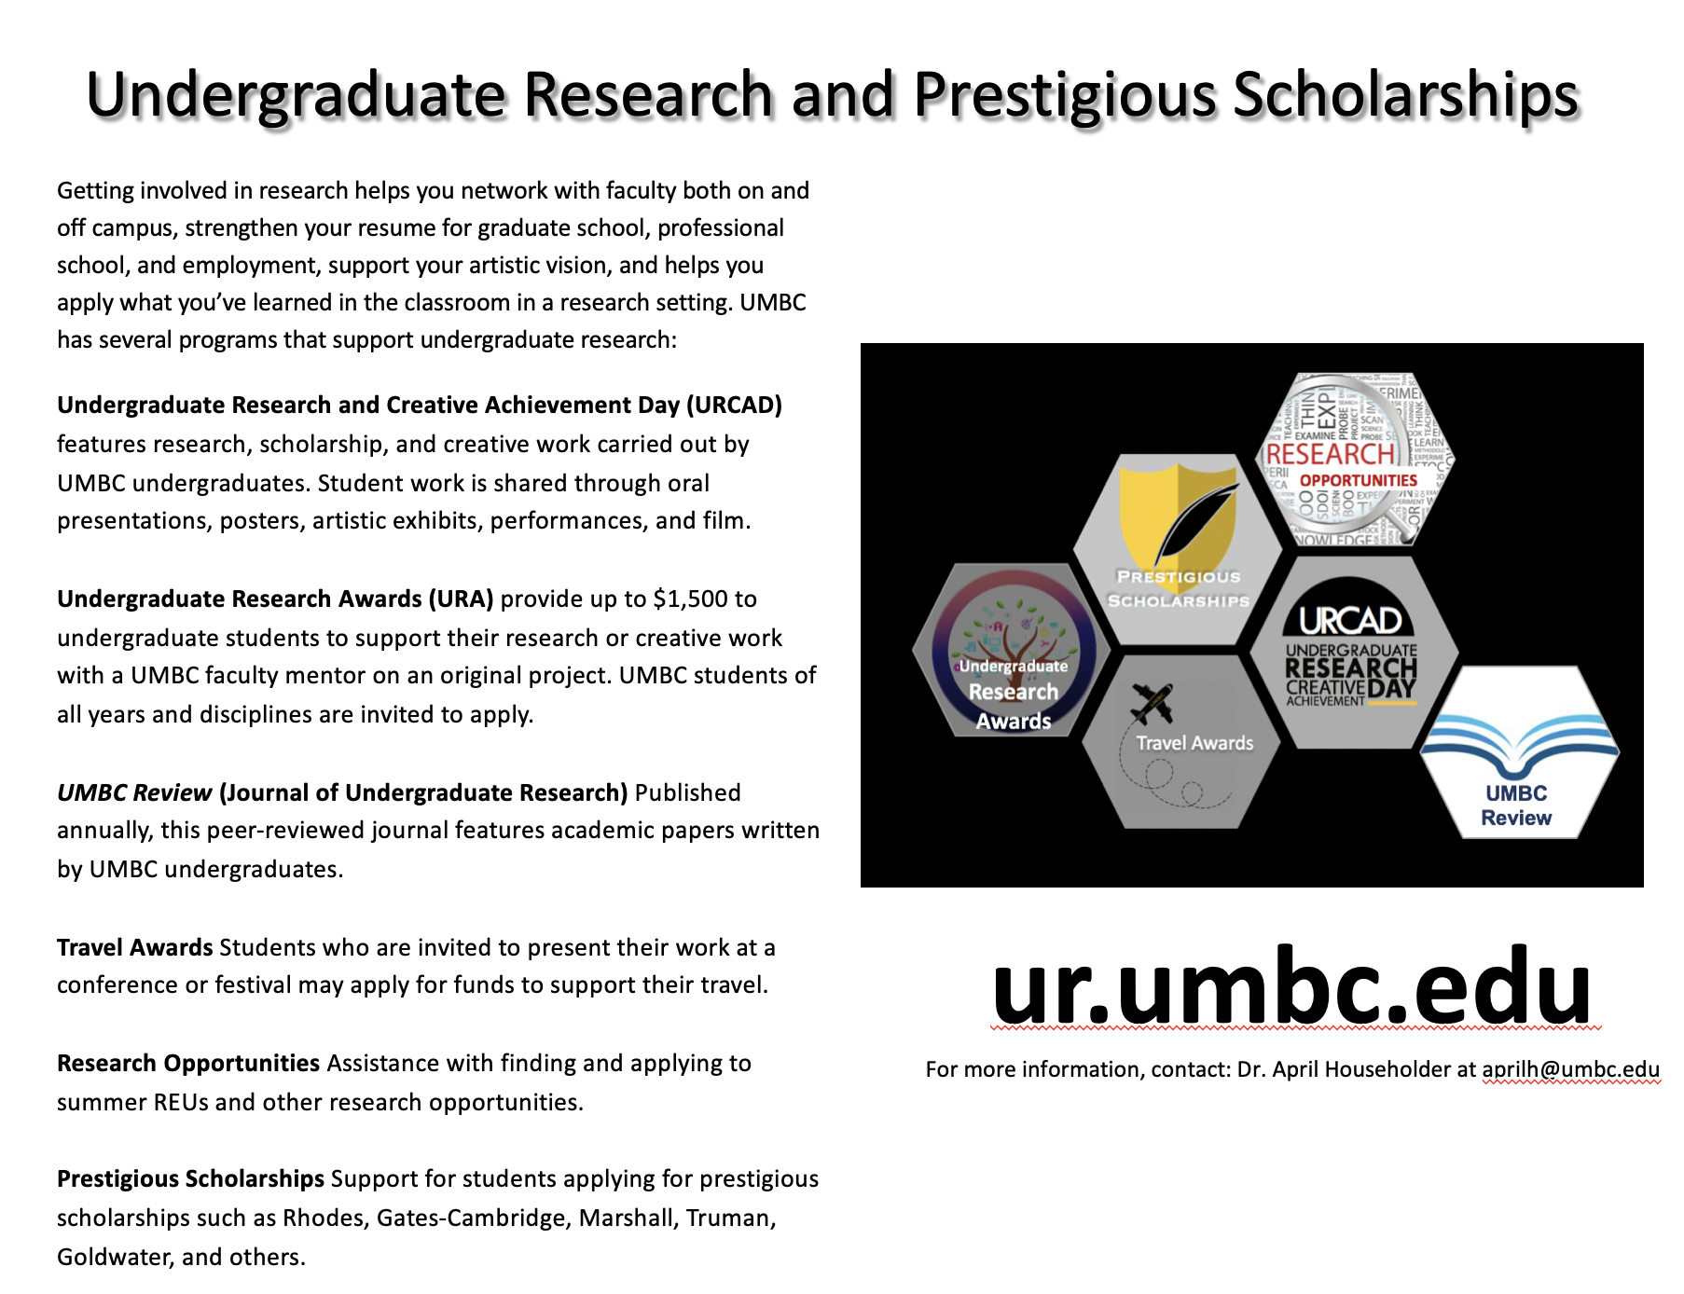
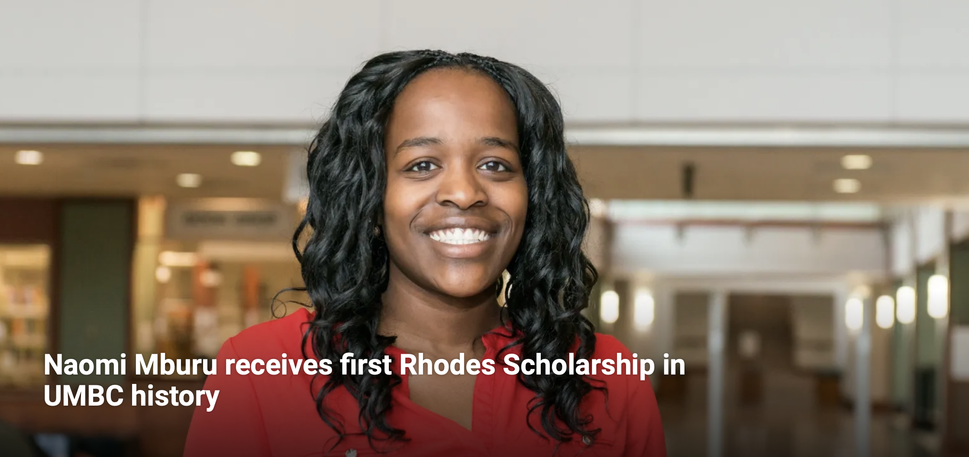
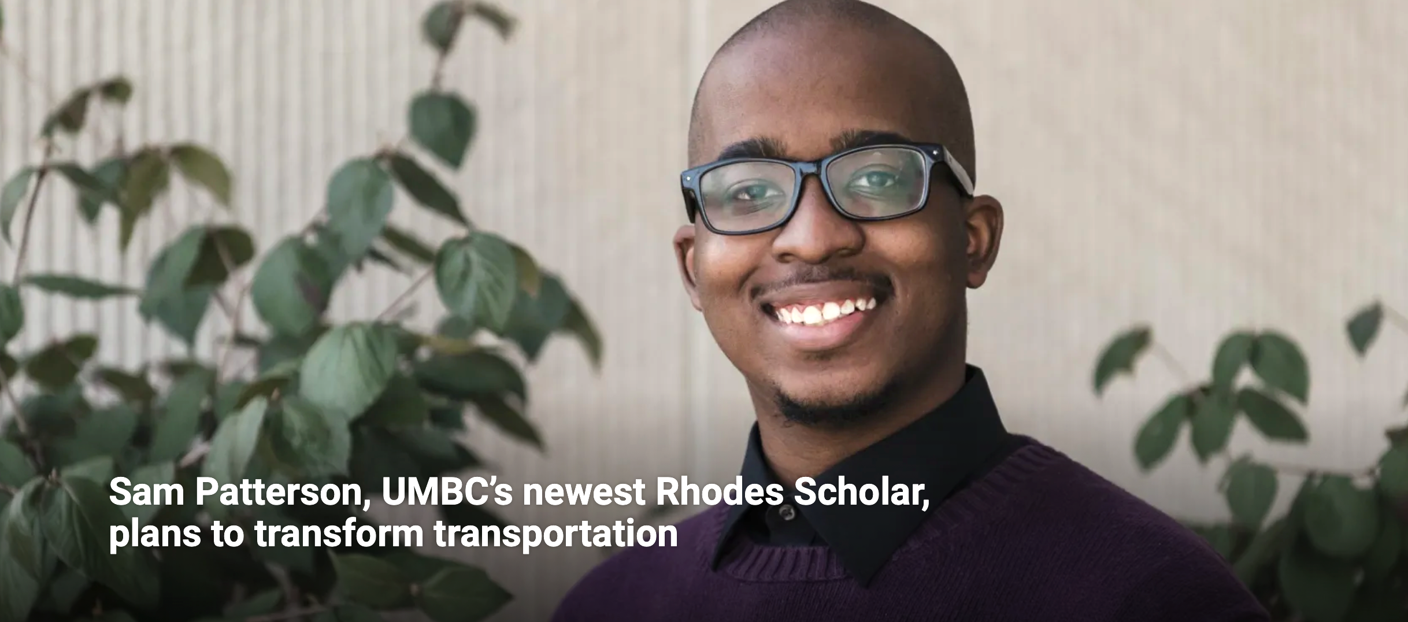
U.K. Scholarships:
Rhodes (Oxford U.)
Gates (Cambridge)
Marshall (roaming)
Truman (Jr.- public service)
Goldwater (So./Jr. STEM)
Knight-Hennessy (Stanford)

Slide 7
For more information, remember…
aprilh@umbc.edu

