Slide 1

Graduate School 101
Navigating the Application Process
Robin H. Cresiski, PhD
Associate Vice Provost for Graduate Student Development & Postdoctoral Affairs
Notes:
About me, reminder that there are very specific things required for law school, medschool, PhD programs, and this presentation is general.

Slide 2





Understanding the Process
Financial Considerations.
Time
Management
Professionalism.
Choosing what you want to do
Application & Letters of Recommendation
Test Requirements

Slide 3

What Program? What School?

Slide 4

Tests

Slide 5
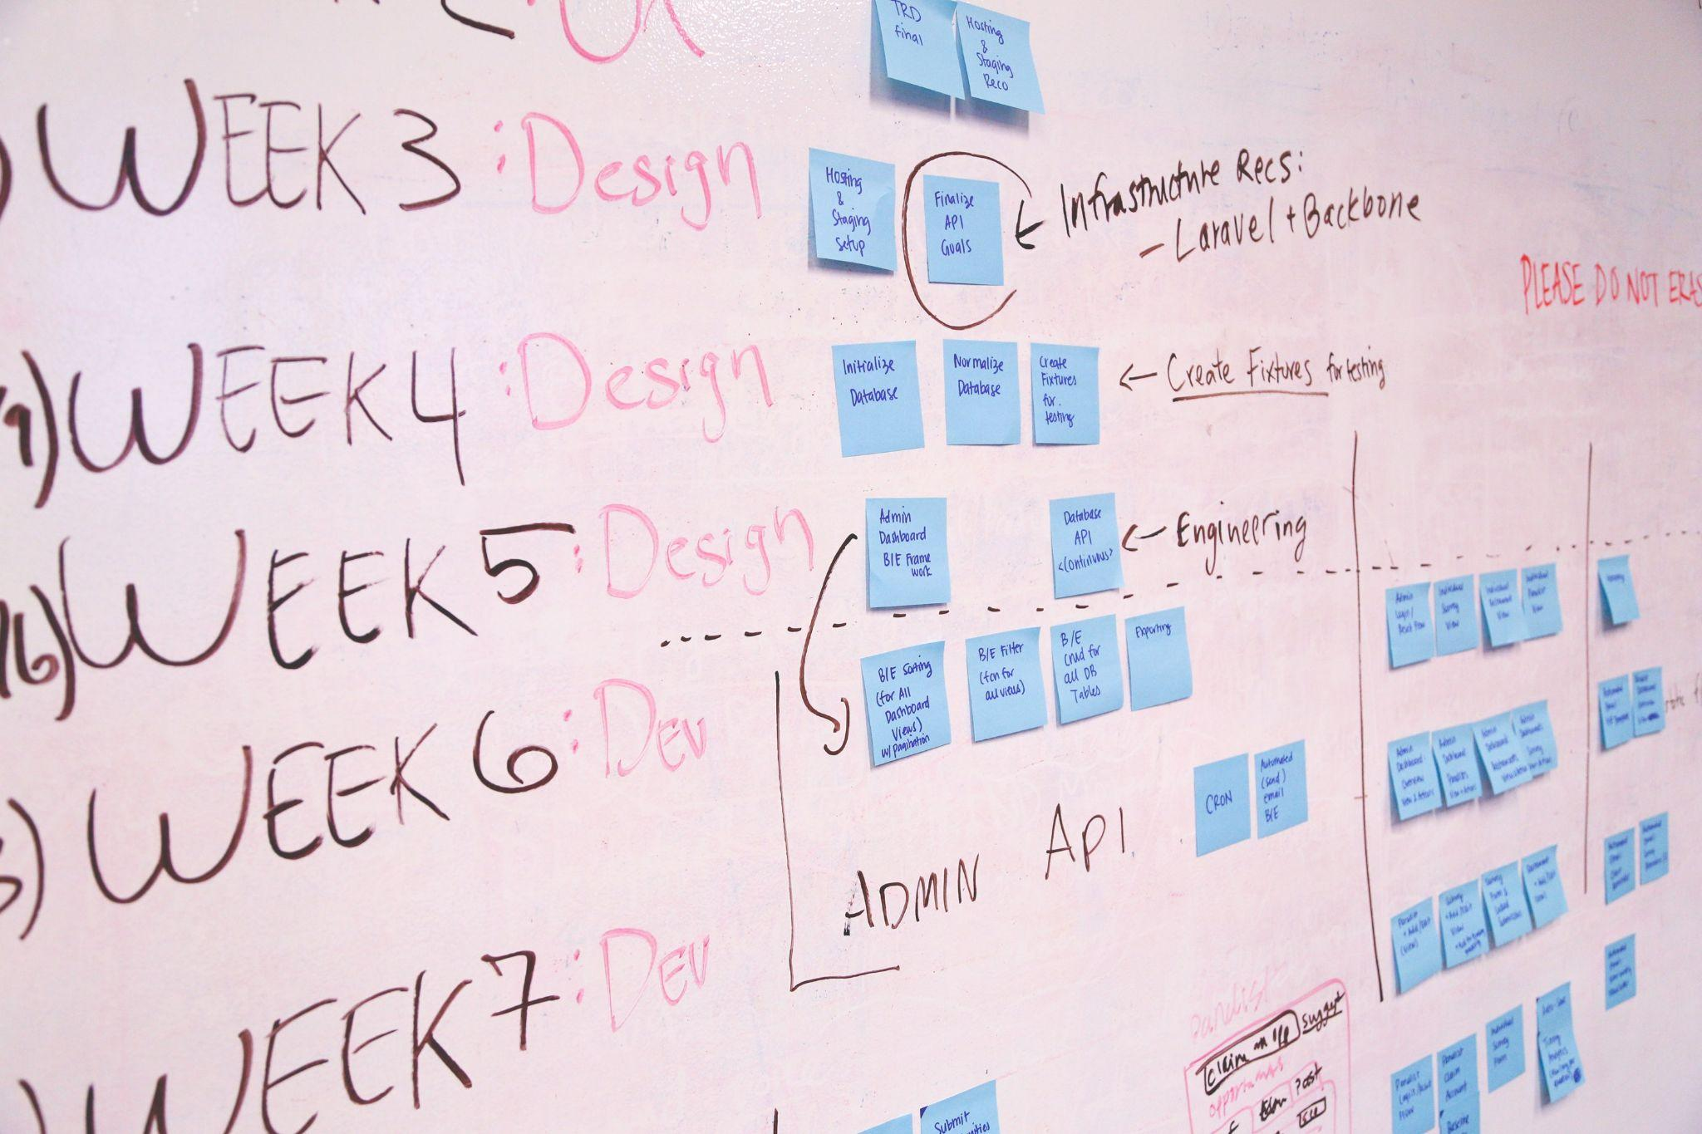
Preparation

Slide 6

In Advance: Letters of Recommendation

Slide 7

Preparing your Letter-writers

Slide 8

Applying
Required Tests
Know your deadlines
Personal Statement
Letters Requested
Transcripts Requested
Apply Online

Slide 9

Avoid Pitfalls

Slide 10

Find Mentors to Help

Slide 11


Proper preparation will be worthwhile.
Welcome to
Graduate School

Slide 12
Take Time to Prepare for
Standardized Tests
(check requirements)
Campus based prep
Commercial preparation
Software
Preparation in advance will result in a better score.

Slide 13

Standardized Tests
Sometimes Required
Graduate School
  GRE General & Subject
Professional School
  MCAT – Medical and Dental Schools
  GMAT – Business Schools
  LSAT – Law Schools
  GRE – Accepted by Some Business & Law Schools
Notes:
GRE is becoming required less often - but some programs still require it. Do your homework.

Slide 14

What Program? What School?
What subject(s) do you enjoy?
What are your skills?
What are your goals?
Where do you want to live?
To Learn More:
  Website (individual schools as well as career related)
  Career counseling (check out your school’s center)
  Professional Journals/Conferences
Consult professionals who are working in the field you are considering.

Slide 15
What Program? What School?
Compile a primary list of institutions; consider costs quality of program, and funding options
Maintain an activity log or calendar to stay on track
Create professional email addresses/social media
Enhance and update resume with information on summer internships, scholarly papers, research experience
Remove any social media info that is unprofessional

Slide 16

What Program? What School?
Steps to Take In the Year Before Applying:
Consult Faculty as Recommenders
    ASK: Will you be able to give me a strong recommendation for Graduate School?
Make appointments with them & advisors
Discuss your initial list of schools with them.

Slide 17
Before Meeting the Recommender, Help Them Help you
Request unofficial copy of your transcript to give to your recommender.
Use the career center for resume assistance and resource materials.
Write a small summary of your activities.
  classes taken with them (when) & grades, growth you experienced in their class, highlight moments/skills demonstrated.
Share your personal statement and your resume with your reviewer.

Slide 18

Before Meeting the Recommender, Help Them Help you
List the names of the institutions with the dates by which you would like forms emailed or uploaded to your institution.
Share your resume/CV and personal statement to your recommender.
Send a reminder email several days in advance.

Slide 19

Time to Apply
Take the required tests, GRE/Subject Tests – allow for time to retake the exam
Finalize Personal Statement/Statement of Purpose (consult others)
Request all required official transcripts

Slide 20

Time to Apply
Apply On-line.
Be consistent. Use the same legal name at all times (unless name has changed).
Double check for errors.
Become an informed applicant – speak to the program’s faculty/staff and the mentors with whom you wish to work.

Slide 21
Developing Professionalism: Identify Mentors
A mentor can help you to develop a deeper understanding of your chosen field and connect you with others in the field.
Finding potential mentors
    Current professors
    Authors of scholarly publications
    Professors from summer research programs
    Supervisors from summer/semester internships/jobs

Slide 22
In Summary
Find the Right School
Pay Attention to Deadlines
Develop a professional persona
Gain Knowledge of Your Chosen Field
Make it Happen
With efficiency and careful planning, the right university will say to you:
Welcome to Graduate School!

