Slide 1

Personal Statements That Get Attention
Dr. Rowena Winkler
Assistant Director for Graduate Student Career Development
UMBC Career Center

Slide 2
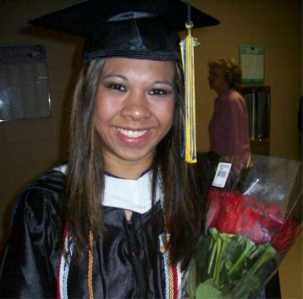
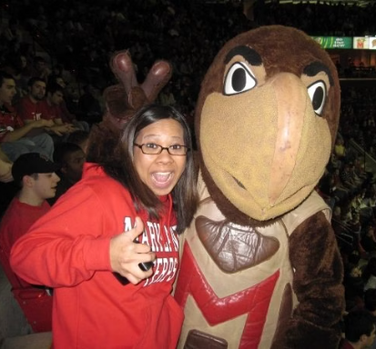
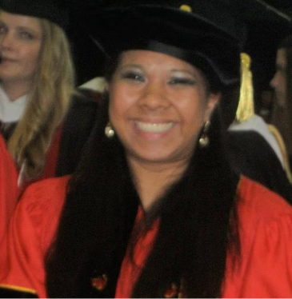
My Graduate School Journey
From undergrad…
…to master's student
…to Ph.D.

Slide 3




Types of Essays
Personal Statement
Statement of Purpose
Research Statement
Secondary Essays
A personal statement is a general essay about your experiences and why you want to attend this specific program.
A statement of purpose is a specific essay about your goals and how this program will help you reach those goals.
A research statement is a detailed explanation of your research interests and your plans for future research.
Secondary essays are supplemental essays that respond to specific prompts provided by the program or university.

Slide 4

What is a Personal Statement?
1
First Impression
2
Writing Skill
The personal statement is your first impression on the admissions committee. It's your chance to make a strong first impression.
It allows the committee to gauge your writing skills and how effectively you can communicate your ideas.
3
Your Voice
4
Reflection
The personal statement is an opportunity to present your unique voice, interests, and motivations. It's your chance to share your story and why you are applying.
A personal statement is a chance to reflect on your journey, both personally and academically. It's a chance to share what has shaped your interests and goals.

Slide 5

What is a Statement of Purpose?
Academic Focus
Reasons for Studying
The Statement of Purpose (SOP) emphasizes your academic and professional achievements in a specific field.
This essay explains your motivations for pursuing a degree in this field of study.
Future Goals
The SOP also outlines your long-term goals in the chosen field.

Slide 6
Difference between SOP and PS?
Statement of Purpose
Personal Statement
A statement of purpose outlines your academic qualifications and career aspirations. It demonstrates your interest in the program and how your skills and knowledge align with the program's goals.
A personal statement emphasizes your personal motivation for applying to the program. It showcases your experiences, accomplishments, and challenges that have shaped your path and fueled your passion for this field.
Academic strengths
Personal motivations
Research interests
Major accomplishments
Career goals
Challenges faced
Program fit
Personal growth

Slide 7




Personal Statement or Statement of Purpose?
Same Goal
Both statements demonstrate your fit for the program and showcase your strengths, experiences, and goals.
Double Duty
Some schools require both a personal statement and a statement of purpose.
Combined Statement
Some programs may request a comprehensive statement that combines elements of both PS and SOP.

Slide 8

Personal Statement of Purpose
1
Comprehensive Statement
2
Goals and Motivation
This statement allows you to communicate your future academic and professional aspirations, as well as any personal motivations or aspects of your identity that influence your academic and career goals.
Some graduate programs request one comprehensive statement that encompasses elements of both a personal statement and a statement of purpose.
3
Prime Real Estate
This statement is typically 2 pages in length (single spaced), so use this space wisely to make a lasting impression.

Slide 9
Questions to Ask Yourself Prior to Writing
It is important to ask yourself the “W” questions to better understand your motivations and experiences.
When did you first became interested in this field and what experiences have deepened your interest?
Who inspired you along the way?
Where did that inspiration occur?
Why was this moment important for your career goals?
What are your career goals?

Slide 10

Additionally…
Think about your personal strengths and how they relate to your goals.
How have you overcome obstacles?
Do you have any relevant skills that you can highlight?
What is your connection to the program?
You should clearly state why the program is a good match for you and your future aspirations.

Slide 11

Questions?
This is the time to ask!
Please feel free to ask any questions you have.

Slide 12

Opening Paragraph
Spark Interest
Demonstrate Ability
Start with an intriguing anecdote or a thought-provoking question.
Showcase your writing skills and show your ability to communicate complex ideas clearly.
Introduce Yourself
Share Goals
Briefly summarize your background and explain what makes you a unique applicant.
State your academic and career aspirations, and connect them to the program you're applying to.

Slide 13



Write Informative Body Paragraphs
Research Experience
Provide details on research conducted. Include your role, learned skills, and challenges.
Research Goals
Detail the goals of the research project. Specify your contributions and learned skills.
Career Goals
Demonstrate how your research and experiences connect to your career goals.

Slide 14
Research Experience
Contribution & Skills
Relevance & Impact
Challenges & Solutions
Future Directions
Mention the current status of your research. If a manuscript is in preparation, feel free to state that.
This section gives you the opportunity to highlight your significant contributions to a project. Focus on your unique skills and how they made a difference.
Discuss how your research work fits into the bigger picture. What are the implications for the field? How does it advance the body of knowledge?
Don't shy away from mentioning challenges you faced. How did you overcome them? Highlight your problem-solving skills and resilience.

Slide 15



Write a Conclusive Final Paragraph
Conclusive Ending
Tying Loose Ends
Why These Labs?
Your conclusion should be a strong ending.
Tie up any loose ends by reiterating your career goals and why the program is a good fit.
Explain why you are interested in working in the research labs you’ve mentioned.

Slide 16



Research Statement
Research Experience
Challenges
Manuscript Preparation
Expand on your experiences —highlighting your contributions, skills developed, and the project's broader impact.
Detail the challenges faced, how you overcame them, and the lessons learned.
Highlight your involvement in preparing research manuscripts for publication, demonstrating your writing and communication skills.

Slide 17

Secondary Essays
Why This Program?
Diversity Statements
Secondary essays are your chance to expand on your experiences. Why is this program unique for you? What are the key aspects of the program that resonate with you?
You'll have a chance to speak about your background. Show the admissions committee how your experiences have shaped your views and approach.
Professional Schools
In your essay, demonstrate how you've learned from past experiences. Highlight specific moments that helped you understand your career goals and the role of this program.

Slide 18

The Inside Perspective
1
Who Are You?
2
Learn About Yourself
Admissions committees want to know what motivates you beyond your academic record.
Be genuine and authentic in your essays. Demonstrate self-awareness and self-reflection.
3
Collaboration
4
Interdisciplinarity
Highlight instances where you've worked with others, demonstrating teamwork and interpersonal skills.
Show how your experiences connect different fields, showcasing a broad perspective and adaptability.

Slide 19



This is a Process!
Reflect
1
Give yourself time to reflect before you begin writing.
Revise
2
A conversation about the draft may be worth 2 revisions.
Review
3
Have various people review your essay draft.
Become comfortable with feedback. You may find that your first draft isn't your best. That's normal! The most important thing is to be open to feedback from others.

Slide 20

2 Drafts… become 3, 4, or 5
1
First Draft
An initial draft is the foundation. Focus on your core ideas, goals, and experiences.
2
Second Draft
Revise, refine, and strengthen your writing. Include feedback from peers, mentors, or advisors.
3
Third Draft+
Continue refining and tailoring your essay for specific programs and schools.

Slide 21
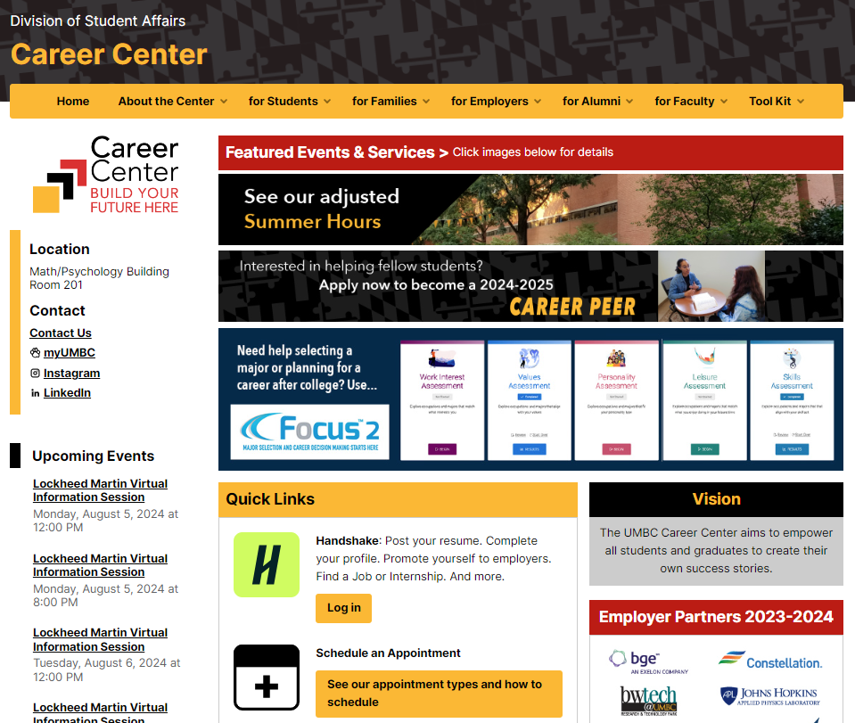
Let Us Help!
The Career Center provides
Personal Statement appointments
to help you work through your drafts.

Slide 22
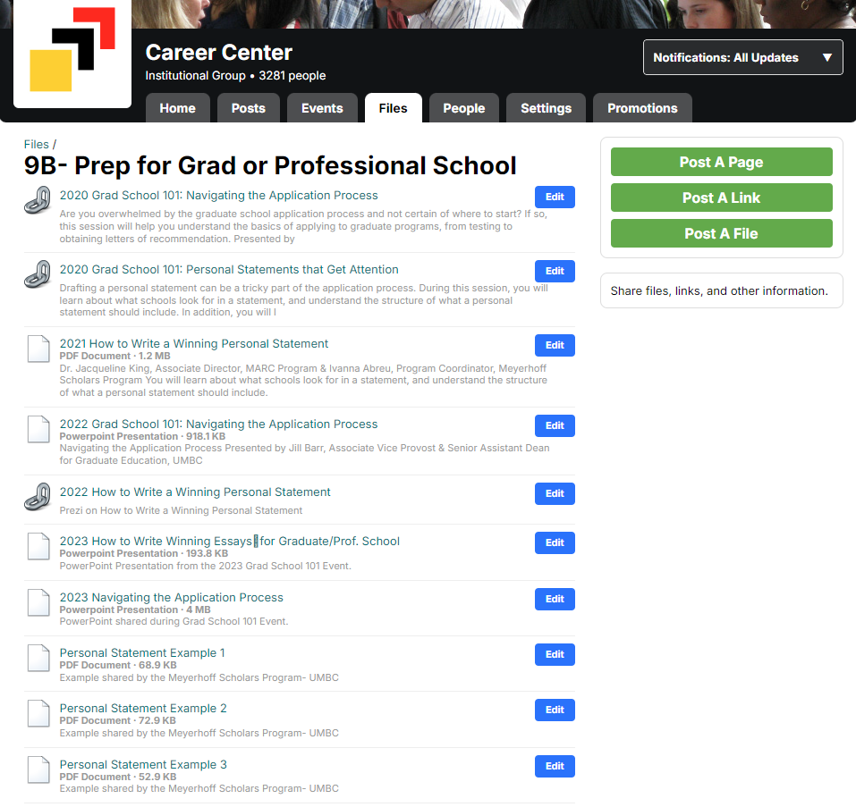
Resources

Slide 23


Additional Resources
EssayEdge
PrepScholar
EssayEdge provides valuable insights on personal statements and statements of purpose, outlining key distinctions between the two.
PrepScholar offers a comprehensive guide to personal statements and statements of purpose, highlighting essential aspects of each.
These resources provide comprehensive information on the purpose and structure of personal statements and statements of purpose, helping you craft compelling and persuasive essays.
https://www.essayedge.com/blog/statement-of-purpose-vs-personal-statement/ https://www.prepscholar.com/gre/blog/statement-of-purpose-vs-personal-statement/

Slide 24

Good luck!
Any questions?
Dr. Rowena Winkler
rbwinkler@umbc.edu

