Slide 1


Writing a Stand-Out Resume
Math/Psychology 201
(410) 455-2216
careers@umbc.edu

Slide 2
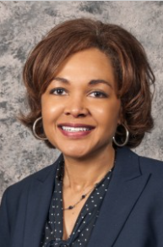
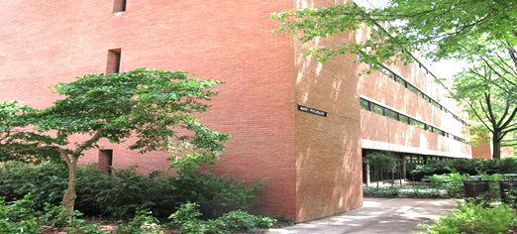
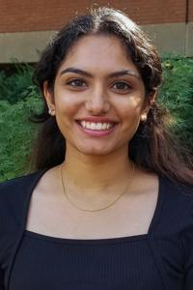
Introduction
Diane Crump-Fogle
Associate Director for Career Development
UMBC Career Center
careers@umbc.edu / crump@umbc.edu
pronouns: she/her/hers
Devanshi Mistry
Career Peer at the UMBC Career Center
Major: Chemical Engineering and Political Science
careers@umbc.edu / dmistry2@umbc.edu
pronouns: she/her/hers
UMBC Career Center
2nd Floor
Math & Psychology Building

Slide 3
Learning Objectives
At the end of the session, students will be able to:
Understand the best resume format for career transitioning
Identify the components of a “standout resume” to use when applying for internships/employment
Apply resume best practices for the creation or updating of your own documents.

Slide 4
Take a Guess….
On average, how long does a recruiter spend reviewing a resume?
6-8 Seconds

Slide 5
What does a “stand-out” resume look like?
WELL-STRUCTURED (clear, consistent format)
CORRECT (follows basic resume rules)
TARGETED (emphasizes skills, experiences, classes that relate to the position)
DETAILED (gives examples, numbers)

Slide 6
Transitioning Your Resume
OUTDATED RESUME:
Multiple pages
Includes outdated skills (e.g. typing speed, faxing, obsolete software)
Uses a standard Microsoft Office template
Stays the same, no matter what you’re applying for
Lacks keywords that align with modern applicant tracking systems (ATS)
NEW RESUME:
One page (two pages, if relevant)
Focuses on achievements, quantifiable results, and impact in past roles
Streamlined, original format
Designed to be adapted to fit each position
Includes recent education, training, projects, or coursework relevant to career goals

Slide 7
Formatting Your Resume
Step One

Slide 8
Keys To a Good-Looking Resume
Keep it to one page! Adjust font size (between pt. 10.5-12 is OK) and margins (0.5”-1”) if needed
  However, you may have two pages if you have experience relevant to the position
Use no more than two fonts
Ensure that all tabs and bullets are aligned
Ensure that bold, italics, ALL CAPS, underline, etc. are used sparingly and consistently
DID YOU CHECK FOR TYPOS?? DON’T RELY ON SPELL CHECK

Slide 9
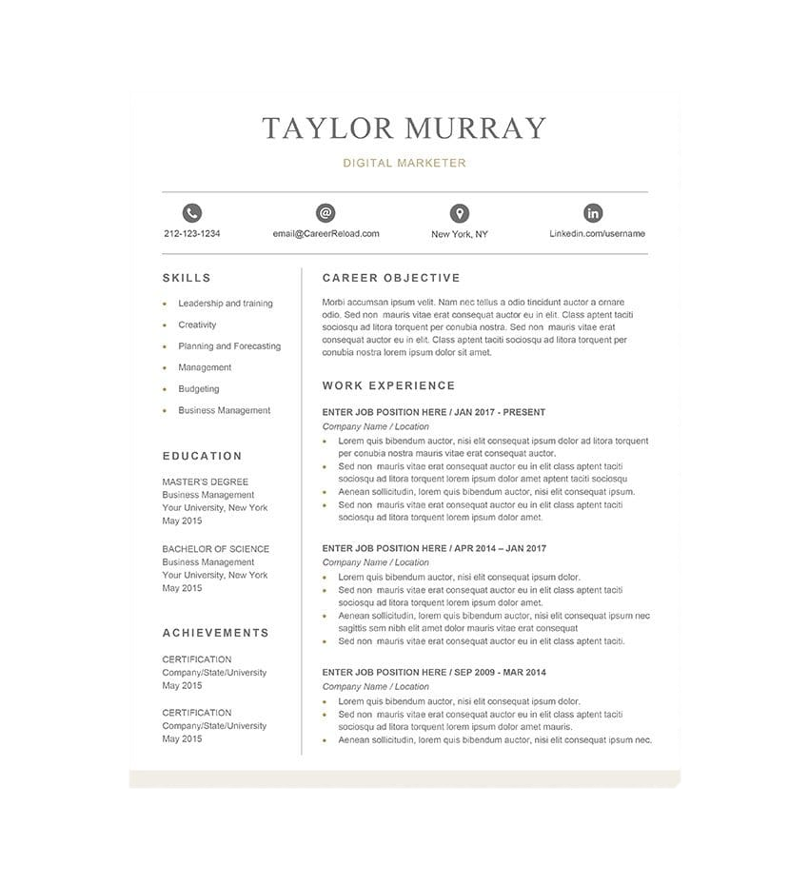
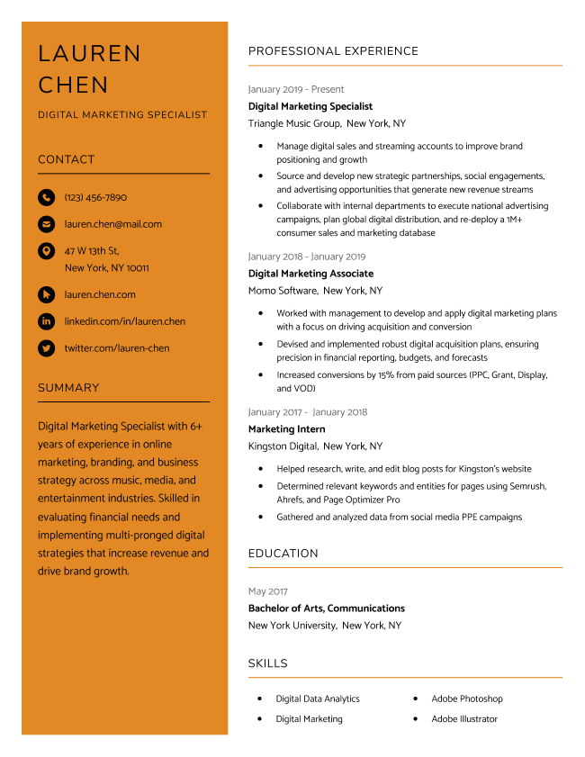
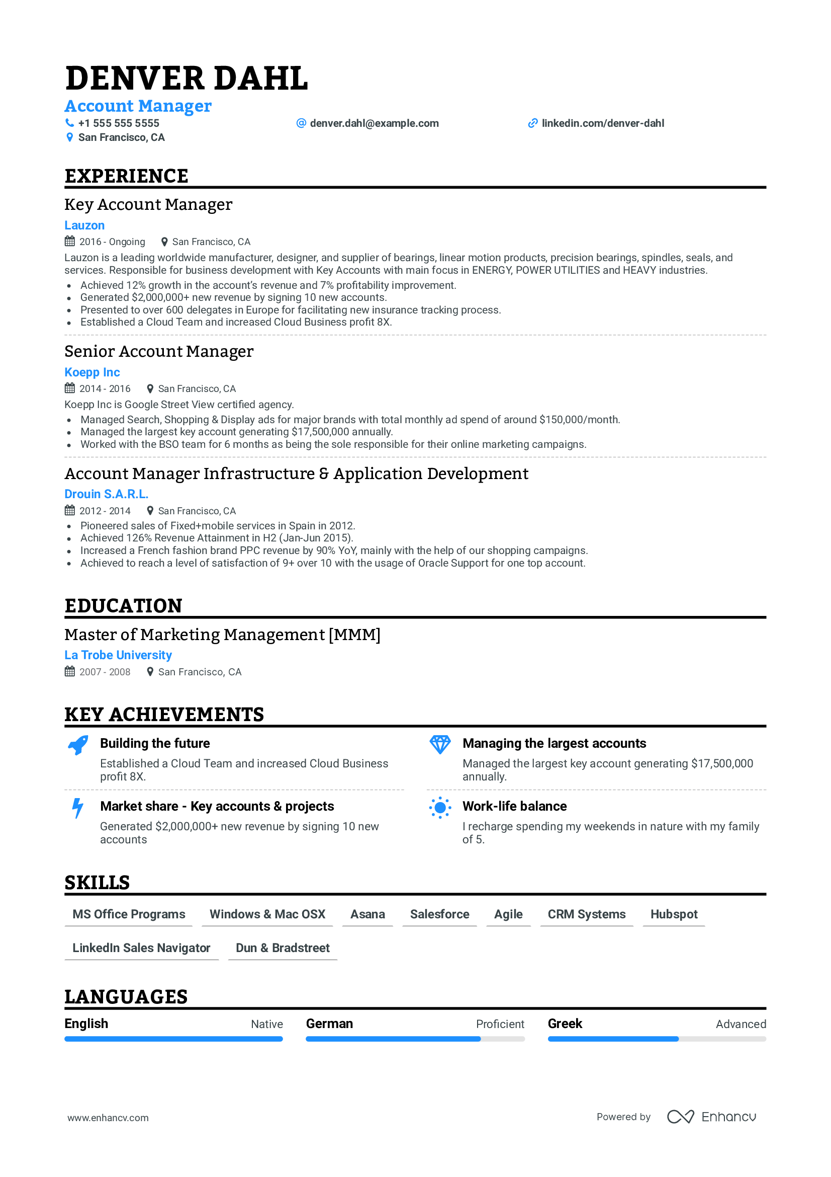
Templates – Unoriginal and Limiting

Slide 10
Structuring Your Content
Step Two

Slide 11
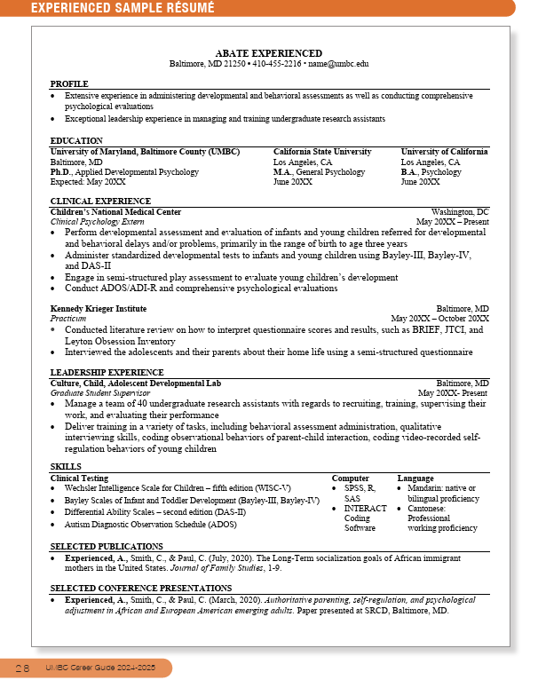
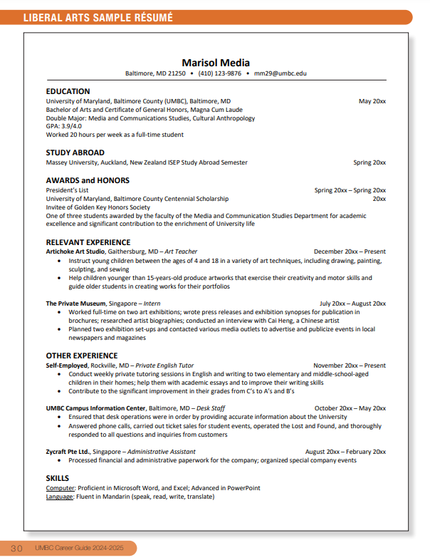

Sample Resume: Entry-level
Resume Guidelines: Pg. 18-25 of UMBC Career Guide
Sample Liberal Arts resume: Pg. 30 of UMBC Career Guide
Entry-level resumes are recommended for current students and recent graduates with limited relevant work experience.

Slide 12
Sample Resume: Experienced
Pg. 28 of UMBC Career Guide
This resume is for those looking to advance themselves in the field they are currently working in. It emphasizes work history and career progression.

Slide 13
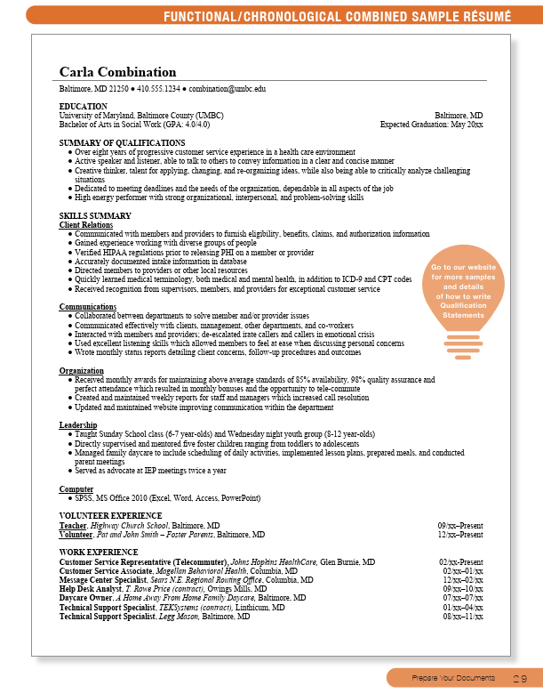
Sample Resume: Functional/Chronological
Pg. 29 of UMBC Career Guide
This resume is recommended for career changers. It emphasizes relevant skills and abilities over work history.
Notes:
We will be using this resume as a guide throughout this presentation

Slide 14
Section Headers
MAIN SECTIONS (Non-negotiable):
Name
Contact Info. (Except Street Address)
Education
Experience
Skills
OPTIONAL:
Objective or Summary
Related Coursework
Projects
Volunteering
Campus Activities
Leadership
Honors & Awards
Certifications
Memberships
Publications
Presentations
Notes:
The skills section will be what we want to highlight the most in our career changers resume

Slide 15
Contact Information
Maria Ramirez
Halethorpe, MD 21253
mramirez1@umbc.edu
(410) 455-1234
Or
Maria Ramirez
Halethorpe, MD 21253 ▪ mramirez1@umbc.edu ▪ (410) 455-1234

Slide 16
Education
UMBC Listing:
University of Maryland, Baltimore County (UMBC) Baltimore, MD
B.S./B.A./B.F.A./M.S./Etc. in (Degree Name), GPA: X.XX / 4.00 Expected: Month Year
Community College / Other College Listing (If no A.A. degree or other, good practice is to list GPA and dates):
College Name City, State
A.A./Etc. in (Degree Name), GPA: X.XX / 4.00 Month Year
Example:
University of Maryland, Baltimore County (UMBC) Baltimore, MD
B.A. in Public Health, Major GPA: 3.87 / 4.00 Expected: May 2024

Slide 17
For Each Experience, Include:
Name of organization
City and state (or country)
Your title/job role
Range of dates (including months)

Slide 18
All Experiences Can Count…
Jobs
Internships
Volunteering/Service Learning (significant)
College and Community Activities
Study Abroad
Independent Projects
…IF they are relevant and/or show you in a positive light

Slide 19
Experience
Job Title, Name of Employer, City, State Month Year – Month Year / Present
Action verb followed by what you did, how you did it, and results
Action verb followed by what you did, how you did it, and results
Action verb followed by what you did, how you did it, and results
OR
Name of Employer City, State
Job Title Month Year – Month Year / Present
Action verb followed by what you did, how you did it, and results
Action verb followed by what you did, how you did it, and results
Action verb followed by what you did, how you did it, and results
OR
Job Title, Name of Employer, City, State Month Year – Month Year / Present

Slide 20
Experience
Example:
University of Maryland, Baltimore County – Baltimore, MD May 2020 – January 2024
Research Assistant
Supported three research projects on social determinants of health, resulting in two publications.
Developed and implemented a new data collection tool, increasing efficiency by 20%.
Presented research findings at two conferences, reaching 100+ public health professionals.
OR
Customer Service Representative (Telecommuter), Johns Hopkins HealthCare, Glen Burnie, MD 02/2024 – Present
Customer Service Associate, Magellan Behavioral Health, Columbia, MD 02/2023 – 01/2024
Message Center Specialist, Sears N.E. Regional Routing Office, Columbia, MD 02/2022 – 02/2023

Slide 21
When To Separate Sections
INTERNSHIP EXPERIENCE
Hirsch and Klozman LLC, Silver Spring, MD
Legal Intern September 20XX-December 20XX
Conducted background research to support clients’ civil cases
Managed multiple phone lines, efficiently satisfying each caller’s needs…
WORK EXPERIENCE
Subway, Fulton, MD
Cashier December 20XX-Present
Provide outstanding customer service by greeting each patron and striving to fulfill all orders in under five minutes
Volunteer for the responsibility of closing the store on weeknights…
Can you think of other scenarios where work experience could be further segmented?

Slide 22
Top 20 Skills Employers Seek
NACE Job Outlook 2025
Problem-solving skills
Ability to work in a team
Communication skills (written)
Initiative
Strong work ethic
Technical skills
Communication skills (verbal)
Flexibility/adaptability
Analytical/quantitative skills
Detail-oriented
Interpersonal skills (relates well to others)
Computer skills
Leadership
Organizational ability
Strategic planning skills
Tactfulness
Friendly/outgoing personality
Entrepreneurial skills/risk-taker
Creativity
Fluency in a foreign language

Slide 23
Skills
Data Analysis: SPSS, SAS, SQL, R programming
Computer: Microsoft Office, Google Suites
Language: Spanish (conversational)
Interpersonal: Cultural competence, leadership, collaboration, communication
Additional: Familiar with MLA and Associated Press style guides

Slide 24
Skills: Functional Resume
Identify core skill areas from the job description and group skills into categories
  Example: Technical Skills, Communication, Leadership
Use bullet points underneath each category to provide evidence of your experience in that skill category
  Example:
Communication
Collaborated between departments to solve member or provider issues
Communicated effectively with 20-25 clients, management, other departments, and co-workers daily
Organization
Received monthly awards for maintaining above average standards of 85% availability, 98% quality assurance and perfect attendance which resulted in monthly bonuses and the opportunity to tele-commute

Slide 25
Projects
Format:
Title of Project, Class Name/Company/Organization Month Year – Month Year
Action verb followed by what you did, how you did it, and results
Action verb followed by what you did, how you did it, and results
Example:
Analyzed food access and nutrition in low-income community Aug 2024 – Dec 2024
Collaborated with the City Health Department's nutrition team to conduct a survey assessing food access and dietary habits among residents in a low-income community.
Surveyed residents, analyzed data (SPSS), and recommended solutions to improve food access and nutrition.
Presented findings to city health department and community partners.

Slide 26
Certifications
Format
Name of certification (expiration date, if applicable) Receipt: Month Year
Example
CPR and Advanced First Aid (Expires May 2026) May 2024

Slide 27
Academic Coursework
Good practice is to limit your listings to no more than three lines
Format:
Course Name Course Name Course Name
Course Name Course Name Course Name
Course Name Course Name Course Name
Example:
Introduction to Public Health
Human Health and Disease
Health Communications
Public Health Ethics
Business Ethics and Society
Research Methods in Health
Health Care Organization and Delivery
Global Health and Diseases
Epidemiology

Slide 28
Publications
The recommendation is to refer to APA format for the citations of your published articles.
Format for Publications:
Names (Date of Publication). Title of Publication. Journal Name, Volume(Issue)*, Page Numbers.
*If Applicable
Example for Publications:
Scharrer, E. (2008). Media Exposure and Sensitivity to Violence in News Reports: Evidence of Desensitization? Journalism & Mass Communication Quarterly, 85(2), 291–310.

Slide 29
Presentations
Majority of people with a presentations section list more than one presentation; however, this should not prevent you from including presentations as a section on your resume.
Format for Presentations
Names (Date of Presentation). Title of Presentation. Paper title* “presented at” name of event, city, state.
*If it was a paper being presented, you would include that detail.
Example for Publications
Experienced, A., Smith, C., & Paul, C. (March, 2020). Authoritative parenting, self-regulation, and psychological adjustment in African and European American emerging adults. Paper presented at SRCD, Baltimore, MD.

Slide 30
Participations/Memberships
Example:
Economics Council, Member September 2024 - December 2024
Participated in…
Coordinated…
Communicated…
Supported…
Discussed…

Slide 31
Writing your Bullets
Step Three

Slide 32
Writing Bullet Points: Ask Yourself…
WHAT exactly did I do? (details)
HOW exactly did I do it? (techniques)
WHO was I working with/for?
WHY was I doing it? (higher purpose)
What was the RESULT of my actions?
Bullet Point Formula:
Action Verb + Description + Impact

Slide 33
Writing Great Bullet Points
“Tutored children”
“Tutored two middle-school children in English and math, raising scores by two letter grades”

Slide 34
Writing Great Bullet Points
“Organized store”
“Ensured that storefront remained neat and tidy throughout high-volume shifts”

Slide 35
Writing Great Bullet Points
“Answered phones”
“Managed multiple phone lines for a busy medical practice; balanced efficiency with strong customer service”

Slide 36
Updating a Resume
Because resumes are crafted for job applications, they only need to be updated when you are in active pursuit of a job or career path (and since you are at UMBC, this should mean always).
  Update your resume at least once per semester while in school, if not more
  Update before every career fair or event the school is hosting, or events you are attending elsewhere
  Update as you complete classes, get new GPA’s, involve yourself in organizations, and gain internship or job experience
  Update as you work on research, projects for classes, or if you gain skills specific to your major such as specific softwares

Slide 37
Next Steps
Update your current resume and upload it to Handshake under “Documents”
If you haven’t already, schedule a Career Center appointment
Stop by during in-person drop-in hours: Mon-Thur, 2-4 pm; virtual express appointments: Tue, 5-7pm & Fri, 2-4pm

Slide 38
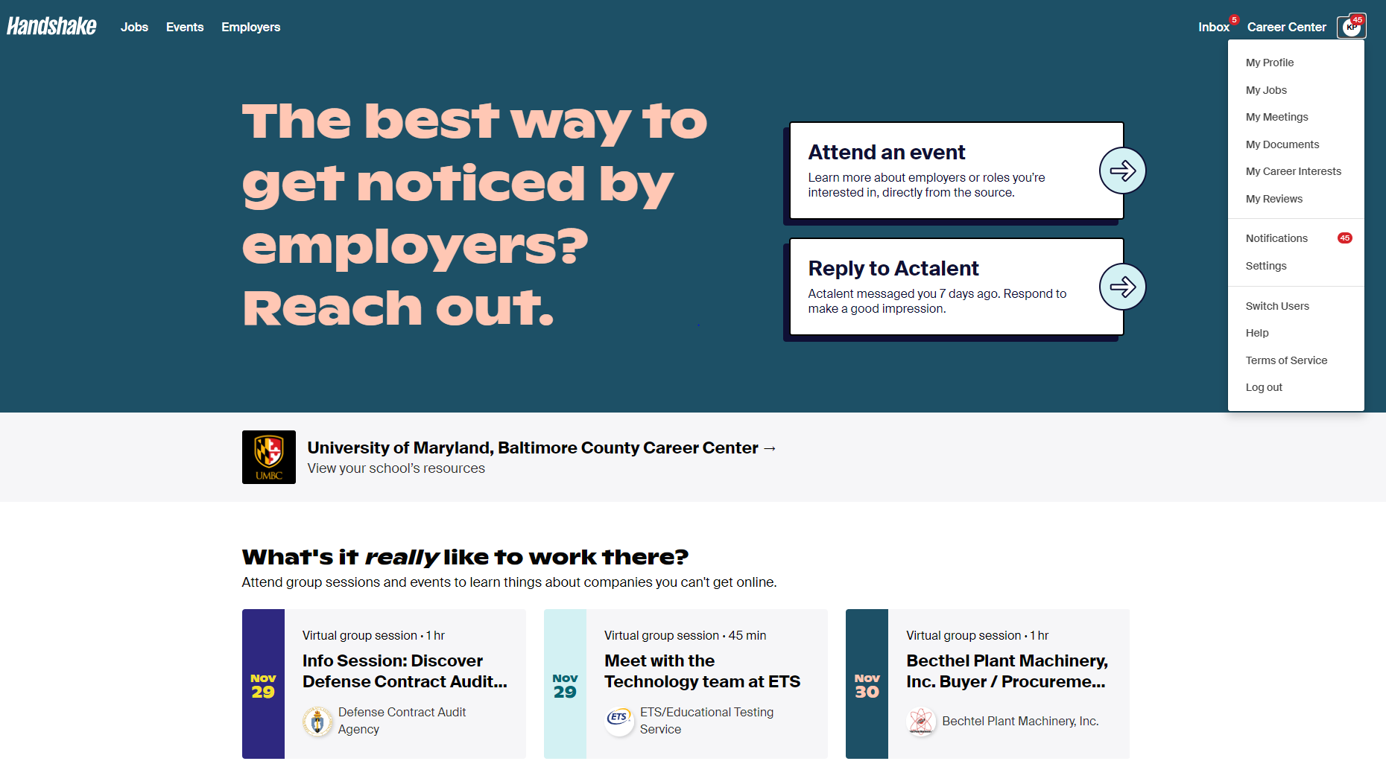
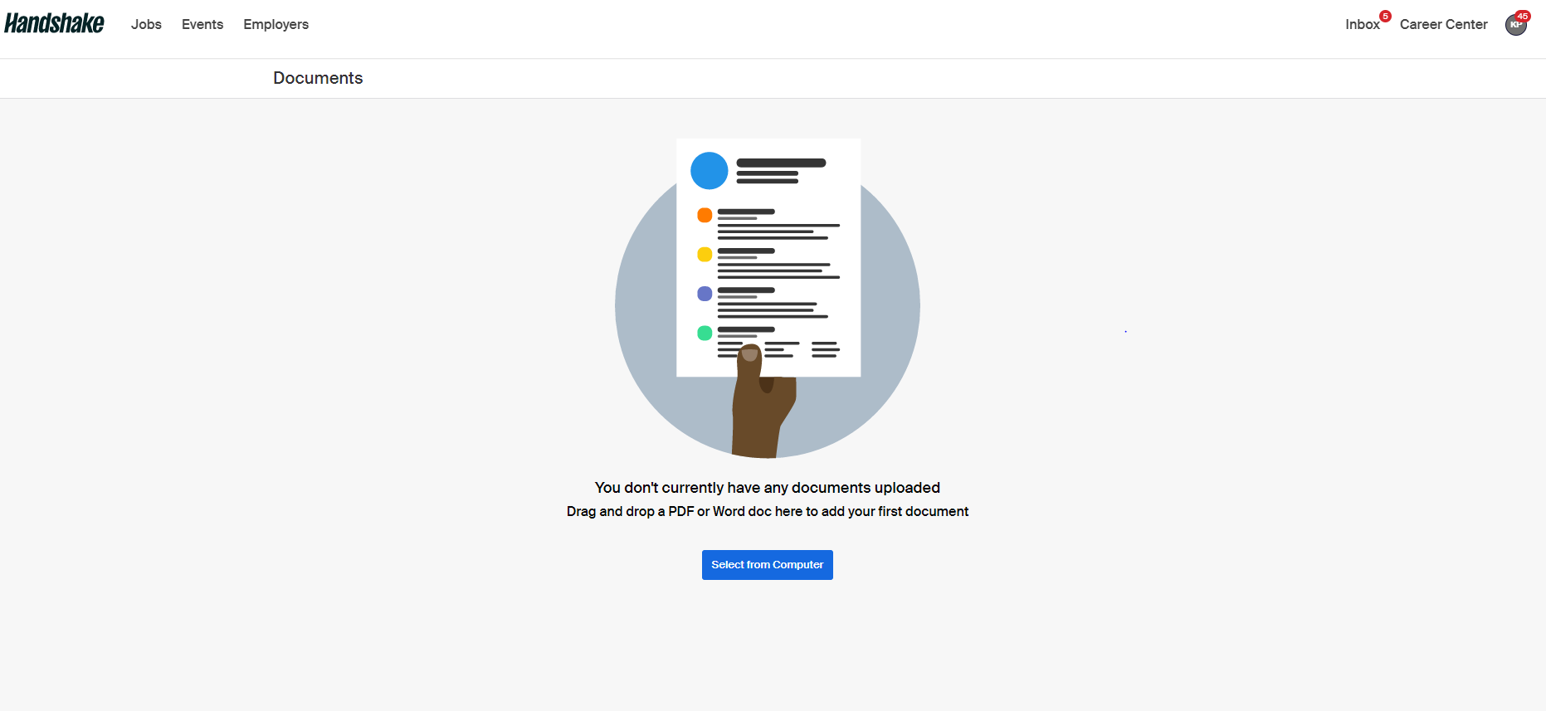
Upload Your Resume
Click “My Documents” from the homepage
Click “Select from Computer”
Upload and submit

Slide 39
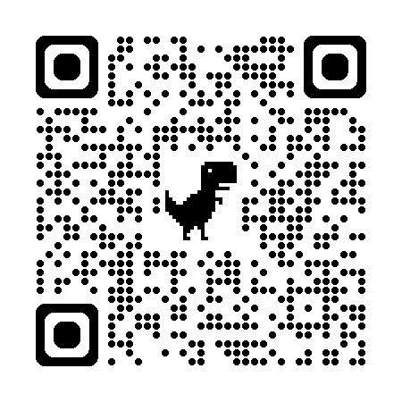
Additional Steps
Gain knowledge about your strengths, skills, and interests
Attend programs, workshops, and events
Seek out networking opportunities to build a strong network of professional contacts
Further education: professional development, certification preparation
Career Center resources for career changers:
  https://careers.umbc.edu/alumni/career-changers/

Slide 40


Upcoming Events: CAREER MONTH!
April is Career Month!
Check out the career month website:
https://careermonth.umbc.edu/
for information on upcoming special events

Slide 41
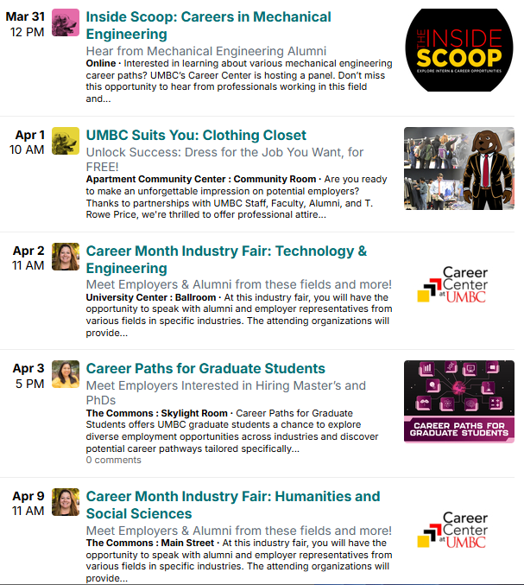
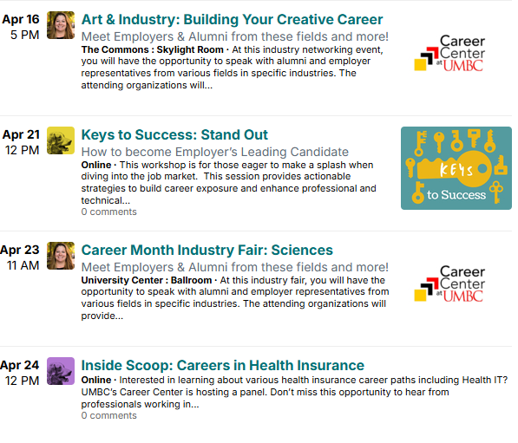
Upcoming Events: CAREER MONTH!

Slide 42




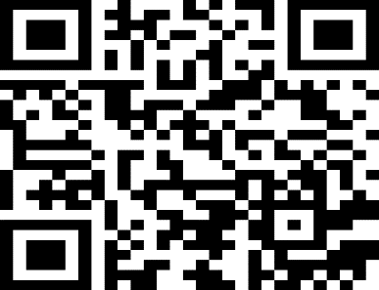



Get Connected – Stay Connected
 | Events tab in handshake
 | UMBC Career Center
 | Contact us
 | www.instagram.com/umbccareers
 | Follow us in myUMBC
UMBC Careers
Unleashed Podcast
Listen or watch wherever you get your podcasts!

Slide 43

Questions?

