Slide 1

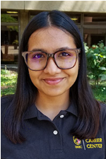
Introduction to
Career Center Resources
Professional Development for First-Year Students
Fall 2026
Khushi Shah
Career Peer | UMBC Career Center
Math/Psychology 201 • (410) 455-2216 • careers@umbc.edu
Notes:
Welcome. Keep it warm and low pressure. These are first-years, many have never thought about careers at all, and some are intimidated by the word. Say plainly: you do not need to know what you want to do. That is the entire point of being a first-year.

Slide 2
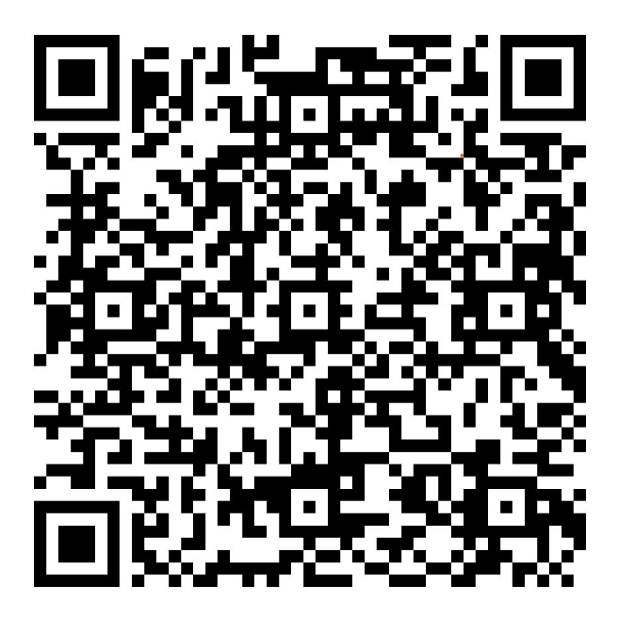
First Things First: Sign In
Scan to sign in
Notes:
Leave up 30 seconds. Mention you will put it back at the end. Good moment to let stragglers settle.

Slide 3
Introduction
Career Peer at the UMBC Career Center
Graduate student here at UMBC
I help students with resumes, LinkedIn, and figuring out what is next
Notes:
Keep to about a minute. The callout matters more than the bio. First-years often think a career session means they are supposed to arrive with answers. Take that pressure off immediately.

Slide 4
What You'll Walk Away With
By the end of class today, you will:
Know what the Career Center actually does, and how to book an appointment
Be logged into Handshake
Know how FOCUS2 can help you explore majors and careers and the MBTI assessment
Have a first draft of your LinkedIn headline and your elevator pitch
Notes:
Point out the last bullet specifically. Their assignment is a resume, so say up front that today sets them up for it. That makes everything else feel relevant instead of optional.

Slide 5
Today's Plan
1
The Career Center: what it is, what it does
2
Your toolkit: Handshake, FOCUS2, and MBTI
3
Networking and your elevator pitch
4
Where to go from here
Notes:
Tell them devices are allowed and expected today. That is unusual enough in a class that it wakes people up.

Slide 6
Quick Check-In
1
You have no idea what you want to do after college
2
You have a major but are not sure where it leads
3
You have never written a resume
4
You have never heard of Handshake
5
You have visited the Career Centre before
6
You have had a job, any job, including in high school
Notes:
ACTIVITY 1, about 2 minutes. Read each one, let hands go up, react out loud. The last two tell you how much ground you need to cover on LinkedIn and on the resume. If almost nobody has had a job, spend extra time later on what counts as experience.

Slide 7
Start Here: The Career Center
PART ONE
Notes:
Transition into the core resource. Keep energy up.

Slide 8
What Is “Career Readiness”?
Career readiness is just the process of preparing for a career. That's it.
Learning skills
Academic skills, transferable skills, communication. A lot of this is already happening in your classes.
Setting goals
Small and specific beats big and vague. “Join one club this semester” is a real goal.
Building a foundation
So that when an opportunity shows up in year two or three, you are ready to take it.
Notes:
Demystify the phrase. Students hear 'career readiness' and picture suits and interviews. It is mostly just doing college on purpose instead of by accident.

Slide 9
Why Start Now, In Your First Year?
93%
of UMBC graduates report being in a position directly related to their career goals
Starting early gives you time to explore, change your mind, and change it again
Students who start in year one are far more likely to land internships before they graduate
The most common thing upperclassmen tell us is that they wish they had started sooner
Nothing you decide today is permanent. You are allowed to explore
Notes:
The regret line lands hardest. It is real feedback from upperclassmen. Deliver it as peer information, not a warning, since you are closer to their age than most presenters.

Slide 10
What the Career Center Actually Does
1
2
3
4
Explore
Gain Experience
Get Prepared
Meet Employers
Figure out what fits you: assessments, coaching, major exploration
Internships, research, part-time jobs, on-campus work, volunteering
Resumes, cover letters, LinkedIn, interview practice
Career fairs, info sessions, networking events, on-campus recruiting
Notes:
Four pillars, about 15 seconds each. The free line is important for first-years, who often assume services like this cost extra or are only for seniors.

Slide 11
Where to Find Us
IN PERSON
Math/Psychology Building
Room 201
(directly across from Starbucks)
Drop-in hours
Monday to Thursday, 2 to 4 pm
Virtual express meetings on friday from 2-4 pm.
One weekly meeting 5-7pm.
ONLINE
careers.umbc.edu
careers@umbc.edu
(410) 455-2216
Book appointments through Handshake
Virtual appointments available
Notes:
Say the drop-in hours twice. For first-years the biggest barrier is thinking they need a reason, an appointment, or a finished document. They do not.

Slide 12
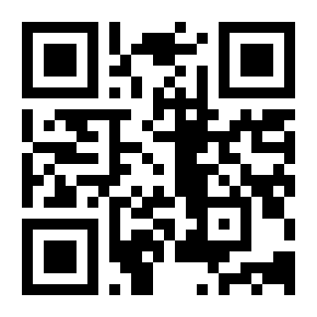
Activity: Explore careers.umbc.edu
1
Find the Quick Links section on the homepage. That is where Handshake, FOCUS2, and the Career Guide live.
2
Find one resource you did not know existed.
3
Find how you would book an appointment.
Scan or type
careers.umbc.edu
Then tell me: what stood out? What surprised you?
Notes:
ACTIVITY 2, about 5 minutes total. Four minutes browsing, one minute of report-out. Walk the room while they browse. Take three or four answers. Common discoveries: the Career Guide, major sheets, Steppingblocks, the podcast. If the room is quiet, call on the people you saw actually scrolling.

Slide 13
Your Toolkit: Handshake, FOCUS2 & MBTI
PART TWO
Notes:
Three tools UMBC pays for. All free to them.

Slide 14

Handshake: Your Career Portal
UMBC's one-stop shop for jobs, internships, events, and appointments
You already have an account. You were added automatically when you enrolled
Log in with your UMBC credentials, not a new username and password
This is also where you book Career Center appointments
Opportunities get posted here daily, including on-campus jobs
Notes:
The 'you already have an account' line surprises people every time. Lead with it. The callout is worth saying out loud, because first-generation students in particular assume internships come through family connections.

Slide 15
What You Can Do in Handshake
Browse jobs and internships
Book Career Center appointments
Find on-campus and work-study jobs
Register for career fairs and events
Message employers directly
See which companies hire UMBC students
Connect with alumni ambassadors
Build a profile employers can find you through
Notes:
Do not read all eight. Point at three or four that matter most to first-years: on-campus jobs, appointments, events. On-campus jobs is usually the one that gets them to actually log in.

Slide 16
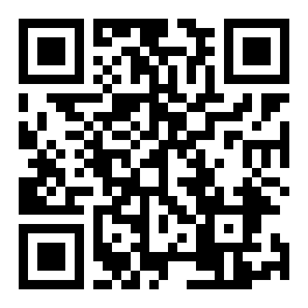
Activity: Log In Right Now
1
Scan the code or go to app.joinhandshake.com
2
Log in with your UMBC credentials
3
Skip the profile setup prompts for now
4
Click “Career Center” on the left menu
app.joinhandshake.com
5
Look at what appointments and events are available this month
Goal today: just get in. You can build the profile later.
Notes:
ACTIVITY 3, about 5 minutes. Do not let them try to complete the whole profile, it takes too long and they will stall. The only goal is that everyone successfully logs in once, so the barrier is gone forever. Walk the room and help anyone stuck on credentials.

Slide 17
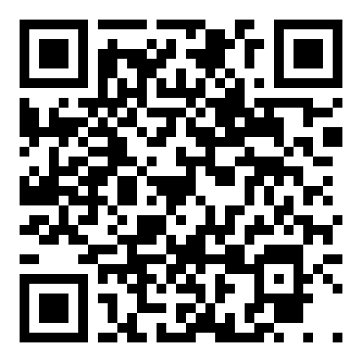
FOCUS2: Figure Out What Fits
A free career assessment platform, paid for by the Career Center
It asks about your interests, values, skills, and personality
Then it suggests majors and careers that actually match your answers
Start with the “Am I Career Ready?” assessment
You do not have to finish in one sitting. It saves your progress
Save the occupations that look interesting, then talk them through with a career coach
Find it under Quick Links
on careers.umbc.edu
Best use: take it, then book an appointment to talk about the results.
Notes:
For undecided first-years this is the single most useful tool on the slide deck. Emphasize that results are a starting point for a conversation, not a verdict. Nobody should take a quiz and feel locked in.

Slide 18
MBTI: Understand How You Work
Also free through the Career Center. A different question than FOCUS2 asks.
Where you get your energy
From being around people, or from quieter time to think
How you take in information
Concrete details and facts, or patterns and big picture
How you make decisions
Through logic and consistency, or through people and values
How you handle structure
Planned and settled, or open-ended and flexible
Useful for: understanding your work style and which environments energize you versus drain you.
Notes:
Keep this to about 90 seconds. Frame it honestly: MBTI describes how you prefer to work, it does not predict what you will be good at. Best taken and then discussed with a career coach, same as FOCUS2. HEADS UP: in a social science class, especially with psych majors, somebody may raise the research criticism of MBTI. Do not get defensive. The honest answer is that its reliability is debated, the Career Center offers it as a self-reflection and conversation starter rather than a diagnostic, and that is exactly how students should treat it. Then point them at FOCUS2, which is built specifically for career matching.

Slide 19
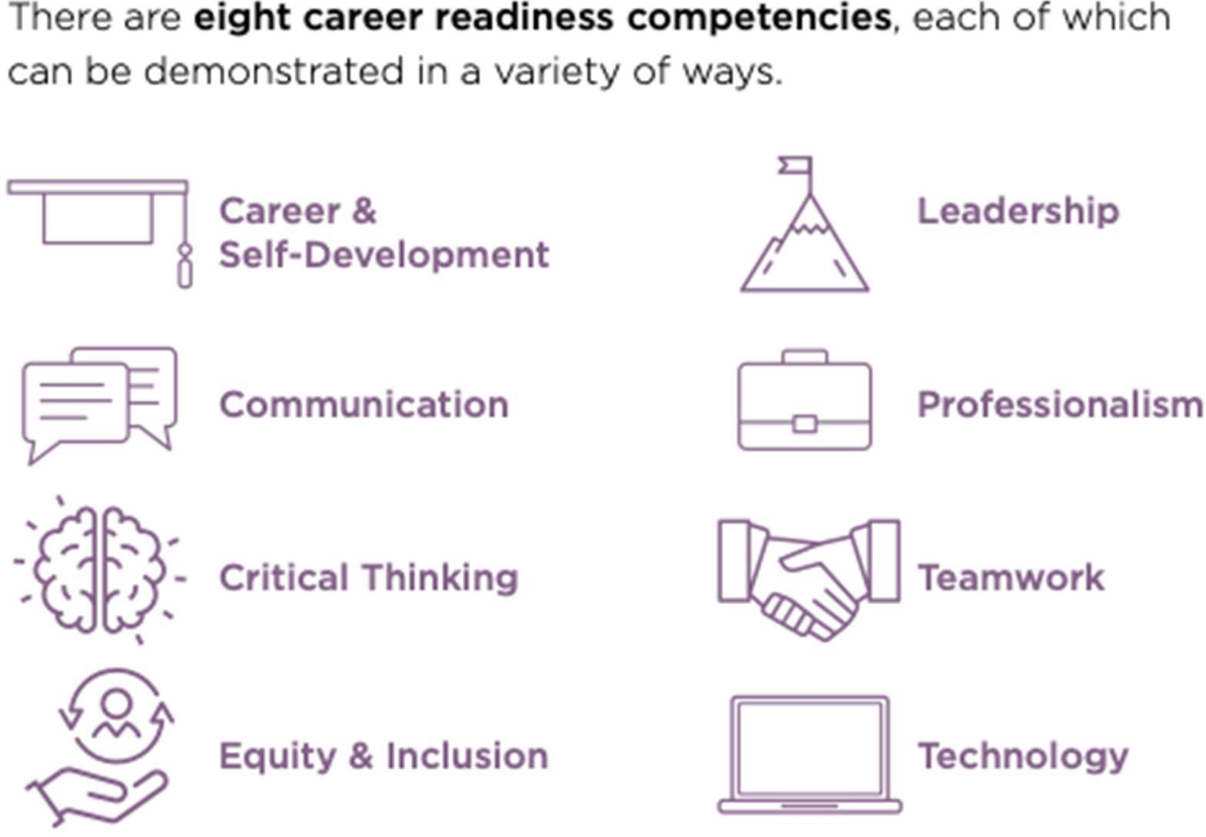
NACE Competencies
Where this comes from
Employers are surveyed every year about what they look for in new graduates. These eight keep coming up.
Why it matters to you now
You build these through classes, clubs, jobs, and volunteering. Not just internships. You are building some of them already.
Notes:
Do not read all eight aloud. Name three or four and connect them to things first-years already do: a group project is teamwork, a club officer role is leadership, any job is professionalism. The FOCUS2 'Am I Career Ready' assessment scores them on these.

Slide 20
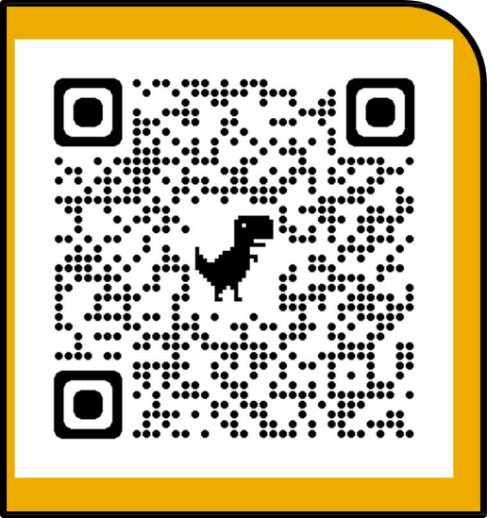
What Can You Do With a Social Science Major?
https://careers.umbc.edu/tools/majors/
ECON / Financial ECON Policy analyst, data analyst, banking, consulting, federal economist
POLI Government, legislative staff, law, advocacy, campaigns, foreign service
PSYC HR, UX research, case management, behavioral health, grad school
SOCY Nonprofit programs, community organizing, research, social services
PBHL Health educator, epidemiology, health policy, community health
GES Environmental consulting, GIS analyst, urban planning, sustainability
EDUC / EDHS Teaching, education policy, student affairs, youth programs
Full major sheets for every UMBC major live at careers.umbc.edu under Quick Links.
Notes:
This is the slide tailored specifically to this class. Read their major out loud and watch who sits up. If someone asks about a major not listed, the major sheets cover all of them. Emphasize: a major is not a job title. Psychology does not only mean therapist.

Slide 21
Networking & Your Story
PART THREE
Notes:
The part everyone dreads. Make it ordinary.

Slide 22
Networking Is Not What You Think
WHAT PEOPLE THINK IT IS
Walking into a room of strangers in a suit, handing out business cards, and pretending to be impressive.
WHAT IT ACTUALLY IS
Asking people who have done the thing you are curious about how they got there. That is the entire skill.
Your network already exists. It includes:
Your professors, who have careers and know people in them
Your academic advisor and the Career Center staff
Upperclassmen in your major who did the internship last summer
UMBC alumni, who are reachable on LinkedIn and respond to students
Family, neighbors, former managers, coaches
Notes:
This reframe is the most valuable thing in part four. First-years hear 'networking' and shut down. Tell them: you are not asking for a job, you are asking a question. Professors are the easiest starting point and students almost never think of them.

Slide 23
Your Elevator Pitch
Thirty seconds. Who you are, what you care about, what you're looking for.
WHO
Your name, your year, your major
WHY
What got you interested, in one specific sentence
NOW
What you are doing about it right now
ASK
What you are hoping to learn or find
EXAMPLE
“Hi, I'm Maya. I'm a first-year psychology major at UMBC. I got interested in how people make decisions under stress after volunteering on a crisis line in high school. Right now I'm taking research methods and trying to find a lab to join. I'd love to hear how you got into UX research.”
Notes:
This is one of their extra credit options, so flag that out loud. Read the example aloud at natural speed so they hear that 30 seconds is short. Point out it ends with a question, which hands the conversation back and is the part students always forget.

Slide 24
Activity: Draft Your Pitch
Three minutes to write, then turn to the person next to you and say it out loud.
WHO
I'm ______, a first-year ______ major at UMBC.
WHY
I got interested in ______ because ______.
NOW
Right now I'm ______.
ASK
I'd love to learn more about ______.
Saying it out loud once is the whole point. It feels different than writing it.
Notes:
ACTIVITY 5, about 5 minutes. Three minutes writing, two minutes in pairs. Do not skip the out-loud part even if you are running behind, because that is where the learning happens. If the room is shy, say they only have to say it to one person and nobody else is listening.

Slide 25
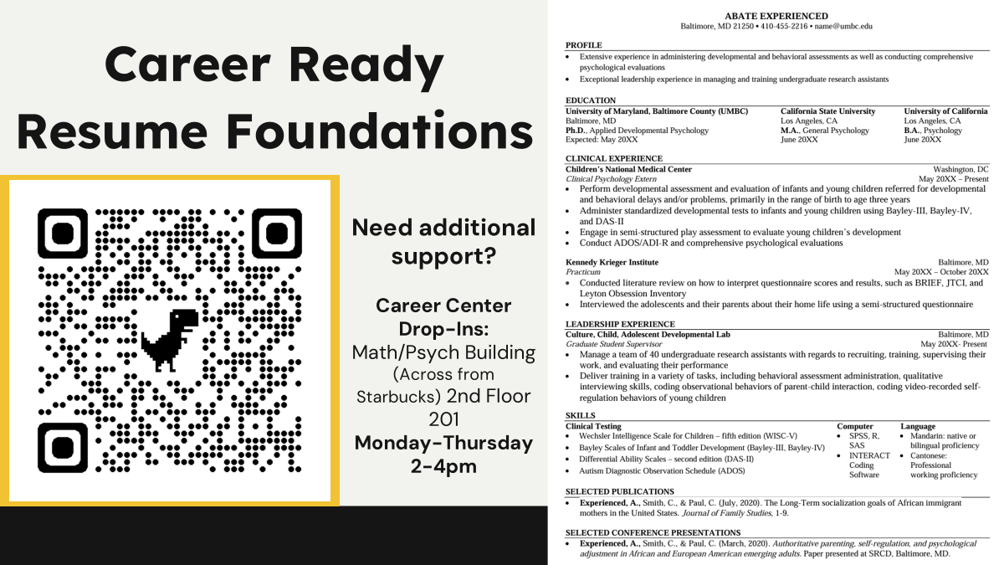

Slide 26
Where to Go From Here
PART FOUR
Notes:
Close out with campus resources and the assignment.

Slide 27
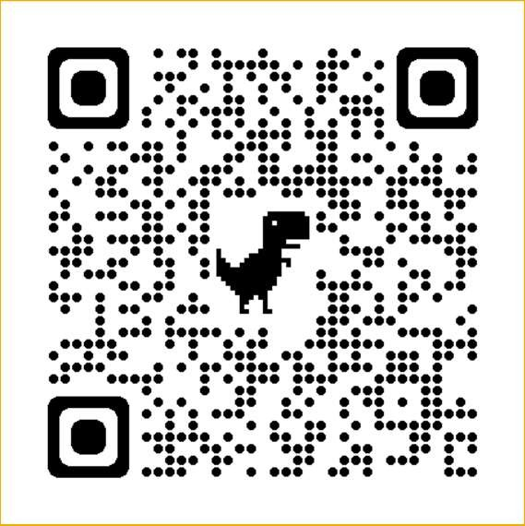
Your Resume: Where to Get Help
Start with the Career Guide
Scan the code. Sample resumes, templates, step by step
Drop-in hours
Mon to Thu, 2 to 4 pm. Math/Psych 201. No appointment needed
Friday Virtual Express Appointments 2-4pm
Weekly Online appointments 5-7pm
Book an appointment
Through Handshake, in person or virtual
UMBC Career Guide
Sample resumes, templates,
and step-by-step instructions
WORRIED YOU HAVE NOTHING TO PUT ON IT?
High school jobs, volunteering, and clubs all count.
Notes:
This is the only resume slide now, so land it well. Two things to say out loud. First, a first-year resume is one page and mostly education, and that is correct rather than thin. Second, you do not have to make it good before you bring it in. Students skip drop-ins because they think the draft has to be presentable first. Say the opposite explicitly.

Slide 28
ADDITIONAL CAMPUS RESOURCES
THE SHRIVER CENTER
Volunteering, community service, and service-learning placements across Baltimore
Public Policy Building, 1st Floor
(410) 455-2493 · shrivercenter@umbc.edu
Service hours, community-based projects, which give you real experience and references, even in your first year.
EDUCATION ABROAD
Semester, summer, and short-term faculty-led programs
University Center, Room 207
(410) 455-2831 · educationabroad@umbc.edu
Monday–Friday, 8:30 am to 4:30 pm
Studying abroad shows employers adaptability and independence, and scholarships and financial aid often transfer, so ask before assuming you can’t afford it.

Slide 29
Your Next Steps
1
TODAY
You already logged into Handshake. That one is done
2
THIS WEEK
Take the “Am I Career Ready?” assessment on FOCUS2
3
THIS WEEK
Try the MBTI or book a Career Decision-Making appointment
4
FOR CLASS
Draft your resume using the Career Guide as a template
5
ANYTIME
Walk into drop-in hours. Mon to Thu, 2 to 4 pm, virtual express hours, friday 2-4pm.
Pick one. Doing one of these this week beats planning all five.
Notes:
Close with the callout. First-years get overwhelmed by lists and then do nothing. Telling them to pick exactly one is far more likely to produce action.

Slide 30
Upcoming events
UMBC Connects: Johns Hopkins Applied Physics Laboratory
Wednesday, October 28 · 11 AM
University Center 312
Keys to Success: Designing Resumes for ATS in the AI Era
Monday, November 2 · 12 PM
Mathematics/Psychology 210
UMBC Connects: bwtech@umbc
Thursday, November 5 · 11 AM
The Commons : Main Street

Slide 31
Stay Connected
careers.umbc.edu
Everything lives here. Start with Quick Links
@UMBCcareers
Instagram, LinkedIn, and YouTube
Career Center myUMBC group
Events, deadlines, and opportunities in your feed
UMBC Careers Unleashed
The Career Center podcast, wherever you listen
Math/Psychology 201 • (410) 455-2216 • careers@umbc.edu • Drop-ins Mon–Thu 2–4 pm
Notes:
Fast slide. Point at the black bar and say the drop-in hours one last time. Repetition is the only reason anyone remembers them.

Slide 32
Questions?
THANK YOU
Last call to sign in
Khushi Shah | Career Peer | UMBC Career Center | careers@umbc.edu
Notes:
If nobody asks, prompt with: 'what is one thing about careers at UMBC that nobody has explained to you yet?' That reliably opens first-years up, because they have a lot of unasked questions.

