Slide 1

Preparing for the …
Presented by:
Christine Routzahn, Director, UMBC Career Center
Notes:
Good Morning
We are absolutely delighted to present this session Preparing for the Maryland Career Consortium Virtual Career Fair as we get ready to host this exciting event on Tuesday, June 8th. Currently, we have OVER 50 employers ready to meet you.
The Maryland Career Consortium (MCC) consists of fifteen colleges and universities in the greater Baltimore region including UMBC.

Slide 2
Update:
Over 50+ Employers Registered to Meet Student and Alumni Talent- that means YOU!
What We’re Going to Cover
What is a Virtual Career Fair
Pre-Event Preparation- How to Make a Great Impression
Entering the Virtual Career Fair and Navigating Your Way Around the Event
Q&A
Notes:
During this session, we will focus on 4 primary areas followed by a Q&A.

Slide 3
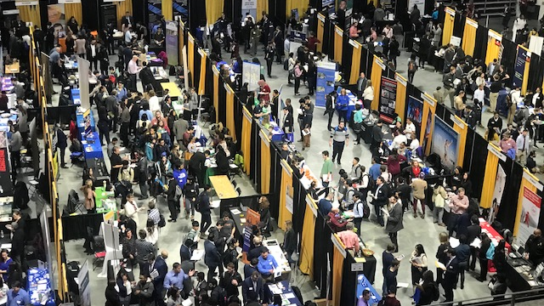
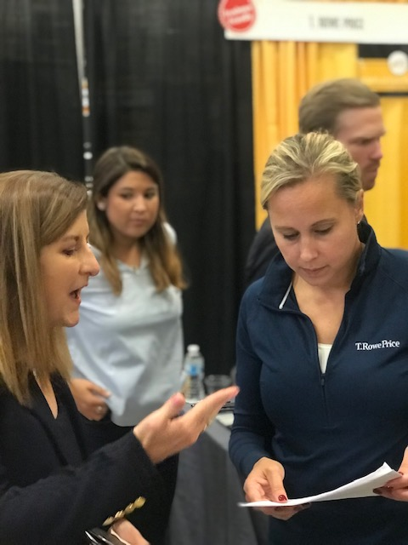
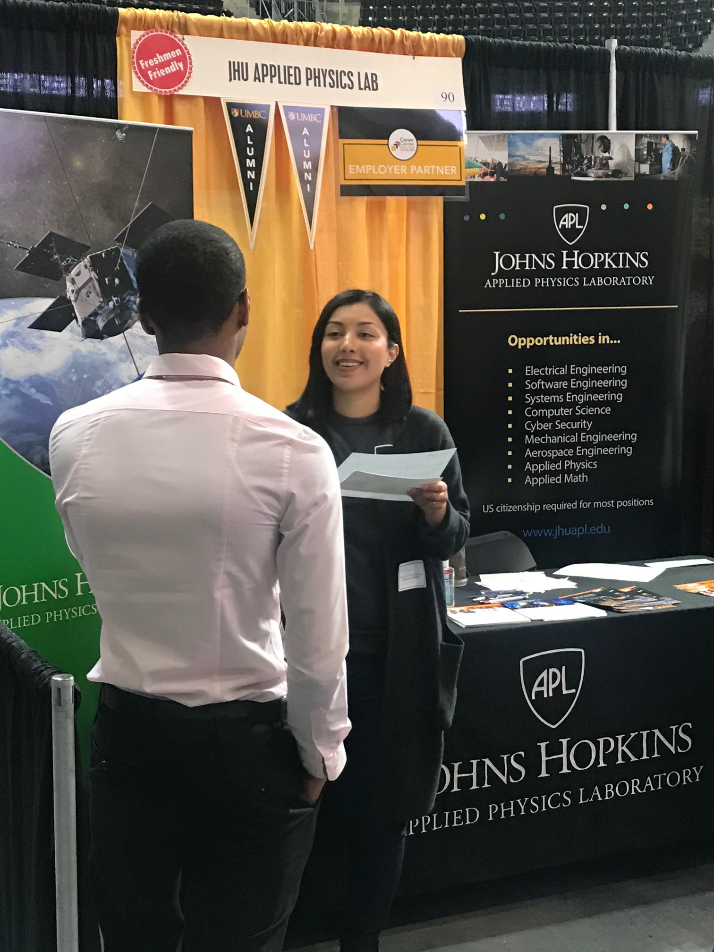
28
Have you ever been to a career fair? What did you think?
Notes:
Many of you on this webinar may have been to one of our Career Fairs in the RAC or Event Center, which look a little like this- right?

Slide 4


What is a Virtual Career Fair?
Real, live recruitment event using a web-based platform (Handshake)
You can share your pitch, chat/connect by video, post your resume, & apply to jobs
Employers will host:
30-minute group sessions with multiple students
10-minute 1:1 Sessions with one student and one employer
Notes:
The MCC Virtual Career Fair is designed to assimilate the same event. In fact, T Rowe Price and Johns Hopkins APL who were in the photo will be there).
The virtual fair is a real, live recruitment event using a web-based platform (Handshake)
You can share your pitch, chat/connect by video, post your resume, & apply to jobs and internships. In essence, it is your virtual reality career fair.
Employers will host:
30-minute group sessions with multiple students
10-minute 1:1 Sessions with one student and one employer
Benefits are:
Great for introverts
No sweaty handshakes/ germs
Convenient
Avoids unconscious bias
Pants optional (just kidding… wear pants!) and dress professionally

Slide 5
Pre-Event Preparation:
What’s Expected of Attendees
Attendees should have:
Identified target organizations and conducted research
Prioritized their list of participating companies and determine which ones are of interest
Present a pitch that addresses specific position types and how their interests and skills align with the employer’s needs
If qualified, applied or plan to apply to positions of interest
Notes:
It is expected
Prior to participating, you have identified the employers that you want to target and researched their openings
During the event that you present yourself through a targeted pitch that both introduces you and addresses how your interests and skills align with the employer’s needs.
That you applied or plan to apply shortly after to open positions of interest. Again, these employers are here for a purpose- to hire talent.

Slide 6

Prepare Your Pitch: Written & Verbal
Name, field of study/major, graduation month & year
Types of positions you’re looking for (be specific!)
Key experiences and skills
  Internships/Work experience
  Volunteering
  Campus involvement
  Coursework/projects
  Skills – technical, “soft”
What attracted you to this employer?
Notes:
You will be introducing yourself via a pitch at the event.

Slide 7
Perfect Your Pitch Which candidate would YOU pick?
“Hi, I’m Amal. I just graduated in May 2021 from UMBC with a BS in business technology. Last summer I completed an operations internship with Morgan Stanley, and am now looking for full-time roles in the finance industry. I’ve gained strong leadership skills as an officer in multiple campus organizations. Your entry-level operations position seems to be a perfect fit for my background, and I would love to discuss it further.”
“Hi, I’m Victor. My major is business technology and I am looking for a job. What positions does your company have open?”
A RECOMMENDATION:
Perfect your pitch prior
to entering the event.
Notes:
Take a look at these two pitches.
Perfect your pitch prior to the event.

Slide 8
Pre-Event Preparation:
Research the Employers
Research the Employers-
Review the List of Attending Employers.
Prioritize the list of participating employers to make the most of your time and apply to their positions.
Come prepared with questions that show you’ve done your research and convey your level of interest in the organization’s opportunities.
Notes:
Review the List of Attending Employers. (check out the Employer Directory)
Prioritize the list of participating employers to make the most of your time and apply to their positions.
Come prepared with questions that show you’ve done your research and convey your level of interest in the organization’s opportunities.

Slide 9




Pre-Event Preparation:
This is a REAL recruitment event!
Take it seriously by…
- Researching the employers
- Dressing professionally
- Watching your spelling & grammar when in chat
- Asking for contact info and following up
Top Virtual Career Fair Tips
Get your resume reviewed (again)
Test your technology
Laptop or desktop, Mic., and Web Camera
Be ready to video chat with representatives
“Arrive” early to maximize time with employers
Notes:
This is a REAL recruitment event!
Take it seriously by…
- Researching the employers
- Dressing professionally
- Watching your spelling & grammar
- Asking for contact info and following up

Slide 10

Pre-Event Preparation:
Virtual Fair “Don’ts”
-
- DON’T ask, “What does your company do?” INSTEAD, say, “I’m particularly interested in [company] and your work with [specific reference].”
- DON’T ask, “What jobs are available?” INSTEAD, say, “I’m interested in the [blank] position.”
- DON’T be too modest. INSTEAD, give specific examples of your strengths and skills.
Notes:
- DON’T ask, “What does your company do?” INSTEAD, say, “I’m particularly interested in [company] and your work with [specific reference].”
- DON’T ask, “What jobs are available?” INSTEAD, say, “I’m interested in the [blank] position.”
- DON’T be too modest. INSTEAD, give specific examples of your strengths and skills.

Slide 11
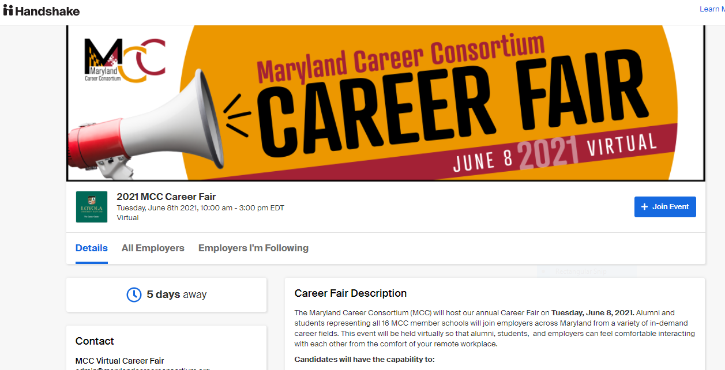
Registering for the Virtual Career Fair :
https://mcc.memberclicks.net/2021-mcc-career-fair
Notes:
First, be sure to register for the Career Fair
The event will be held on Handshake which is a new platform or UMBC. As a student, you will be required to complete a profile.

Slide 12

Signing up for Sessions :
In order to sign up for sessions with employers, you must be registered for the fair.
To sign up for Group or 1:1 sessions, you may be prompted to update your profile privacy setting.
We recommend using Community to make the most of your Handshake experience,
Will allow you to participate in all fair sessions and engage with other students/alumni!
Notes:
First, be sure to register for the Career Fair
The event will be held on Handshake which is a new platform or UMBC. As a student, you will be required to complete a profile and upload your resume.
In order to sign up for sessions with employers, you must be registered for the fair.
To sign up for Group or 1:1 sessions, you may be prompted to update your profile privacy setting.
We recommend using Community to make the most of your Handshake experience,
Will allow you to participate in all fair sessions and engage with other students/alumni!

Slide 13
Signing up for Sessions: Part 2
Review employers are attending the fair
Sign up early to ensure your spot!
Two types of sessions are available:
- 30-minute group sessions with employers
- 10-minute 1:1 sessions with employers
You'll be able to sign up for sessions with employers prior to the event and during the Fair.
Give yourself time between 1:1 and group sessions. This will allow you time to reset, present for each session and ensure you are on time.
Note: Only sign up for session with employers you have a real interest in learning more about.
Notes:
Review employers are attending the fair
Sign up early to ensure your spot!
Two types of sessions are available:
- 30-minute group sessions with employers
- 10-minute 1:1 sessions with employers
You'll be able to sign up for sessions with employers prior to the event and during the Fair.
Give yourself time between 1:1 and group sessions. This will allow you time to reset, present for each session and ensure you are on time.
Note: Only sign up for session with employers you have a real interest in learning more about.

Slide 14
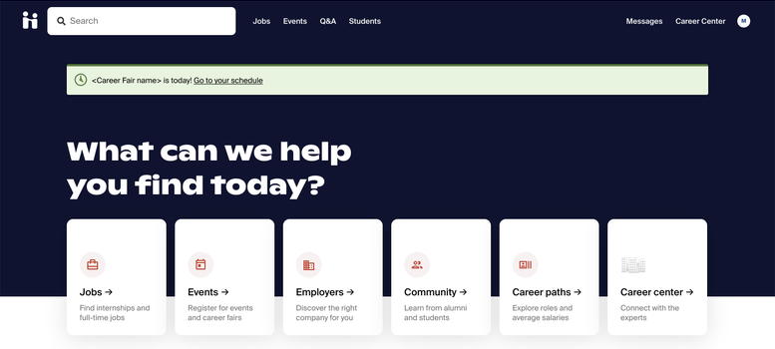
Entering the Virtual Career Fair :
On the day of the virtual fair, you'll be able to join sessions via the Your Sessions tab in the fair.
You'll see a banner on your dashboard that will take you directly there.
Notes:
On the day of the virtual fair, you'll be able to join sessions via the Your Sessions tab in the fair.
You'll see a banner on your dashboard that will take you directly there.

Slide 15
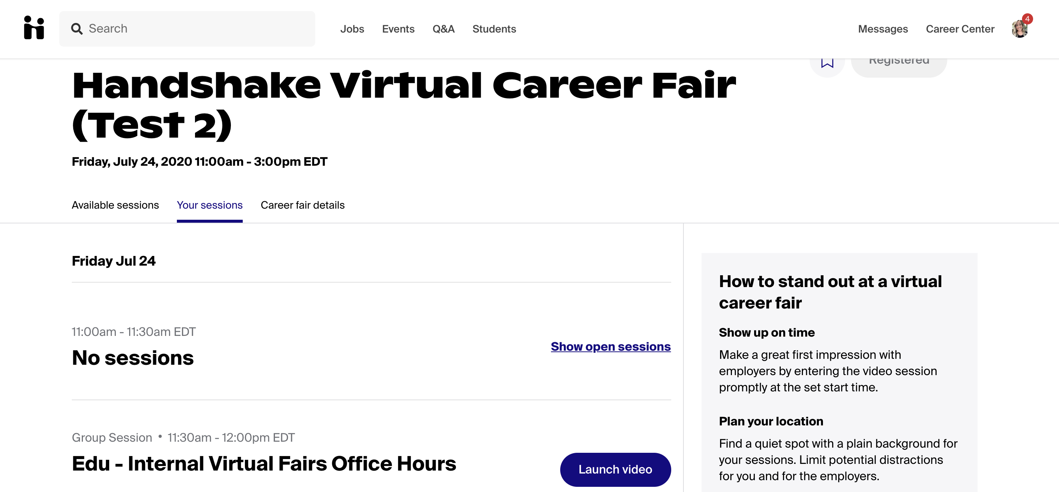
Handshake:
Joining Sessions
Navigate to the fair in Handshake and click on the Your sessions tab.
Notes:
Navigate to the fair in Handshake and click on the Your sessions tab.

Slide 16
Handshake:
Joining Sessions
Click the blue Launch Video button in order to join the session. You can join up to five minutes early to test your audio and video connection.
You'll need to make sure you've allowed microphone and video access in your app or browser in order to participate in audio and video.
Notes:
Click the blue Launch Video button in order to join the session.
You can join up to five minutes early to test your audio and video connection.
You'll need to make sure you've allowed microphone and video access in your app or browser in order to participate in audio and video.

Slide 17
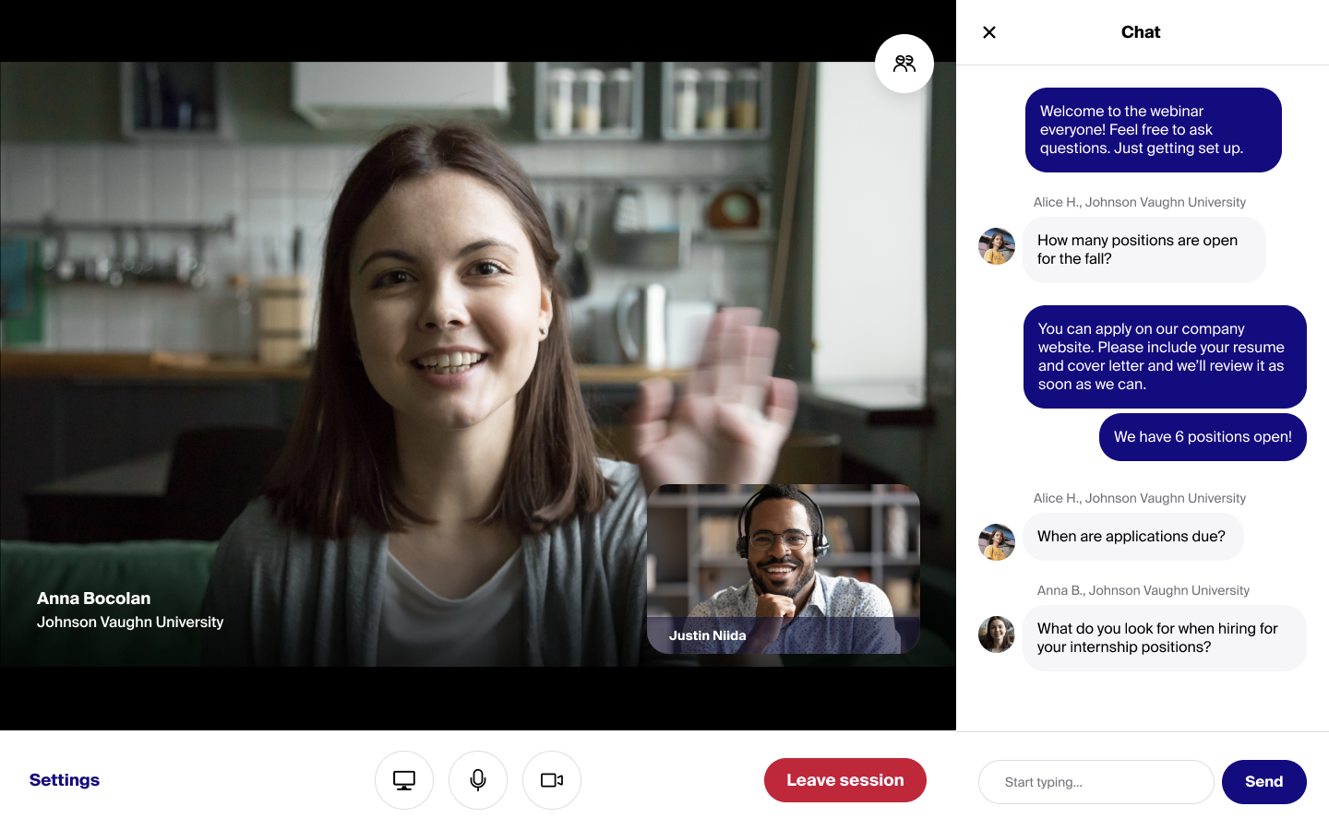
Handshake:
Joining Sessions Continues
All sessions will have the option for Handshake video, audio and text-based chat.
There is no customization for types of interaction; it is up to the employer and student joining the session to determine how they would like to connect.
Note: In group sessions with more than 15 participants, Handshake will automatically disable participant audio and video to preserve session quality. When this happens, the meeting host will be able to enable a Raise Hand feature.
Notes:
All sessions will have the option for Handshake video, audio and text-based chat.
There is no customization for types of interaction; it is up to the employer and student joining the session to determine how they would like to connect.
As long as you're signed up for the session successfully, you'll be able to join up to 5 minutes prior to the session start and throughout the duration of the session.
Note: In group sessions with more than 15 participants, Handshake will automatically disable participant audio and video to preserve session quality. When this happens, the meeting host will be able to enable a Raise Hand feature.

Slide 18

Handshake:
Support During the Fair
Should you need help during the fair, a Zoom link will be provided where you can pop in and ask any question you might have.
Check out the Candidate Guide available on Handshake for more assistance.
https://bit.ly/3tAG1ei
PLUS the following MCC resources:
https://www.marylandcareerconsortium.org/2021-career-fair-student-resource#ATE
Notes:
Should you need help during the fair, a Zoom link will be provided where you can pop in and ask any question you might have.
Check out the Candidate Guide available on Handshake for more assistance.
https://bit.ly/3tAG1ei

Slide 19

Thank you again for your interest in the
MCC Career Fair
Questions?

