Slide 1
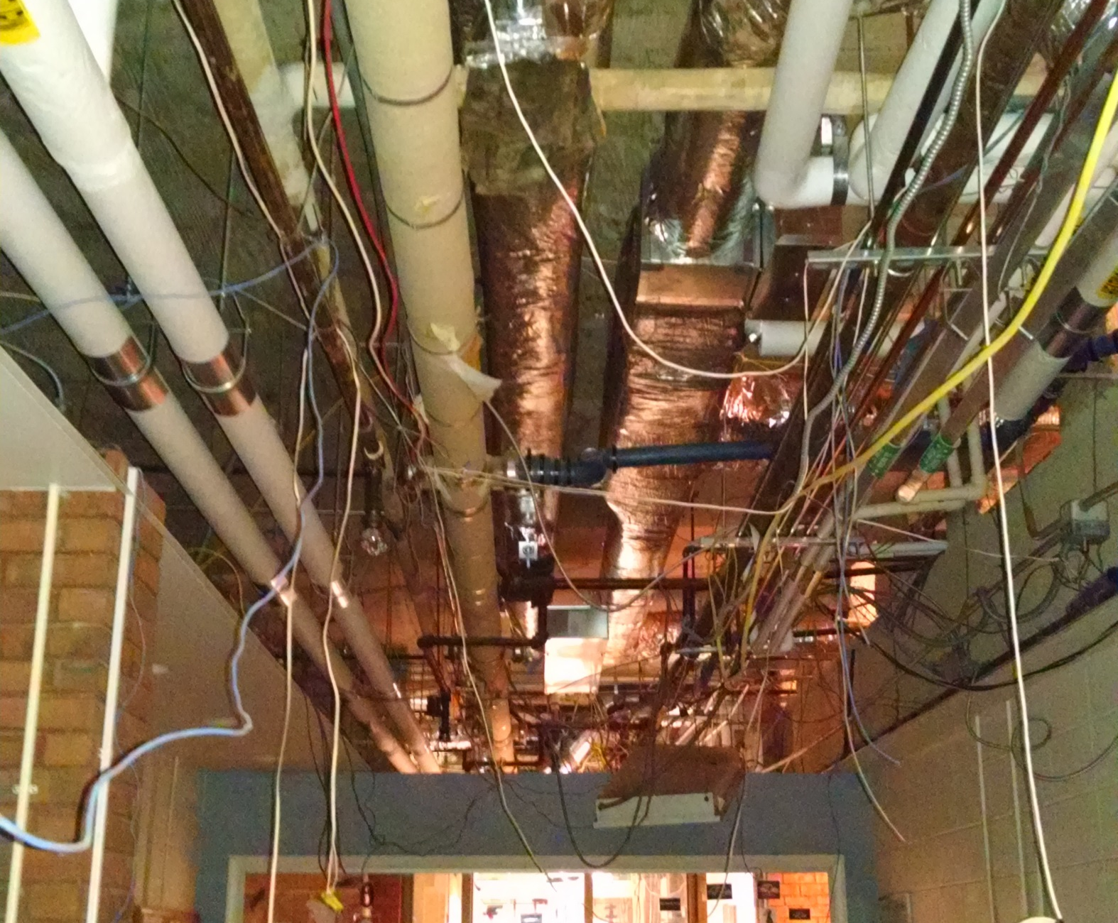
Main Office
Supply and return lines for Room 100

Slide 2
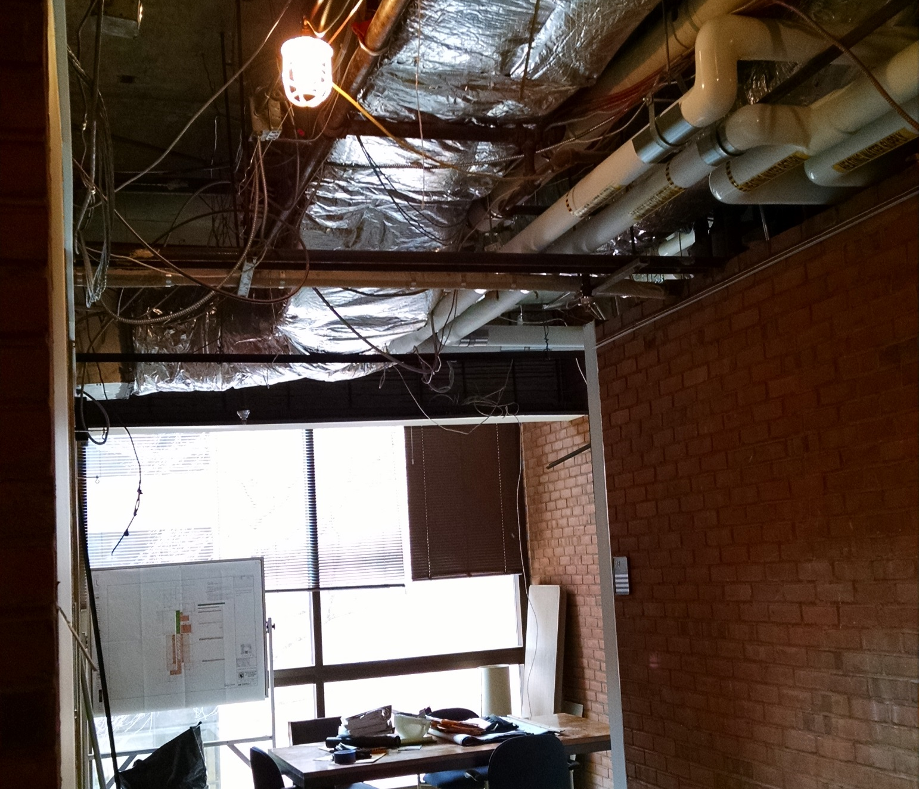
Back Office Area
Back Office HVAC work

Slide 3
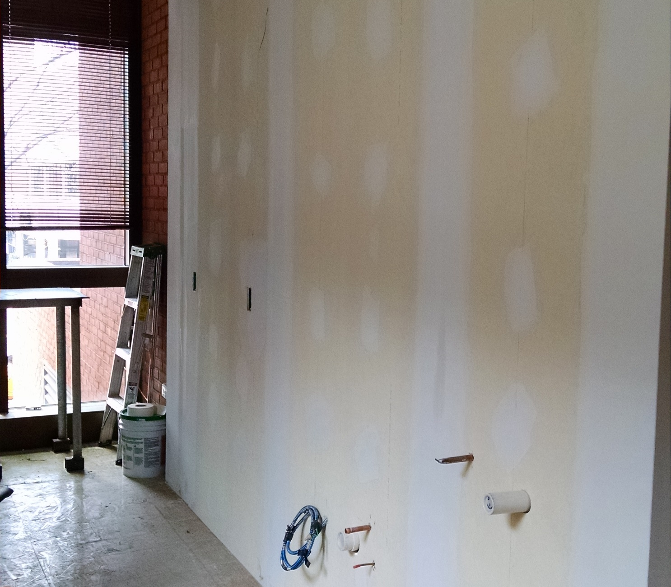
Back Office Kitchenette
Roughing in Water, electric and drain lines.

Slide 4
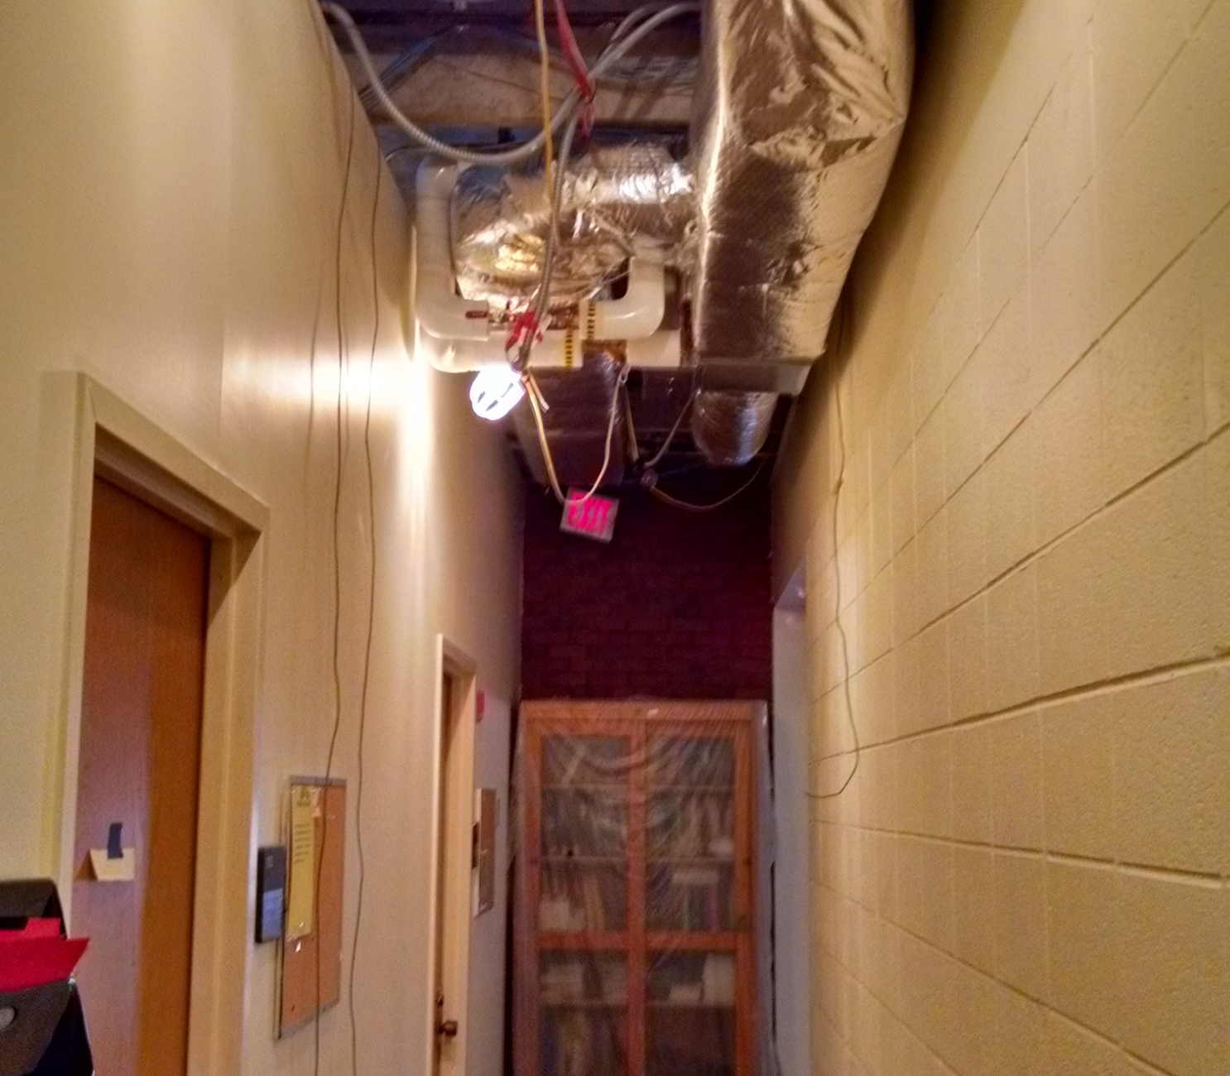
North Hallway HVAC
Tempering water tie in and HVAC supply

Slide 5
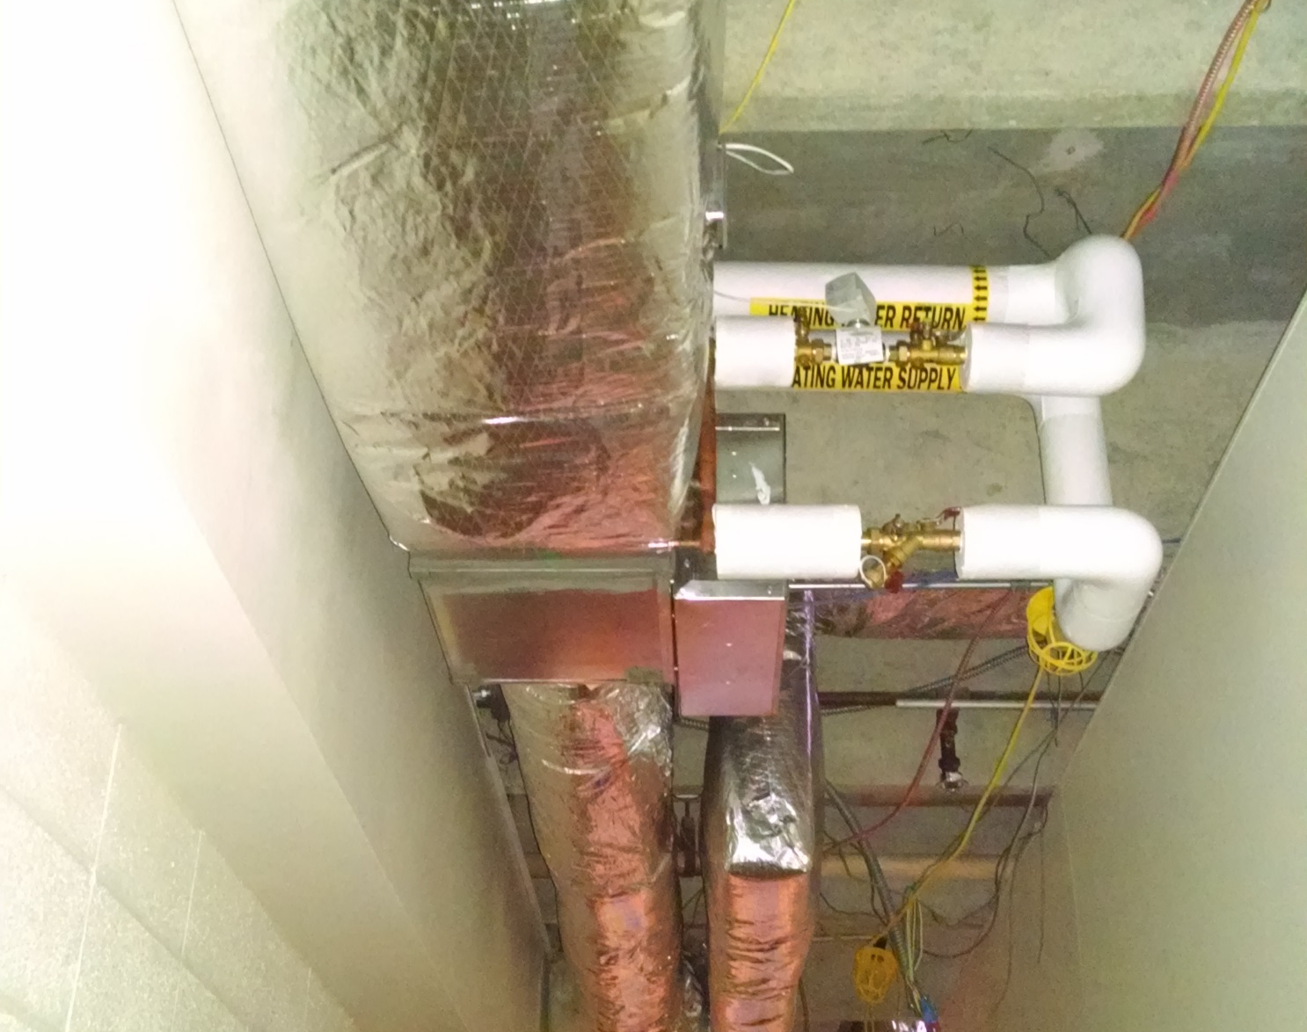
South Wing HVAC
Tempering water tie in and both supply and return lines

Slide 6
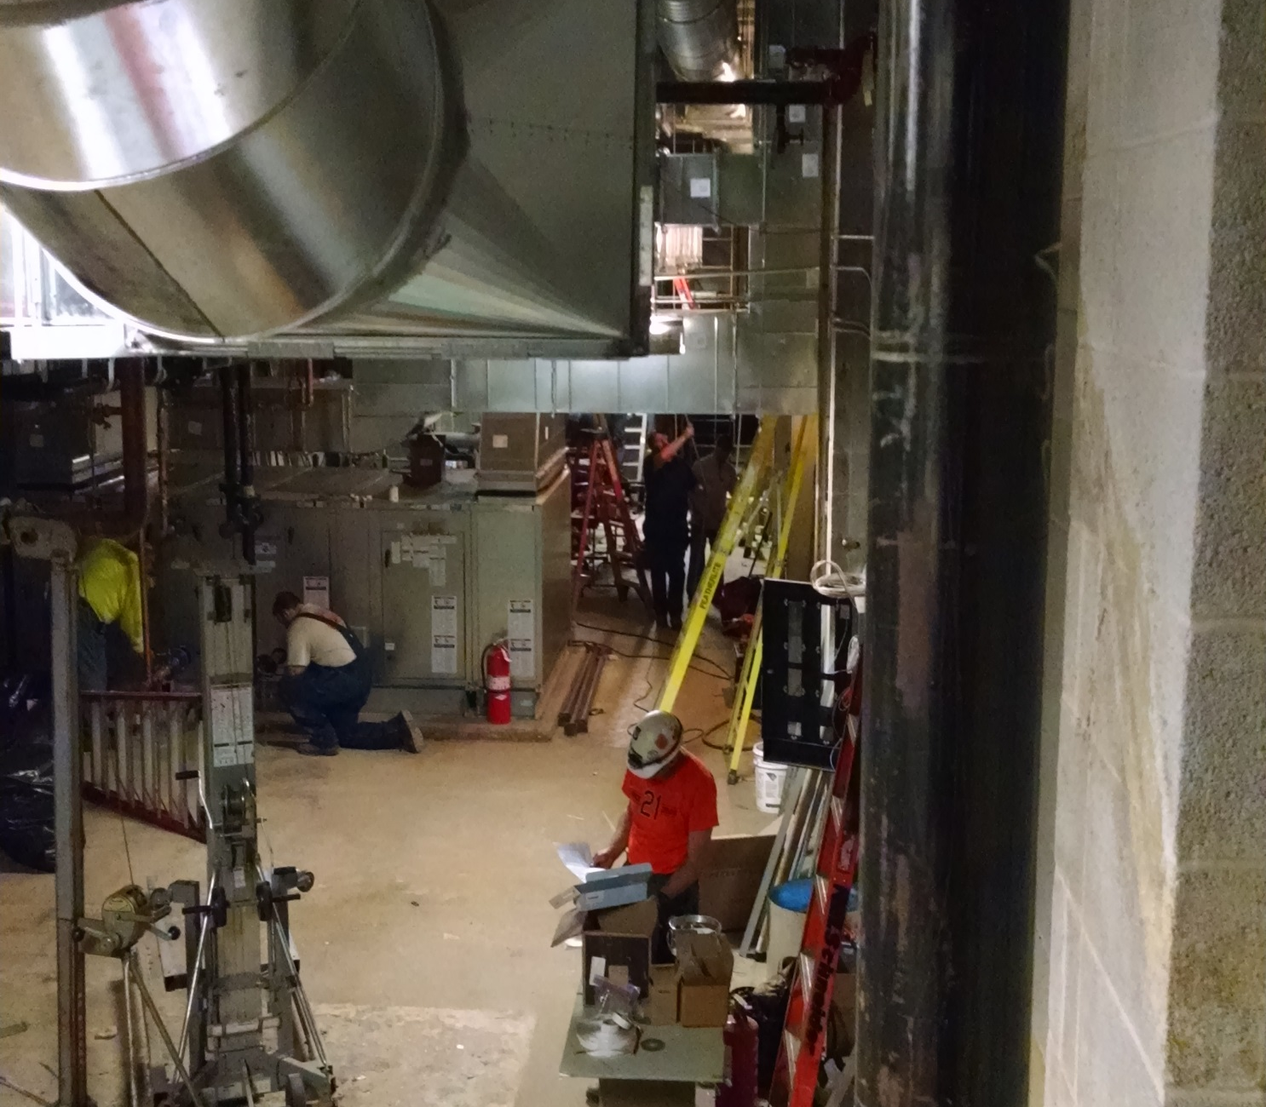
Basement work
Still a lot of plumbing and electrical work to complete

Slide 7
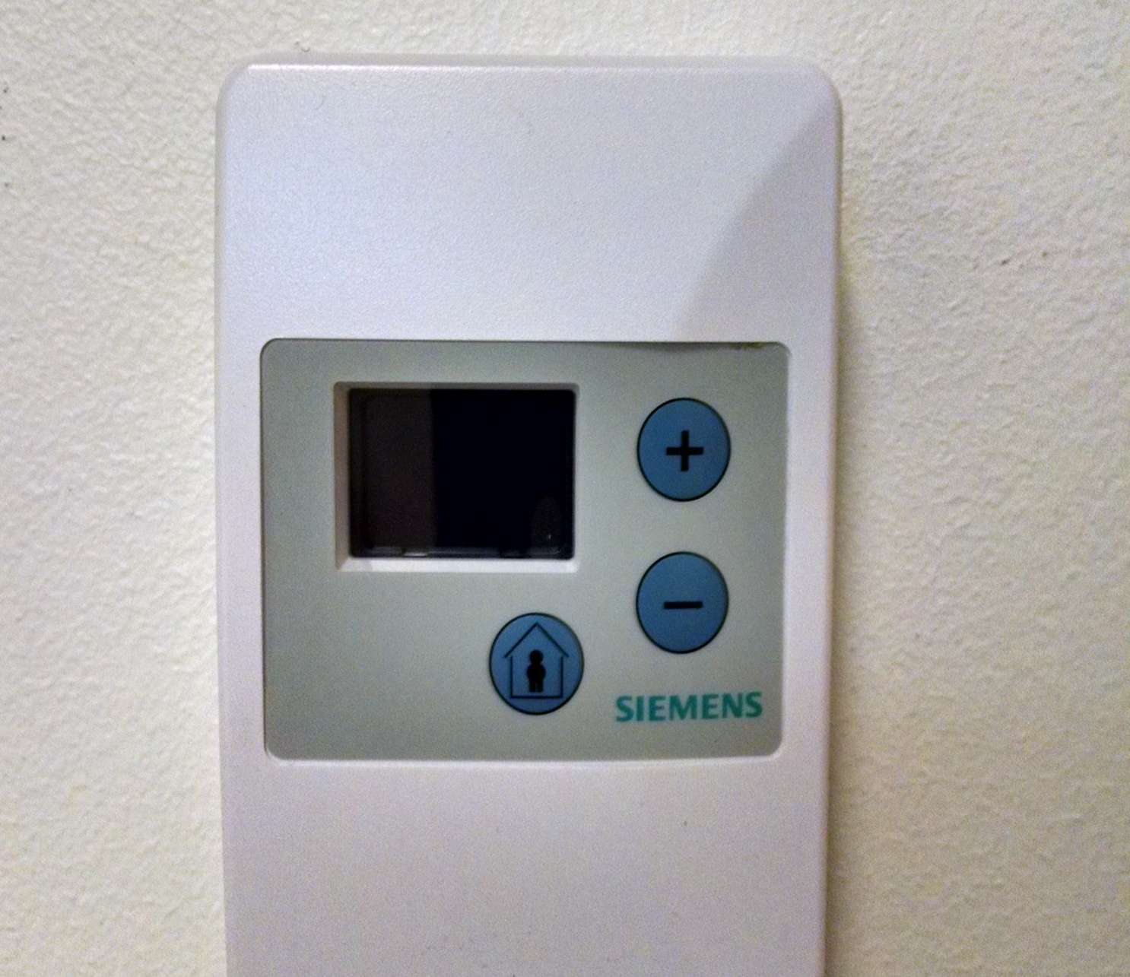
One week later 4/1/2016
New thermostats

Slide 8
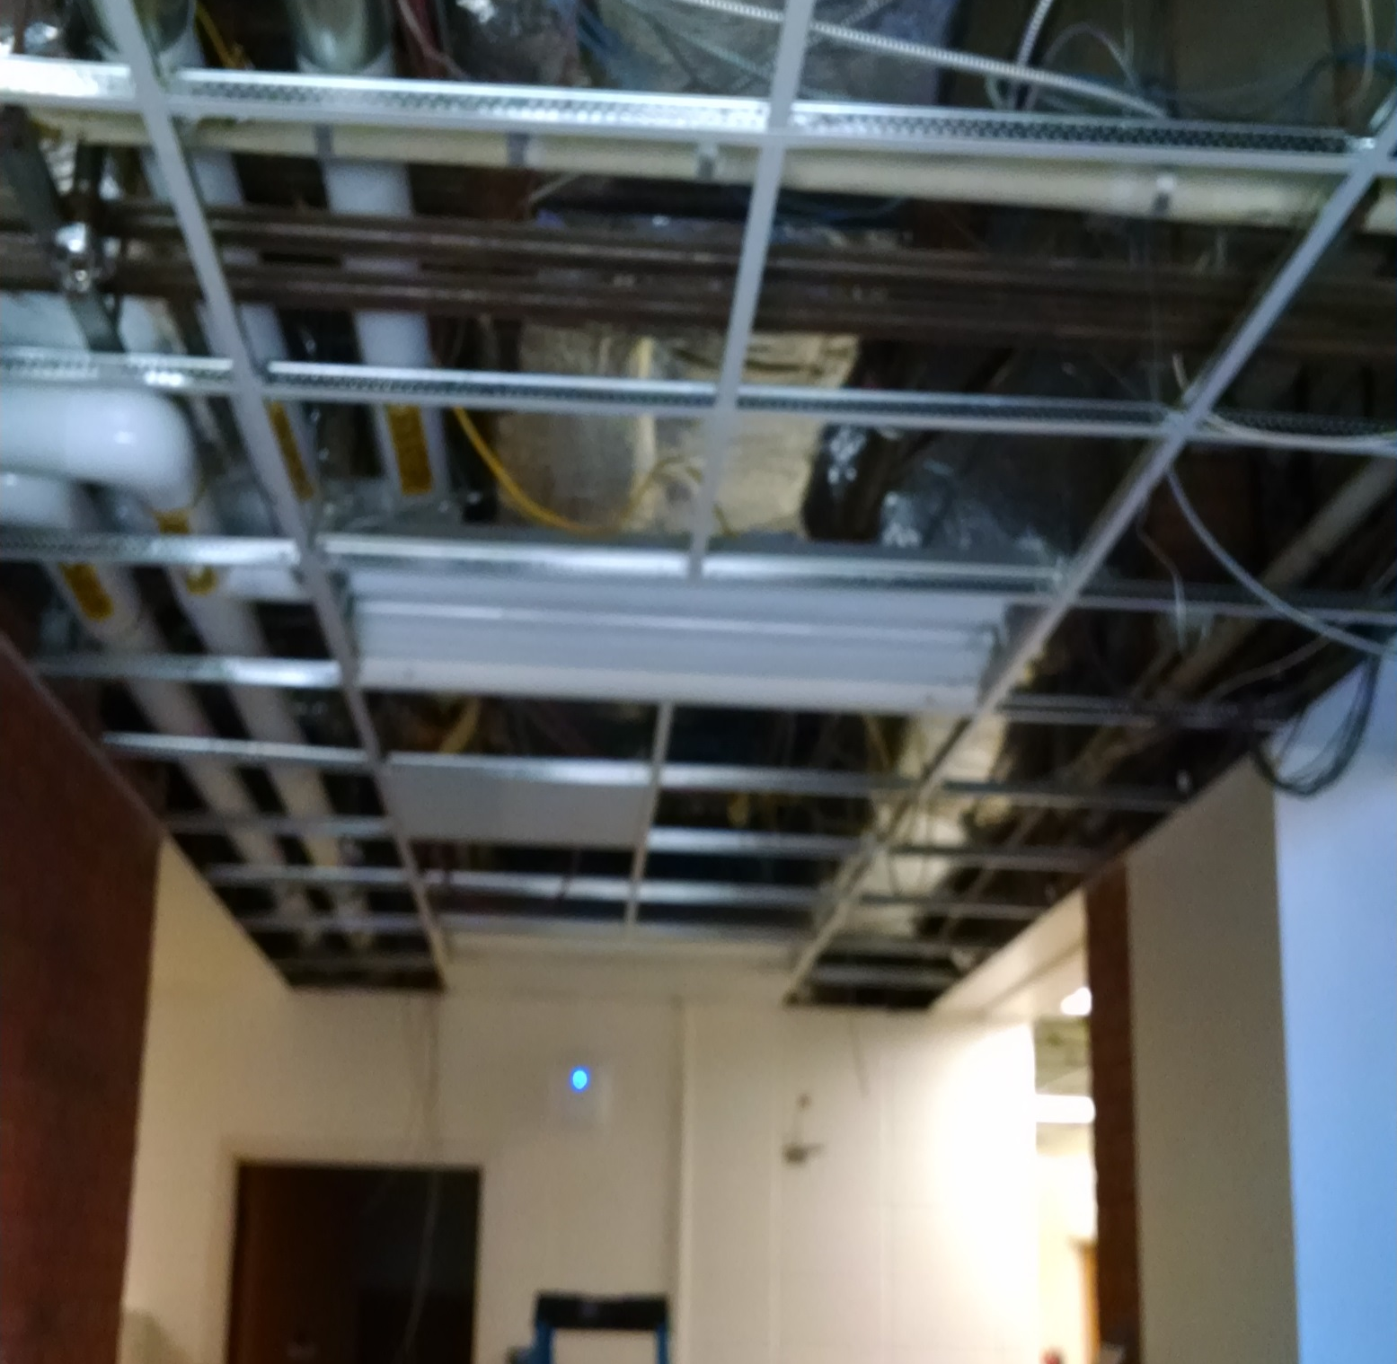
Ceiling grids being reinstalled
Back office area

Slide 9
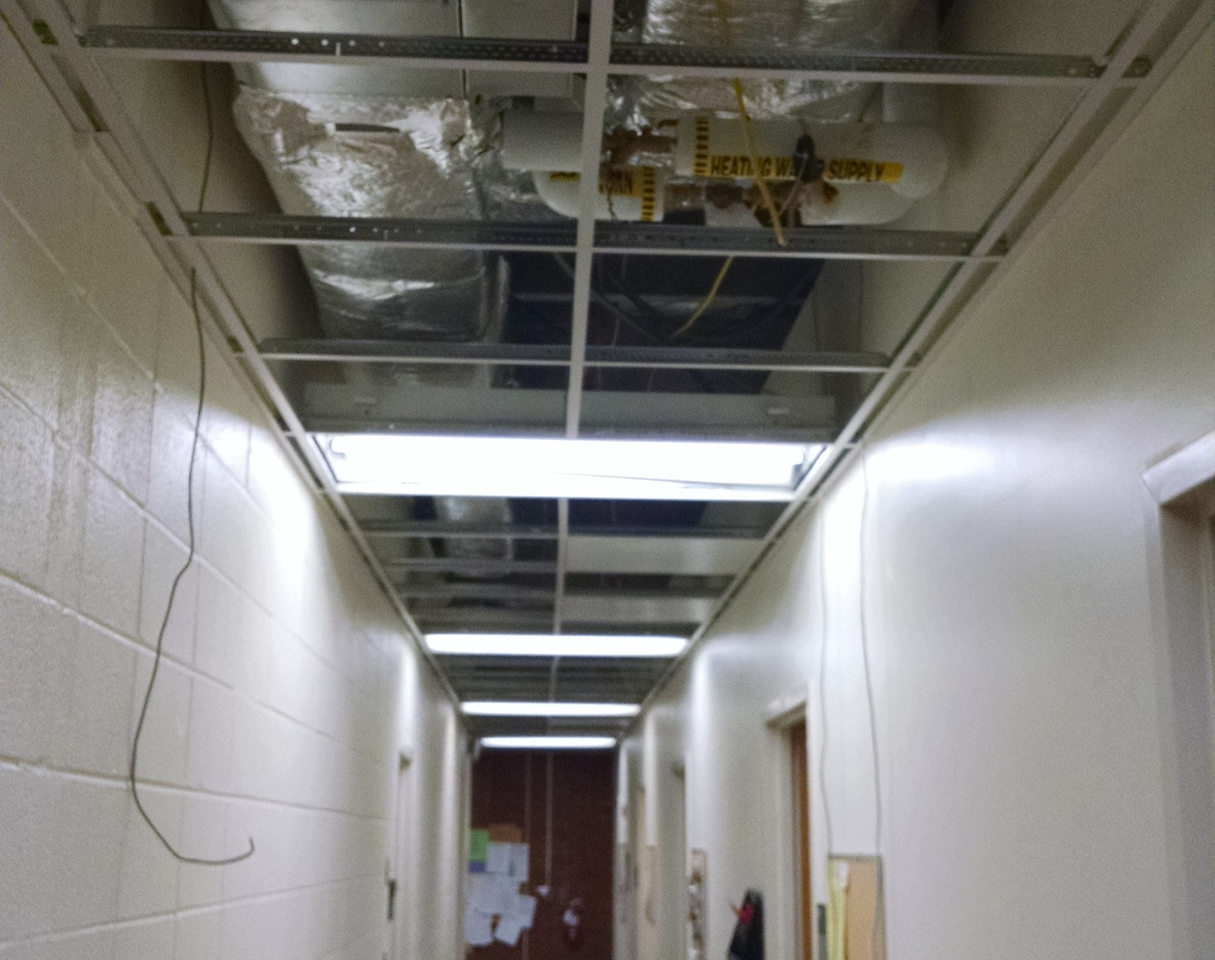
Hallway gridwork
Lower Lights are improving lighting

Slide 10
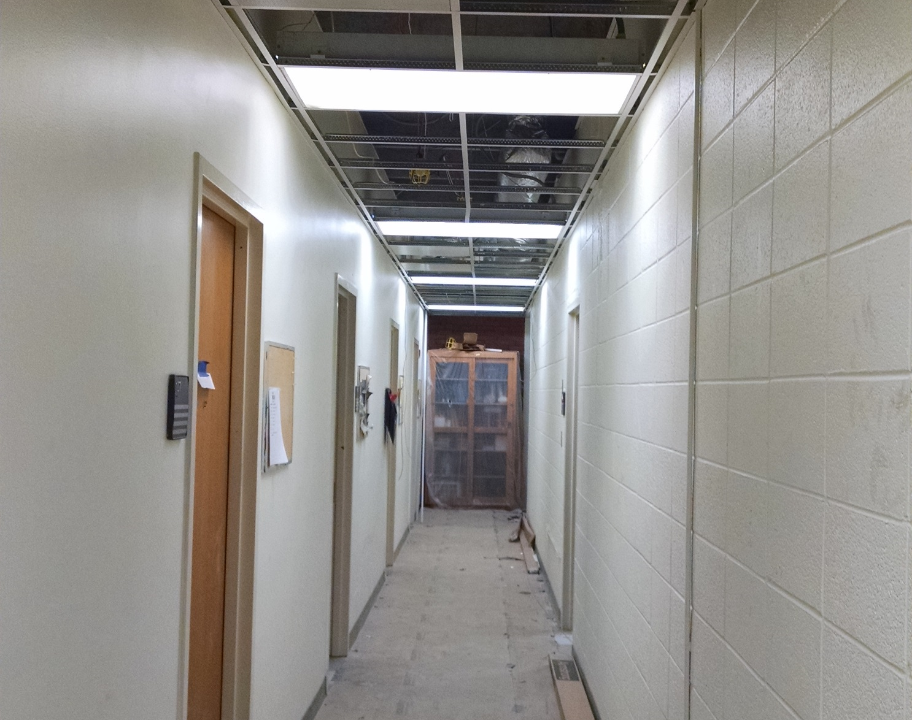
Northside Hallway
Lower lighting to allow ductwork

Slide 11
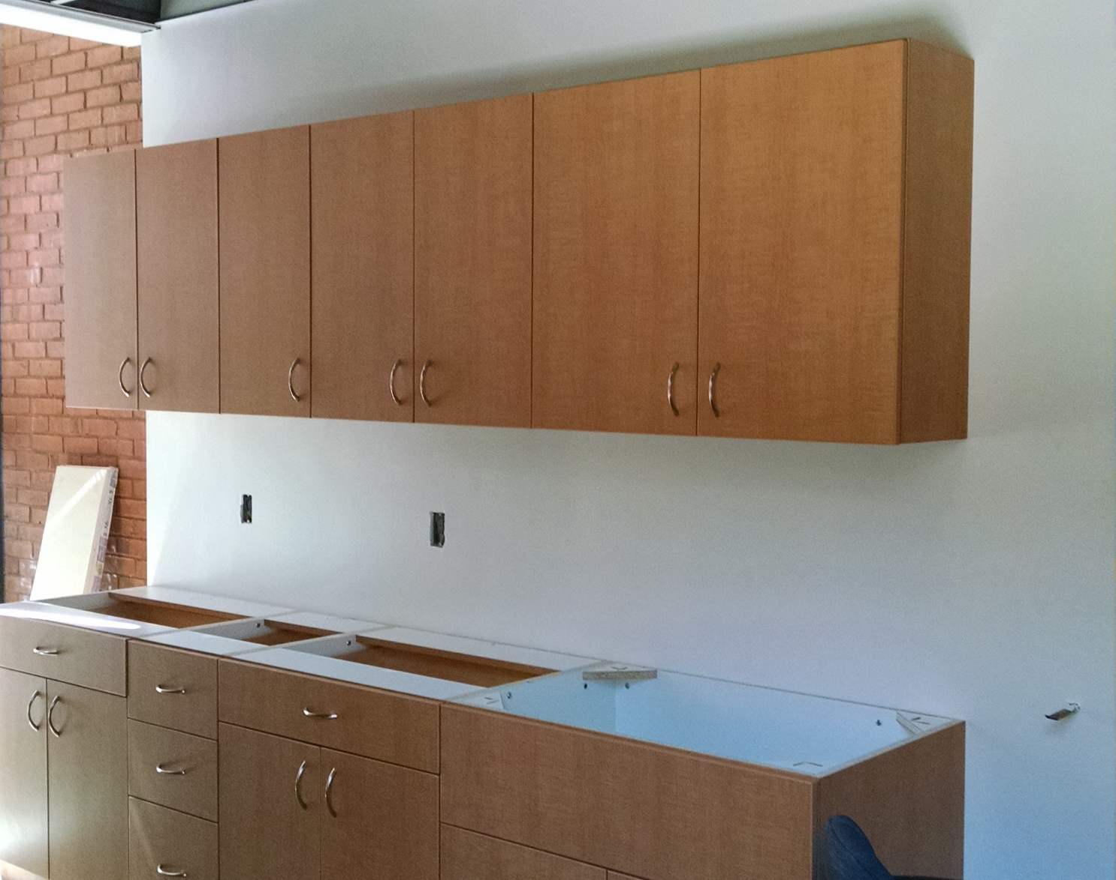
Kitchenette
Cabinets are installed

Slide 12
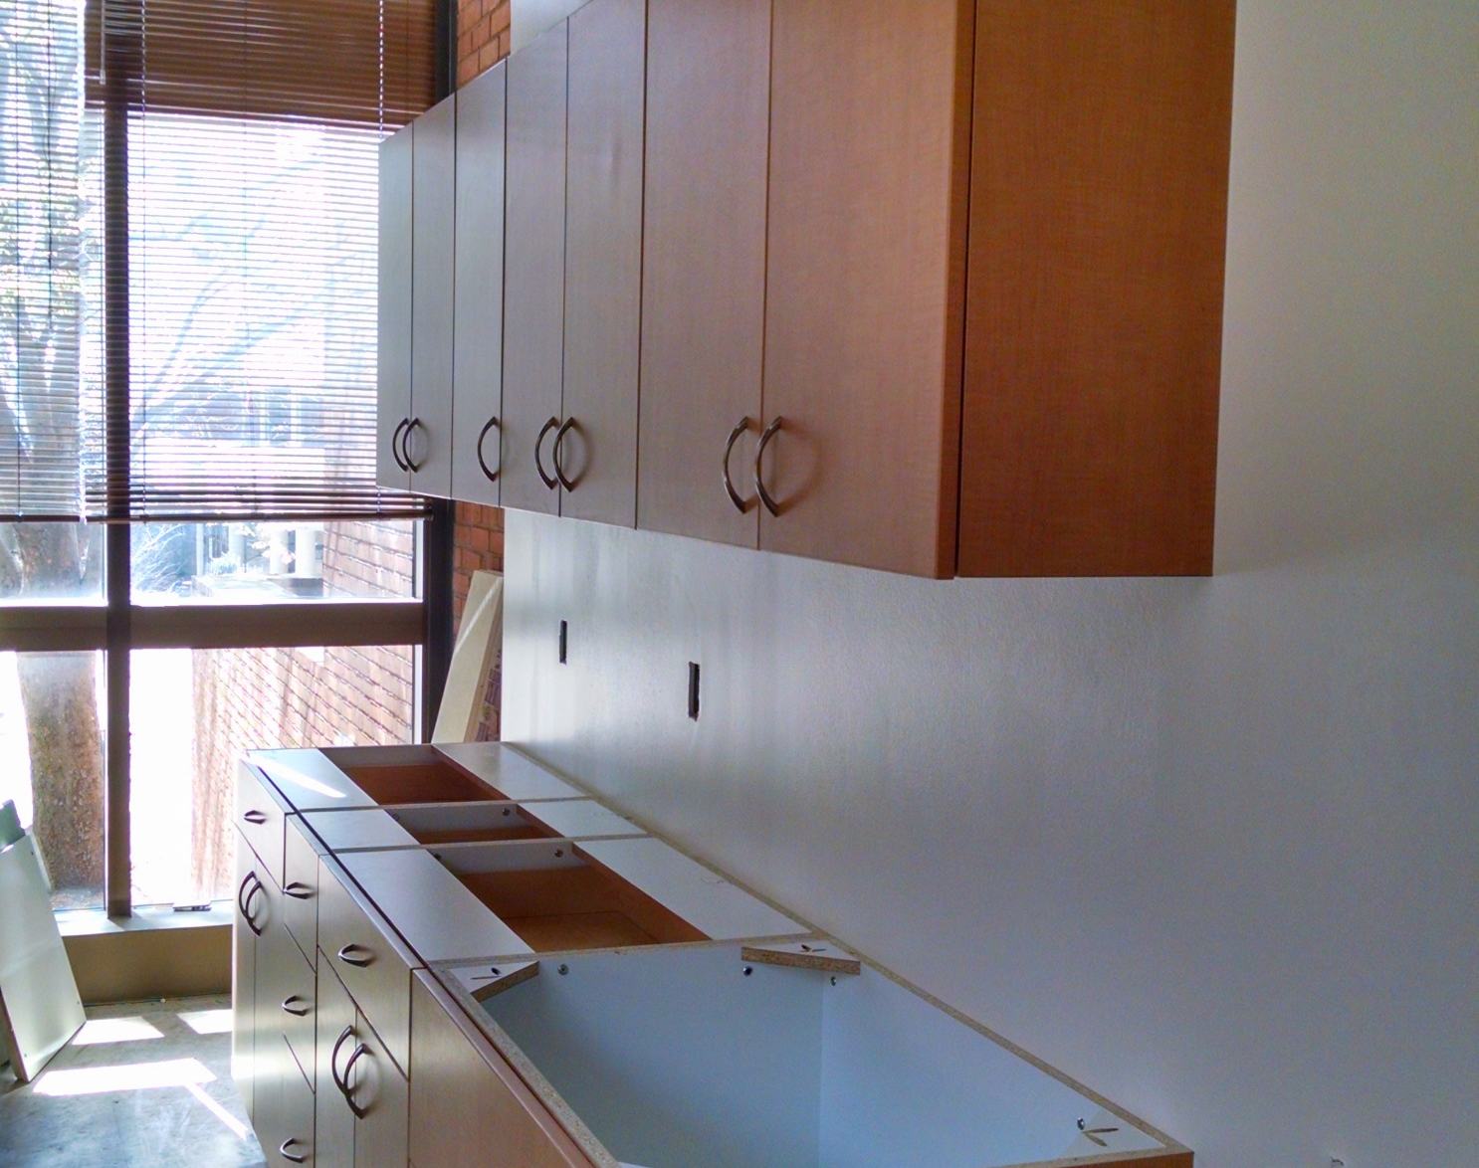
New LED Lighting in the back
Sunlight like spectrum of Light

