Slide 1
Joint Center for Earth Systems Technology (JCET)
A Cooperative Agreement Between
UMBC and NASA/GSFC
Belay Demoz (bdemoz@umbc.edu); Director; Ph.D.-Atmospheric Physics
Susan Hoban (hoban@umbc.edu); Associate Director/Academics; Ph.D.-Astronomy
Mary Dawson (mdawson@umbc.edu); Assistant Director, JCET
Presentation for UMBC’s Research and Creative Achievements Council. 11/10/2017

Slide 2
JCET Status-Update
Outline
Brief Status report
  History & budget
  Academics/Research
  Collective vision and going forward
  Faculty input

Slide 3
JCET Status Update
Administration: History
7/1/95 – 6/30/98 - JCET Cooperative Agreement (started with 6 faculty: Director – H. Melfi)
7/1/98 – 12/31/05 - JCET Cooperative Agreement (reached 85 faculty/fellows: Director – H. Melfi/ R. Hoff )
10/1/05 – 9/30/10 - Proposal for New Exploration
(JCET-GEST transition: Director – R. Hoff )
10/1/10 – 9/30/15 – Proposal for Continued Research in the Earth Systems Sciences
(38 faculty, 6 Tenure/Tenure-Track faculty); Director –R. Hoff/ D. Eichenlaub/B. Demoz )
2015 – 2020 – Proposal for Continued Research in the Earth Systems Sciences – Current
GEST @ UMBC
5/2000 – 4/2011
provided flexibility to transfer between Centers depending on career goals and interests.
facilitated proposals between GEST and JCET faculty.
JCET 2015
Celebrating 20 years of collaborative research and education

Slide 4
JCET Status Update
Funding History
7/1/95 – 6/30/98 - JCET ($20M - ~ 6 faculty; Director – H. Melfi)
7/1/98 – 12/31/05 - JCET ($20M - ~ 85 faculty; Director – H. Melfi/R. Hoff )
10/1/05 – 9/30/10 - JCET-(GEST transition; Director – R. Hoff )
10/1/10 – 9/30/15 – JCET ($20M - ~38 faculty; Director–Hoff/ D. Eichenlaub/Demoz)
10/1/15 – 9/30/20 – JCET ($46.3M – 40 faculty; Director – B. Demoz)
Current JCET Cooperative Agreement NNX15AT34A 66 Tasks to date
Tenure -Track | Non-Tenure Track | Students | Admin
5 | 51 | 20 | 6
JCET 2020: Celebrating 25 years of collaborative research and education
Notes:
Mary – we need to update this table.

Slide 5
JCET Status Update
Funding & Salary Distribution
5-year Cooperative Agreement Renewal Cycle
External research - $9.7 in FY17.
- Direct expenditures of $7.4M and F&A of $2.3M
- Institutional Funds - $1.1M – (operating budget, Bridge fund, non-grant activities (teaching, proposal writing, UMBC committees, etc).
39% grant funded; 56% task funded; 5% state funding
Current JCET Cooperative Agreement
Total Award Ceiling– $46.3M

Slide 6
JCET Status Update
Funding
5-year Cooperative Agreement Renewal Cycle
External research - $9.7 in FY17.
- Direct expenditures of $7.4M and F&A of $2.3M
- Institutional Funds - $1.1M – (operating budget, Bridge fund, non-grant activities (teaching, proposal writing, UMBC committees, etc).
39% grant funded; 56% task funded;
5% state funding
Examples of other Funding Sources
  - NOAA - DoE - NSF - DoT
  - State of MD.
  - Department of Environment
  - Department of Natural Resources
  - Anne Arundel Public Schools
  - City College of New York
  - Howard University
  - Hampton University
  - University of MD College Park
  - Atmospheric and Environmental Research
  - Hazen and Sawyer
  - JPL
  - Smithosonian Astrophysical
Current JCET Cooperative Agreement
Total Award Ceiling– $46.3M

Slide 7
JCET Status Update
Impact/Publication/Proposals
~2 papers/faculty
~2 proposals/faculty

Slide 8
JCET Status Update
Impact in UMBC Departments
PHYSICS/CNMS
Affiliated Tenure/Tenure-Track:
Atmospheric Physics
  Demoz, Belay Martins, Vanderlei
  Sparling, Lynn Zhang, Zhibo
  Zhai, Pengwang Strow, Larabee
  *Hoff, Ray *Melfi, Harvey
Affiliate (@ UMBC):
  De Souza-Machado, Sergio
  Delgado, Ruben
  Hoban, Susan
  Remer, Lorraine
Affiliate (@ GSFC):
  Olson, William Varnai, Tamas
Geography & Env. Systems (GES)/CAHS
JCET- Affiliated Tenure/Tenure-Track:
M. Fagan (GES)
Affiliate (@ UMBC):
Remer, Lorraine
  Affiliate (@ GSFC):
Tokay, Ali Turpie, Kevin Huemmrich, Fred
Campbell, Petya Shuman, Chris Mehta, Amita
Remer, Lorraine
COEIT: Engineering and Information Technology
CSEE
Affiliate: Hoban, Susan
Collaborators:
C. Hannigan (CBEE)
Chemistry/CNMS
Affiliates:
St. Claire, Jason
Wolfe, Glenn
Mathematics & Statistics/CNMS
Affiliate: Tangborn, Andrew
* Emeritus

Slide 9
JCET Status Update
Impact: Physics - success
ATPH Grads
2012 | 13
2013 | 15
2014 | 14
2015 | 12
2016 | 11
2017 | 9
Where students were recently hired
NOAA NESDIS STAR, Camp Springs, MD
NASA Jet Propulsion Laboratory
NASA Langley Research Center
NASA Goddard Space Flight Center
Army Research lab, Aberdeen
MD Department of the Environment
More places…
JCET, UMBC
CNR (Italian National Research Council), Matera, Italy
Meteo France, Toulouse, France
University of California, Davis
Penn State University, State College, PA E.ON, Energy Company, TX

Slide 10
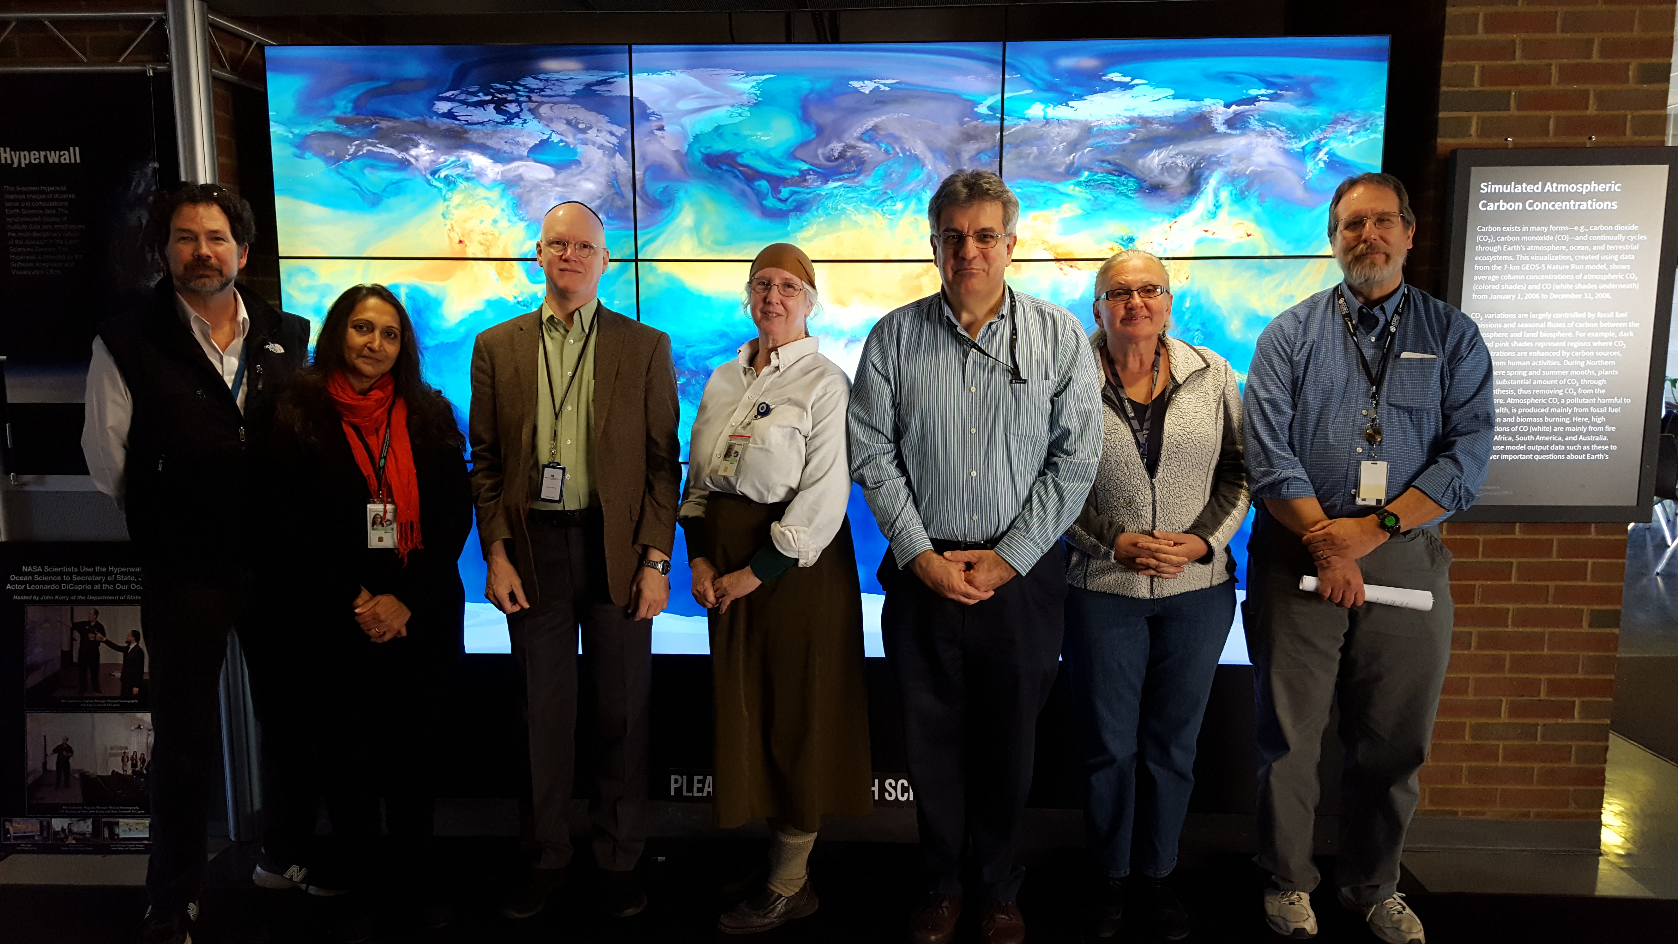
  JCET Status Update
  Impact: - Geography and Environmental Studies (GES) - success
Strong relationship with Dept. of Geography & Environmental Science
7 GES Affiliated JCET faculty
  Growing!
Teaching 1 or 2 courses each semester
Active involvement in Department
  Attend faculty meetings; Participated in Chair Search
  Develop new courses
Planning to grow student interaction
    We hope to contribute more to strengthening the GES Graduate program

Slide 11
JCET Status Update
Increased Departmental interaction
Departmental outreach within UMBC
  Chemistry: Increase interaction
  Math/Stat: Expand on what we started
  Public policy: Climate policy connection (Prados)
  - Expand Engineering & Computing (CBEE, CSEE, IS)
      A. Nader (PANDORA) – CoEIT home.
      C. Hannigan (Aerosol chemistry)
Graduate Student Support
- Reach more students (Graduate/UG)
  Need interactions with departments for recruiting

Slide 12
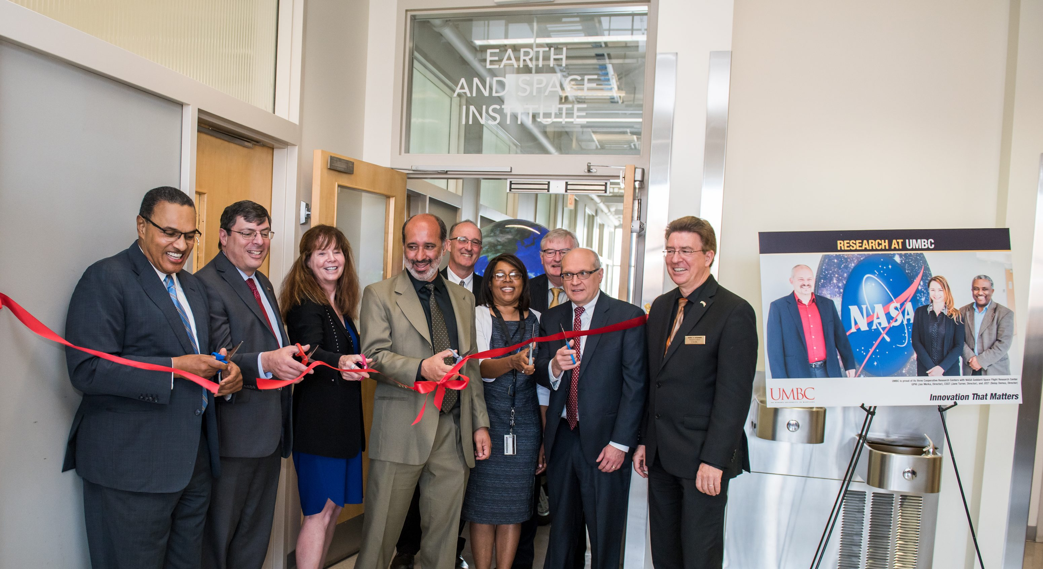

JCET Status Update
JCET : Collective vision Exercise
Non-NASA funding
NOAA-UMBC Center
Towards an Institute
A Place for remote sensing
JCET faculty were divided into groups (5);
Provided comments (39)
Serve as a guide for the center
✔
✔
JCET Renewal
✔
Promote STEM Education
✔
Earth and Space Institute (3rd Floor of Physics Bldg)
Satellite Mission
JCET-Industry partnership
Think Patents
Private Sector Sponsorship
A leader in Contracting
Work-life arrangements
Research Professorship
Laboratory Facilities

Slide 13
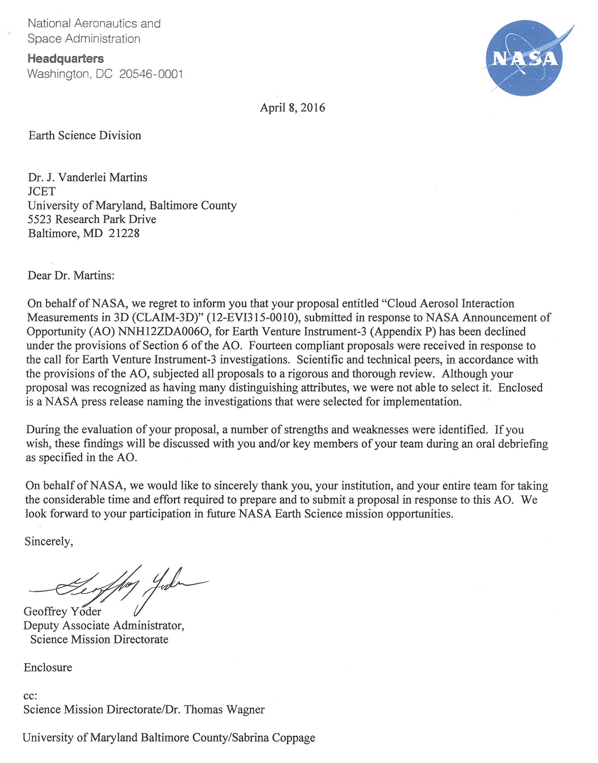
JCET Status Update
Collective vision - Satellite
PI: V. Martins ; Physics/JCET
HARP (HyperAngular Polarimeter) Science Goal
Demonstrate the ability to characterize the micro physical properties of aerosols and clouds at the scale of individual moderate-sized clouds for the ultimate purpose of narrowing uncertainties in climate change.
CLAIM-3D
not funded
We will keep proposing …

Slide 14
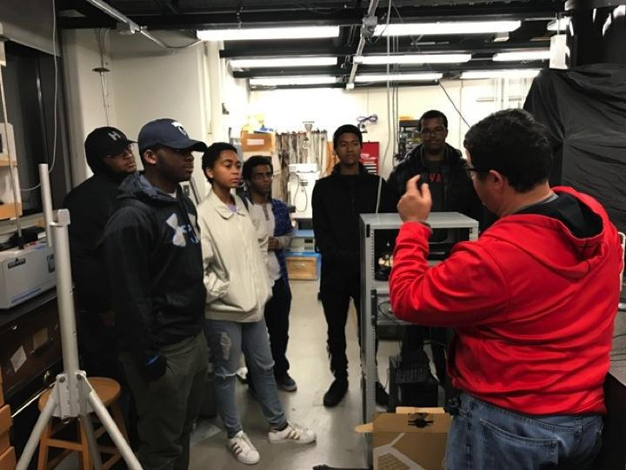
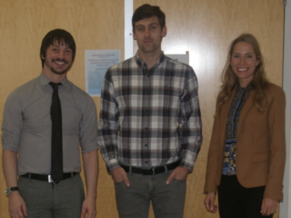
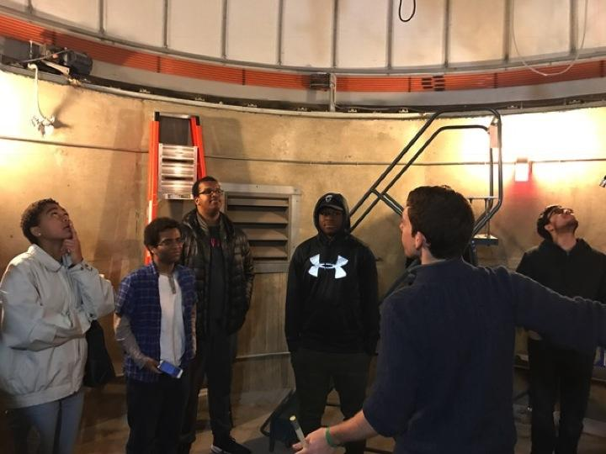
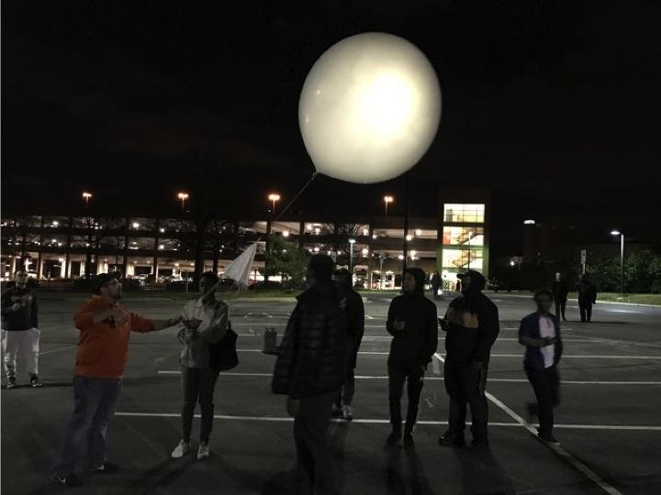
JCET Status Update
Collective Vision: ...: training the next generation
MUREP MOO project with Howard Univ.
6 minority undergrads working with GSFC mentors and interacting with JCET scientists and graduate students (3 yrs)
NOAA project with CUNY and Howard Univ. supporting graduate student research (5 yrs)
UMBC Seeing Science
2017 PhD Graduates
UMBC Observatory
Monthly Open House
Weekly Public Viewing
School groups
Others (scouts, clubs)

Slide 15
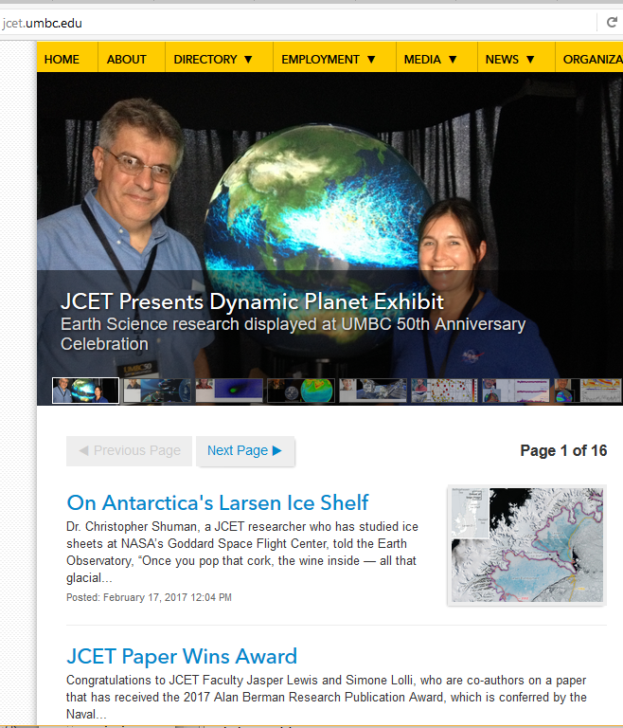
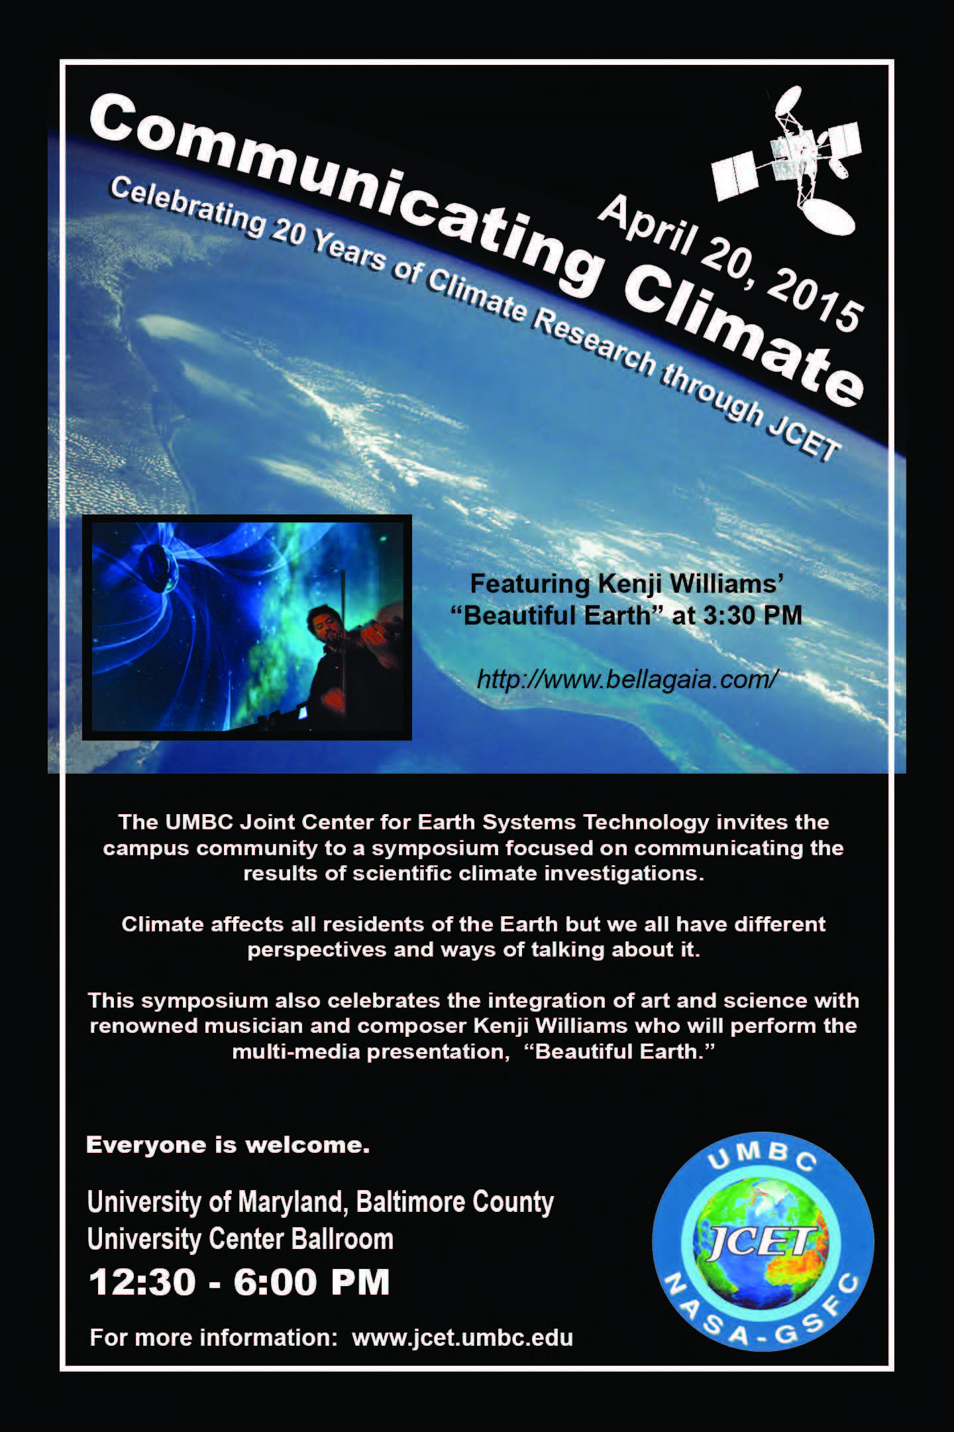
JCET Status Update
Collective vision: ...Communicating what we do

Slide 16
JCET Status Update
Over the next year
Collective Vision …
  Continue Departmental Interaction
  Support development of local group of
  institutions interested in Climate Studies
  (working with Sustainability Committee)
  GSFC leadership engagement
    JCET’s unique feature –
    a bridge between NASA and UMBC

Slide 17
BACKUP

Slide 19
JCET Status Update
Impact/HR beyond UMBC
Civil Servants (10+)
  NASA/GSFC (e.g. Platnick, Markus, Oreopoulos, Marshak, Welton, Demoz, etc)
  NASA/LaRC (e.g. Berkoff, Ferrare, …)
  NOAA (e.g. Barnett, Mengwa Wang,..)
  JSCDA/WMO
  Other: Environment Canada; Max-Planck Institute; MetoFrance
Tenure-track Faculty (10+)
  East Carolina University
  Howard University
  CCNY
  UMBC (5)
  Michigan Tech University
  University of Redding
  Valparaiso University
  Weizman Institute, Israel
  Univ. Of Lille, France
  Univ. of Oregon
Graduate Student Placement
NASA/LaRC/GSFC/ARC
NOAA MDE
ARMY STC
UC-Davis Northrop Grumman

Slide 20
JCET Status Update
Classification

Slide 21
JCET Status Update
Impact: Teaching Component
Over the last 20yrs, JCET faculty has been associated with over 300* undergraduate students!!
90+ credits in the last five years
*Does not include lectures
Annual JCET Graduate Fellowship Awarded
3 - 4 UMBC students supported annually for summer internships at GSFC or UMBC
JCET supports 25% of Teaching faculty’s salary for 16 weeks from the operating budget.
Everyone benefits!

Slide 22
JCET Status Update
Impact: Teaching Component
  PHYSICS
  PHYS 621: Intro to Atmospheric Science
  PHYS 622: Clouds, Aerosol and Radiation
  PHYS 640/440: Computational Physics
  PHYS 721: Atmospheric Radiation
  PHYS 741: Inverse Methods
  PHYS 335: Physics & Chemistry of the Atmosphere
  PHYS 112: Basic Physics II
  JCET Seminars – Professional development for graduate students
GES
GES 302: Arctic Geography
GES 311: Weather and Climate
GES 381: Remote Sensing
GES 400x: Earth’s Cryosphere
GES 415: Climate Change
GES 481/681: Remote Sensing and Image
Processing for Environmental Applications
CSEE
CSMC 626: Computer Security
Proposed:
Climate Change & Public Policy

