Slide 1
Entrepreneurs at UMBC
Interest Meeting

Slide 2



Who are we?
UMBC Entrepreneurs is a student organization dedicated to creating an ecosystem of collaboration and entrepreneurial ventures.
We help YOU turn your ideas into real student-led ventures
Meet other ambitious and like-minded students
Create real products and services and earn real money
Surround yourself with students that support your goals and ambitions today

Slide 3
Meetings & Idea lab
Meetings on Monday’s from 12:00 – 1:00 PM, Locations announced via myUMBC
Idea Lab on Friday’s from 12:00 – 1:00 PM, Location TBA

Slide 4
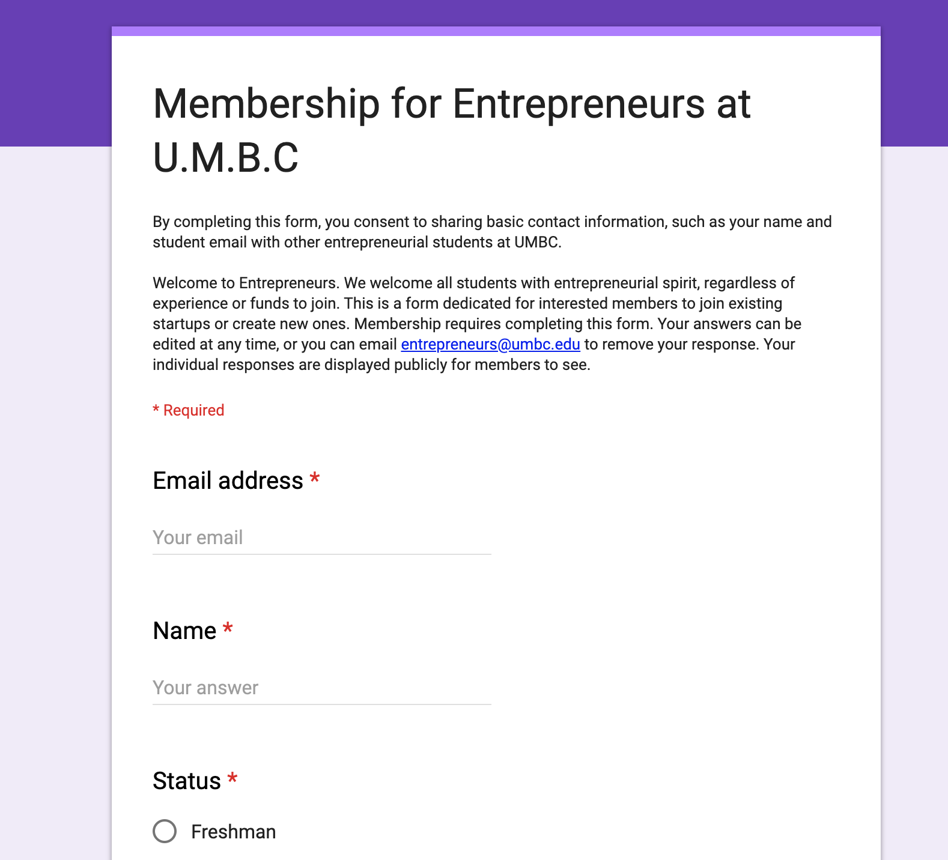
How to submit OR JOIN A venture
Go to our myUMBC group (https://my3.my.umbc.edu/groups/entrepreneurs)
Fill out our Google Form (https://forms.gle/usRMkCmKAQuHkt9u7)
To view existing ventures, go to Files → Student-led Ventures Looking for Cofounders

Slide 5

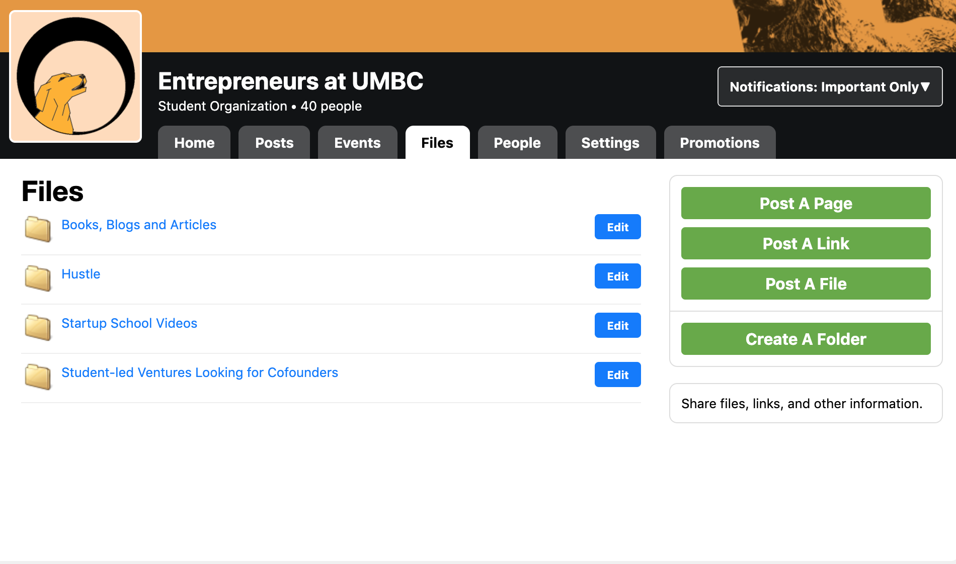
Resources
Find resources and other information under Files

Slide 6
Alex brown center
Idea Competition
Cash prize of $750
Deadline for submittals is October 10th at 1:00 PM
Event will be held November 14, 2019, in the Sports Zone in The Commons
To enter the competition, complete the UMBC Idea Competition Entry Form (which can be found on the Alex Brown Center website), which asks you to
1. Describe a problem or opportunity
2. Describe your idea for addressing it.
Any Questions? Contact Vivian Armor at armor@umbc.edu

Slide 7
Activity!

Slide 8
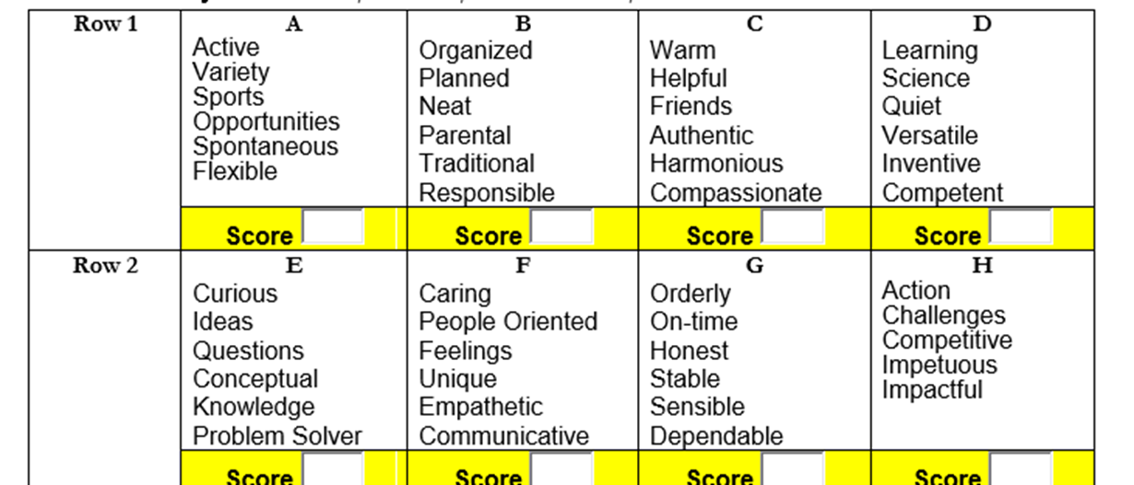

Slide 9
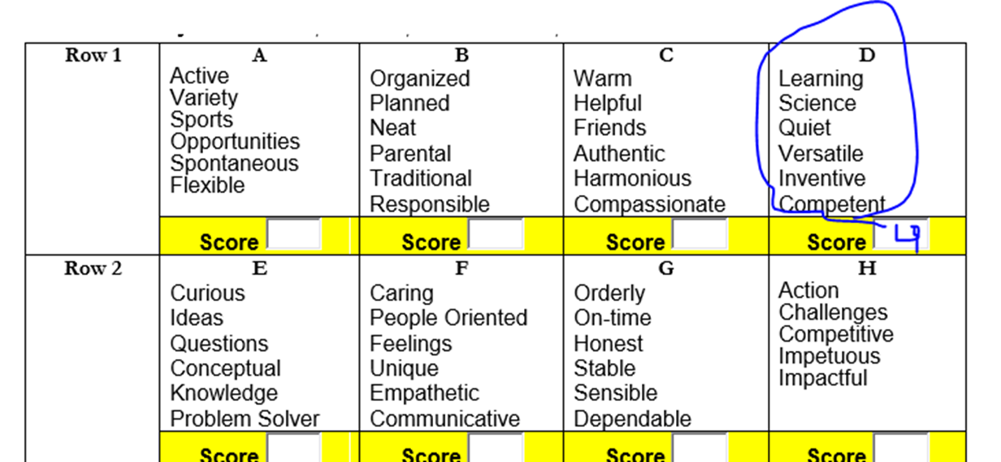

Slide 10
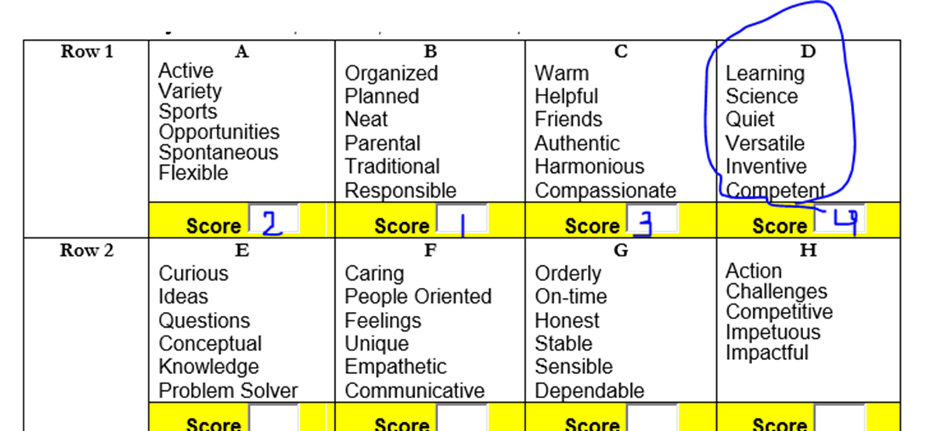

Slide 11
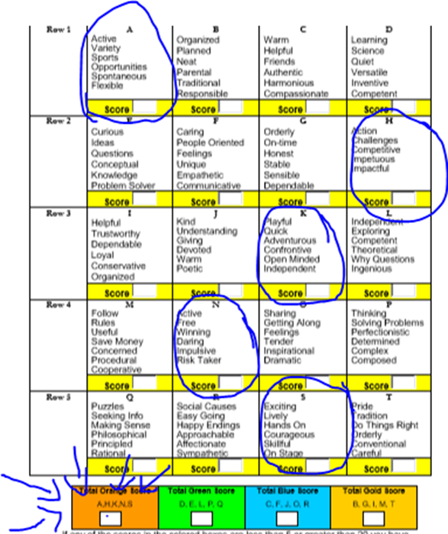

Slide 12
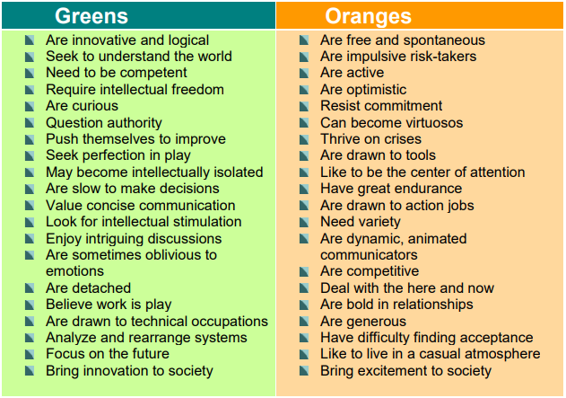

Slide 13
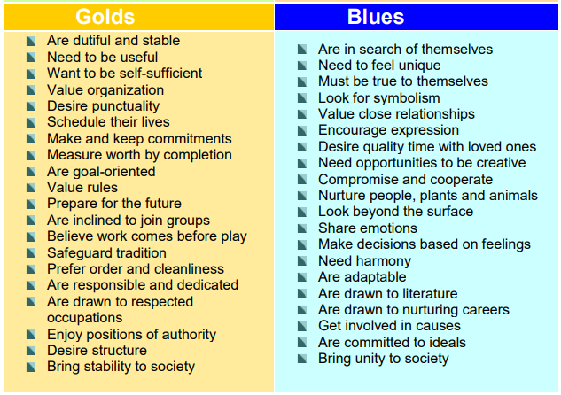

Slide 14
WHAT HAPPENS WHEN WE LACK PEOPLE WITH THESE TRAITS IN OUR TEAM OR BUSINESS?

Slide 15


Slide 16
Questions?

