Slide 1
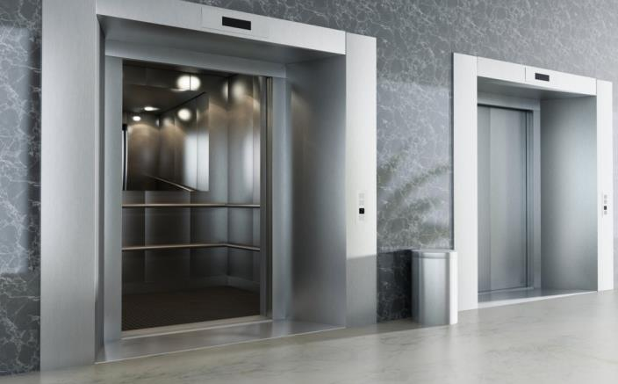
Perfecting the Pitch
Stephen Auvil
Sr. Vice President Technology Transfer & Commercialization
Maryland Technology Development Corporation (TEDCO)
sauvil@tedco.md

Slide 2

Overview
Types of pitches
Communication basics
Purpose of a pitch
The pitch itself
  What to cover
  Suggestions
Examples
Venture pitch slide deck
Questions

Slide 3

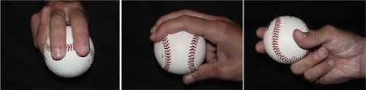
Types of Pitches
Type of Pitch | Slides | Duration
Introduction | N | 5-10 Seconds
Elevator Pitch* | N | 30 – 90 Seconds
Standard Pitch – Competition | Y | 5 – 10 Minutes
Venture Pitch - Investment | Y | 20 Minutes

Slide 4
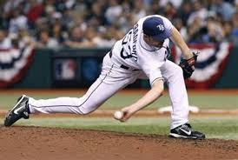
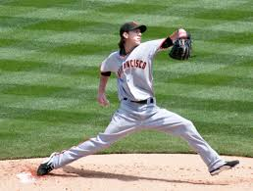
Types of Pitches
Get investment
Get a job
Get a promotion
Get a sale
Get a date
Etc.

Slide 5

Volunteer Needed

Slide 6

Communication Basics
Feedback
Message
SENDER
Code
Decode
RECEIVER
WORDS
7%
38%
VOCAL
55%
VISUAL

Slide 7

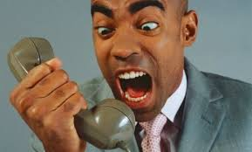
Communication: Written vs Verbal
Written (Executive Summary) | Verbal (Elevator Pitch)
Only Words | Words & Everything Else
Unidirectional | Bidirectional
Static | Dynamic

Slide 8
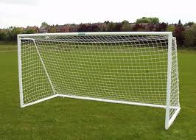
Goal of an Elevator Pitch
Questions/continued conversation
An action
It is called a “Pitch” because you are selling something
IT IS NOT:
  A detailed description of your product/company
  An infomercial – product features
  A justification for investment

Slide 9
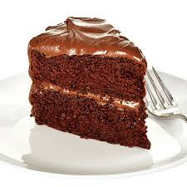
Icing versus Cake
IDEA
Good
Bad
Good
Goal
Dangerous
PITCH
Bad
Potential
Hopeless

Slide 10

What should be covered?
Start with your Name (clearly)
One sentence overview
Problem – its significance
Solution – its uniqueness
Business opportunity
End with an ask

Slide 11
What should be covered?
All from your customer’s perspective
How does your customer “Win” – get value?
The “So What” Test

Slide 12
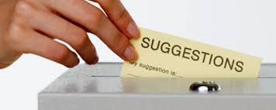
Suggestions for Pitches

Slide 13

Attention Span
Are you still paying attention???
8 Seconds – Average Adult Attention Span

Slide 14
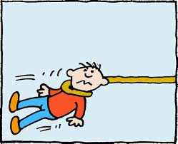
The Hook
Something attention-getting in first 8 seconds
  One sentence overview
  Your pitch should be relatable to the audience – they need to get it QUICK
  Fast facts

Slide 15
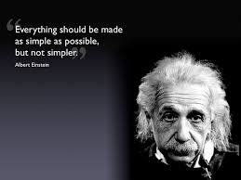
Keep it Simple
Stay away from technology/product description
Stay away from technology/product description [for emphasis]
Rather, focus on the benefit of your product – what value it is to your customers

Slide 16
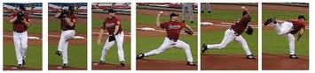
It’s More about How you Pitch
>90% is not the words
It’s about you – the company will change – you won’t (as much)
Pace – not too fast, but energetic
Hand gestures
Facial expressions
Eye contact
Use microphone

Slide 17
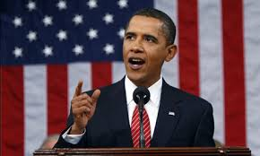
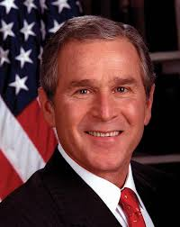
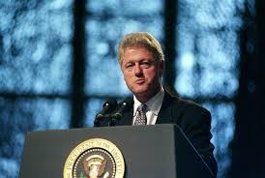
Sound Bites
Name drop - partners
Awards/recognition
Customers/traction
Capital secured/investment

Slide 18
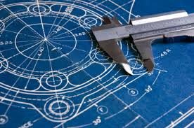
Be Specific
Use numbers not generalities
Avoid things like “Large market”, “Everyone [is our customer]”, etc.
Gives the impression of being knowledgeable

Slide 19

Tell a Story

Slide 20
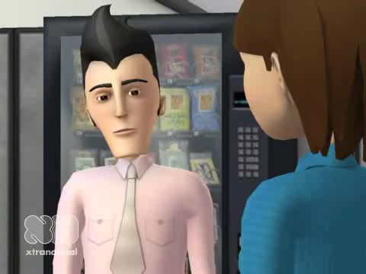
Watching a Pitch

Slide 21

Can You Pitch?
Pen
Jet Aircraft
Smart phone

Slide 22
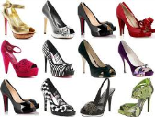
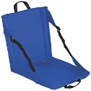

Setting the Bar – with Examples
OneSole
Hot Seat
CupAd

Slide 23

Venture Pitch – Slide Deck
Problem
Solution
Competitive advantage/IP
Market
Competition
Revenue Model
Go-to-market strategy
Financials/Financing needs
Team/Advisors
Summary

Slide 24

Stephen Auvil
Sr. Vice President Technology Transfer & Commercialization
Maryland Technology Development Corporation (TEDCO)
sauvil@tedco.md

