Slide 1
Social Media Marketing
UMBC
September 23, 2015

Slide 2
1. Social Media Marketing Increases Website Traffic and Search Ranking
2. Social Media Marketing Generates Leads at Minimum Costs
3. Social Media Marketing Boosts Content Marketing
4. Social Media Marketing Increases Brand Awareness
5. Social Media Marketing Legitimizes Your Brand
6. Social Media Marketing Increases Sales
7. Social Media Marketing Gives You Great Audience Insight
8. Social Media Marketing Improves Brand Loyalty
Taken from http://www.business2community.com/infographics/top-8-benefits-social-media-marketing-small-business-infographic-01240453

Slide 3









Slide 4
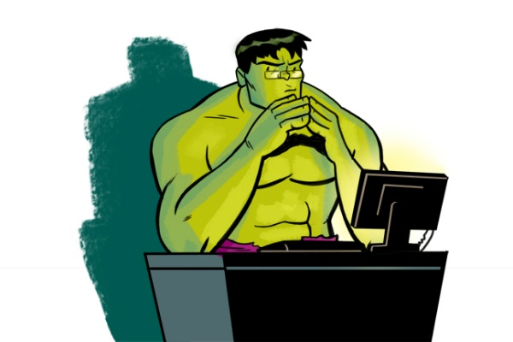
Which social media outlet should I start with??

Slide 5
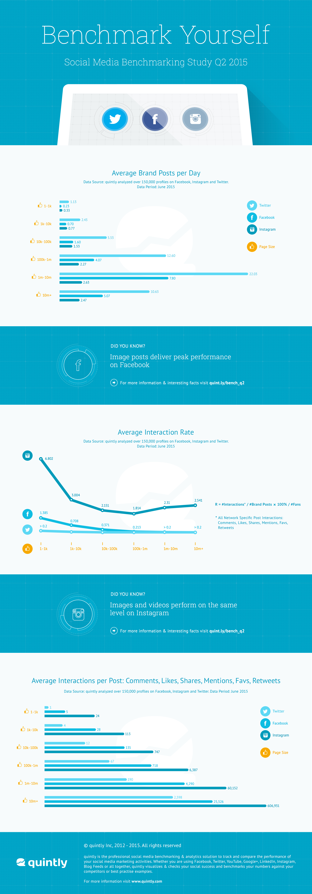

Slide 8

Before you begin your marketing campaigns, make sure you have your infrastructure set up.

Slide 9
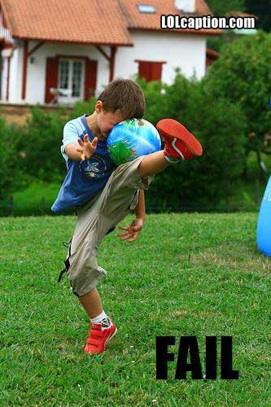
Be prepared to fail!!

Slide 10
What’s been working for me

Slide 11
Thank you very much for coming out today!
Be sure to follow me on Facebook and Instagram
www.facebook.com/dipgrips
www.Instagram.com/dipgrips

