Slide 1
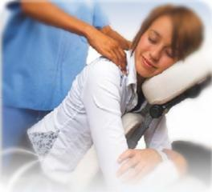
Stress Buster Event
Take a break from the end of the semester and general winter mayhem and come join us for a free massage or acupuncture!
Where: Flat Tuesdays
When: December 13, 2012
11:00 am – 2:00pm
*Light refreshments will be served
RSVP at http://my.umbc.edu/groups/pss/events/15052
Feeling Stressed???
Professional Staff Senate Outreach Sponsored Event

