Slide 1
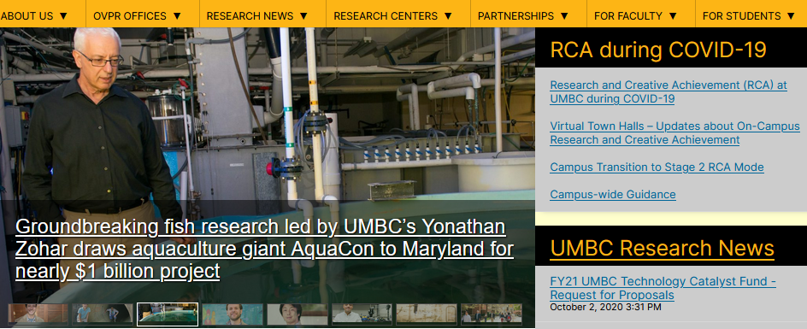
RESEARCH
October 9, 2020
Research & Creative Achievement Council

Slide 2
Discussion Topics
Kuali OSP Implementation Wins UMBC Award
Faculty External Relationships & 889 NDAA
– Tim Sparklin, Compliance Officer ORPC
– Stan Jackson, Director OSP
Multi Unit Proposals and Kuali Credit Split Implementation
– Dean Drake
Late Progress and Final Reporting Requirements
– Stan Jackson, Director OSP
USM Economic Impact Study
– Dean Drake

Slide 3
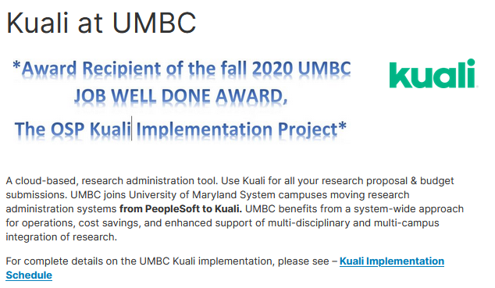
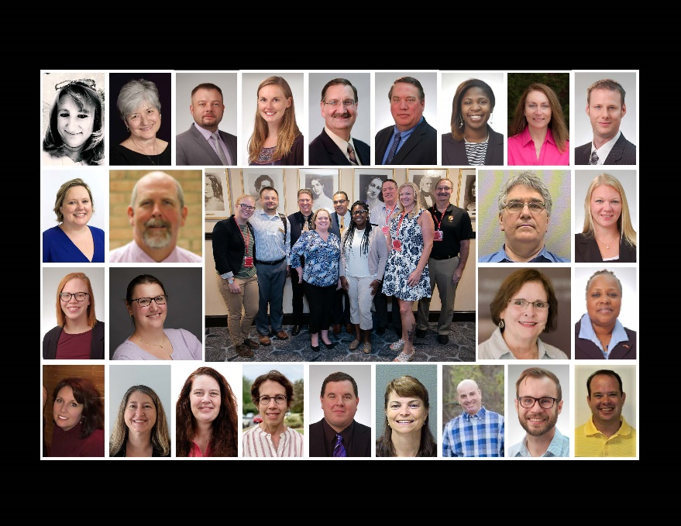

Slide 4
Faculty External Relationships
– Dean Drake
Domestic and International Affiliations and Collaborations
Late Progress and Final Reporting Requirements
Proposal & Award Requirements for Disclosure of Domestic and International Involvement Matrix Impact Study
ORPC FAQs for Domestic and International Affiliations
Policy on Professional Commitment of Faculty – Dean Drake
Policy on Conflict of Interest
State Ethics Law

Slide 5
External Relationship Timeline
Increasing harmonization / Increasing Enforcement / Conflation with Broader Economic & Political Issues
National / Economic Security
August 2018
Winter / Spring 2018/19
Summer / Fall 2019
Winter - Summer 2019/20
Awareness
Understanding & Increased Risk Acknowledgement
Agency Clarifications & University Interpretation
Agency Implementation & Continued Enforcement & Harmony
NIH Letter
Foreign
Component /
Foreign Influence
Disclosure
Other Support
(NIH / NSF)
National Security, Economic Security, Integrity of Research
Diversion of intellectual property (IP) in grant applications
Sharing of confidential information during peer review
Failure to disclose substantial resources
Affiliations & appointments
Include non-financial support
Talent Programs
Other Inclusions?
“Significant”
Outside of U.S.
OSTP Communication: “Enhancing the Security and Integrity of America’s Research Enterprise”
Sponsor Communication & Implementation
FBI
Congressional Activity
Increased Harmonization
NIH: Letters to Universities & ACD
NSF – JASON, Etc.
DoD – National Security
December 2019
Congressional Interest
JASON Report
JCORE – Joint Comm. on Research Environ.

Slide 6
Talent Programs – What’s the Issue?
Receive from the Chinese Govt:
Significant salary
Appointment at a foreign university
Funded “Shadow” lab in China
Access to high tech equipment
And in return may include one or more:
Commitment to keep the terms of the agreement confidential
Do not disclose the results of work conducted under Chinese patronage
Turn over any intellectual property that they develop (in US or in China)
Require permission of the Chinese government to terminate the agreement
Provide appointments in the US lab to Chinese collaborators or visitors

Slide 7
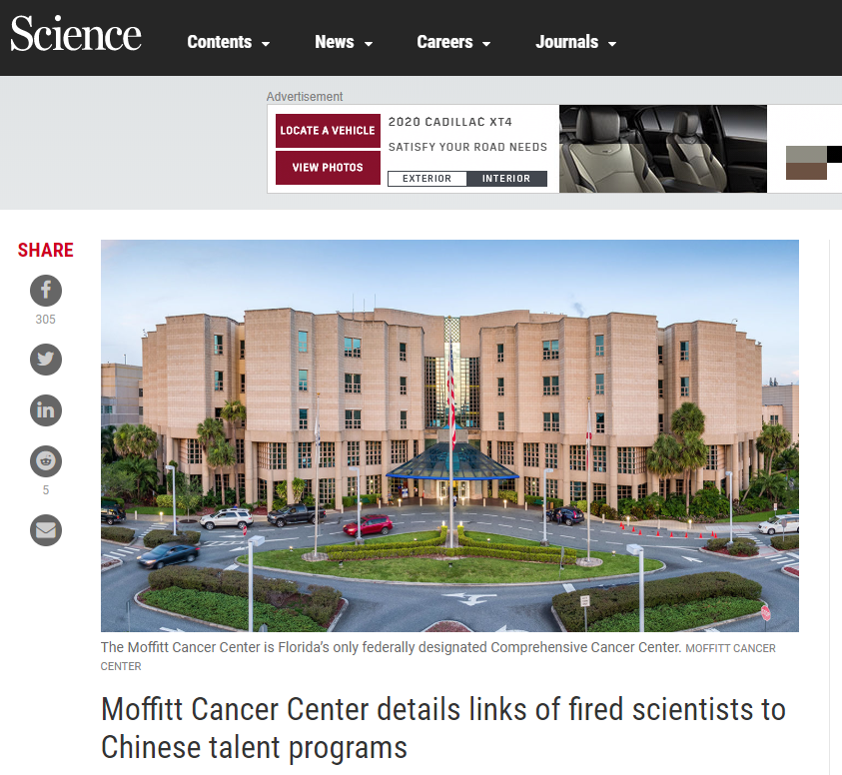
“Several Moffitt faculty cited the personal participation of Moffitt leadership in the Talents …as a reason for their own agreement to participate.”
“… they failed to disclose the existence of personal bank accounts in China in which the unreported funds were deposited.”
“.. But the report also suggests several Moffitt scientists were scamming their Chinese funders by not putting in the time they had promised under their Thousand Talents deals.”

Slide 8
The Extent of the Problem..
399 NIH Researchers were identified
70% failed to disclose the receipt of a foreign grant
54% failed to disclose participation in a foreign talent recruitment program
9% hid ties for a foreign company
5% involved violation of NIH’s peer review system
189 NIH-funded scientists at 87 institutions have been sanctioned either by NIH or by their employer
77 investigators have been blocked from applying for a new NIH grant
Source: SCIENCE – By Jeffry Mervis Jul. 14, 2020 , 12:00 PM

Slide 9
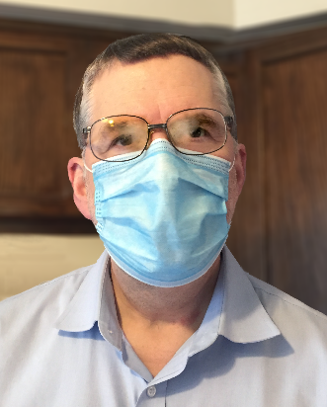
“Principled International Collaborations”?
Undisclosed foreign employment,
Undisclosed obligations to generate foreign patents that may be related to NIH-funded work,
Undisclosed preferential treatment in American laboratories for certain students or visiting scientists,
Undisclosed research support – often for similar if not identical research being supported by the NIH,
Undisclosed compensation deposited into secret foreign bank accounts,
Undisclosed obligations to assign credit to foreign institutions for work done largely in the U.S.,
Undisclosed obligations to keep foreign arrangements and scientific work secret,
Undisclosed obligations to transfer propriety information and technologies to foreign institutions,
Stringent restrictions on termination of contract,
Undisclosed significant financial conflicts of interest, and
Egregious violations of peer review confidentiality rules.
Open Mike: Addressing Foreign Interference and Associated Risks to the Integrity of Biomedical Research, and How You Can Help

Slide 10
Faculty External Relationships
Key Takeaways:
Regulations are changing. OSP and ORPC resource pages are as well.
While Chinese relationships are the news, all external relationships and collaborations need to be considered for disclosure requirements.
If things change after a submission, you must revise your disclosure in line with the sponsor requirements
Some sponsors require disclosure if relates to scope. Others require even if they do not relate.
If there is a question – include it! Reach out to OSP or ORPC for guidance.

Slide 11
Aug 13, 2020 889 National Defense Authorization Act
Issued to UMBC awards via UG 2 CFR 200.216 & 200.471 as well as the FAR
Basically restricts UMBC from working with certain Chinese companies or any subsidiary or affiliate.
Huawei & ZTE - Telecommunications Equipment
Hytera, Hangzhou Hikvision Digital Tech, Dahua Tech – Telecommunications and video surveillance
This prohibition applies even if the award is not intended to procure or obtain, any equipment, system, or service that uses covered telecommunications equipment or services.
OVPR/ORPC working with OSP, Procurement, IT Security and MAS-P-card
Web page with regulation and complete list of companies under
OVPR/ORPC/Export Controls/Restricted Party Screening for Foreign Entities

Slide 12
Multi Unit Proposals & Kuali Credit Split
Multi Unit Proposal Basic Tenets
Who will be PI & decision on multiple PS projects is collaborative and includes all units involved both faculty and admin.
Sometimes not prudent to set up separate PS projects for non-lead unit(s)
At all times PI and the PI Business Office are responsible for entire proposal and award.
If a resource it is not monetized, you can’t charge it to the sponsored award – Can be listed in Facilities & Other Support so long as no $ assigned.

Slide 13
Multi Unit Proposals & Kuali Credit Split
– Dean Drake
Multi Unit Proposal Basic Tenets - Continued
Kuali Credit Split can be utilized to distribute appropriate credit for DRIF or Academic credit.
Home department Business Office of Faculty is “always” responsible for their faculty payroll and managing total salary picture of their faculty
If a faculty has one appointment and is the PI, then faculty home unit (where appointment is housed) is lead
When multiple appointments the faculty must designate which unit they are assigning their effort.

Slide 14
Multi Unit Proposals & Kuali Credit Split
– Dean Drake
Kuali CREDIT SPLIT
Completed pilot test of Credit Split with MIPAR & Dresher
Once it is on, it is on for everyone and is required for proposal routing
Plan is to have training in Dec 2020 for OSP, RAG then Expanded RAG before Turning on in Jan 2021
s and Final Reporting Requirements

Slide 15
Multi Unit Proposals & Kuali Credit Split
– Dean Drake
Kuali CREDIT SPLIT
s and Final Reporting Requirements
Credit Type | Description
DRIF | Shared financial credit for more than one person and unit and expending budgeted dollars from the actual award. This percentage will be utilized to allocate DRIF to be returned to each defined unit by matching it up with the People Soft expenditures associated with the award. Use this category when the units have agreed on the percentage of DRIF allocations. If the split is based on each units’ budget, use that percent.
Academic | Intellectual Credit for multiple individuals. This is a place where faculty can designate an academic contribution. This credit might be different than DRIF.

Slide 16
Late Progress & Final Reporting
– Dean Drake
PI is responsible for technical deliverables
Late reports impact UMBC & PI reputation
Late reports may prevent your colleagues from another department from getting an award
NSF has told OSP that we had 24 hours to submit late reports or new award will be made to next organization in line
If late reports are not resolved OSP will be directed to stop all award set up & PI Eligibility will be in jeopardy.

Slide 17
Late Progress & Final Reporting
– Dean Drake
30 days – Reminder to PI w/ cc unit business office.
60 days - Reminder to PI w/ cc unit business office, Chair or Director, and Associate Dean for Research.
90 days – OSP director will send an email to the PI with cc unit business office, Chair or Director, Associate Dean for Research , Dean, and Associate Vice President for Research (AVPR). The OSP Director will indicate if overdue report is not submitted within the next 30 days OSP may be directed to suspend processing any award actions for PI until overdue report has been cleared.
120 days - AVPR will direct OSP cc’ing all in #3 about enforcement action. This may also impact PI status at UMBC

Slide 18
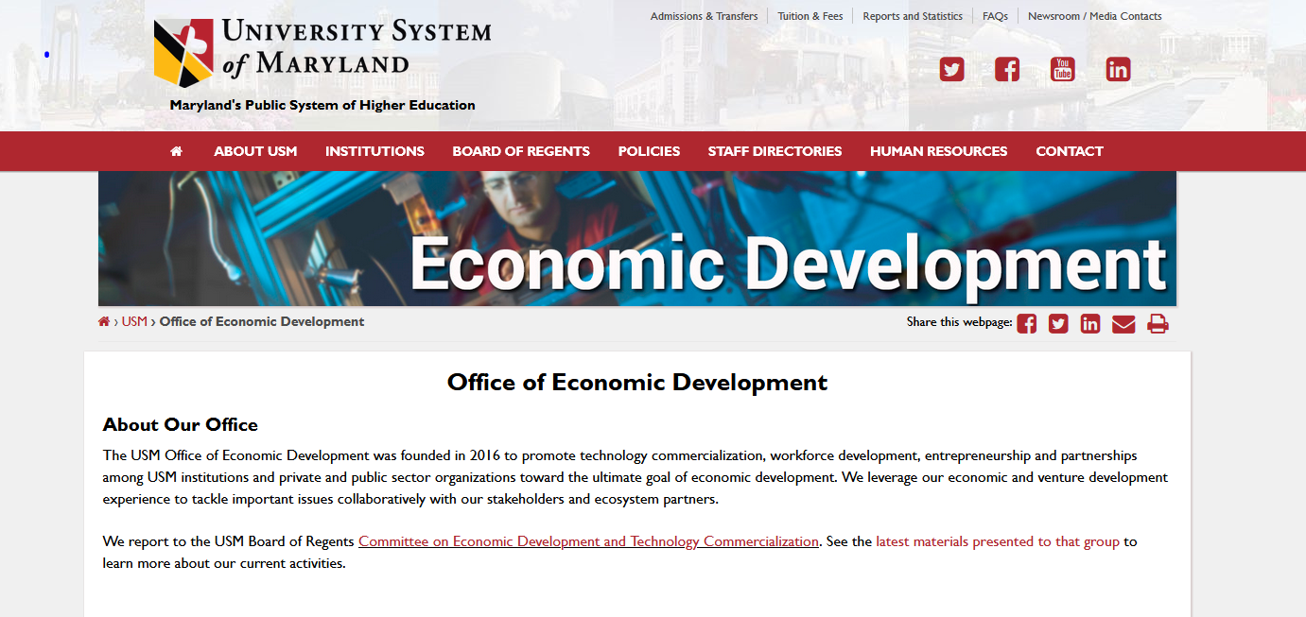
USM ECONOMIC IMPACT STUDY
Dean Drake
One of three different requests in August that have some relationship
1) Industry Engagement/Partnership Inventory
2) USM Economic Impact Study 3) USM working on Economic Strategic Plan

Slide 19
USM ECONOMIC IMPACT STUDY
Dean Drake
The Study was last completed in 2011-2012
Data is accumulated by the UB Jacob France Institute
2020 submission involved about 30 individuals and groups across campus
Covers three main areas of how UMBC impacts the:
1) Workforce
2) Economic Development
3) Community

Slide 20
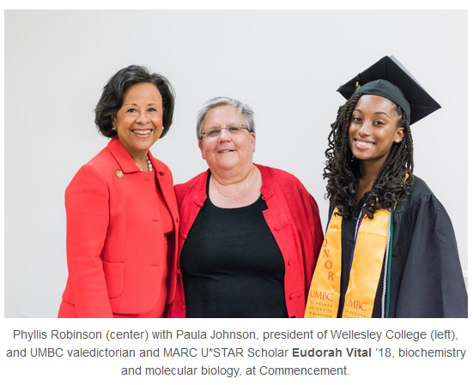
USM ECONOMIC IMPACT STUDY - Workforce
Dean Drake
Training & Education:
Division of Professional Studies
Alex Brown Center for Entrepreneurship
Entrepreneurial Skills Training for Faculty
MARC U*STAR ended and URISE begins
Shady Grove
UMBC Training Centers
Adult Literacy on Community

Slide 21
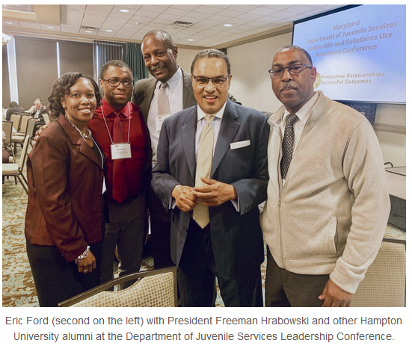
USM ECONOMIC IMPACT STUDY - Workforce
Dean Drake
Work-based Learning (Internships & Coop Education):
Maryland Technology Internship Program
MxD Collaboration – Manufacturing Cyber Skills
Shriver Center
Public Service Scholars Program
The Choice Program
Peaceworker Fellows Program
Master’s of Professional Studies in Community Leadership
Career Center
Undergraduate Research and Creative Achievement Day (URCAD)

Slide 22
USM ECONOMIC IMPACT STUDY – Economic Development
Dean Drake
Technology Commercialization
Technology Catalyst Fund
Maryland Innovation Initiative (MII)
UMBC Express License Agreement (XLA)
Start-up Round Table
Start-ups (15 Active FY20 and 9 formed or being formed)
Core Facilities
The CENTRE funding
Bwtech – 131 tenants employing 1,890 $241M in Bus Sales as of 7/31/20 Cyber Incubator
Cync & SCALEUP Program
Cybersecurity Venture Fellowship Program $1.3M Grant

Slide 23
USM ECONOMIC IMPACT STUDY – Community Impact
Dean Drake
Carnegie Foundation – Distinguished Community Engagement Classification
Shriver Center – 18K people served 5M hours with community partners
France-Merrick Scholarship Program
Public Service Scholars
Choice Program
Peaceworker Fellows
Partnership with Arbutus Middle School
Promoting Engaged Research and Teaching
PARCC Tests reveal Balt City schools partnering with UMBC show dramatic growth in math performance
Feeding Individuals to Support Health (FISH) - IMET/DMB & United Way
OCA Mocha

Slide 24
USM ECONOMIC IMPACT STUDY – Community Impact
Dean Drake
From the Environment to COVID-19 UMBC research impacts the Community
Office of Sustainability
Imaging Research Center (IRC) – Matthew Henson Elementary School
Center for Democracy & Civic Life – Breaking Ground, Alternative Spring Break, STRiVE
The PLACE Project
Student Athletes – 17 committed 300 hours of community service
The MD Center for Computing Education (MCCE)
First State Recognized Arts & Entertainment (A&E) District in Balt. County.

Slide 25
USM ECONOMIC IMPACT STUDY
Dean Drake
Some Key Takeaways
UMBC should be proud of the impact it is having on the Economy and its community
While extensive, we could not include everything
Less than 2 months is not enough time
Carnegie Classification Study
Communications Group/Dinah – The stories

