Slide 1

Best Practices for Evaluating Applications
UMBC STRIDE
Tuesday, October 8, 2024
10:30 am -noon (optional specific Q&A)
Next Up: STRIDE Office Hours Tuesday, October 15, 2024 1:00-3:00pm WebEx | Next Up: Best Practices for Interviewing Tuesday, November 5, 2024 10:30 am -noon (optional specific Q&A) WebEx
See myUMBC Faculty Affairs group (Events tab) for full schedule

Slide 2
STRIDE
UMBC Committee on Strategies and Tactics for Recruiting to Increase Diversity and Excellence
STRIDE fellows provide faculty peer education supporting search committees and departments/programs to recruit, retain, and promote diverse faculty and foster more inclusive and equitable academic spaces for faculty.
As a peer education resource, the UMBC STRIDE Committee does not create or enforce institutional policy or approve faculty searches

Slide 3

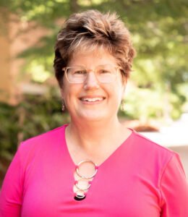

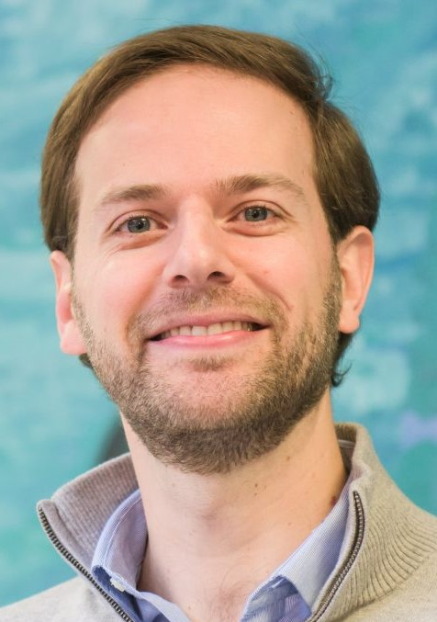
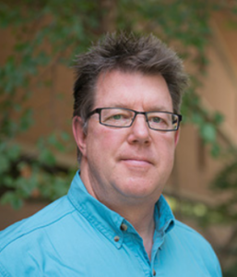
UMBC Committee on Strategies and Tactics for Recruiting to Increase Diversity and Excellence (STRIDE)
Dena Aufseeser
Associate Professor
Geography and Environmental Systems
Ramon Goings
Associate Professor
Language, Literature and Culture
Lisa Kelly
Professor
Chemistry
and Biochemistry
Daniel Lobo
Associate Professor
Biological Sciences
Tim Topoleski
Professor
Mechanical Engineering

Slide 4
Conversation Goals
Recognizing bias
Evaluation process Issues
Rubrics
  Developing
  Calibrating & using
  Weighting research, teaching, service, and DEIA
Mitigating problems

Slide 5
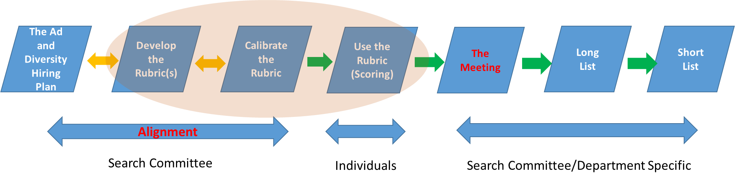
Back to Reality - You Have a Faculty Search!
SYSTEMATIC PROCESS REDUCES BIAS

Slide 6
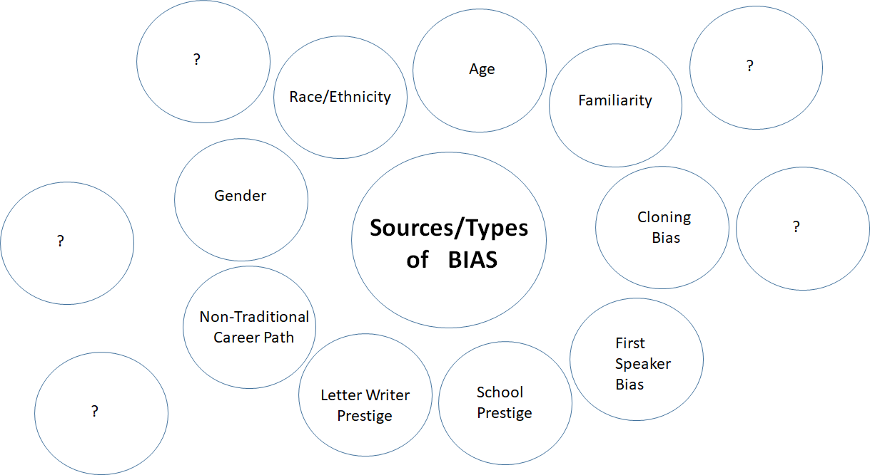

Slide 7
Video:
Clip from UW ADVANCE:
https://vimeo.com/video/76718065
(use password: bias355!)
Breakout Rooms:
Identify problematic elements?
Rewrite the script, what to do differently?

Slide 8
Using Rubrics
It’s a tool to help with consistency and fairness in the process
A rubric is not a substitute for active committee deliberations
Can help open discussion of how members define concepts like “merit,” “quality,” “excellence,” and “potential.”
Do committee members assume these concepts have singular definitions?
Comments section can help document key evidence

Slide 9
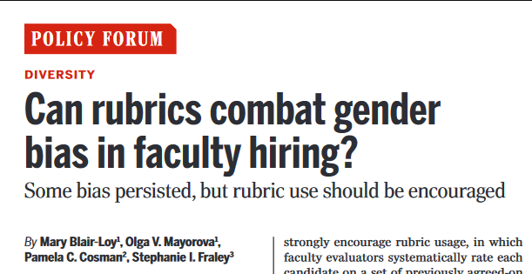
Blair –Loy, et al. (2022). Can rubrics combat gender bias in faculty hiring? Science. 377(6001) 35-37.

Slide 10
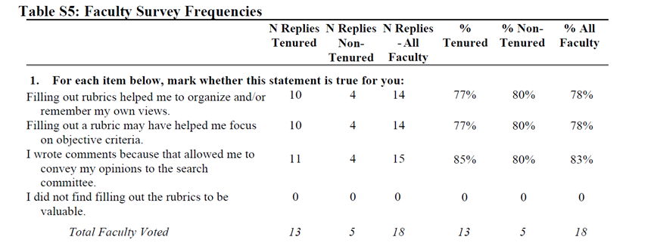
Faculty Survey on Rubrics
Blair –Loy, et al. (2022). Can rubrics combat gender bias in faculty hiring? Science. 377(6001) 35-37.

Slide 11
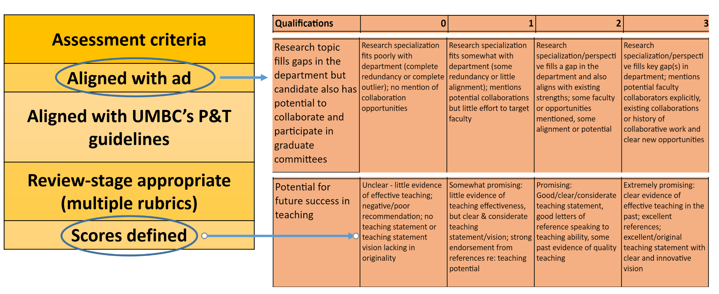
Developing the Rubric(s)

Slide 12
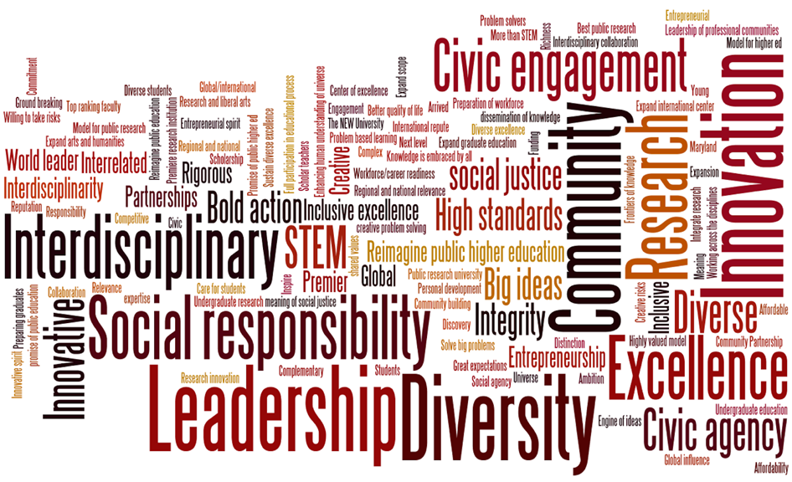
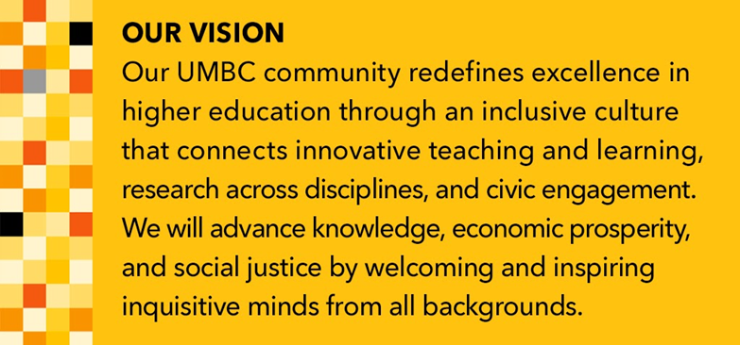

Evaluating DEIA Statements
EXAMPLES (PAST AND FUTURE)
Knowledge and commitment to equity, diversity, inclusion, and access
Knowledge of underrepresentation in their field(s);
Involvement with recruitment, retention, and/or mentoring of underrepresented students;
Organization of, or engagement in, seminars, etc., that address concerns of underrepresented groups;
Presentations or performances for underrepresented communities;
Participation in programs aimed at increasing the pipeline of underrepresented groups entering higher education;
Public service activities and invitations to give talks within the field that address the needs of culturally diverse groups;

Slide 13
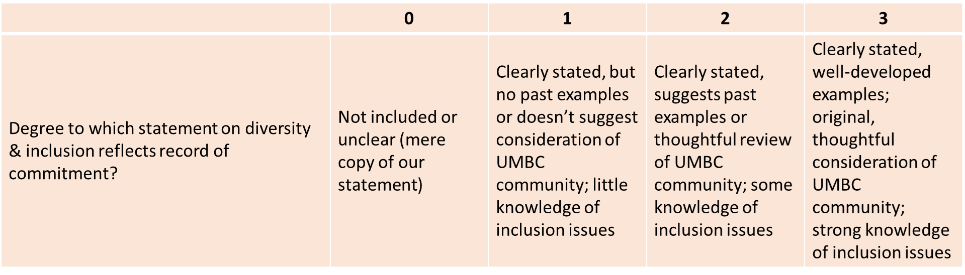
Evaluating DEIA Statements
Sample Rubric

Slide 14
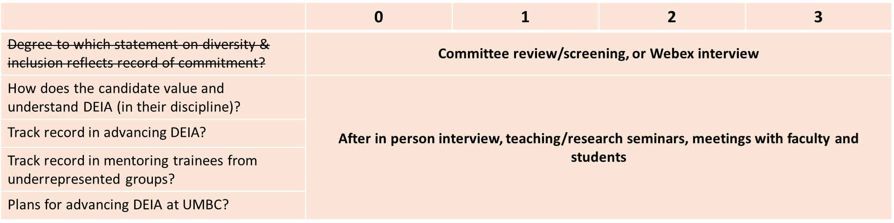
Evolution of a Rubric
Adapted from Thomas, K. and Nguyen, K. “A Model for Diversifying Faculty Recruitment,” Nature (Career Column), 05 Oct. 2021.

Slide 15
Evaluating DEIA Statements
Candidate Statement:
Throughout my education, I have been particularly mindful of barriers faced by women and underrepresented people of color in the sciences. While a graduate student, I participated in my university’s K-12 outreach program to engage female high school students in science for three years. As a professor, I am interested in working with the campus to expand this kind of “lab-based” outreach to K-12 educators from low performing, majority-minority middle schools, so they can help ignite the interest of their students in science. With help from the campus, I will recruit an educator each year to work for the summer on research in my lab, expose them to new ideas and developments in my research area, and encourage them to bring some of these into their curriculum. I would also work to engage other faculty in science as part of their NSF Broad participation in their research grant proposals.
(Adapted From UCLA “Short Diversity Statement Examples” )

Slide 16
Developing Multiple Rubrics
* Example of multiple rubrics (from UMBC Political Science):
Rubric 1: Preliminary Screening of Candidates
Rubric 2: Committee Review of Candidate Applications
Rubric 3: Committee Review of Candidate Interviews on Webex
Rubric 4: Departmental Review of Top Candidates
Rubric 5: Departmental Review of Interviewees
Poll question: Have you used multiple rubrics in faculty searches?

Slide 17
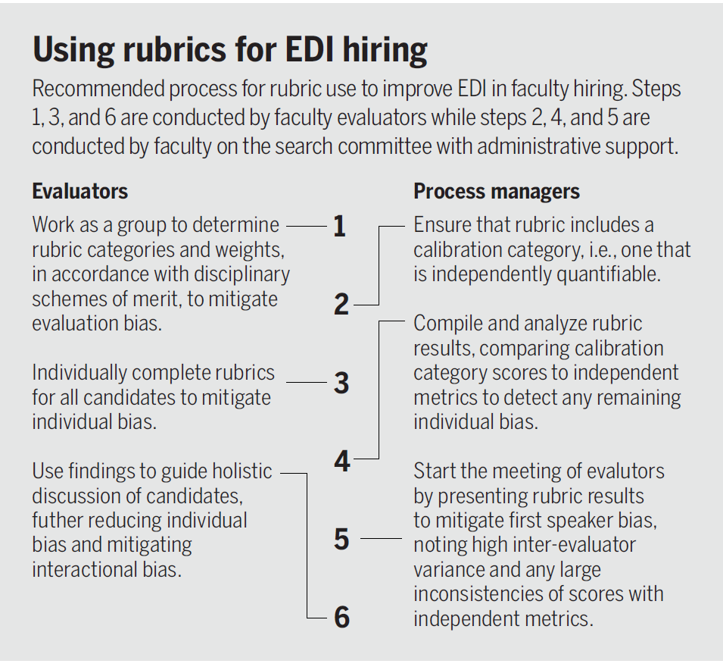

Recommendations
Blair-Loy, M. et al. (2022). Can Rubrics Combat Gender Bias in Faculty Hiring? Science (New York, NY), 377(6601), 35 - 37.

Slide 18
Calibrating “Shared understanding” of rubric & scoring
Calibrate Rubric With Search Committee on ~3 applicants
1. As a committee, discuss each rubic element, reviewing criteria and rating categories. Discuss examples of the kinds of evidence motivates low, medium, or high scores.
2. Select 3 applicants for applying the rubric.
3. Apply the rubric with each committee member individually scoring applications & adding comments.
4. Analyze the scores assigned to each application across all categories and by all committee members.
5. DISCUSS interpretations and discrepancies between reviewer scores & comments.
6. Recalibrate the scoring/assessment system as needed.
7. Apply the agreed upon rubric to the entire applicant pool.
Poll question: Have you ever calibrated your rubrics during a search?

Slide 19
Lessons Learned
Be mindful of meeting dynamics and “first speaker bias” and other issues.
Use of rubrics holds us accountable as a search committee about the criteria we are looking for in a candidate
Implementation of multiple rubrics as the evaluation/interview process evolves
Calibrating our rubrics is important*
Rushing the search process introduces bias
Potential Challenges
  Not enough time for faculty to review candidate materials
  Need for multiple meetings to review rubrics and calibrate
…. others?
*Culpepper, D. et al. (2023). Do rubrics live up to their promise? Examining how rubrics mitigate bias in faculty hiring. J. Higher Ed., 94(7), 823.

Slide 20
Resource List
Sample rubrics and resources
University of Washington “Best Practices for Faculty Searches”
Culpepper, D. et al. (2023). Do rubrics live up to their promise? Examining how rubrics mitigate bias in faculty hiring. J. Higher Ed., 94(7), 823.
Blair-Loy, M. et al. (2022). Can Rubrics Combat Gender Bias in Faculty Hiring? Science, 377(6601), 35 - 37.
Kaiser, J. (2023). To reduce ‘reputational bias,’ NIH may revamp grant scoring. Science, 379(6629), 223.
“Evaluating Job Candidates: Choosing the Short List and Treating Interviewees Equitably” in A. J. Stewart and V. Valian An Inclusive Academy: Achieving Diversity and Excellence, MIT Press (2022), pgs. 201 - 242.

Slide 21
Next Up (Fall 2024):
STRIDE Office Hours WebEx | Focused Conversations 10:30 - noon (Optional specific Q&A) WebEx
Tuesday, October 15, 2024 1:00-3:00pm
Tuesday, October 29, 2024 1:00-3:00pm
Monday, November 11, 2024 1:00 - 3:00pm | Interviewing/Intro to Onboarding Tuesday, November 5, 2024
Monday, November 25, 2024 10:00am - noon | Inclusive Mentoring/Onboarding Tuesday, December 3, 2024
Monday, December 9, 2024 10:00am - noon

Slide 22
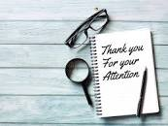
Just-in-Time Consultations (Q&A)
For those interested:
Please stay for informal Q&A and discussion about your evaluation process.

