Slide 1
A Taxing Time
I’M GLAD I LEARNED ABOUT PARALLELOGRAMS IN HIGH SCHOOL MATH INSTEAD OF HOW TO DO MY TAXES. IT COMES IN SO HANDY DURING PARALLELOGRAM SEASON.
Wednesday, April 6, 2022

Slide 2
Kahoot
https://create.kahoot.it/details/fcc644c6-af1d-4679-8971-4164c9271787

Slide 3
Agenda
Progressive Income Tax and Income Tax Brackets
Using the tax code for behavior modification
What are some other taxes that we pay (including Payroll Taxes)
What counts as income on your income tax return?
Withholding and the W-4
How to read a pay stub
Are you a dependent or not?
Completing a tax return

Slide 4
Progressive Income Tax and Income Tax Brackets
A progressive tax is based on the taxpayer’s ability to pay. A flat tax is the same rate no matter your ability to pay.
Deductions, adjustments or refundable/non-refundable tax credits make taxes quite complex. Things like dependents, tuition expenses, mortgage interest, or having a low-income rate impact your income tax situation.
2,600 pages of tax law and 67,500 pages of related court rulings
Employers must, by law, withhold federal income taxes from every paycheck which provides the Federal government has a stable, predictable revenue stream.
Notes:
Why progressive instead of a flat tax? Because the total you make matters. Imagine you earn $20k per year. 10% of that is $2k so you’ll have $18k to live on. Imagine you earn $120k per year. 10% is $12k but you’ll still have $108k to live on. Your real spending power is much more impacted by the flat tax.
In the 1970’s, the top bracket percent was 70%. Note that things get more complex when the income gets way higher. This session assume less than $58k household income.
16th Amendment says: The Congress shall have power to lay and collect taxes on incomes, from whatever source derived, without apportionment among the several states, and without regard to any census or enumeration.
Even the language of the tax code makes it harder. It will say “under 19” instead of 18 and under.
You’ll hear people say “it’s a write off” like that makes something free. It’s like BOGO deals; you still are spending money. State and Local Taxes example. It’s a deduction so it only reduces my taxable income. Also, has a cap so my standard deduction might be better.

Slide 5
Notes:
https://www.youtube.com/watch?v=VJhsjUPDulw

Slide 6
Tax Brackets for 2022
 | Single | Married Filing joint
10% | Up to $10,275 | Up to $20,550
12% | $10,276 to $41,775 | $20,551 to $83,550
22% | $41,776 to $89,075 | $83,551 to $178,150
24% | $89,076 to $170,050 | $178,151 to $340,100
32% | $170,051 to $215,950 | $340,101 to $431,900
35% | $215,951 to $539,900 | $431,901 to $647,850
37% | $539,901 or more | $647,851 or more
2022 Single Filer Standard Deduction = $12,950
2022 Married Filing Jointly Standard Deduction = $25,900
2022 Head of Household Standard Deduction = $19,400

Slide 7
Let’s do some math…
How much income tax would someone in the below situation owe:
Single person with
an income of $62,500

Slide 8
Example
$62,500 – $12,950 (Standard deduction)= $49,550

Slide 9
Using the tax code for behavior modification
Congress shows what they think is important by what reduces taxes.
Research shows that home ownership builds better neighborhoods so mortgage interest is deductible. Or because bank lobbyists convinced Congress.
Retirement savings reduce poverty among the elderly so contributions to a traditional IRA can be deducted. (You’ll learn more about this at the retirement saving session in November)
As the mortgage example implies, there is a social justice aspect to tax law wealth can have a deciding factor on access to tax deductions.

Slide 10
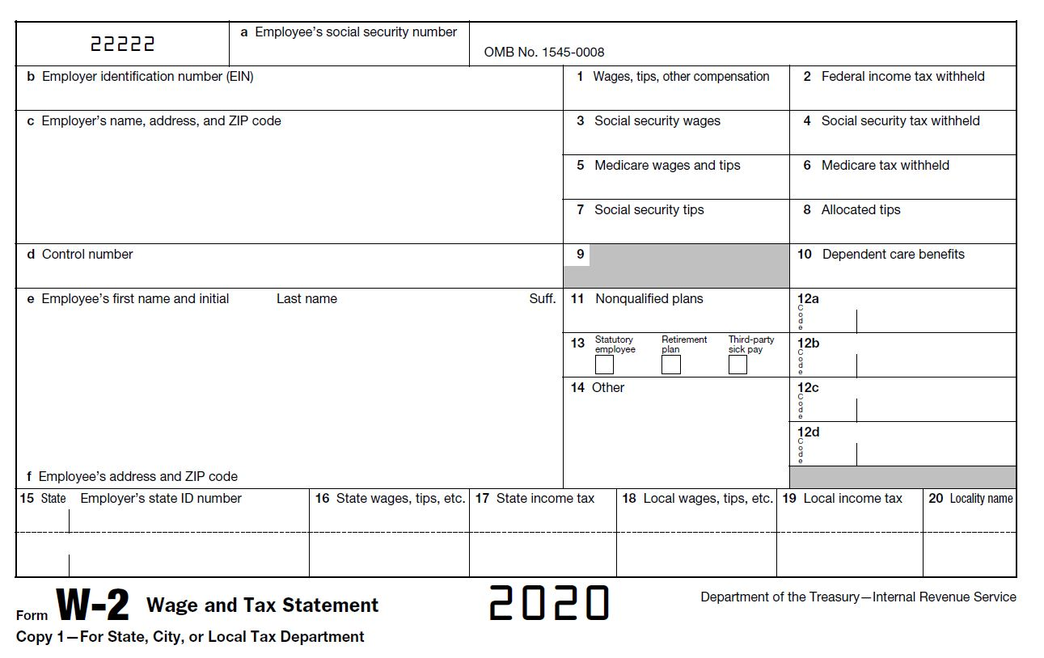
What counts as Income?
Wages/tips from a job (W2)

Slide 11
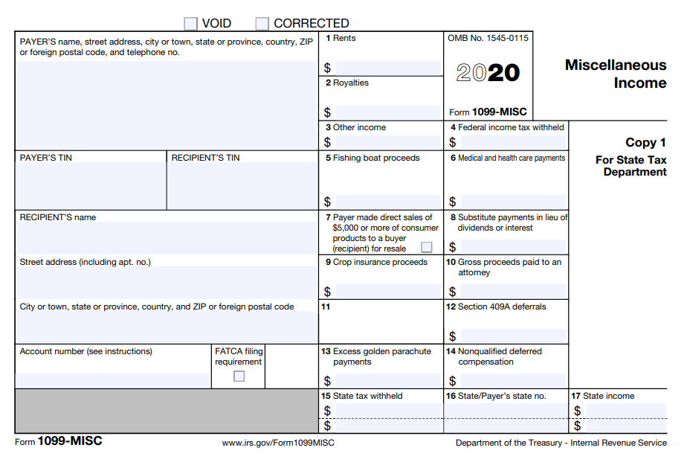
What counts as Income?
Self Employment revenue (1099-MISC, personal records)

Slide 12
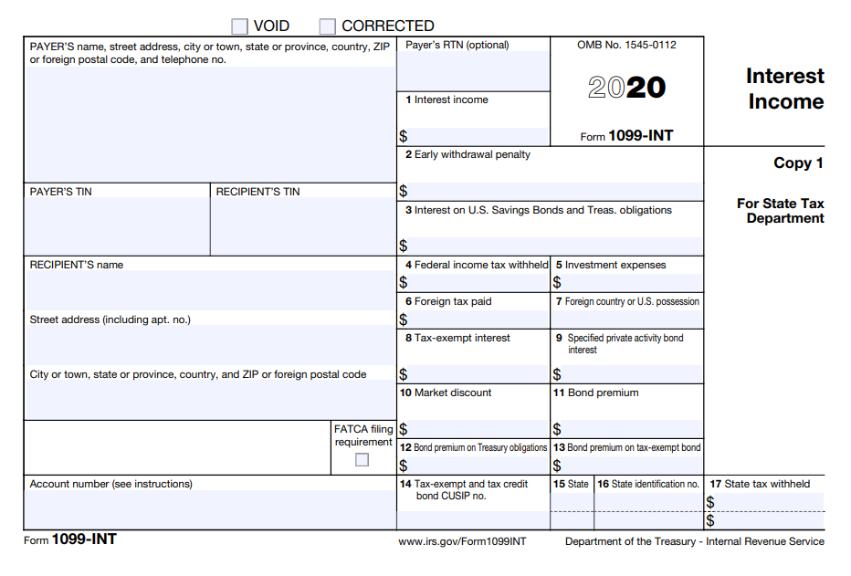
What counts as Income?
Interest (1099-INC)

Slide 13
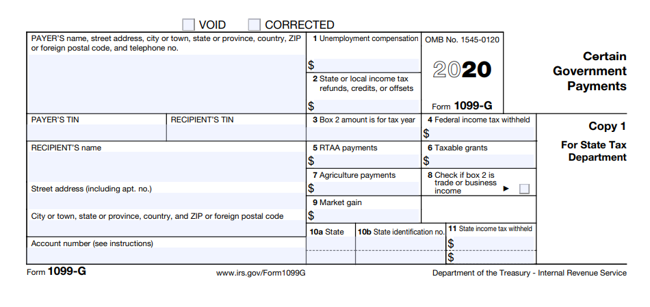
What counts as Income?
Unemployment

Slide 14
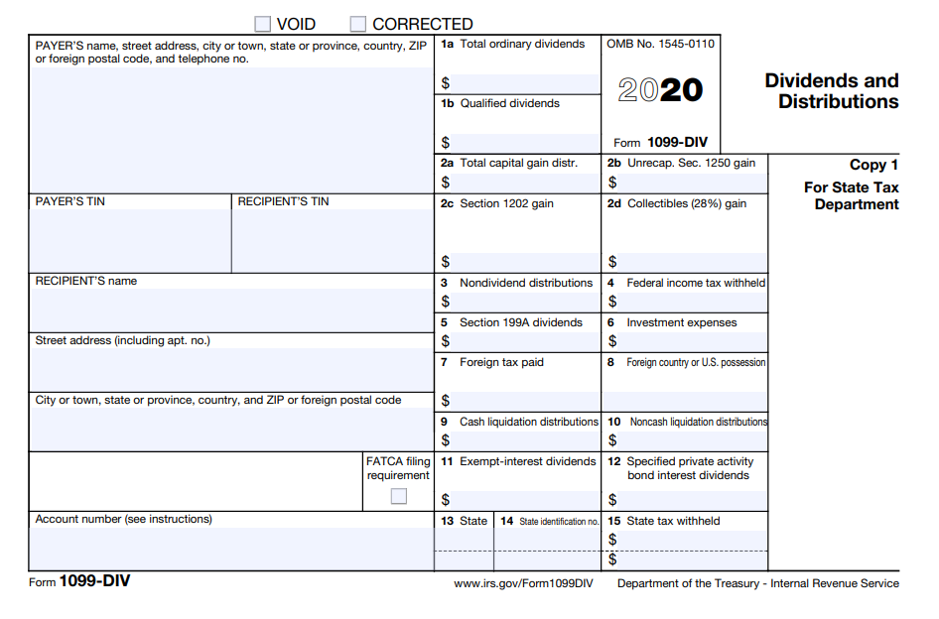
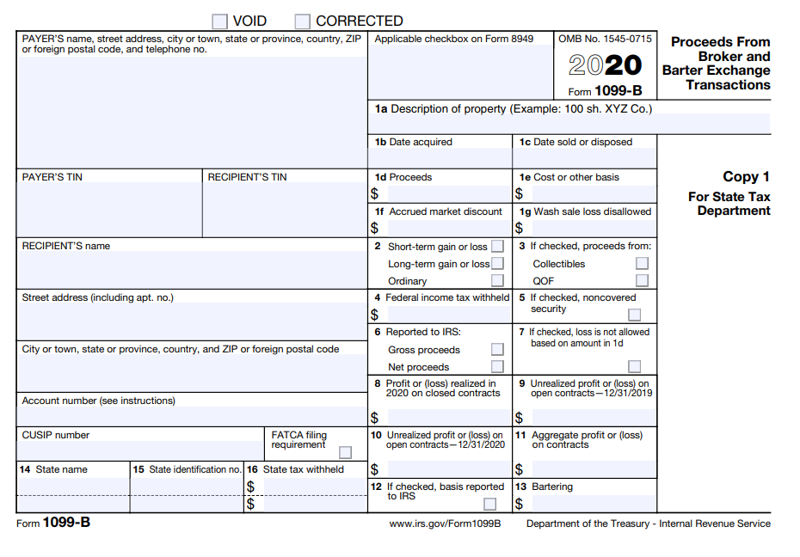
What counts as Income?
Investment income: Dividends
Investment income: Capital gains

Slide 15
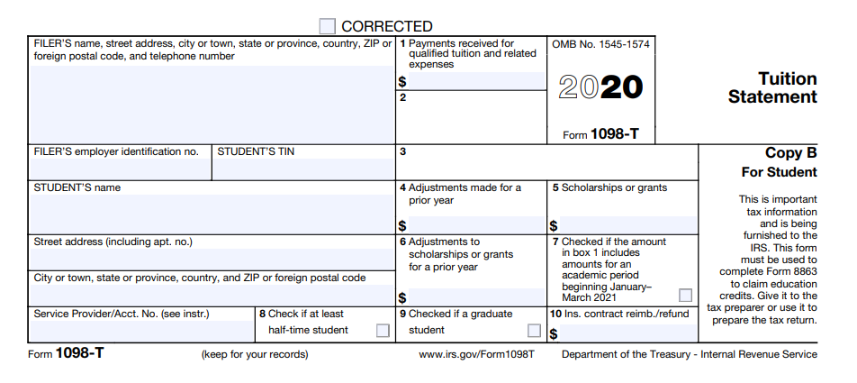
What counts as Income?
Taxable Scholarships and grants
Box 5 includes all scholarships, including money
used for qualifying educational expenses
Does NOT include loans

Slide 16
Scholarships
Loans are treated like you paid the expense yourself.
Room and board provided as part of a job are not taxable. (you have to live in the provided housing to hold the job, like RA).
Scholarships used for Qualified Educational Expenses are not taxable.
The following are qualified education expenses for the purposes of tax-free scholarships and fellowships:
Tuition and fees required to enroll at or attend an eligible educational institution. Course-related expenses, such as fees, books, supplies, and equipment that are required for the courses
Qualified education expenses don’t include the cost of:
Room and board, Travel, Research, Equipment and other expenses not required for enrollment
Lots of grey areas here. How do you find out specific answers? Hire a tax accountant or call the IRS.

Slide 17
Many different kinds of taxes
Federal Income Tax
State/County/City Income Tax
Sales Tax
Gas/Excise Tax
Real Estate Tax
Personal Property Tax
Government Fees
Estate Tax
Gift Tax
Capital Gains Tax
Sin Tax
Luxury Tax
Hotel Tax
Customs Tax
Payroll Tax (FICA = Social Security, Medicare)
Notes:
Maryland gas tax: 35.3 cents per gallon

Slide 18
Payroll Taxes versus Income Taxes
Also called FICA - Federal Insurance Contributions Act
Deducted from your paycheck, 7.65% of all earnings up to $147,000. Your employer is also required to pay 7.65% on your behalf.
Funds Social Security and Medicare
Full time students are exempt from FICA when enrolled and working for UMBC (not other jobs). International students are always exempt from FICA.
UMBC automatically makes you exempt from FICA if you are enrolled
During the summer, your enrollment is checked every two weeks. During any two week period that you are not enrolled, you’ll have FICA withheld from your check.
FICA exempt is DIFFERENT than income tax exempt.
Notes:
Pay attention to your pay stub! If the employer gets it wrong, even if it is the employer’s mistake, it is very difficult for you to get the money back.

Slide 19
Example – payroll tax
$62,500 – $12,950 (Standard deduction)= $49,550
Income Tax = 6,605
FICA = 4,781
Total Taxes 11,386
$62,500 x 7.65% = $4,781

Slide 20
Withholding of Income Taxes
Income tax is “pay as you go”. Either your employer pays along the way or you make payments directly to the IRS along the way.
Self assess whether the correct amount was paid along the way by filing a tax return prior to April 15 of the following year
Withholding is calculated by employer based on your W4 form
If you will not owe federal income taxes, you can indicate EXEMPT on W4
Exempt means no tax liability last year and don’t expect to owe this year
Change withholding by submitting a new W-4
Notes:
Points to mention
Most financially advantageous is to owe just a little on April 15
You may not be required to file if you didn’t make very much, but do so anyway if you had withholding

Slide 21
W-4
https://www.irs.gov/pub/irs-pdf/fw4.pdf
Notes:
https://www.irs.gov/pub/irs-pdf/fw4.pdf

Slide 22
W-4 Section 1
If nothing else applies, your answer to this question and the amount of your paycheck determine how much income tax is withheld. This is typically the right choice when you work for UMBC only and will earn more than $12,950 for the calendar year.
Notes:
International students (non-resident alien) must select single even if that is not your status

Slide 23
W-4 Section 2
This is where it starts to get tricky! The easier decisions are in these situations:
If the multiple jobs you are holding are all with UMBC, do not check the box.
If you have two jobs (not all at UMBC) and will make more than $12,950, checking this box on both W4s is more accurate.
If the jobs are not held at the same time, do not check the box.
Notes:
If something changes, give your employer a new W4 at any point during the tax year.

Slide 24
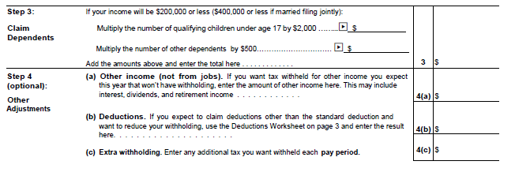
W-4 Section 3 & 4
Here’s where you’ll write EXEMPT
If you won’t make more than $12,950 on the job, mark Exempt
Best option is to visit irs.gov and use the withholding calculator if you have several jobs or other forms of income
You can use multiple jobs worksheet on page 3, but you’ll have to find it at irs.gov (UMBC doesn’t provide it)
EXEMPT
Notes:
Step 3 – rarely an area that students will complete
4a - I have Apple stock that pays a dividend. So I put an amount on 4a equivalent to the amount of dividends I usually get
4b – rarely an area that students will complete
4c – rarely an area that students will complete
There’s no line for Exempt so you write it on the for after 4c

Slide 25
Quiz – Exempt or not? Check the box or not?
In all the below examples, you did NOT owe any tax the previous year. Also, you are a single, not a dependent, and don’t have any other special tax circumstances.
You work about 7 hours per week in the UMBC library (about $3000 per year) and a summer internship for an accountant where you earn about $9500. What should you put on your UMBC W4?
You have a Graduate Assistantship with an annual stipend of $16,250. What should you put on your UMBC W4?
You will have a $6000 scholarship for room/board and a summer research job with your faculty advisor for $5000. What should you put on your UMBC W4?
Anyone have an example to share?

Slide 26
How to Read Pay Stubs
If you have direct deposit, you need to access POSC (Payroll Online Service Center) to see your pay stub
If you don’t have direct deposit, get it then sign up for POSC
The date on your pay stub is WRONG
Student Employees get paid three weeks after the last Friday of a pay period
If you don’t expect to owe income tax and are enrolled, your gross pay and net pay should match
Notes:
Put the link to POSC in the chat.
https://interactive.marylandtaxes.gov/Extranet/cpb/POSC/User/Start.aspx

Slide 27
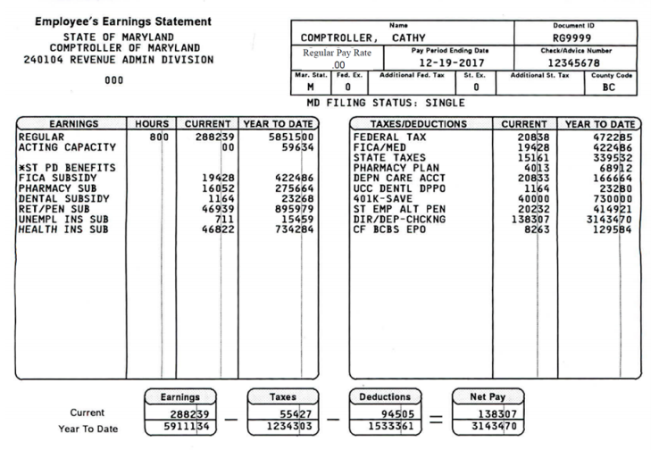
Gross Pay
Federal W/H
Payroll Tax
State W/H
Employee contribution to benefits
Net Pay
Employer Paid Benefits
Notes:
Pay period dates are WRONG!!!!

Slide 28
Are you a Dependent?
Are you single (not married)?
Are you the child, stepchild, brother, sister, or descendant of the taxpayer?
Are you either under age 19? Or under age 24 and a full-time student? Or permanently and totally disabled?
Did you live with the taxpayer for more than half the year except for temporary absences?
Did the taxpayer pay more than half your support?
If all answers are yes, you are a dependent of the tax payer
Notes:
A dependent can only be claimed by one person.
“More than half your support” is the tricky one. If your parents pay the rent/mortgage and other costs of maintaining your permanent residence, you are likely a dependent.
It doesn’t matter if your parents claim you or not. If they CAN claim you, you must file as a dependent.

Slide 29
Why does it matter?
MOST of the time, it is financially advantageous for your parent(s) to claim you.
Example: You are 21 and have a scholarship for half tuition/fees and live in an off campus apartment (you don’t spend even one night with your parents in 2020). Your rent and food is paid by savings from your summer job. Your parents only pay the other half of your tuition and for your health insurance. You could make an argument that you are paying more than half of your support and therefore can claim yourself.
Impact: your income for the year is $10,000 from a summer job. Once the dependent standard deduction of $10,350 is used to reduce your income, you don’t owe any taxes.
Your parents make $74,900/year (MFJ). If they claimed you as a dependent, their tax owed is $6,312. By not claiming you as a dependent, their tax owed is $6,812.
Notes:
The dependent standard deduction is the amount of earned income plus $350 until you hit $12,400.
If you have one parent and no younger siblings, your parent’s standard deduction would increase from 12.4k to 18.65k. In this example, tax owed swings by $1375 because of dependent.

Slide 30
Do you need to file an income tax return?
Yes!
Credits
Stimulus Payments
Losses
Notes:
If you had withholdings and made less than $12,400, file to get your money back
If you are a depending, it is a bit more nuanced. However, the general concept is still that if you made less than $12,400 you don’t need to file.
https://www.irs.gov/help/ita/do-i-need-to-file-a-tax-return

Slide 31
Completing a tax return
Use software if possible; guards against errors
https://www.irs.gov/filing/free-file-do-your-federal-taxes-for-free
Use UMBC VITA by making an appointment at: www.bmorefreetaxes.org
If you don’t understand, ask questions. You are responsible for your tax return.
If you are a dependent, talk with your parent(s)/guardian(s).
Notes:
https://www.irs.gov/filing/free-file-do-your-federal-taxes-for-free

Slide 32
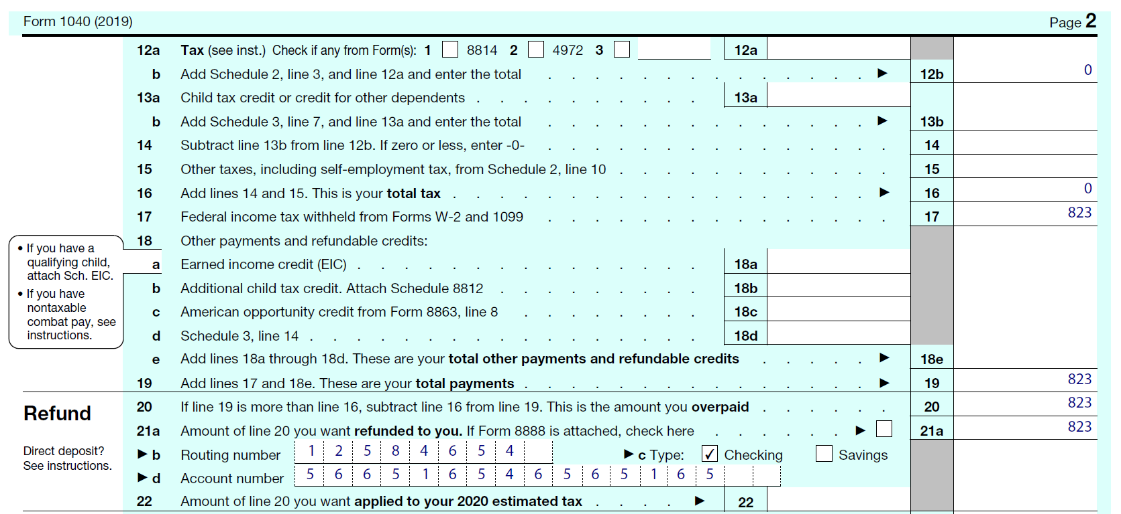
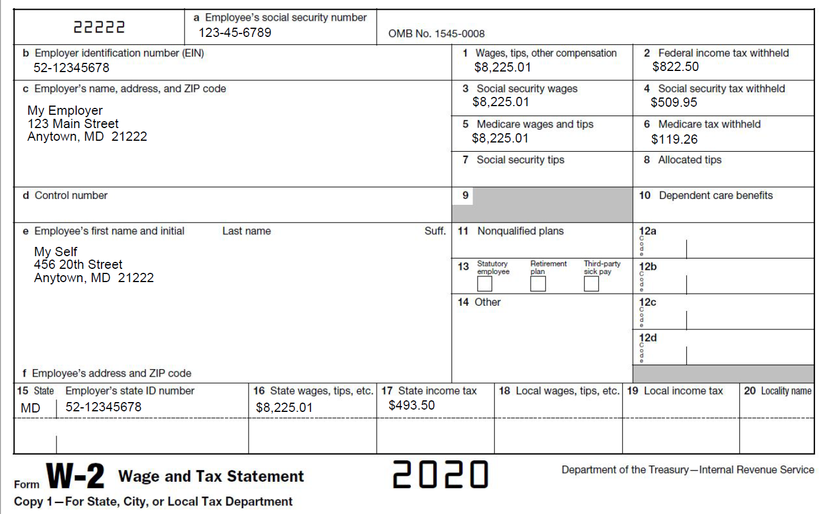
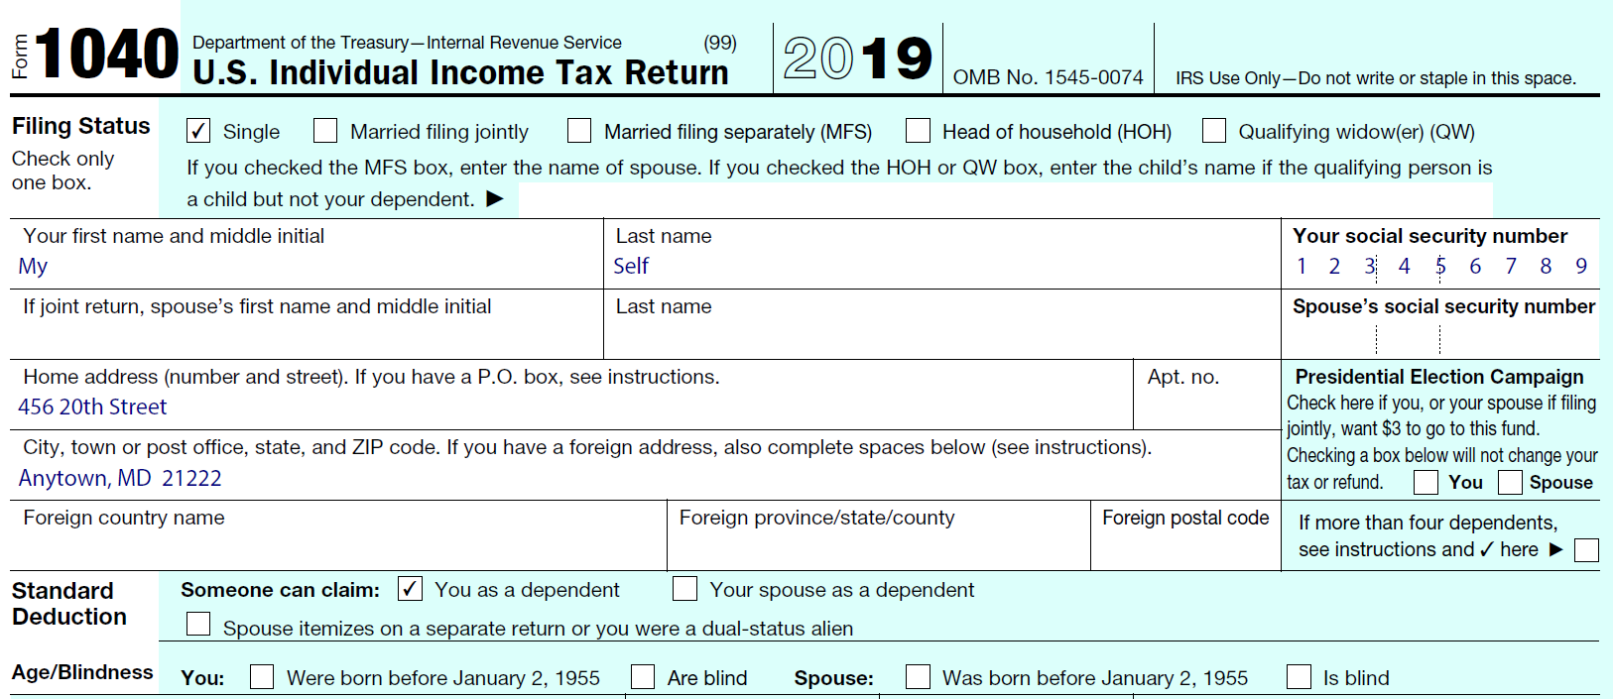
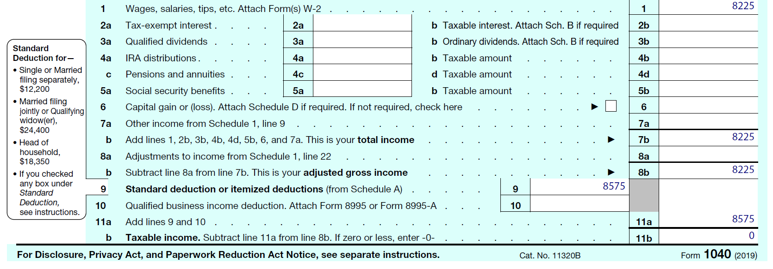

Slide 33
Employer Benefits = Tax Deductions
Healthcare
Flex spending Accounts
Health
Daycare
401k contributions

Slide 34
Example – payroll tax after employer deductions
$62,500 – $12,950 (Standard deduction)= $49,550
FICA: $62,500 x 7.65% = $4,781
$62,500 – (401k)3,125 - (health premiums) 1,200 - $12,950 (Standard deduction)= $45,225

Slide 35
Questions?
Notes:
In case there’s ever a copyright question about the tax form images, I got them from screen shots of the IRS website.

Slide 36
Australia:
Canada:
Sweden:
Notes:
International students: US income is generally taxable, including your scholarship. UMBC is required to withhold 30% of your non-qualified expense scholarship for federal income taxes. You are required to file a tax return every year whether you have income or not.
Some treaties (France, for example) also allow some US income to be non-taxable for several years. China: wages up to $5k forever and scholarships.
Canada: wages are exempt from US tax up to $10k, but scholarships are not wages. Australia and Sweden don’t have any exemptions. State of MD has until March 15 to provide your 1042-S (which you need to prepare your return) plus your W2. You’ll file federal as a non-resident and state as a resident. Mailing address is important!
NRA: must select single on W4
https://www.internationalstudent.com/tax/faqs/
https://www.mtu.edu/fso/financial/tax/nonresidents/student/

