Slide 1


Slide 2

Credit Reporting Bureaus
Their job is to gather and organize pertinent information about you and your credit history.
There are many bureaus. They do not contain identical info.

Slide 3
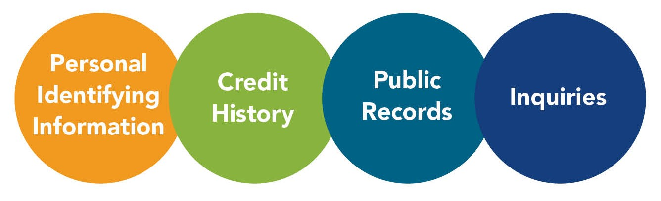
What’s On Your Credit Report?

Slide 4
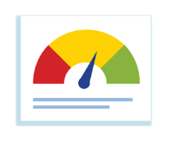
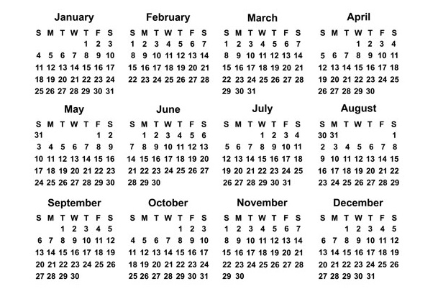
Consumer Access to Credit Reports
www.annualcreditreport.com: One free report each year from each of the three major credit bureaus.
Adverse action: When denied for credit or favorable terms.
MD law also allows free report per year
COVID 19 = Free reports weekly until April 2022
Equifax
Transunion
Experian
Free Credit Monitoring!
Notes:
4

Slide 5

Credit Scores
A number based on the analysis of an individual’s credit report that represents their creditworthiness.
Same info in a report used

Slide 6

Cost of Credit Score Exercise (Small Loan)
Credit Score
Interest Rate
760 - 850
680 - 759
620 - 679
580 - 619
300 - 579
10%
12%
14%
38%
N/A
36 Mo PERSONAL LOAN of $2,000 FOR NEW LAPTOP
Interest for highest credit score tier= $323
Interest for lowest tier= $1,422
Opportunity Cost: $1,099

Slide 7
Where Can You Retrieve Your Credit Score?
Is it on your credit report? No (typically not).
Do the reporting bureaus have it? Yes, but it’ll cost you!
What about Credit Karma? Yes, but there’s a catch?
Then WHERE!? You can try…
  Your Bank
  Your Credit Card Company

Slide 8
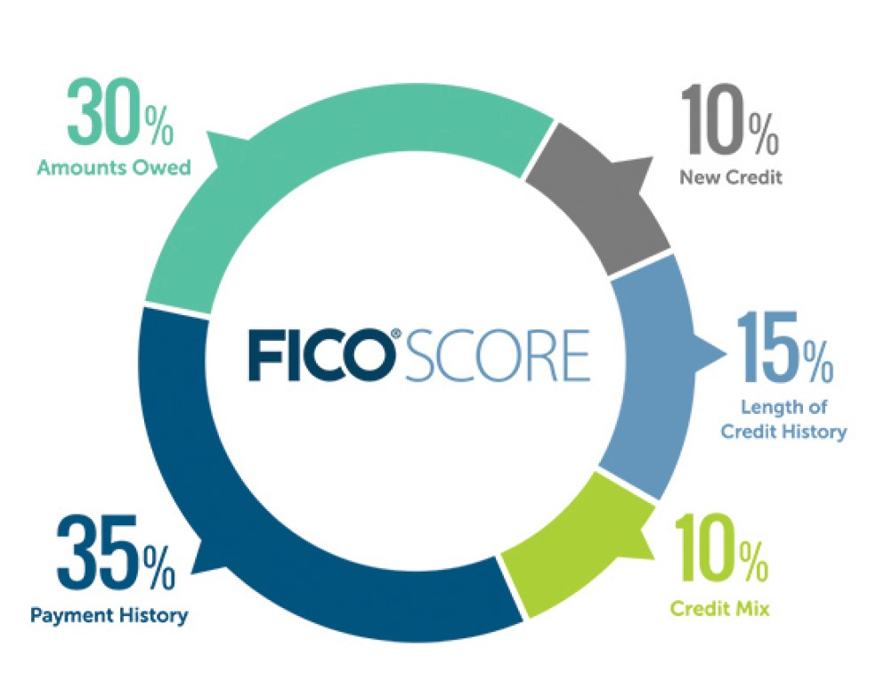
Fair Isaac Corporation
SOURCE: FICO
Notes:
8

Slide 9

Best Practices for Strong Credit Scores
Keep it Active! Establish and maintain a mix of at least three active installment and revolving credit tradelines – ALWAYS PAY ON TIME!
Keep it Low! Lower debt balances on revolving lines of credit.
Keep it Up! You want at least six months of credit history -- and activity! -- on your credit report at any time.

