Slide 1
Know What to Expect When You Buy Your Home!

Slide 2
Homeownership
Homeownership is about building something for you and your family.
Your home is your own
You save money at tax time
Offers stability as your
children grow up.
Live the life you want
Creates memories for a lifetime
Now is a GREAT time to own your own home!

Slide 3
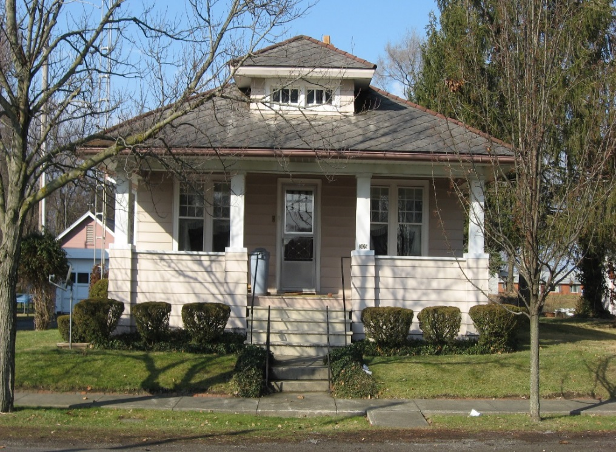
A Closer Look at the Loan Process
Know what you can afford
Get pre-approved for a loan
Get prepared for the loan application
Underwriting your loan

Slide 4
Getting Pre-Approved
Benefits of Pre-Approval
Determine your purchasing potential
Determine what your potential monthly payment may be
Identify loan programs that may fit your needs
Strengthen your offer

Slide 5
Preparing for Loan Application
Information you’ll need to provide
Your residence history
Your employment history
All outstanding loans and credit cards
Savings, checking and/or investment accounts
Personal property you own

Slide 6
The Mortgage Payment
What makes up the Mortgage Payment?
Principal
Interest
Taxes
Hazard Insurance
PMI (Private Mortgage Insurance)
FHA – MIP (Mortgage Insurance Premium)
VA – Funding Fee (May also be financed)

Slide 7
Closing Costs
Commonly incurred Closing Costs:
Loan Origination Fee
Loan Discount
Appraisal Fee
Credit Report Fee
Title Insurance Fees
Miscellaneous Title Charges
Document Preparation Fee
Prepaid Interest
Private Mortgage Insurance (PMI)
Taxes and Hazard Insurance

Slide 8
Underwriting Your Loan
The three C’s: Collateral, Capacity and Credit
The Property
Your Income
Your Employment History
Your Credit History
Your Debts
Your Assets

Slide 9
Loan-to-Value (LTV): Loan amount vs. Sales price (or appraised value)
$97,000 loan/$100,000 price =97% LTV
Down Payment: The amount required based on your Sales Price. The payment typically represents only a percentage of the full purchase price. The down payment is the difference between the selling price and the amount of money you borrow to buy the property.
In the above example it is $3,000 ($100,000 price - $97,000 loan)
LE : Loan Estimate- estimate of total costs and payment for your mortgage
CD: Closing Disclosure- final numbers of total cash to close; Discloses the rate and terms of mortgage you agreed upon when locking in your loan.
Interest Rate: Annual cost of borrowing money
Annual Percentage Rate (APR): Total finance charges over the loan term
(higher % than interest rate = total cost of interest and closing costs over life of the loan)
Points: A percentage of the loan amount. You can be used points to discount the interest rate (1% of 100,000= $1,000 cost)
Mortgage Insurance (MI): A monthly cost to insure loans when certain down payments are not met.
Escrow Account: Money set aside from your monthly payment to pay future taxes and insurance premiums
Loan fees: These fees could include origination fee, flood check fee, appraisal fee, etc.
* Fees vary by loan product and by financial institution, so check with your Loan Officer *
Appendix:
Key Loan Terminology

Slide 10
Closing
Thank you for your time today
Denise Dedee Johnson, NMLS #415208
Mortgage Loan Officer
301-497-4056 office 202-236-9862 cell
Denise.Johnson@pnc.com
Denise Flynn, NMLS #702769
Mortgage Loan Officer
410-530-3140 (cell)
Denise.Flynn@pnc.com

