Slide 1
A Taxing Time
Wednesday, April 7, 2021

Slide 2
Kahoot - 5893171
FinancialSmarts
Notes:
https://create.kahoot.it/details/fcc644c6-af1d-4679-8971-4164c9271787

Slide 3
Topics
1.Progressive Income Tax and Income Tax Brackets
2.Using the tax code for behavior modification
3.What are some other taxes that we pay (including Payroll Taxes)
4.What counts as income on your income tax return?
5.Withholding and the W-4
6.How to read a pay stub
7.Are you a dependent or not?
8.Completing a tax return
FinancialSmarts

Slide 4
Progressive Income Tax & Income Tax Brackets
•A progressive tax is based on the taxpayer’s ability to pay. A flat tax is the same rate no matter your ability to pay.
•Deductions, adjustments or refundable/non-refundable tax credits make taxes quite complex. Things like dependents, tuition expenses, mortgage interest, or having a low income rate impact your income tax situation.
•2,600 pages of tax law and 67,500 pages of related court rulings
•Employers must, by law, withhold federal income taxes from every paycheck which provides the Federal government has a stable, predictable revenue stream.
FinancialSmarts
Notes:
Why progressive instead of a flat tax? Because the total you make matters. Imagine you earn $20k per year. 10% of that is $2k so you’ll have $18k to live on. Imagine you earn $120k per year. 10% is $12k but you’ll still have $108k to live on. Your real spending power is much more impacted by the flat tax.
In the 1970’s, the top bracket percent was 70%. Note that things get more complex when the income gets way higher. This session assume less than $58k household income.
16th Amendment says: The Congress shall have power to lay and collect taxes on incomes, from whatever source derived, without apportionment among the several states, and without regard to any census or enumeration. (1913)
Even the language of the tax code makes it harder. It will say “under 19” instead of 18 and under.
You’ll hear people say “it’s a write off” like that makes something free. It’s like BOGO deals; you still are spending money. Mortgage Interest example. It’s a deduction so it only reduces my taxable income. Also, my standard deduction might be better.

Slide 5
FinancialSmarts
Notes:
https://www.youtube.com/watch?v=VJhsjUPDulw

Slide 6
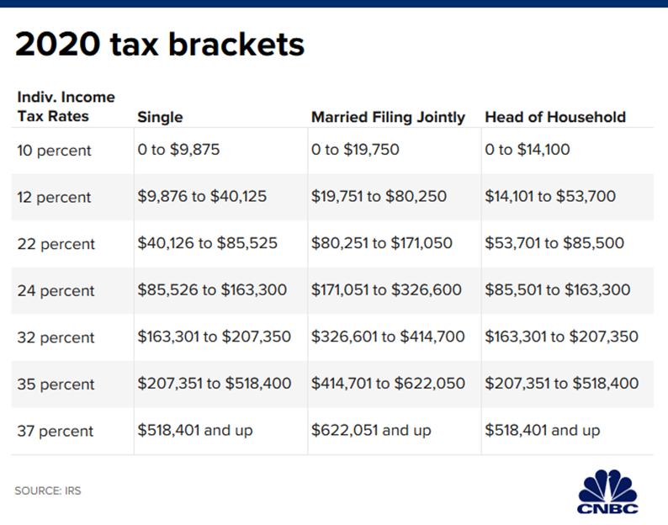
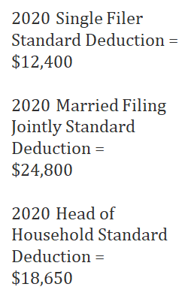
FinancialSmarts

Slide 7
Let’s do some math…
•How much income tax would someone in the below situation owe:
Single person with
an income of $62,500
FinancialSmarts

Slide 8
FinancialSmarts

Slide 9
Example
FinancialSmarts

Slide 10
Topics
Using the tax code for behavior modification
What are some other taxes that we pay (including Payroll Taxes)
What counts as income on your income tax return?
Withholding and the W-4
How to read a pay stub
Are you a dependent or not?
Completing a tax return
FinancialSmarts

Slide 11
Using the tax code for behavior modification
•Congress shows what they think is important by what reduces taxes.
-Research shows that home ownership builds better neighborhoods so mortgage interest is deductible. Or because bank lobbyists convinced Congress.
-Retirement savings reduce poverty among the elderly so contributions to a traditional IRA can be deducted.
•As the mortgage example implies, there is a social justice aspect to tax law. Wealth can have a deciding factor on access to tax deductions.
FinancialSmarts
Notes:
Redlining blocked African Americans from purchasing homes so they couldn’t access the same tax deductions that white taxpayers could.

Slide 12
Example – Hope Tax Credit (1998)
•Built upon the foundation of the Higher Education Authorization Act of 1965 which created federal student aid (Pell; subsidized loans)
•The problem: enrollment gap between poor and wealthy students continued despite HEA of 1965
•The tax solution: A tax credit for paying higher education expenses
•$2500 non-refundable tax credit if you spend $2500 on education
•Expected result: more students go to college
Source: http://files.eric.ed.gov/fulltext/ED543302.pdf
FinancialSmarts

Slide 13
Topics
Using the tax code for behavior modification
What are some other taxes that we pay (including Payroll Taxes)
What counts as income on your income tax return?
Withholding and the W-4
How to read a pay stub
Are you a dependent or not?
Completing a tax return
FinancialSmarts

Slide 14
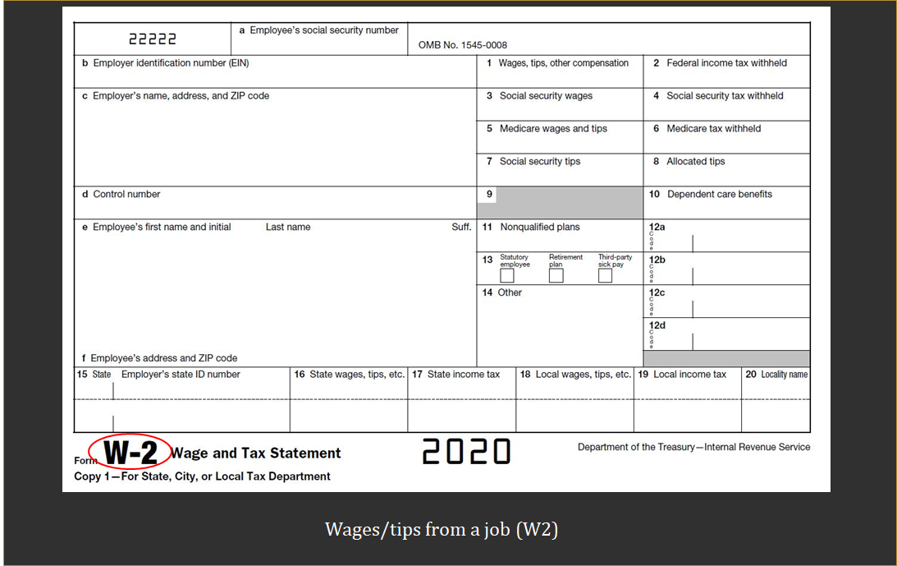
What counts as Income?
FinancialSmarts

Slide 15
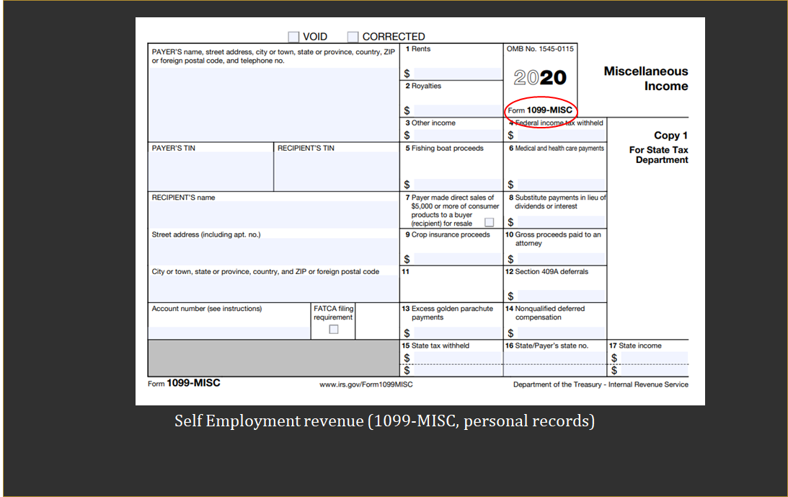
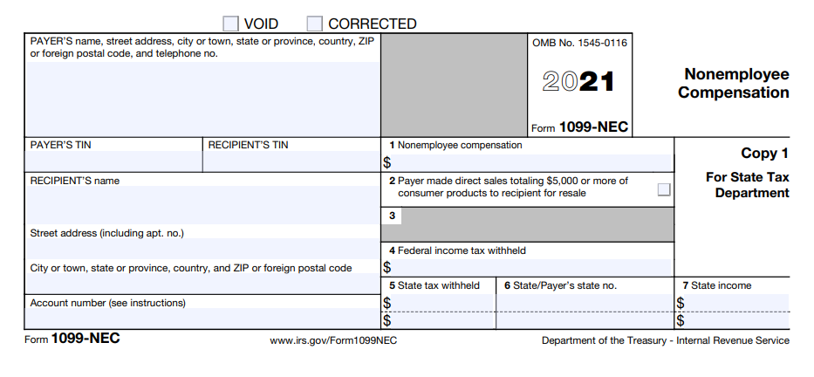

Slide 16
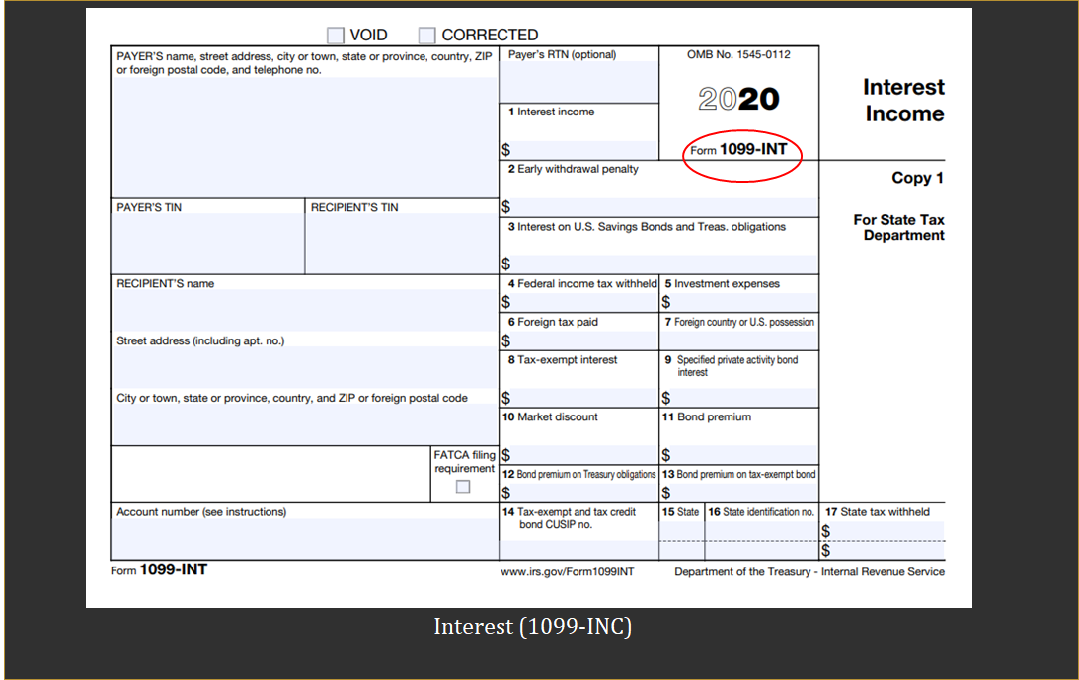
FinancialSmarts

Slide 19
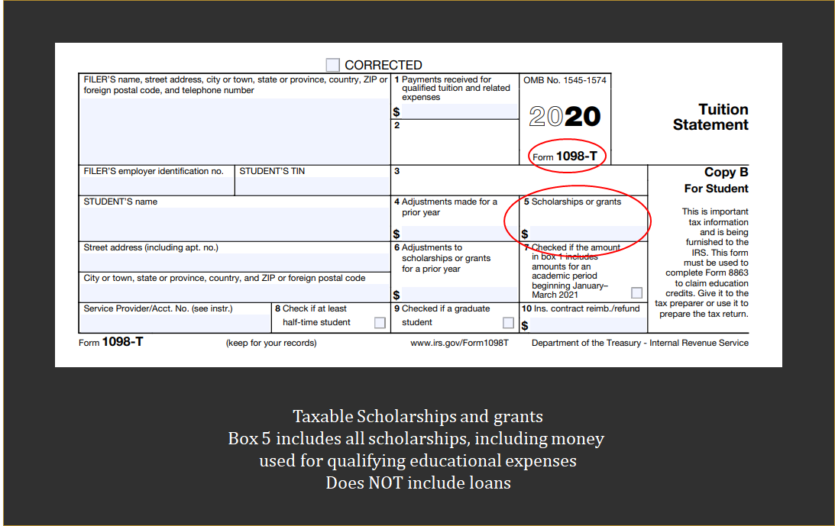
FinancialSmarts

Slide 20
Scholarships
•Loans are treated like you paid the expense yourself.
•Room and board provided as part of a job are not taxable. (you have to live in the provided housing to hold the job, like RA).
•Scholarships used for Qualified Educational Expenses are not taxable.
•The following are qualified education expenses for the purposes of tax-free scholarships and fellowships:
Tuition and fees required to enroll at or attend an eligible educational institution. Course-related expenses, such as fees, books, supplies, and equipment that are required for the courses
•Qualified education expenses don’t include the cost of:
Room and board, Travel, Research, Equipment and other expenses not required for enrollment
•Lots of grey areas here. How do you find out specific answers? Hire a tax accountant or call the IRS.
FinancialSmarts

Slide 21
Topics
Using the tax code for behavior modification
What are some other taxes that we pay (including Payroll Taxes)
What counts as income on your income tax return?
Withholding and the W-4
How to read a pay stub
Are you a dependent or not?
Completing a tax return
FinancialSmarts

Slide 22
Many different kinds of taxes
Federal Income Tax
State/County/City Income Tax
Sales Tax
Gas/Excise Tax
Real Estate Tax
Personal Property Tax
Government Fees
Estate Tax
Gift Tax
Capital Gains Tax
Sin Tax
Luxury Tax
Hotel Tax
Customs Tax
Payroll Tax (FICA = Social Security, Medicare)
FinancialSmarts
Notes:
Maryland gas tax: 35.3 cents per gallon

Slide 23
Payroll Taxes versus Income Taxes
•Also called FICA - Federal Insurance Contributions Act
•Deducted from your paycheck, 7.65% of all earnings up to $137,700. Your employer is also required to pay 7.65% on your behalf.
•Funds Social Security and Medicare
•Full time students are exempt from FICA when enrolled and working for UMBC (not other jobs). International students are always exempt from FICA.
•UMBC automatically makes you exempt from FICA if you are enrolled
•During the summer, your enrollment is checked every two weeks. During any two week period that you are not enrolled, you’ll have FICA withheld from your check.
•FICA exempt is DIFFERENT than income tax exempt.
FinancialSmarts
Notes:
Pay attention to your pay stub! If the employer gets it wrong, even if it is the employer’s mistake, it is very difficult for you to get the money back.

Slide 24
Topics
Using the tax code for behavior modification
What are some other taxes that we pay (including Payroll Taxes)
What counts as income on your income tax return?
Withholding and the W-4
How to read a pay stub
Are you a dependent or not?
Completing a tax return
FinancialSmarts

Slide 25
Withholding of Income Taxes
•Income tax is “pay as you go”. Either your employer pays along the way or you make payments directly to the IRS along the way.
•Self assess whether the correct amount was paid along the way by filing a tax return prior to April 15 of the following year
•Withholding is calculated by employer based on your W4 form
•If you will not owe federal income taxes, you can indicate EXEMPT on W4
•Exempt means no tax liability last year and don’t expect to owe this year
•Change withholding by submitting a new W-4
FinancialSmarts
Notes:
Points to mention
Most financially advantageous is to owe just a little on April 15
You may not be required to file if you didn’t make very much, but do so anyway if you had withholding

Slide 26
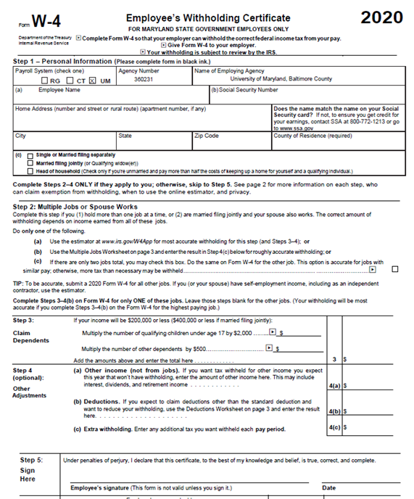
FinancialSmarts
Notes:
https://www.irs.gov/pub/irs-pdf/fw4.pdf

Slide 27
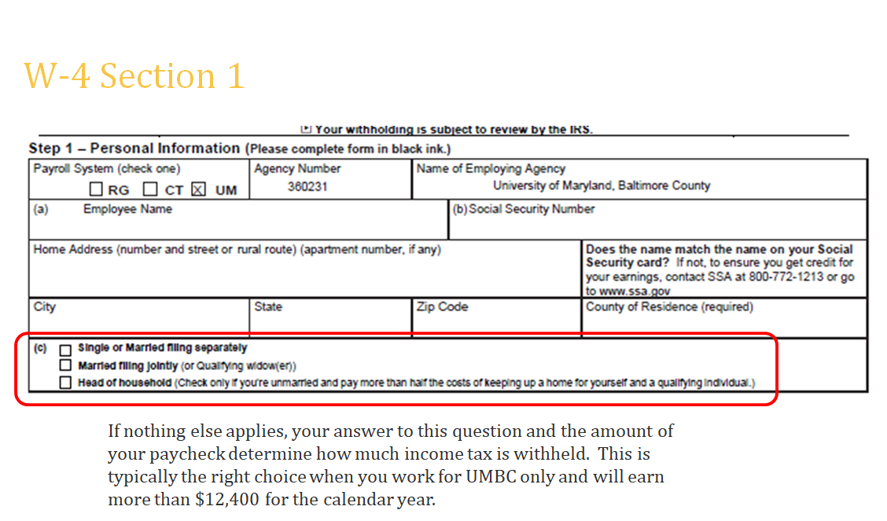
FinancialSmarts
Notes:
International students (non-resident alien) must select single even if that is not your status

Slide 28
FinancialSmarts
Notes:
If something changes, give your employer a new W4 at any point during the tax year.

Slide 29
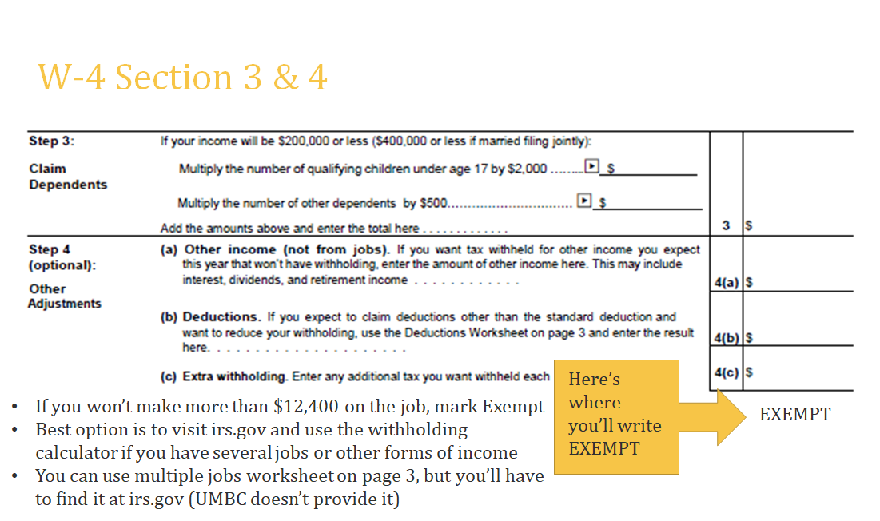
FinancialSmarts
Notes:
Step 3 – rarely an area that students will complete
4a - I have Apple stock that pays a dividend. So I put an amount on 4a equivalent to the amount of dividends I usually get
4b – rarely an area that students will complete
4c – rarely an area that students will complete
There’s no line for Exempt so you write it on the for after 4c

Slide 30
Quiz – Exempt or not? Check the box or not?
•In all the below examples, you did NOT owe any tax the previous year. Also, you are a single, not a dependent, and don’t have any other special tax circumstances.
-You work about 7 hours per week in the UMBC library (about $3000 per year) and a summer internship for an accountant where you earn about $9500. What should you put on your UMBC W4?
-You have a Graduate Assistantship with an annual stipend of $16,250. What should you put on your UMBC W4?
-You will have a $6000 scholarship for room/board and a summer research job with your faculty advisor for $5000. What should you put on your UMBC W4?
-Anyone have an example to share?
FinancialSmarts

Slide 31
Topics
Using the tax code for behavior modification
What are some other taxes that we pay (including Payroll Taxes)
What counts as income on your income tax return?
Withholding and the W-4
How to read a pay stub
Are you a dependent or not?
Completing a tax return
FinancialSmarts

Slide 32
How to Read Pay Stubs
•If you have direct deposit, you need to access POSC (Payroll Online Service Center) to see your pay stub
•If you don’t have direct deposit, get it then sign up for POSC
•The date on your pay stub is WRONG
•Student Employees get paid three weeks after the last Friday of a pay period
•If you don’t expect to owe income tax and are enrolled, your gross pay and net pay should match
FinancialSmarts
Notes:
Put the link to POSC in the chat.
https://interactive.marylandtaxes.gov/Extranet/cpb/POSC/User/Start.aspx

Slide 33
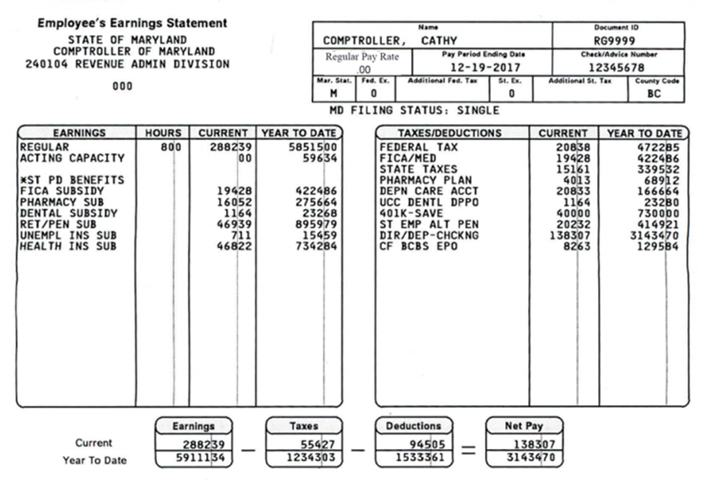
Gross Pay
Federal w/h
Payroll Tax
State w/h
Employee contributions to benefits
Net Pay
Employer Paid Benefits
FinancialSmarts
Notes:
Pay period dates are WRONG!!!!

Slide 34
Topics
Using the tax code for behavior modification
What are some other taxes that we pay (including Payroll Taxes)
What counts as income on your income tax return?
Withholding and the W-4
How to read a pay stub
Are you a dependent or not?
Completing a tax return
FinancialSmarts

Slide 35
Are you a Dependent?
•Are you single (not married)?
•Are you the child, stepchild, brother, sister, or descendant of the taxpayer?
•Are you either under age 19? Or under age 24 and a full time student? Or permanently and totally disabled?
•Did you live with the taxpayer for more than half the year except for temporary absences?
•Did the taxpayer pay more than half your support?
If all answers are yes, you are a dependent of the taxpayer
FinancialSmarts
Notes:
A dependent can only be claimed by one person.
“More than half your support” is the tricky one. If your parents pay the rent/mortgage and other costs of maintaining your permanent residence, you are likely a dependent.
It doesn’t matter if your parents claim you or not. If they CAN claim you, you must file as a dependent.

Slide 36
Why does it matter?
•MOST of the time, it is financially advantageous for your parent(s) to claim you.
•Example: You are 21 and have a scholarship for half tuition/fees and live in an off campus apartment (you don’t spend even one night with your parents in 2020). Your rent and food is paid by savings from your summer job. Your parents only pay the other half of your tuition and for your health insurance. You could make an argument that you are paying more than half of your support and therefore can claim yourself.
•Impact: your income for the year is $10,000 from a summer job. Once the dependent standard deduction of $10,350 is used to reduce your income, you don’t owe any taxes.
•Your parents make $74,900/year (MFJ). If they claimed you as a dependent, their tax owed is $6,312. By not claiming you as a dependent, their tax owed is $6,812.
FinancialSmarts
Notes:
The dependent standard deduction is the amount of earned income plus $350 until you hit $12,400.
If you have one parent and no younger siblings, your parent’s standard deduction would increase from 12.4k to 18.65k. In this example, tax owed swings by $1375 because of dependent.

Slide 37
Topics
Using the tax code for behavior modification
What are some other taxes that we pay (including Payroll Taxes)
What counts as income on your income tax return?
Withholding and the W-4
How to read a pay stub
Are you a dependent or not?
Completing a tax return
FinancialSmarts

Slide 38
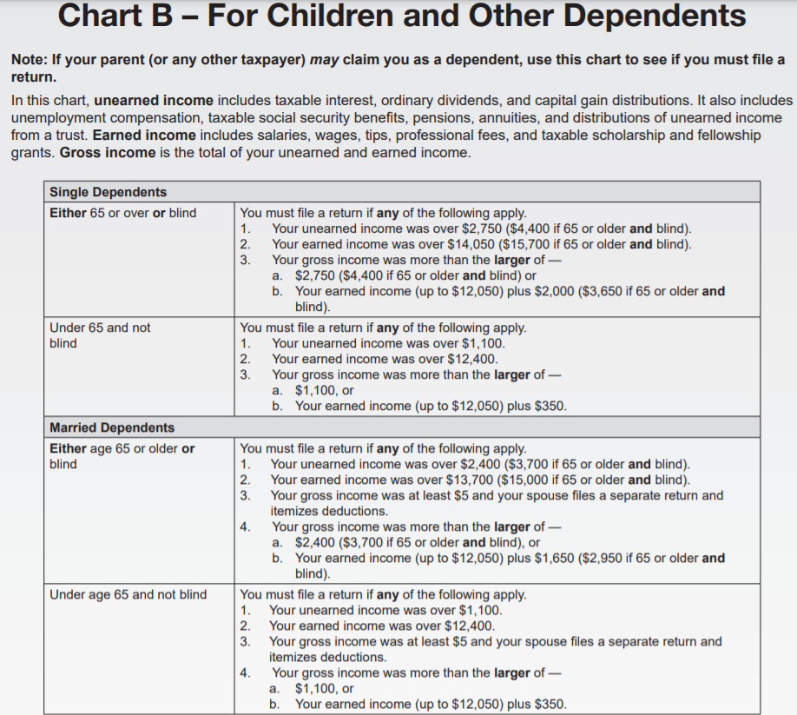
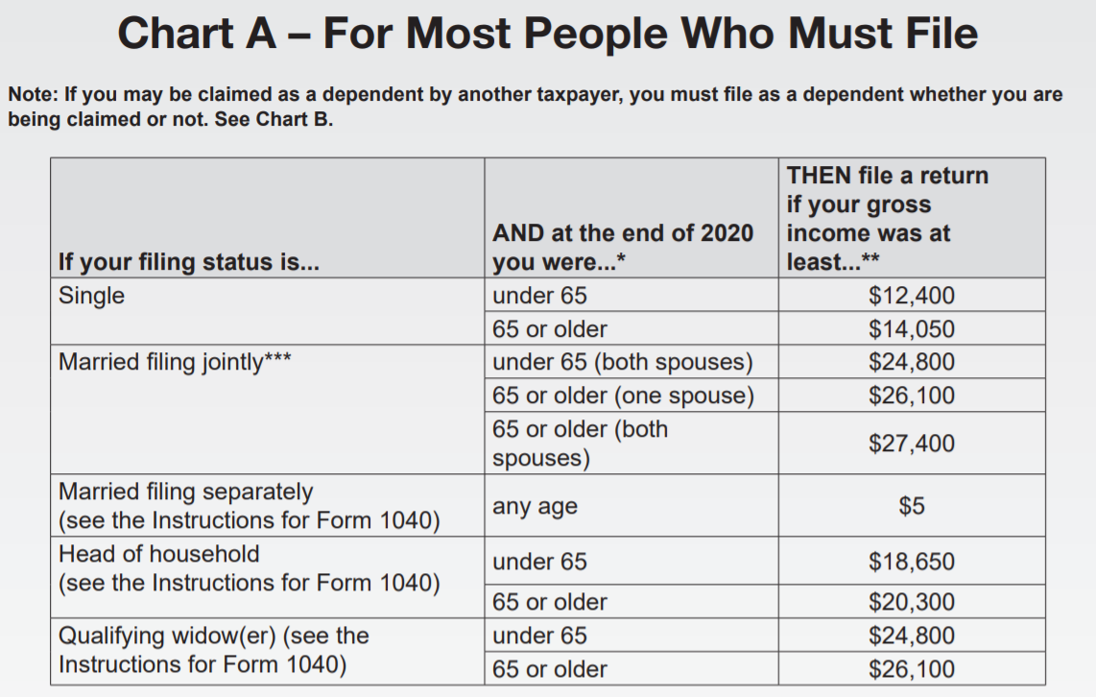
Do you need to file an income tax return?
FinancialSmarts
Notes:
If you had withholdings and made less than $12,400, file to get your money back
If you are a dependent, it is a bit more nuanced. However, the general concept is still that if you made less than $12,400 you don’t need to file.
https://www.irs.gov/help/ita/do-i-need-to-file-a-tax-return

Slide 39
Completing a tax return
•Use software if possible; guards against errors
https://www.irs.gov/filing/free-file-do-your-federal-taxes-for-free
•Use UMBC VITA by making an appointment at: www.bmorefreetaxes.org
•If you don’t understand, ask questions. You are responsible for your tax return.
•If you are a dependent, talk with your parent(s)/guardian(s).
FinancialSmarts
Notes:
https://www.irs.gov/filing/free-file-do-your-federal-taxes-for-free

Slide 40
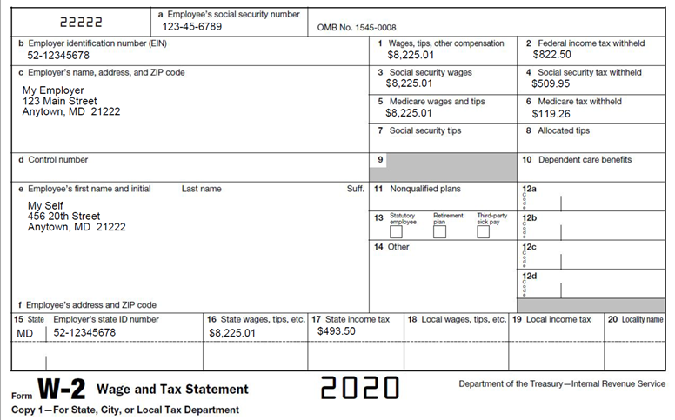
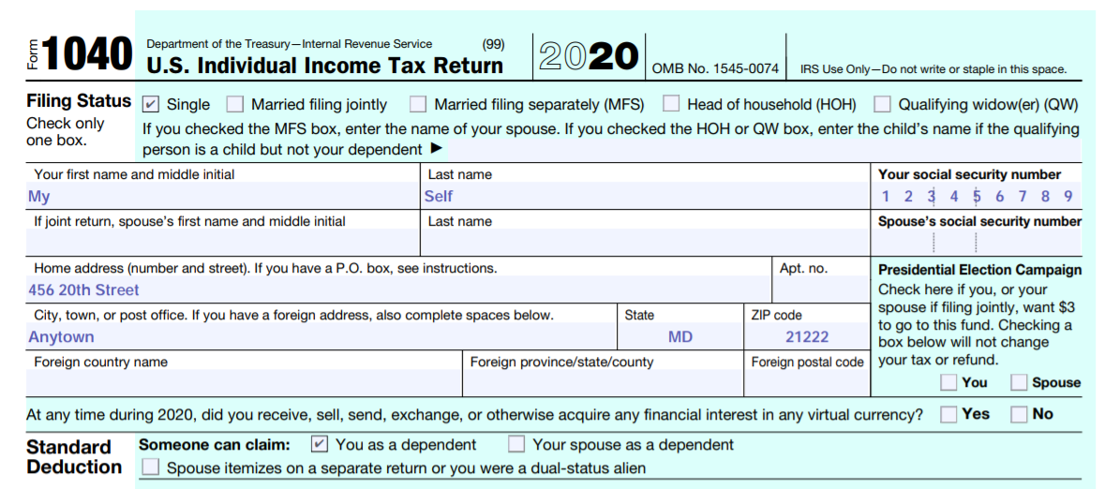
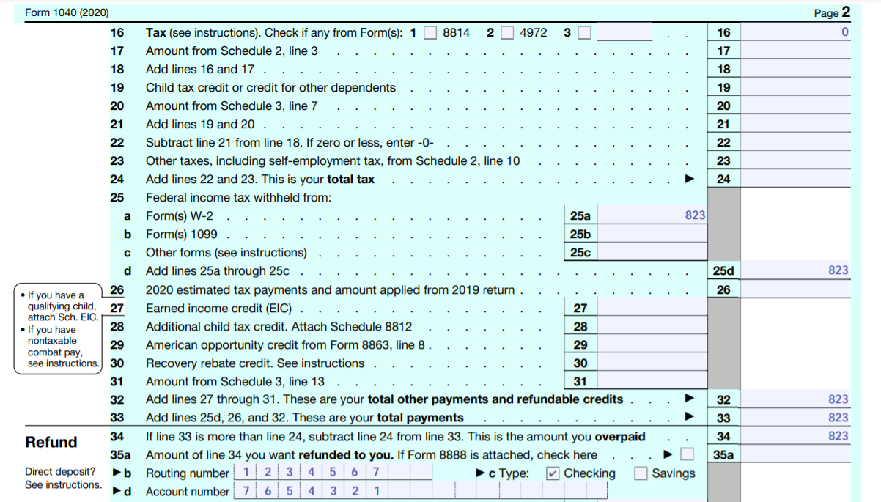
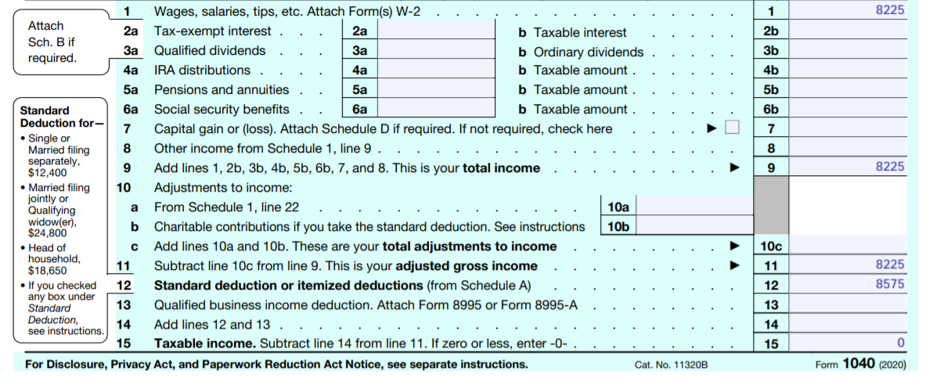
FinancialSmarts

Slide 41
Top 5 things you should know
Withholding and FICA are different
Plan ahead if you are self employed
Know if you are a dependent
File a tax return by the deadline if you are required to file
Keep records of all financial activity
FinancialSmarts
Notes:
In case there’s ever a copyright question about the tax form images, I got them from screen shots of the IRS website.

