Slide 1
Wise Up! Preventing Identity Theft
Thursday, April 8, 2021
Yvette Mozie-Ross (mozie@umbc.edu)
Kevin Mitchell (kevinm@umbc.edu)
Notes:
Yvette Intro -
Kevin Intro - My name is Kevin Mitchell, I'm the Manager of IT for the Office of Enrollment Management and part of my job at UMBC is making sure that my users are educated and protected from bad actors so Identity Theft is a topic that I'm passionate about.

Slide 2
Housekeeping
Respect one another
Mute yourself if you’re not speaking
Ask questions…we welcome them!
Utilize the chat feature
Session will be recorded
FinancialSmarts
Notes:
Kevin
Okay, before we get started a couple of housekeeping items.
Please be respectful of one another, if you're posting a comment in the chat if it's not something you'd say to someone's face please don’t say it in the chat.
Please mute yourself, we don’t want to be picking up background noises.
Don’t be afraid to ask questions, we have several breaks in the presentation where we'll prompt you for feedback and questions please use the chat or unmute yourself if youre comfortable
This session will be recorded, so if you want to review the information later we will be making the presentation available.

Slide 3
Session Goals and Objectives
By the end of this session, participants will be able to:
Define identity theft
Identify different forms of identity theft.
Understand the financial and emotional impact of identity theft.
Know how to prevent identity theft.
Know what to do if they are a victim of identity theft.
FinancialSmarts
Notes:
Yvette

Slide 4
Poll #1
FinancialSmarts
Notes:
Kevin
Alright, with that we're going to start with a poll technology permitting.
How many Americans have had their identity stolen per year?
1 Million
5 Million
9 million (correct answer)
12 million

Slide 5
What Is Identity Theft? Someone uses your personally identifying information, like your name, Social Security number, account number, or credit card number, without your permission, to commit fraud or other crimes.
FinancialSmarts
Notes:
Yvette
Video: https://youtu.be/DJ9bA6tm2SY

Slide 6
FinancialSmarts
Notes:
Yvette

Slide 7
What’s Your Thoughts/Experiences with Identity Theft?
FinancialSmarts
Notes:
Yvette

Slide 8
Poll #2
FinancialSmarts
Notes:
Kevin
Alright, were going to put another poll out there.
Which of the following is a way to steal your identity?
Shoulder Surfing (correct answer)
Opening a bank account
Showing your Social Security card to your employer
All of the above

Slide 9
How do thieves steal your identity?
FinancialSmarts
Notes:
Kevin
Alright! Staying on topic of the last poll lets go over some more ways that bad actors will attempt to steal your identity.

Slide 10
Dumpster Diving
“Dumpster Diving” – digging through your trash – is still one of the most popular methods for stealing large amounts of your personal information.
What are thieves trying to steal?
FinancialSmarts
Notes:
Kevin
Pre-approved credit card offers, street addresses, social security numbers, telephone number, email addresses, bank account information, employment history, and other personal information. They're looking to build a profile of you, basically theyre trying to get as much information about you as possible. They want to know potential answers to your online security questions. Things like where you went to high school, your home town, your parents' names, the make and model of your car. These can all be obtained from your mail.

Slide 11
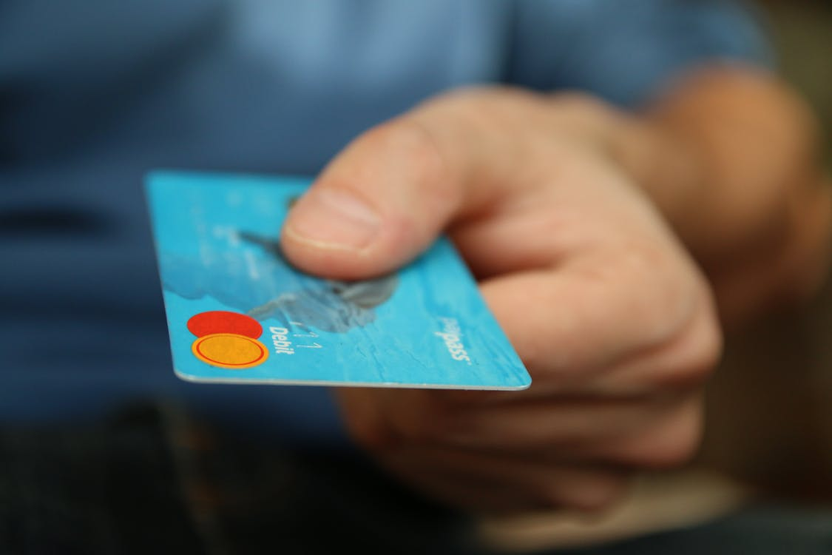
Skimming
Skimming is a method used by identity thieves to capture payment and personal information from a credit card holder.
Thieves often use a device called a skimmer
Some machines act like point-of-sale technology.
Card users are warned to always keep their cards in their sight and to cover the pin pad when inputting security codes at ATMs.
FinancialSmarts
Notes:
Kevin
A skimmer can be installed at gas pumps or ATM machines to collect card data.
An acquired card is swiped, and a touchpad allows the user to enter a security code.
A common method for skimming now actually involves purchasing or building a devices that can pick up the wireless NFC chip data on your card. The attacker simply has to walk up to you and get the device within a few inches of your purse or wallet and it has your data.

Slide 12
Shoulder Surfing
Shoulder surfing can occur anytime you're sharing personal information in a public place.
At a restaurant
At an ATM
At the airport
FinancialSmarts
Notes:
Kevin
You're at a crowded restaurant bar waiting for your date. To pass the time, you log into Instagram or TikTok. Unfortunately, you don't realize the person jammed up against you is eyeing your password—which happens to be the same password you use for your email account and bank account.
You're getting cash at an ATM. You feel safe because the man behind you in line is at least 6 feet away, looking at his phone (or so you think). Actually, he's recording your finger movements on his phone and will quickly decipher them to get your PIN number.
Your flight is delayed, so you grab your laptop and kill time in the airport lounge with a little online shopping. You don't see the woman a few seats away staring at your screen as you input your credit card information.

Slide 13
Phishing
Scammers use email, text messages, or phone calls to trick you into giving them your personal information.
They may say they’ve noticed some suspicious activity or log-in attempts
Claim there’s a problem with your account or your payment information
Say you must confirm some personal information
Include a fake invoice
Want you to click on a link to make a payment
Say you’re eligible to register for a government refund or Stimulus
Offer a coupon for free stuff
FinancialSmarts
Notes:
Kevin
Phishing scam are getting more and more difficult to spot. Advanced scammers will make a copy of websites that are indistinguishable from the actual one. Or they’ll spoof your teachers , supervisor, or HR reps email so it looks like someone you know and trust is contacting you.

Slide 14
Changing Addresses
Address fraud is a form of identity theft where an individual uses the change of address process to reroute your mail to a different address.
Signs of Change of Address. You receive a move validation letter.
You stop receiving mail.
The billing address for your credit card changes.
You get notified that an account has been opened in your name.
FinancialSmarts
Notes:
Kevin

Slide 15
Pre-Texting
Pretexting is another form of social engineering where attackers focus on creating a good pretext, or a fabricated scenario, that they use to try and steal their victims’ personal information. Pretexting attacks rely on building a false sense of trust with the victim.
FinancialSmarts
Notes:
Kevin
Very similar to phishing but the person is going to likely email or call you and attempt to establish a relationship they’re going to sound nice and kind and reputable. They’ll call offering you free concert tickets or a free weekend vacation somewhere if you're willing to participate in their survey except some of the questions they're going to ask you happen to be about personal information such as your pets name, the name of the street you grew up on, and mysteriously they’ll require a credit card number or social security number to give you your prize.

Slide 16
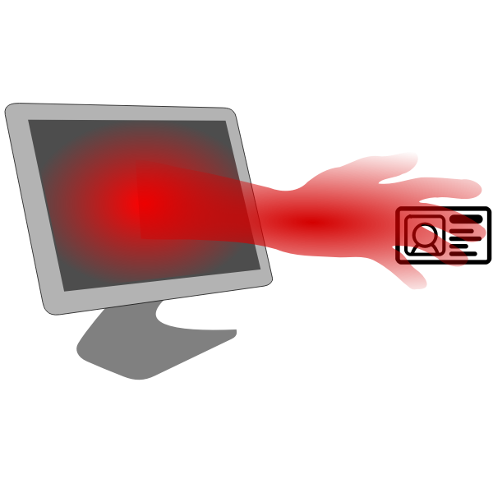
Identity Theft Methods - Summary
Dumpster Diving
Skimming
Shoulder Surfing
Phishing
Changing Your Address
Pretexting
FinancialSmarts
Notes:
Kevin
https://freesvg.org/identity-theft-symbol pulled from a site that says this image is public domain

Slide 17
What are other methods of identity theft?
FinancialSmarts
Notes:
Kevin

Slide 18
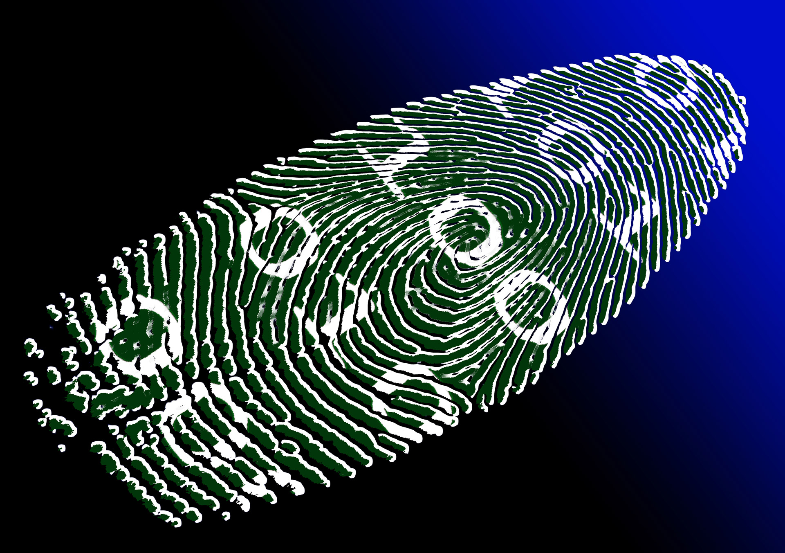
What do thieves do with your stolen identity?
Credit Card Fraud
Phone and Utility Fraud
Bank and Finance Fraud
Government Document Fraud
Other Fraud
FinancialSmarts
Notes:
Yvette

Slide 19
Poll #3
FinancialSmarts
Notes:
Yvette
Which is a warning sign that someone is using your information?
You find credit card charges you didn’t make (correct answer)
You get bills for medical services you did not use (correct answer)
Debt collectors call about debts that are not yours (correct answer)
Debit card transactions are taking a long time to process

Slide 20
Signs You May Be a Victim of Identity Theft
Information regarding credit you never applied for
Statements from lenders and/or businesses that you never contacted
No statements from bills that you should pay
Missing mail in general
Credit card purchases, or account withdrawals you don’t recognize
Claims you owe money for an account you have never opened or used
FinancialSmarts
Notes:
Yvette

Slide 21
Steps To Take If You Suspect You Are A Victim
Contact bank or financial institution(s) and credit card issuers – freeze or close the account
Contact 3 major credit bureaus: request a fraud alert and a copy of your credit report
Equifax: 1-800-685-1111
Experian: 1-888-397-3742
TransUnion: 1-800-680-7289
FinancialSmarts
Notes:
Yvette

Slide 22
Steps To Take (continued)
Report the identity theft to the FTC at identitytheft.gov or 877-438-4338
File a police report
Notify appropriate authorities about lost license or passport immediately
Passport: Notify U.S. Dept. of State, Passport Services, Consular Lost/Stolen Passport Section at www.travel.state.gov/passport/lost/lost_849.html
License: Report to the issuing states Department of Motor Vehicles at http://www.usa.gov/Topics/Motor_Vehicles.shtml
Maintain a written chronology of contact and follow-up.
FinancialSmarts
Notes:
Yvette

Slide 23
Keeping Track
Fill out “My Accounts Log”
Keep it safe!
FinancialSmarts
Notes:
Yvette
Digital Methods
mSecure
LastPass
ENPass

Slide 24
Liabilities
By law, first $50 of unauthorized credit card charges
If you report lost/stolen debit card within 2 days, only $50
If you wait 3 days to report, you may be liable for $500 of more if thief uses account
FinancialSmarts
Notes:
Yvette

Slide 25
Poll #4
FinancialSmarts
Notes:
Yvette
What can you do to protect your identity online?
Always use the same password for every account
Create a unique password with special characters
Be Cautious of personal information you are sharing online
Shop only on secure sites

Slide 26
Notes:
Yvette
Video – ID Theft Victim – Its Been Hell

Slide 27
How to Prevent Identity Theft?
FinancialSmarts
Notes:
Kevin
Okay, so now that we've scared you about identity theft. Let's transition to steps you can take to empower yourself with some methods of how you can go about preventing identiy theft.

Slide 28
Be Prudent with Your Social Security Number
Don’t carry around your social security card with you
If a job or organization asks for multiple forms of identification offer another one
Don’t Use Your SSN as a Password
Ask questions
FinancialSmarts
Notes:
Ideally, you’d keep your social security card at home in a fireproof safe that is physically bolted to the ground
If a business or other organization asks for your SSN, offer your driver’s license number instead. Other alternative forms of ID include a passport, proof of current and previous address (such as utility bills), or even a student ID from UMBC. It is far easier to change your drivers license number or get a replacement passport then to get a new social security number.
Don’t use your SSN or a portion of your SSN as a bank pin, phone pin, or password
Ask Why They Want It and How It Will Be Handled. If the business insists, ask questions. You have a right to know why it’s necessary to provide your SSN and how it will be handled. Ask questions such as: Why is having my SSN necessary? With whom will you share my number if I provide it? How will my number be stored? Do you have a privacy policy, and may I see it? Will you cover my liability or losses if my number is stolen or compromised?

Slide 29
Shred, shred, shred
Documents Containing Financial Information
Documents Containing Personal Information
Documents Containing Account Information
Junk Mail
Child- and School-Related Mail
FinancialSmarts
Notes:
An identity thief could potentially use anything that comes from a financial institution. Although you should keep copies of bank and credit card statements for record-keeping purposes, you only need to do so for one year and you can opt to receive this information digitally which leaves a smaller footprint.
Personal information is what identity thieves are after. Your date of birth and Social Security number are especially vulnerable. So shredding anything that contains that information is a good idea. Other information to be wary of is your full name, address, home or work telephone numbers, and driver’s license number.
Identity thieves also try to capture account numbers, usernames, and passwords. You should shred any documents printed with this information, such as credit card statements, personal and real property tax statements, and bills. You should also shred mail that contains information about your utility accounts, cell phone, and internet bills.
Junk mail can be dangerous. Most people don’t realize it, but junk mail usually has a computer barcode on the front that can sometimes contain personal identifying information.
Identity thieves don't discriminate. They will steal a child's Social Security number just as soon as they would an adult's. Therefore, any mail you receive concerning your children, their medical records, and school information should go directly into the shred pile.

Slide 30
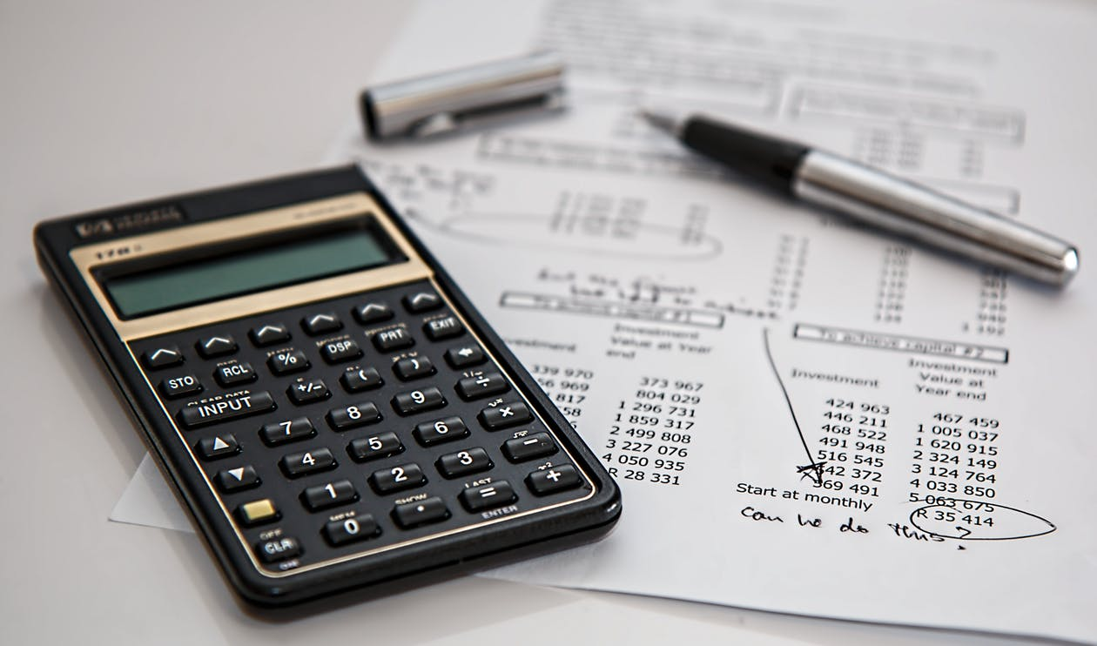
Review bank account activity regularly
Early identification of fraudulent activity on your account
Speak to your bank about enabling fraud alerts
FinancialSmarts
Notes:
If you regularly check your account information then when there are mysterious charges youll be able to identify often stop payment
Your bank or credit union will have several anti-theft and security measures in place to protect your accounts and money. Usually related to online access to your accounts or your card facility, these measures check your accounts for suspicious or unusual purchase behavior. Or people logging into your account.

Slide 31
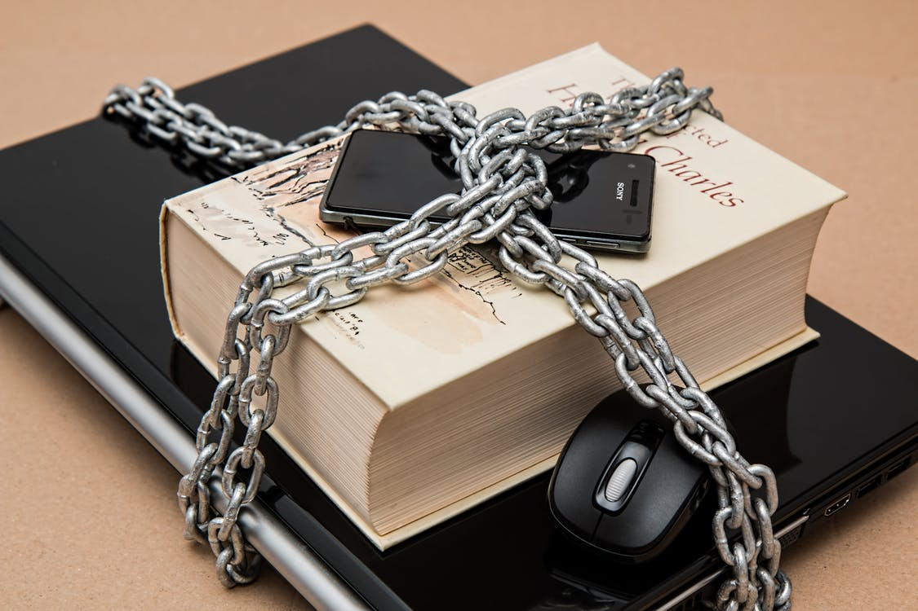
Protect your PINs and passwords
If possible don’t write down your passwords
Use a different complex password for every website. Use a password manager to keep track of your password
Add multi-factor authentication for accounts that offer it.
Keep track of when websites have been hacked and change all associated password. Use websites like HaveIBeenPWNed
FinancialSmarts
Notes:
If you must make sure to utilize a password book with a lock and keep it in your home safe.
Dashlane. NordPass. RoboForm. 1Password. LastPass. Keeper. Zoho Vault.
Multi-factor authentication offers extra security by requiring two or more credentials to log in to your account. If someone manages to steal your password they wont be able to access your account with out a second approved device.
Utilize websites like HaveIBeenPWNed to see which account have been neutralized and if you use the same password on multiple sites change them.

Slide 32
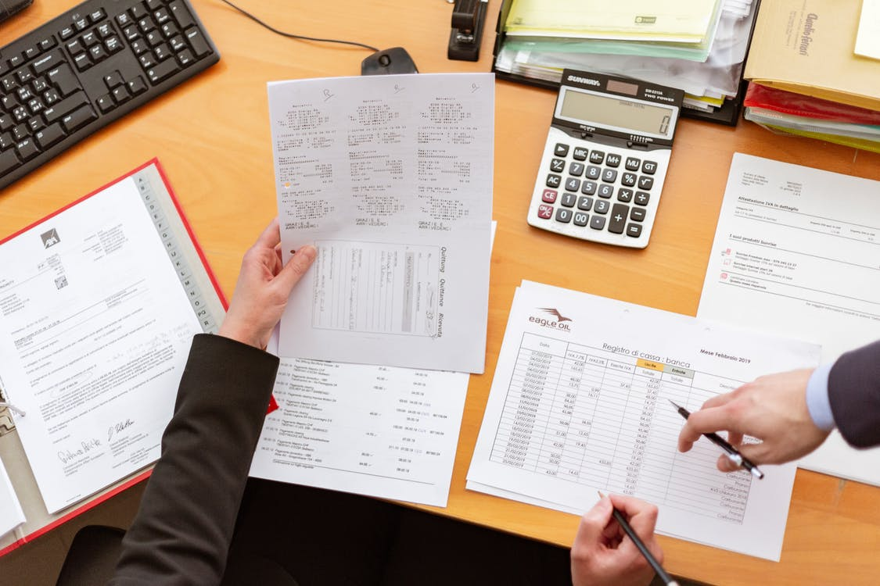
Order your free credit report annually
Why do I want a copy of my credit report?
How do I order my free report?
How long does it take to get my report after I order it?
FinancialSmarts
Notes:
Help guard against identity theft. That way if someone uses your personal information — like your name, your Social Security number, or your credit card number — to commit fraud you'll know
The three nationwide credit reporting companies have set up a central website, a toll-free telephone number, and a mailing address through which you can order your free annual report.
To order, visit annualcreditreport.com, beware of websites that claim you have to pay to access your credit report
If you request your report online at annualcreditreport.com, you should be able to access it immediately.

Slide 33
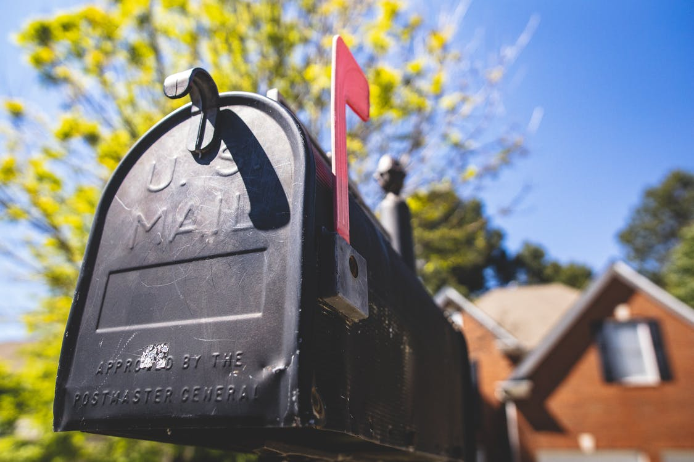
Protect your mail
Do not leave it in your mailbox overnight
Tell your Post Office when you will be out of town
Upgrade to a locking mailbox with drop slots
Sign up for Informed Delivery® by USPS®
FinancialSmarts
Notes:
If you are expecting checks, credit cards, or other negotiable items, ask a trusted friend or neighbor to pick up your mail.
They can hold your mail until you return. You can alert them through forms online. Or have a trusted friend, neighbor, or family member pick up mail while you are gone.
Digitally preview your mail and manage your packages scheduled to arrive soon! Informed Delivery allows you to view greyscale images of the exterior, address side of letter-sized mailpieces and track packages in one convenient location.*

Slide 34
How to Prevent Identity Theft - Summary
Be prudent with your Social Security number
Shred, shred, shred
Review bank account activity regularly
Protect your PINs and passwords
Order your free credit report annually
Check your mailbox
FinancialSmarts
Notes:
Kevin

Slide 35
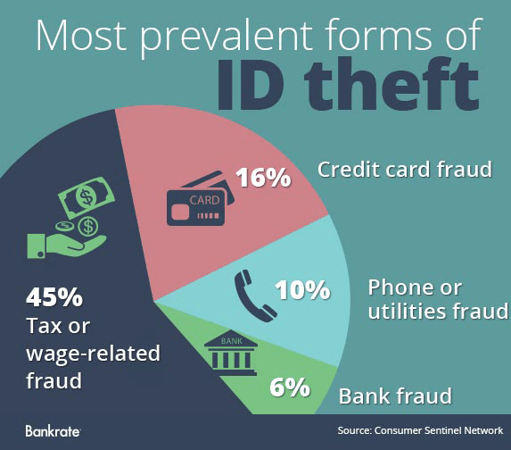
Think You Are Safe?
FTC reports that 18-29 year olds are most commonly affected
FinancialSmarts
Notes:
Yvette

Slide 36
Now What?
Secure personal information in your room or apartment
Do not give out personal info unless you’ve initiated the contact
Guard your mail and trash
Keep your Social Security card in a secure place
Update your virus protection software regularly
FinancialSmarts
Notes:
Yvette

Slide 37
Thoughts/Reactions/Questions
FinancialSmarts

