Slide 1
Sustainability at UMBC
Office of Sustainability

Slide 2
Agenda
UMBC’s Commitment to Sustainability & Progress
Spring Events
Compost Residuals
What we Need Student Support on
UMBC’s SEI Climate Corps Fellowship: Invasive Species

Slide 3
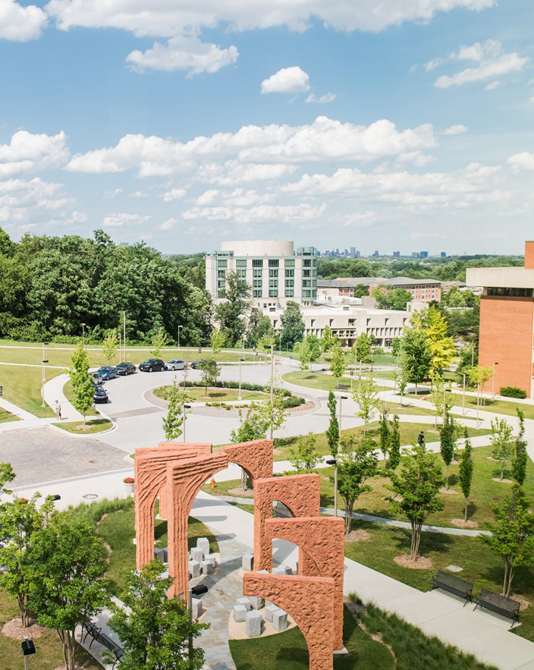
UMBC’s Office of Sustainability
Established in 2019
2 Full Time Staff
Ryan Kmetz, Director of Sustainability
Claire Runquist, Sustainability Coordinator
1 SEI Climate Corps Fellow (for the 2022-2023 school year)
Bella Dastvan
Located in Facilities Management
Mission: to provide excellence in planning, design, construction, operations and maintenance of UMBC’s facilities, grounds and utilities.

Slide 6
UMBC’s Commitment
2007
2008
2009
2012
UMBC signed on to the ACUPCC
The Climate Change Task Force was established
First Climate Action Plan (CAP) was published with the goal of carbon neutrality by 2075
UMBC’s first Greenhouse Gas Inventory was completed
UMBC hired first full-time sustainability staff member
Notes:
Check out UMBC’s full sustainability timeline here: https://sustainability.umbc.edu/about/sustainability-timeline/

Slide 7
UMBC’s Commitment
2018
2019
2020
2021
2022
33.3% of UMBC’s electricity it powered by renewables
Updated CAP with a goal of carbon neutrality of 2050
UMBC received a Silver rating from AASHE STARS
UMBC received a Gold rating from AASHE STARS
UMBC established the Office of Sustainability with 2 full time staff
UMBC awarded Maryland Green Registry Leadership Award
Notes:
Check out UMBC’s full sustainability timeline here: https://sustainability.umbc.edu/about/sustainability-timeline/
Check out UMBC’s revised CAP: https://sustainability.umbc.edu/home/cap20/
Check out UMBC’s STARS Report: https://reports.aashe.org/institutions/university-of-maryland-baltimore-county-md/report/2020-02-25/

Slide 8
UMBC’s Progress
19
Electric vehicle chargers
15%
Reduction in electricity use
42%
Energy from renewable sources
44%
Reduction in GHG emissions

Slide 9
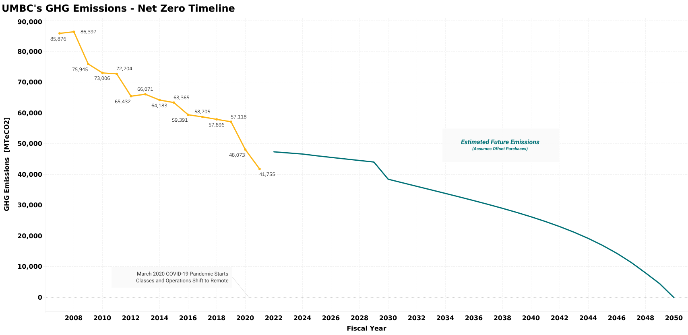

Slide 11
Spring Event Calendar
2/20
National Invasive Species Awareness Week tabling event 12-1pm on Commons Main Street
4/19
Earth Day Celebration on the quad 9 AM-1 PM
Force of Nature Eco-Anxiety and Climate Grief Workshops, 11-12:30
4/7
4/14
4/21
TBD
Compost Video Screening, and Spring Service Project with So What Else

Slide 12
Composting
Food Residuals Law
In 2021, Maryland passed a law that requires, beginning January 1, 2023, certain persons who generate certain quantities of food residuals in Maryland to separate their food residuals from other solid waste and divert those food residuals from final disposal in a refuse disposal system (2021 Md. Laws 439 and 440)

Slide 13
Follow us online! Instagram, myUMBC, the Sustainability Discord Server
Consider serving as an Eco-Ambassador for the 2023-2024 school year
Attend our events
Share your ideas with our office!
Advocate for sustainability at UMBC
How You can Help!

Slide 14
WHAT IS SEI CLIMATE CORPS?
1
SEI: Strategic Energy Innovations is an environmental nonprofit that strives to build leaders to drive sustainability solutions
Climate Corps: fellowship program providing professional development opportunities for emerging leaders through implementation of sustainability & resiliency projects with local governments, nonprofits, schools, and for-profit businesses.
2
10 month full-time fellowship program at our host site: UMBC Office of Sustainability in Facilities Management
3

Slide 15
UMBC’S SEI CLIMATE CORPS SUSTAINABILITY FELLOWSHIP
1
Researching best practices to produce an invasive species management plan for campus
Skill development in ArcGIS Pro & research techniques
2
Collaboration & outreach with internal & external stakeholders
3
Upcoming event: National Invasive Species Awareness Week tabling event 2/20 12-1pm on Commons Main Street
4

Slide 16
Fall 2022 Invasive Plant Survey
TOP INVASIVE PLANTS OF CONCERN:
English Ivy
Porcelainberry
Wavyleaf Basketgrass

Slide 17
GIS WORK

Slide 18
LESSONS LEARNED SO FAR
1
Sometimes there’s never a right answer for everything
Be proactive in learning & developing skills, and looking for professional development opportunities as you progress throughout your career
2
3
Don’t be afraid to ask for help, reach out to colleagues and network
4
Don’t be afraid to pitch your ideas, even if they are big ideas!
5
Everyone grows at their own pace!

Slide 19
QUESTIONS?
Our website: sustainability.umbc.edu
Email us: sustainability@umbc.edu

