Slide 1
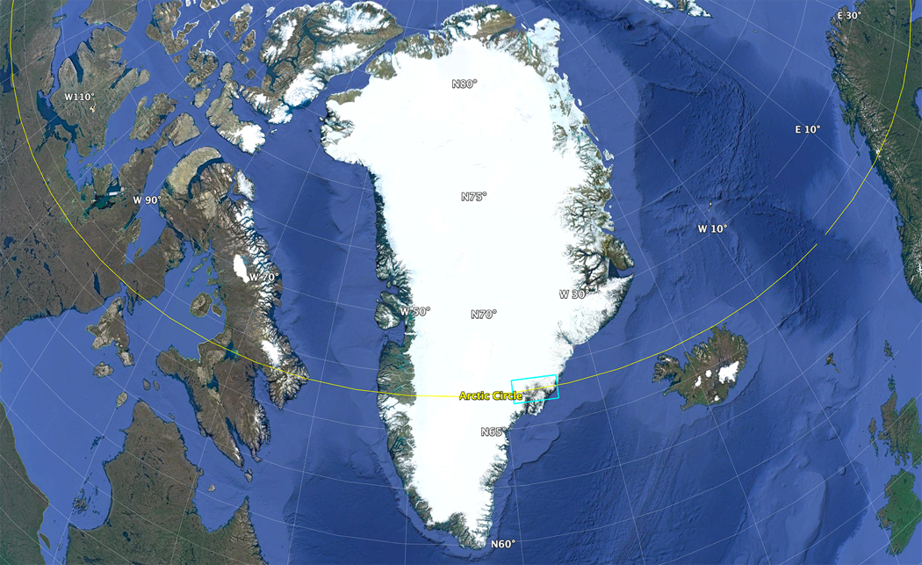
50 Years of Landsat - Ice Cover Changes, East Greenland, from 1972 to 2022
Christopher A. Shuman, UMBC at Code 615 NASA GSFC
Greenland
Ice Sheet
Landsat
coverage area
Rectangle is ~212.8 x 110.9 km

Slide 2
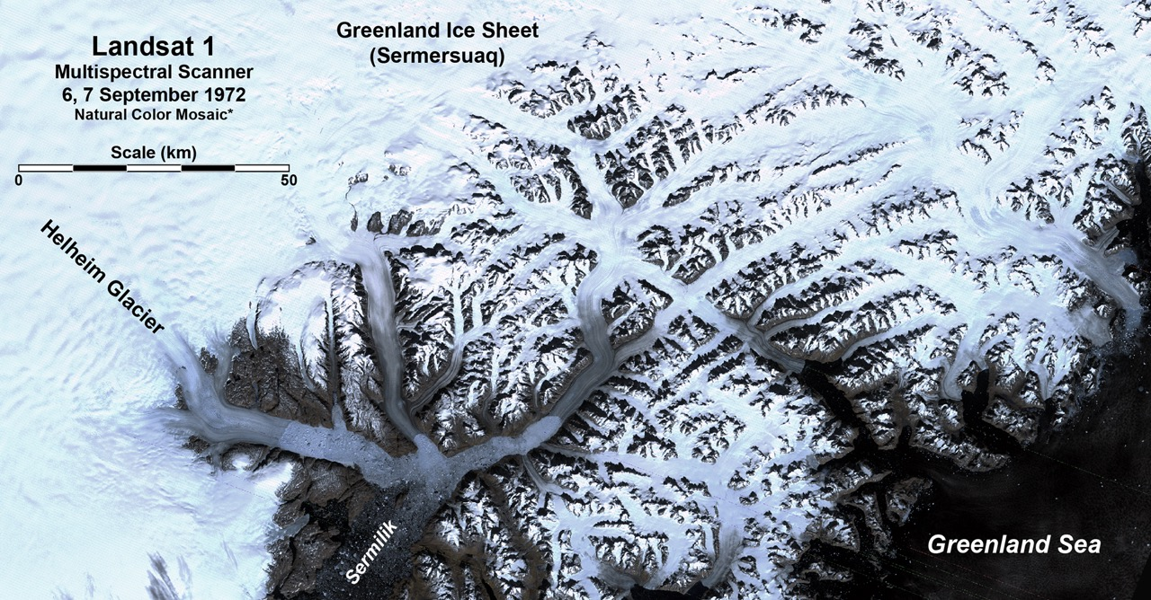
50 Years of Landsat - Ice Cover Changes, East Greenland, from 1972 to 2022
Helheim Glacier
Fenris Glacier
Midgard Glacier
Glacier de France
K.J.V. Steenstrup
Glacier (north)
Area shown is ~212.8 x 110.9 km

Slide 3
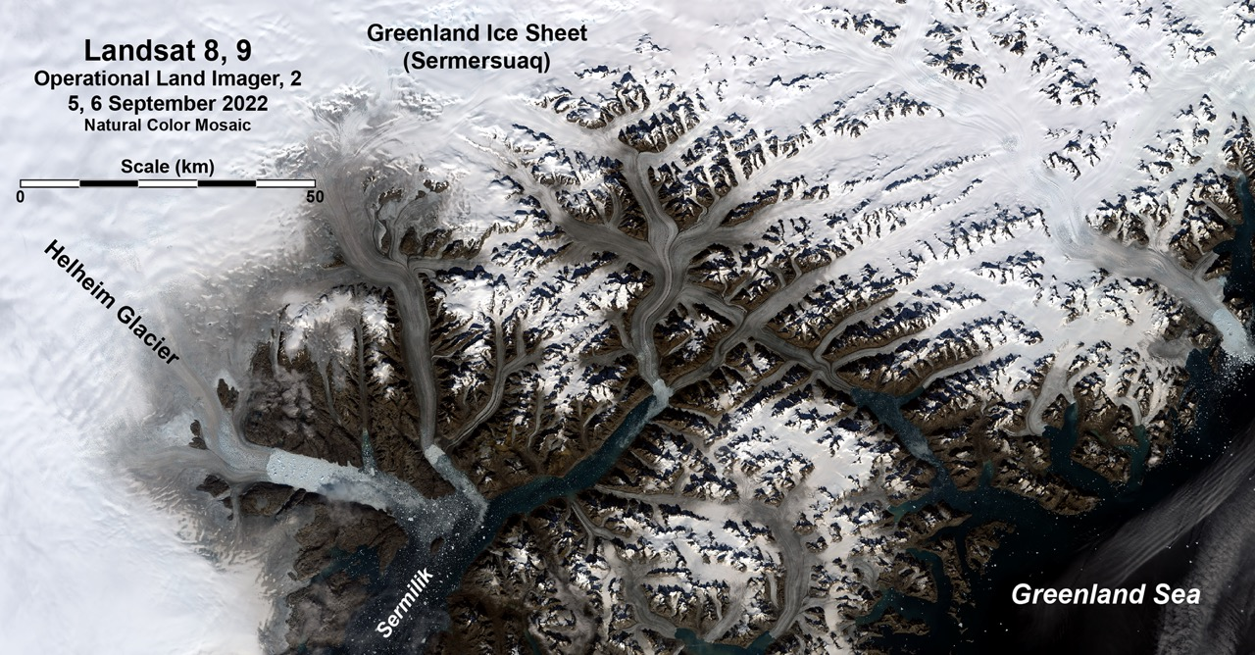
50 Years of Landsat - Ice Cover Changes, East Greenland, from 1972 to 2022
Helheim Glacier
Fenris Glacier
Midgard Glacier
Glacier de France
K.J.V. Steenstrup
Glacier (north)
Area shown is ~212.8 x 110.9 km

Slide 4
50 Years of Landsat - Ice Cover Changes, East Greenland, from 1972 to 2022
Landsat’s freely accessible archive allowed this major east Greenland outlet glacier and ice cap area to be compared across 5 decades of time.
Imagery from Landsat 1 can be directly examined against a composite image from Landsat 8 and 9 almost exactly 50 years apart.
Substantial ice retreats are clearly visible on multiple major outlet glaciers including one of the largest in Greenland, Helheim Glacier (Helheimgletscher). Colored arrows indicate approximate 1972 front positions.
Both surface and subsurface melting of the major named outlets likely contributed to the ice front retreat. Thinning is less evident at this scale but can be seen by the narrowing of glaciers.
A large difference in albedo (reflectivity) is also distinct across the selected imagery region, due in large part to warming temperatures in this coastal area as well as Greenland generally.
Smaller ice caps and their grounded ice show reduced areas and extents to the southeast of the ice sheet (Sermersuaq) that is the source of the major glaciers.
In some cases, ice retreat has been large enough that major tributaries (e.g. Midgard) have separated (near the center of the image area).

